Slide 1
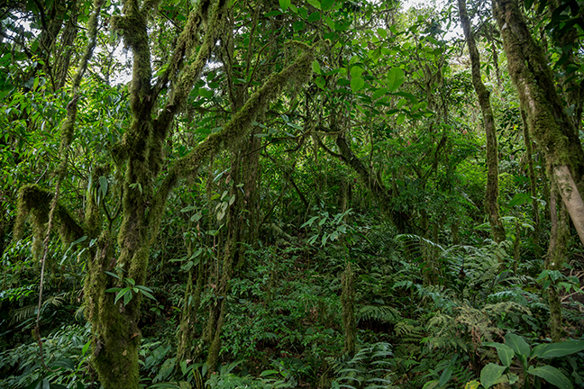
I’m a Celebrity get me out of here!
Far away
in the middle of the jungle.
What would you need to do to survive?
© PrimaryUpd8 To subscribe, visit www.primaryupd8.org.uk

Slide 2

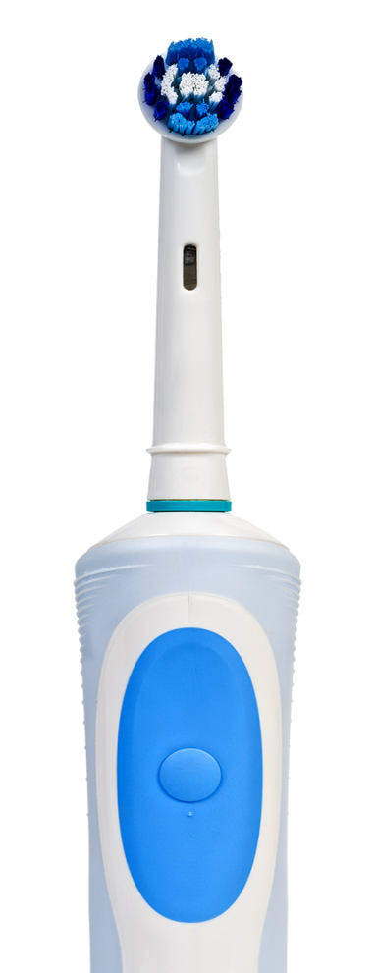
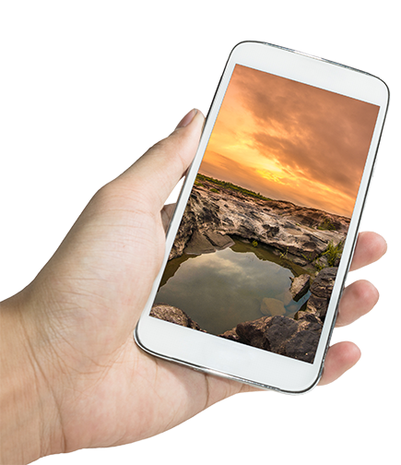
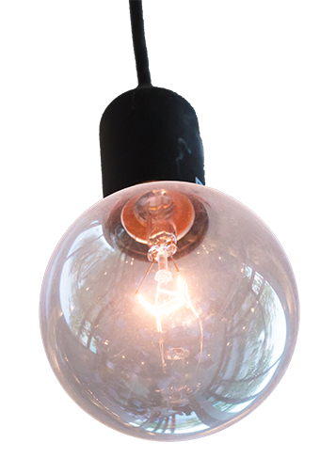
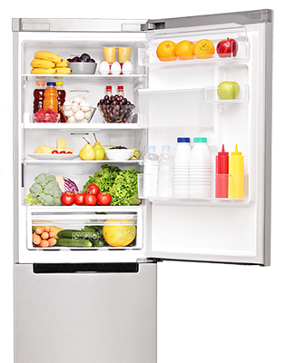
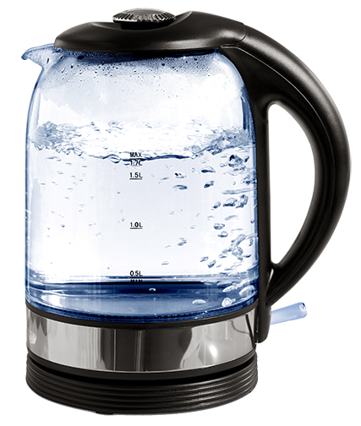
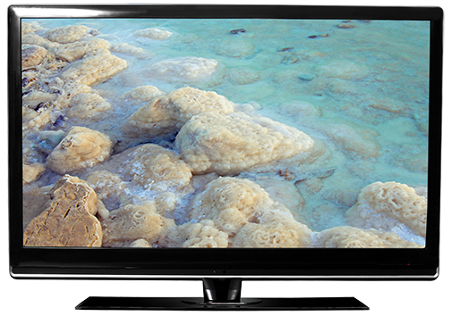
What do we use electricity for?
To help us each day we
use lots of electrical devices
What am I?
Sort your devices into those that are essential and those that you can manage without.

Slide 3
Living with limited electricity
You are given the following six electrical items to improve your stay
in the jungle.
A device for heating water
A light source
A mobile phone
A device for keeping food cold
A device for cooking food
A
fan
With your group, put these devices in order from the most to the least important device to make your stay more comfortable.
What other factors
may influence your choice. Time of day? Temperature? Your age?
Would you swap one of the devices for something different?
© PrimaryUpd8 To subscribe, visit www.primaryupd8.org.uk

Slide 4
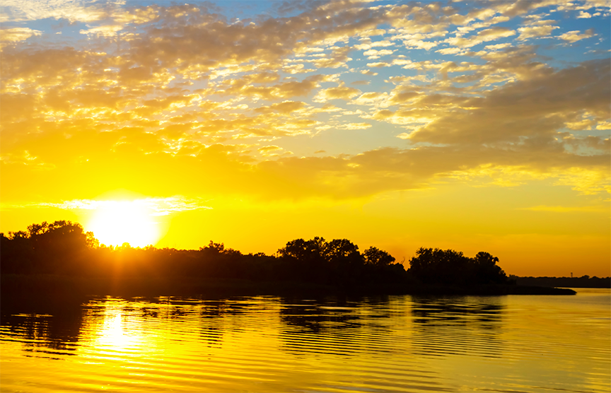
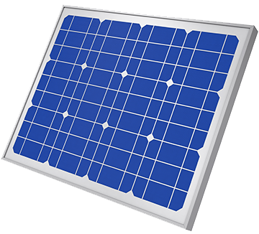

Making the most of a free resource
After 6 hours each battery is fully charged
Daylight 5am to 5pm
If charged for...
The device will work for...
A water heater
30 minutes
20 minutes
There must be
a light on during the hours of darkness
A small fridge
30 minutes
20 minutes
A light
10 minutes
30 minutes
A cooker
30 minutes
30 minutes
The mobile phone must always be working
A fan
15 minutes
1 hour
A mobile phone
10 minute charge
1 hour
What would you charge up
each day and for how long?
Would you charge the same devices each day?

Slide 5

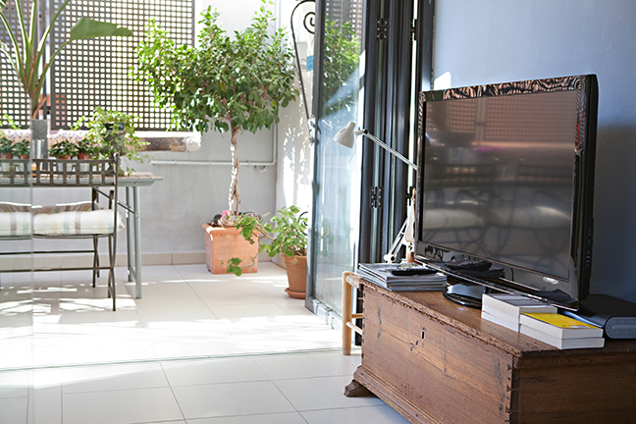

Living without electricity
Living with electricity
What are the three biggest benefits that electricity brings to your lifestyle?
In the jungle with no
solar cells.
What would be the three biggest challenges to your survival?
Notes:
123659026 286592765 298059479

