Slide 1





Book 4
Name:_________________________
Home
Learning Log

Slide 2
This homework book provides opportunities for you to support and enjoy mathematics with your child through playing various fun activities at home. All the games are focused at your child’s stage of development.
The aim of all the activities is to develop mathematical confidence and fluency through practise and repetition.
Your child’s class teacher may advise particular games for your child to practise, or they may let the choice be yours.
Thank you for your support ☺.

Slide 3

For the following activities, you will need:
A pencil and paper
Paperclips
Counters (they can be made from paper)
Playing cards
Catalogues
Clocks (digital and analogue)

Slide 4
Counting On
This is an extension from the activity in books one, two and three. The aim is to apply what they know about numbers up to 100, and master counting fluency up to and beyond 1000.
In Year 4, children should be confident counting forwards and backwards up to 1000 in any steps. They should be able to start on any number.
This is a game that requires no equipment and can be played in pairs.
One person chooses a number from the first column (jump size), and the other chooses a number from the second column (the starting number). You must take it in turns to say the next number in the sequence. You can make up your own starting points.
For example, if you chose to start with jumps of 25, and your child decided to start at 88, the conversation would go:
Child: ”88”
You: “113”
Child: “138” etc.
Set a limit to reach, or stop whenever you feel that your child is struggling. You can swap your roles over.
Jump Size | Starting Number
6 | 0
25 | 50
11 | 9
7 | 88
9 | 346
1000 | 1075
 | Initials & Date
1
2
3
4
5
6
7
8
9
10

Slide 5
Counting Back
Jump Size | Starting Number
6 | 3400
25 | 700
11 | 375
7 | 99
9 | 9050
1000 | 62
 | Initials & Date
1
2
3
4
5
6
7
8
9
10
It is very important that children learn to count backwards as well as forwards. The aim in Year 4 is that children should be confident counting forwards and backwards up to and beyond 1000 in steps 1 to 10, 100s and 50s, 11s and 25s.
As in the previous activity ‘Counting On’, one person chooses a number from the first column (jump size), and the other chooses a number from the second column (the starting number). You must take it in turns to say the next number in the sequence when counting backwards. You can make up your own starting points.
For example, if you chose to start with jumps of 9, and your child decided to start at 375, the conversation would go:
Child: ”375”
You: “384”
Child: “393” etc.
Keep counting until you reach zero or you have reached a target number set before beginning to count.
As an extra challenge you could ask your child to count through zero into negative numbers!

Slide 6
Doubling and Halving Machine
 | Initials & Date
1
2
3
4
5
6
7
8
9
10
Ask your child to imagine a line floating in front of them. Then tell them a number between 1 and 100. They must imagine partitioning the given number into tens and ones (e.g. 44 is 40 and 4), and then pushing each part through the double machine.
As the numbers pass the line, they double. So, 40 becomes 80, and 4 becomes 8. Bringing the two parts back together gives a total of 88. Use lots of examples and see if they can get 10 correct in a row. As an extra challenge you could extend the game to 3-digit numbers.
Children may discover that they can split numbers into alternative parts before doubling. For example, to double 26, instead of doubling the 20 and then the 6, they might choose to double 25 (to make 50) and then 1 (to make 2).
You can switch the game around by halving instead. To make it harder you could use odd numbers or 3-digit number.

Slide 7
Divide Me
5
6
 | Initials & Date
1
2
3
4
5
6
7
8
9
10
8
3
30 | 56 | 48 | 72 | 24 | 20
64 | 36 | 56 | 35 | 42 | 21
36 | 45 | 63 | 49 | 81 | 54
24 | 54 | 35 | 54 | 50 | 30
28 | 40 | 40 | 32 | 63 | 48
4
9
590
460
470
7
2
This is a game for two players.
You will need counters in two different colours.
Use a paperclip and pencil as a spinner to select a number at random.
Using your colour counter, cover a number in the grid that can be divided exactly by the number the spinner lands on - without any remainder.
If you cannot divide a number in the grid by the number on the spinner, you must miss a go.
The winner is the player with the most answers covered.

Slide 8
Spend £10
 | Initials & Date
1
2
3
4
5
6
7
8
9
10
It is a great idea to let children familiarise themselves with the world of currency from an early age.
Challenge your child to spend a virtual £10 using catalogues around the home or online shops.
You could ask your child various questions, such as:
“Which two/three/four items can you buy that would cost exactly £10?”
“How much change will you get from £10 if you buy…? Which coins could you receive as change?”
“Which two/three/four items can you buy that will give you at least £2 change?”
“Which two/three/four items can’t you afford to buy?”

Slide 9
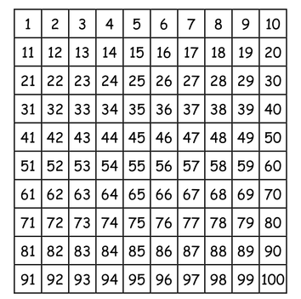
Guess the Number
 | Initials & Date
1
2
3
4
5
6
7
8
9
10
Looking at the hundred square to the right, choose a number and ask your child to guess what it is by asking questions with a ‘yes/no’ answer.
They may start by asking lots of “it is greater/less than…?” questions. This is a good starting point, but do encourage your child to use a wider range of mathematical language.
Here are some examples of additional questions:
“Is it a multiple of 3/6/9…?”
“Is it odd/even?”
“Is it a factor of…?
“Do both digits add to give an even/odd total?”
“Is the digit in the place of the ones greater/less than the digit in the place of the tens?”

Slide 10
Time Tellers
 | Initials & Date
1
2
3
4
5
6
7
8
9
10
In Year 4, your child will learn to tell the time using analogue and digital clocks and how to tell the time when the minute hand is pointing at any of the numbers.
They also need to be able to switch between analogue and digital confidently.
Look at a clock with your child and ask them to read and write the time.
Ask your child to tell you what a digital clock would say. Make this become part of your child’s daily routine by asking them to read the time regularly.
You can ask your child a range of questions, such as:
“What will the time be in 10/15/30 minutes etc.?”
“What is the time on a 24-hour clock?”
“How many minutes are there until ___?”
“Our film began at ___ and finished at ___. How long was the film? If we began watching the film 15 minutes earlier, when would the film have finished?”

Slide 11
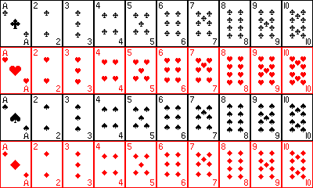
Cards Times Tables
 | Initials & Date
1
2
3
4
5
6
7
8
9
10
Find a pack of cards and remove all picture cards so you are left with Ace-10 of all suits. Shuffle the cards and take 20 each. Both turn a card face up at the same time and call out the product. For example, if you turned a 7 and your child turns over a 3 you must call out “twenty-one”. The first person to get the answer scores a point.
Play until one person reaches 20 points or until a player runs out of cards.

Slide 12
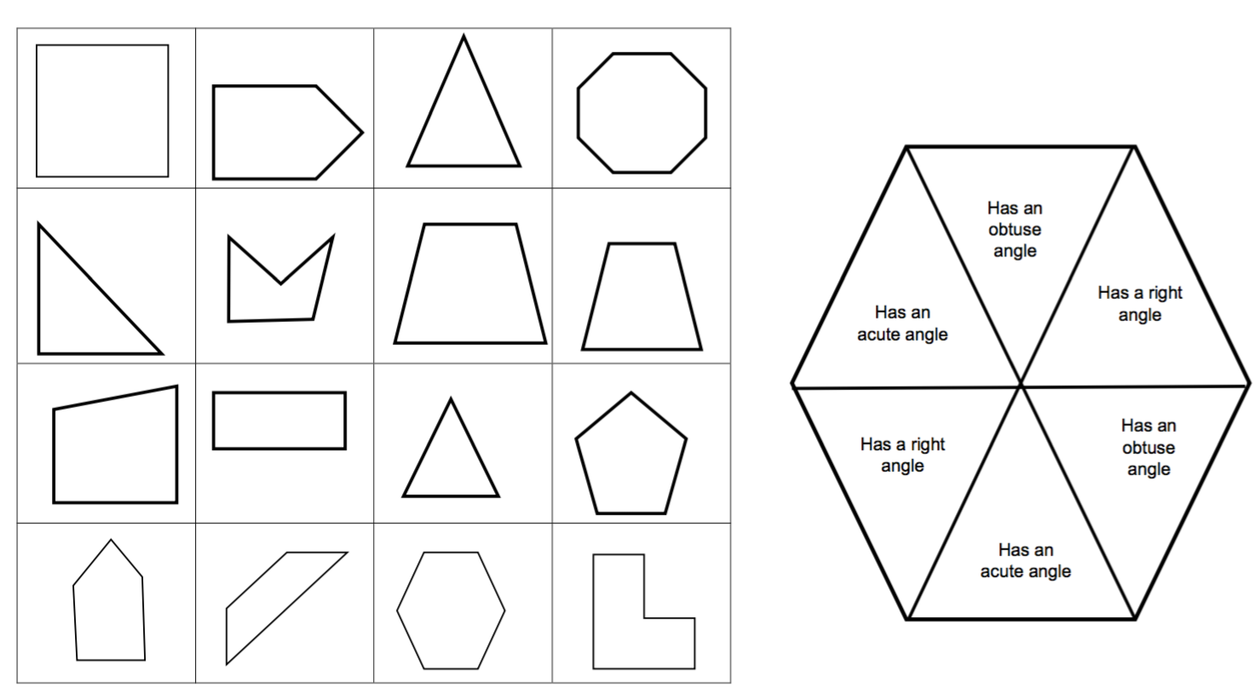
4 in a Row
 | Initials & Date
1
2
3
4
5
6
7
8
9
10
This is a game for two players. You will need counters in two different colours.
Use a paperclip and pencil as a spinner to select a property at random. Place your colour
counter on a shape with that property. The winner is the first person to cover 4 shapes in a row.
Has an obtuse angle
Has an acute angle
Has a
right-angle
Has a
right-angle
Has an obtuse angle
Has an acute angle

Slide 13

 | Initials & Date
1
2
3
4
5
6
7
8
9
10
When it comes to times tables, speed and accuracy are important – the more facts your child remembers, the easier it is for them to do harder calculations.
Using your child’s login details provided by the class teacher, support your child to practise their times tables online or using the app.
In Year 4, your child can begin by playing on the single player game ‘Garage’, and the multiplayer game ‘Arena’, in which they can play against rock stars from their class.
Once your child has learnt all of their times tables at school, they may begin to play on ‘Studio’ and ‘Festival’ which display all times tables up to 12 x 12.

