Slide 1

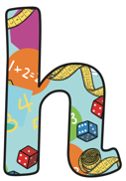
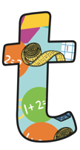

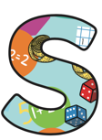
Book 3
Name:_________________________
Home
Learning Log

Slide 2
This homework book provides opportunities for you to support and enjoy mathematics with your child through playing various fun activities at home. All the games are focused at your child’s stage of development.
The aim of all the activities is to develop mathematical confidence and fluency through practise and repetition.
Your child’s class teacher may advise particular games for your child to practise, or they may let the choice be yours.
Thank you for your support ☺.

Slide 3
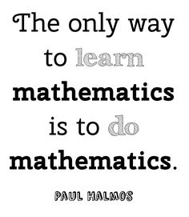
For the following activities, you will need:
A pencil and paper
Paperclips
Counters (they can be made from paper)
Playing cards
Coins
A tape measure

Slide 4
Counting On
 | Initials & Date
1
2
3
4
5
6
7
8
9
10
This is an extension from the activity in books one and two. The aim is to be apply what they know about numbers up to 100 and develop fluency and confidence up to 1000.
In Year 3, children should be confident counting forwards and backwards up to 1000 in steps 1 to 10, 100s and 50s.
This is a game that requires no equipment and can be played in pairs.
One person chooses a number from the first column (jump size), and the other chooses a number from the second column (the starting number). Should be confident starting at a range of numbers.
You must take it in turns to say the next number in the sequence.
Jump Size | Starting Number
3 | 0
4 | 5
100 | 500
8 | 28
6 | 117
9 | 455
For example, if you chose to start with jumps of 100, and your child decided to start at 28, the conversation would go:
Child: ”28”
You: “128”
Child: “228” etc.
Set a limit to reach, or stop whenever you feel that
your child is struggling. You can swap your roles over.

Slide 5
Counting Back
 | Initials & Date
1
2
3
4
5
6
7
8
9
10
This is an extension from the activity in books one and two. The aim is to be apply what they know about numbers up to 100 and develop fluency and confidence up to 1000.
In Year 3, children should be confident counting forwards and backwards up to 1000 in steps 1 to 10, 100s and 50s.
It is very important that children learn to count backwards as well as forwards. As in the previous activity ‘Counting On’, one person chooses a number from the first column (jump size), and the other chooses a number from the second column (the starting number). You must take it in turns to say the next number in the sequence when counting backwards.
For example, if you chose to start with jumps of 3,
and your child decided to start at 136, the conversation would go:
Child: ”136”
You: “133”
Child: “130” etc. You may decide to stop after 100.
Keep counting until you reach a target number or zero, or you can’t go any further as the next number would be below zero. There is no need to explore negative numbers at this stage.
Jump Size | Starting Number
3 | 100
4 | 75
8 | 98
100 | 136
6 | 405
9 | 350

Slide 6
Five Facts
 | Initials & Date
1
2
3
4
5
6
7
8
9
10
Start by giving your child a multiplication fact up (from the 2, 5, 10, 3, 6, 9, 4 or 8 times table). For example, you might say “Three times ten equals thirty”.
You have given them one fact an in return they have to give you five related facts. The five related facts for this fact would be:
“Ten times three equals thirty”
“Thirty divided by three equals ten”
“Thirty divided by ten equals three”
“One third of thirty equals ten”
“One tenth of thirty equals three”
Once more confident, you can vary they type of fact you start the game with. For example, you could start with “Thirty divided by ten equals three”.
Encourage your child to spot that the facts come in pairs: two multiplication, two divisions and two fractions. They can also explore addition and subtraction connections. For example 5 x 6 = 30 is same as 5 + 5 + 5 + 5+ 5 + 5 = 30
Children should be encouraged to link mathematical concepts and patterns.
10 x 3 = 30
5 x 6 = 30
30 ÷ 10 = 3
30 ÷ 5 = 6

Slide 7
This is a 2 player game. You will need some coloured counters (or equivalent).
Begin by choosing one of the four numbers.
Use a pencil and paperclip as a spinner to select the multiple of 100 that you will add or subtract from the chosen number.
Place your colour counter over the correct answer. The winner is the player with the most answers connected together by their sides.
Hundreds
 | Initials & Date
1
2
3
4
5
6
7
8
9
10
340 | 170 | 240 | 890
290 | 260 | 760 | 740
670 | 660 | 640 | 60
490 | 140 | 690 | 770
70 | 440 | 270 | 190
790 | 840 | 570 | 940
860 | 990 | 160 | 360
370 | 560 | 870 | 390
590
460
470
590
460
470
540
+ 300
- 100
+ 200
– 200
– 300
+ 400
+ 100
– 400

Slide 8
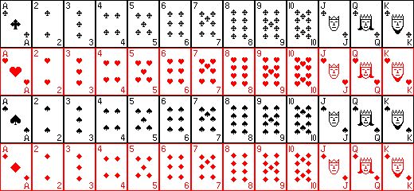
Running Total
 | Initials & Date
1
2
3
4
5
6
7
8
9
10
Find a pack of cards and remove all court cards (Jacks, Queens and Kings), and black cards (spades and clubs) so you are left with the ace to ten of hearts and diamonds.
Shuffle the cards and then deal one card face up. Deal the next card on top for your child to add mentally to the one before. Repeat dealing and adding until every card has been dealt. You should finish on 110 if all calculations are correct.
As an extra challenge you could time the activity with the aim of getting faster and more accurate each time.
For example, if the first four cards were 3, 6, 7 and 9, the game would go like this:
YOU DEAL 3 then YOU DEAL 6
Child “9”
YOU DEAL 7
Child “16”
YOU DEAL 9
Child “25” etc.

Slide 9
Shopping Trip
 | Initials & Date
1
2
3
4
5
6
7
8
9
10
It is a great idea to let children familiarise themselves with the world of currency from an early age.
When shopping, go to the self-serve checkouts. For a small number of items, allow your child to estimate the total price of all items before scanning the items.
Was their estimation close?
Allow your child to pay by inserting the correct amount, choosing the appropriate coins. Or pay to the nearest 10p, 50p, £1 etc. and let them work out and check the change given. For example the cost is £2.37 and I pay £2.50. How much change will I receive?
You can obviously role play this at home if necessary. Real prices can be found online and via shopping apps.

Slide 10
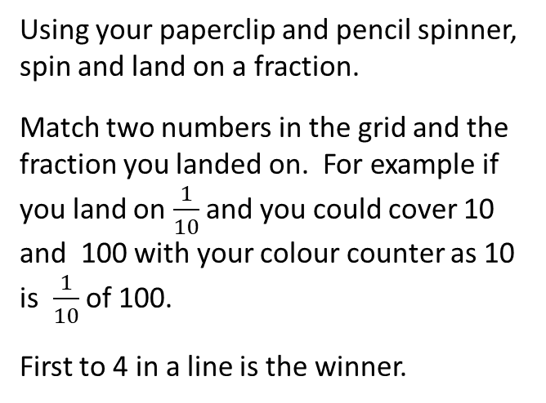
Find the Fraction
 | Initials & Date
1
2
3
4
5
6
7
8
9
10
100 | 1 | 2 | 24 | 4 | 3
10 | 9 | 5 | 30 | 3 | 21
25 | 45 | 9 | 4 | 36 | 1
6 | 12 | 50 | 16 | 3 | 27
18 | 30 | 8 | 14 | 15 | 40
32 | 7 | 3 | 50 | 6 | 9
5 | 2 | 20 | 8 | 16 | 1
15 | 4 | 7 | 50 | 2 | 3
1
1
1
2
10
3
1
1
8
1
5
4
Using your paperclip and pencil spinner,
spin and land on a fraction.
Match two numbers in the grid and the
fraction you landed on. For example if you land on $\frac{1}{10}$ and you could cover 10 and 100 with your colour counter as 10 is $\frac{1}{10}$ of 100.
First to 4 in a line is the winner.

Slide 11
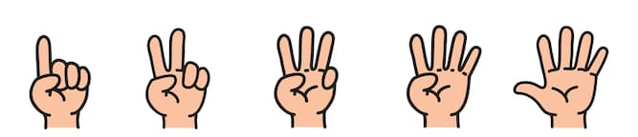
Multiply
 | Initials & Date
1
2
3
4
5
6
7
8
9
10
You and your child should each put a hand behind your back. Secretly extend between 1 and 5 fingers. Say “Ready, Steady, Go!” and both bring your hands out to the centre.
Each of you must call out the product of the numbers displayed on each hand.
For example, if you show 3 fingers and your child shows 4, you must quickly call out ”TWELVE!”
The winner writes down one letter from the work ‘MULTIPLY’ in sequence. The first person to complete the word is the winner of the whole game.

Slide 12
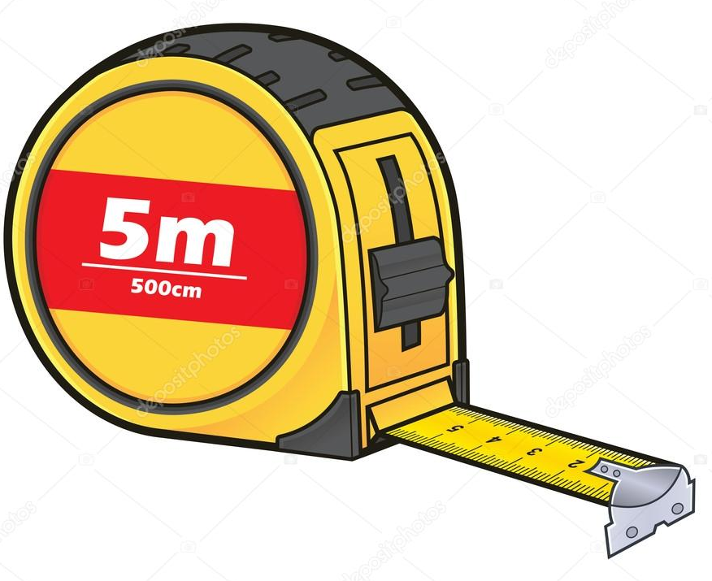
DIY
 | Initials & Date
1
2
3
4
5
6
7
8
9
10
It is important that children get regular, hands-on practise of measuring. This will help them to fully understand the units of measurement, and how they relate to one another.
Set your child a challenge to measure part of an object in the house using a tape measure. For example: the sofa, the dining table, their bedroom walls etc. This can be the height, width or length. To make it more difficult you may want them to measure all three dimensions! Get them to label this on draft paper.
You can ask your child additional questions, such as:
“Which object was the tallest?”
“How much shorter/taller was one item compared to another?”
“How many of one object would fit into the height of another?”
“How many of one object would fit across the wall?”
As an extra challenge you could ask your child to convert their measurements to ‘cm’ or ‘m’.

Slide 13

 | Initials & Date
1
2
3
4
5
6
7
8
9
10
When it comes to times tables, speed and accuracy are important – the more facts your child remembers, the easier it is for them to do harder calculations.
Using your child’s login details provided by the class teacher, support your child to practise their times tables online or using the app.
In Year 3, your child can play on the single player game ‘Garage’, and the multiplayer game ‘Arena’, in which they can play against rock stars from their class.

