Slide 1

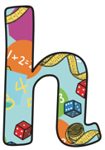
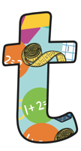
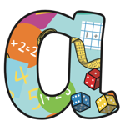
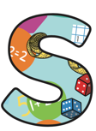
Book 6
Name:_________________________
Home
Learning Log

Slide 2
This homework book provides opportunities for you to support and enjoy mathematics with your child through playing various fun activities at home. All the games are focused at your child’s stage of development.
The aim of all the activities is to develop mathematical confidence and fluency through practise and repetition.
Your child’s class teacher may advise particular games for your child to practise, or they may let the choice be yours.
Thank you for your support ☺.

Slide 3
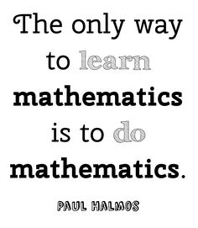
For the following activities, you will need:
A pencil and paper
Dice (can use interactive versions online)
Counters (they can be made from paper)
Recipe books
Tape measure

Slide 4
Place Value Products
 | Initials & Date
1
2
3
4
5
6
6
8
9
10
This is a game for two players.
Choose one number out of 10, 100 or 1000 and one from 6.06, 0.06, 6.66 or 0.066
Decide whether to multiply or divide the two numbers together and cover the answer on the grid with a counter. Not all the totals are achievable.
The first player to get 3 products in a row wins
0.66 | 660 | 606 | 666 | 6006 | 6660
6060 | 606 | 0.066 | 6060 | 0.606 | 666
0.66 | 0.666 | 0.006 | 0.066 | 6600 | 6.6
660 | 6060 | 0.606 | 0.666 | 0.66 | 6.06
66.6 | 6060 | 6006 | 6660 | 66.6 | 6.6
10 | 100 | 1000 | 6.6 | 6.06 | 6.66 | 66

Slide 5
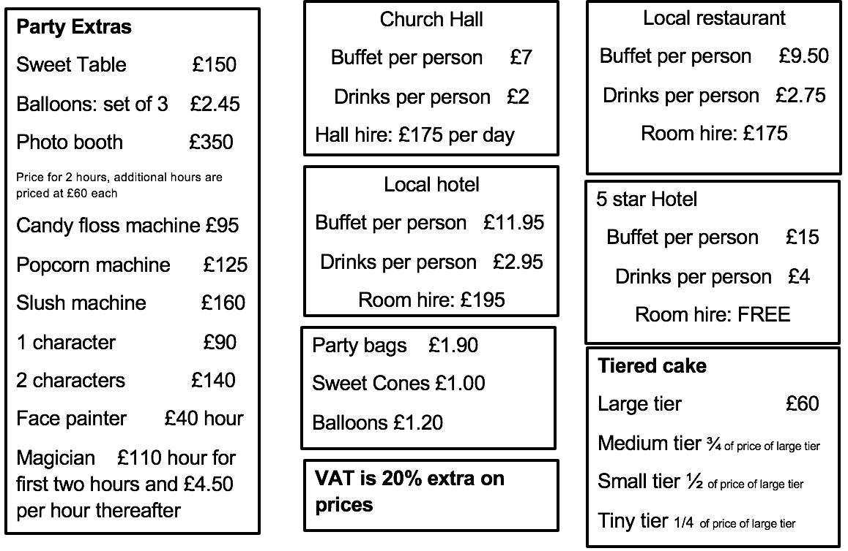
Party Planner
Set your child the challenge of planning an imaginary party and working out the total cost - they can choose what the celebration is! Your child could plan their own perfect party or you could set them a budget to work within. You could also give a criteria for your own party for your child to plan. Support them to price this up and check if it is within your price range.
 | Initials & Date
1
2
3
4
5
6
6
8
9
10

Slide 6
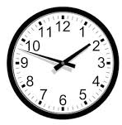
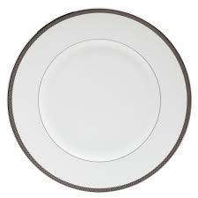
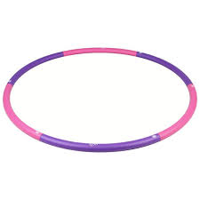
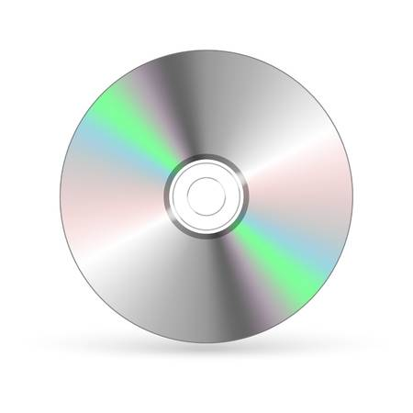
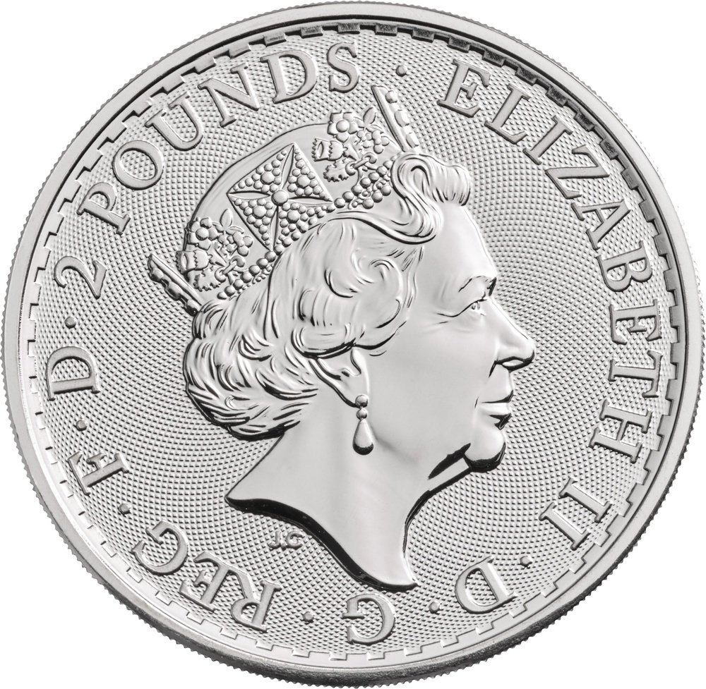
Circles
 | Initials & Date
1
2
3
4
5
6
6
8
9
10
Ask you child to hunt for an everyday object around the house in the shape of a circle.
They should measure the diameter of the circle to the nearest mm, and use this information to calculate the circle’s radius.
As an extra challenge, you could ask your child to convert the measurements between mm, cm and m.

Slide 7
Divide My Decimal
 | Initials & Date
1
2
3
4
5
6
6
8
9
10
0.5 | 0.1 | 0.8 | 0.2 | 0.65 | 0.5
0.8 | 0.6 | 3 | 0.33 | 0.3 | 0.625
3 | 0.125 | 0.5 | 0.33 | 1 | 8
0.65 | 1.5 | 0.9 | 0.25 | 0.6 | 2
0.25 | 0.6 | 5 | 2.5 | 0.5 | 2
0.3 | 0.5 | 4.5 | 0.4 | 3.5 | 0.33
Throw two 1 – 10 dice.
Divide one number rolled by the other.
If the quotient appears on the grid, cover it with a counter.
Play 4 in a row wins or the one with the most counters.

Slide 8

Countdown
 | Initials & Date
1
2
3
4
5
6
7
8
9
10
Make a set of countdown cards by writing three 1s, three 2s, three 3s, and so on up to three 9s on separate strips of paper. Make a second set of cards consisting of two 50s and two 100s. Or download a set:
https://www.paperzip.co.uk/resource/countdown-game/
Shuffle each pack of cards separately and ask your child to choose 4 small numbers from set one and two large numbers from set 2 (slightly harder than the year 5 rules).
Roll a dice 3 times and use the three digits rolled to generate a 3-digit number.
Your challenge is to combine the cards using addition, subtraction, multiplication and division to get as close as possible to the 3-digit number. Each card can only be used once.
You could even play online:
https://nrich.maths.org/6499

Slide 9
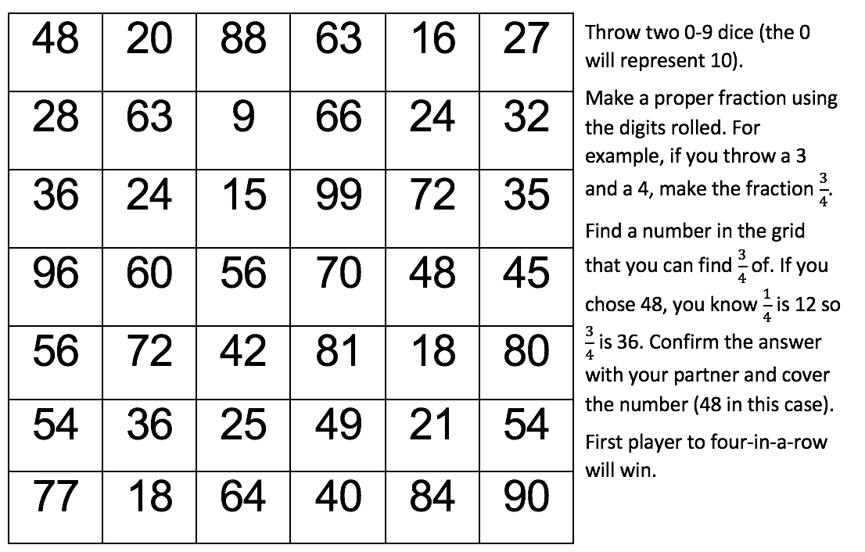
Fraction Fun
 | Initials & Date
1
2
3
4
5
6
6
8
9
10

Slide 10
Timetable Maker
 | Initials & Date
1
2
3
4
5
6
6
8
9
10
Support your child to make a timetable for a day of their choice. They should write down the start and end time of each activity for that day in digital and analogue, and the duration of each activity in minutes and hours where possible. Encourage your child to use the 24 hour clock when writing the digital time.
Here is an example of how the timetable could look:
Activity | Start Time |  | End Time |  | Duration
 | Digital | Analogue | Digital | Analogue | Minutes | Hours
Eating breakfast | 9:00 | 9 o’clock | 9:20 | 20 past 9 | 20 | 0:33
Getting ready | 9:20 | 20 past 9 | 9:50 | 10 to 10 | 30 | 0.5

Slide 11

Cooking on a Budget!
 | Initials & Date
1
2
3
4
5
6
6
8
9
10
Your child should find a simple recipe in a cookbook or online. They must then accurately measure the recipe and using scales, measuring cylinders etc AND try and calculate the cost of the meal. For example if they need 300g of flour and a Kg of flour costs 90p. They can work out this is accurately 27p or approximately 30p (a third).
As an extra challenge, you could let your child take charge of timings using a stopwatch or a phone timer. They could also ensure the oven is set to the correct temperature.
You are welcome to share photographs of the final product with the class!

Slide 12
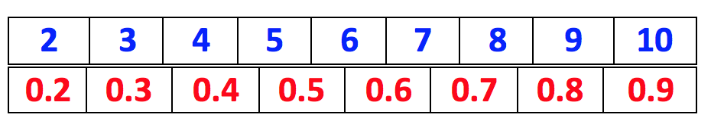
Find Your Product
Start by placing one counter on any blue number and another on any red number number.
Player 1 leaves the counter on the red track in place and moves the counter in the blue track to any number. They find the product of the two numbers and cover the product in the grid with a counter.
Player 2 leaves the counter on the blue track in place and moves the one on the red track. They find the product of the two numbers and cover the product in the grid with a counter.
The game continues with player one only moving counters on the blue track and player two only moving the counters on the red track before finding the product.
The winner is the player to cover 4 products in a row.
 | Initials & Date
1
2
3
4
5
6
6
8
9
10
0.4 | 2 | 0.6 | 3.6 | 2.6
2.5 | 4.8 | 5.6 | 4 | 5.4
6.3 | 6.2 | 3.5 | 1.5 | 8
1.2 | 6 | 4.2 | 4.9 | 3.2
5 | 0.8 | 6 | 1.6 | 9
8.1 | 1.4 | 1 | 2.4 | 3
1.8 | 2.8 | 4.5 | 2.1 | 0.9

Slide 13

 | Initials & Date
1
2
3
4
5
6
6
8
9
10
When it comes to times tables, speed and accuracy are important – the more facts your child remembers, the easier it is for them to do harder calculations.
Using your child’s login details provided by the class teacher, support your child to practise their times tables online or using the app.
In Year 6, your child can begin by playing on the single player game ‘Garage’, and the multiplayer game ‘Arena’, in which they can play against rock stars from their class.
Once your child has learnt all of their times tables at school, they may begin to play on ‘Studio’ and ‘Festival’ which display all times tables up to 12 x 12.

