Slide 1
Phonics Workshop
January 2020

Slide 2
In school, we follow the Letters and Sounds programme. Letters and Sounds is a phonics resource published by the Department for Education and Skills which consists of six phases.

Slide 3
Phase 1
There are 7 aspects with 3 strands.
A1 – Environmental
A2 – Instrumental sounds
A3 – Body Percussion
A4 – Rhythm and rhyme
A5 – Alliteration
A6 – Voice sounds
A7 – Oral blending and segmenting.

Slide 4
Phase 2
Set 1: s, a, t, p
Set 2: i, n, m, d
Set 3: g, o, c, k
Set 4: ck, e, u, r
Set 5: h, b, f, ff, l, ll, ss

Slide 5
Phase 3
Set 6: j, v, w, x
Set 7: y, z, zz, qu
Consonant digraphs: ch, sh, th, ng
Vowel digraphs: ai, ee, igh, oa, oo, ar, or, ur, ow, oi, ear, air, ure, er

Slide 6
Phase 4
This phase consolidates all the children have learned in the previous phases.

Slide 7
Phase 5
Children will be taught new graphemes and alternative pronunciations for these graphemes.
Vowel digraphs: wh, ph, ay, ou, ie, ea, oy, ir, ue, aw, ew, oe, au
Split digraphs: a_e, e_e, i_e, o_e, u_e

Slide 8
Phase 6
The focus is on learning spelling rules.
-s -es -ing -ed
-er -est -y -en
-ful -ly -ment -ness

Slide 9
Blending
Building words from phonemes to read.
c a t
cat

Slide 10
Blending
Qu ee n
queen

Slide 11
Segmenting
Breaking down words for spelling.
cat
c a t

Slide 12
Segmenting
Queen
qu ee n

Slide 13
What does a Phonics lesson look like?
Revisit/review | Practice phonemes and tricky words taught so far.
Teach | Teach new phoneme, teach any new tricky words.
Practice | Game/ writing/ reading/ spelling
Apply | Writing or reading caption or sentence.

Slide 14
Phonics screening

Slide 15
What is the phonics screening check?
Children in Y1 throughout the country will be taking part in a phonics screening check during the same week in June. Children in Y2 will also take the check if they did not achieve the required result in Y1.
The phonics screening check is designed to confirm whether individual children have learnt sufficient phonic decoding and blending skills to an appropriate standard.

Slide 16
What happens during the test?
The test contains 40 words.
Each child will sit one to one and read each word aloud to Mrs Preece.
The test will take approximately 10 minutes per child; although all children are different and will complete the check at their own pace.
The list of words the children read is a combination of 20 real words and 20 nonsense words.

Slide 17
Nonsense words
The nonsense words will be shown to your child with a picture of an alien. This provides the children with a context for the word which is independent from any existing vocabulary they may have.
Nonsense words are included because they will be new to all pupils; they do not favour children with a good vocabulary knowledge or visual memory of words.

Slide 18
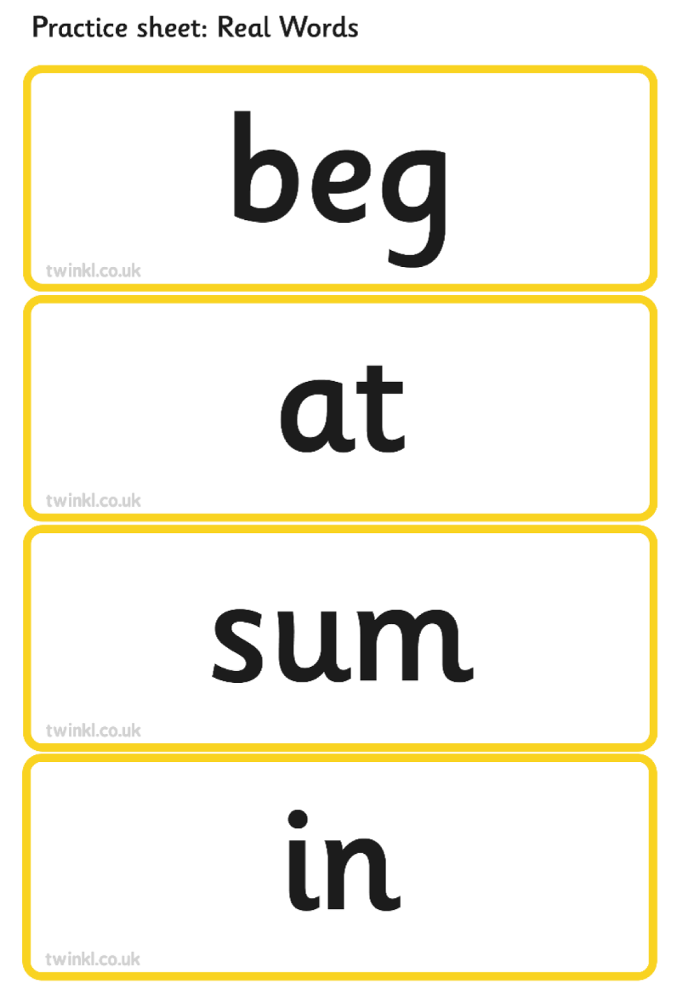
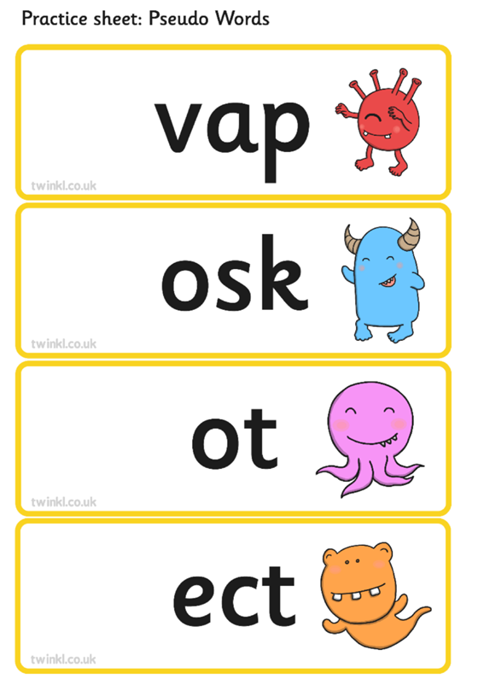
Example of the check

Slide 19
Reporting to parents
By the end of the Summer term all schools must report their child’s results to parents.
They will also confirm if the child has met the standard threshold.
Children who do not achieve the expected level will retake the test when they are in Y2.
Results from the check will be used by the schools to analyse their own performance and for Ofsted to use in inspections.

Slide 20
How can I help my child at home?
Play lots of sound and listening games with your child.
Read as much as possible to and with your child.
Encourage and praise – get them to have a ‘good guess’.
If your child is struggling to decode a word, help them by encouraging them to say each sound in the word from left to right.
Blend the sounds by pointing to each letter, e.g. /c/ in cat, or the letter group, e.g. /ng/ in sing. Next move your finger under the whole word as you say it.
Please try to not use the examples online as we use these to test children’s progress throughout the year.

Slide 21
Any questions?

