Slide 1
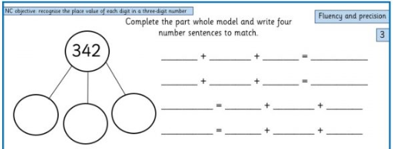
Part Whole Model
Year 3

Slide 2
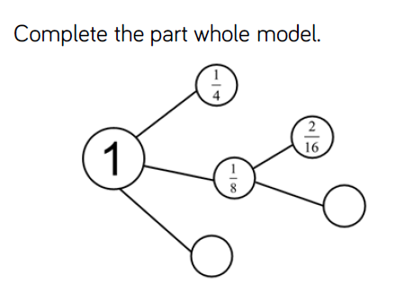
Part Whole Model
Year 5

Slide 3
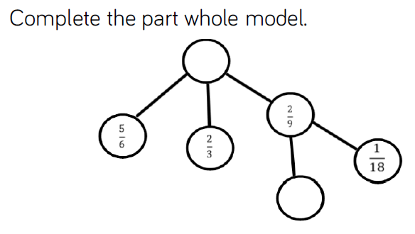
Part Whole Model
Year 5

Slide 4
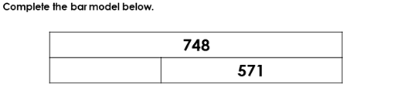
The Bar Model
Year 3

Slide 5
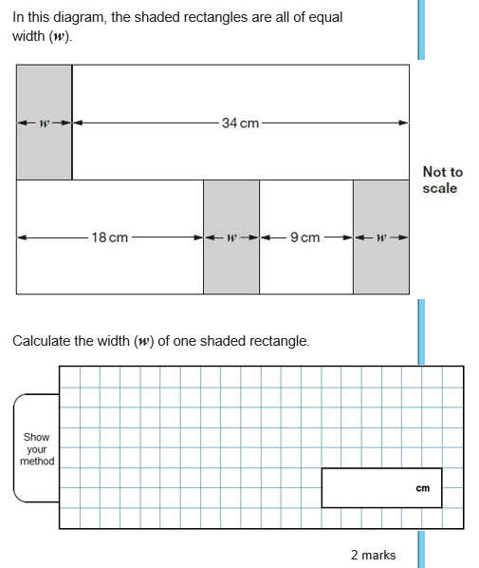
The Bar Model
Year 6

