Slide 1
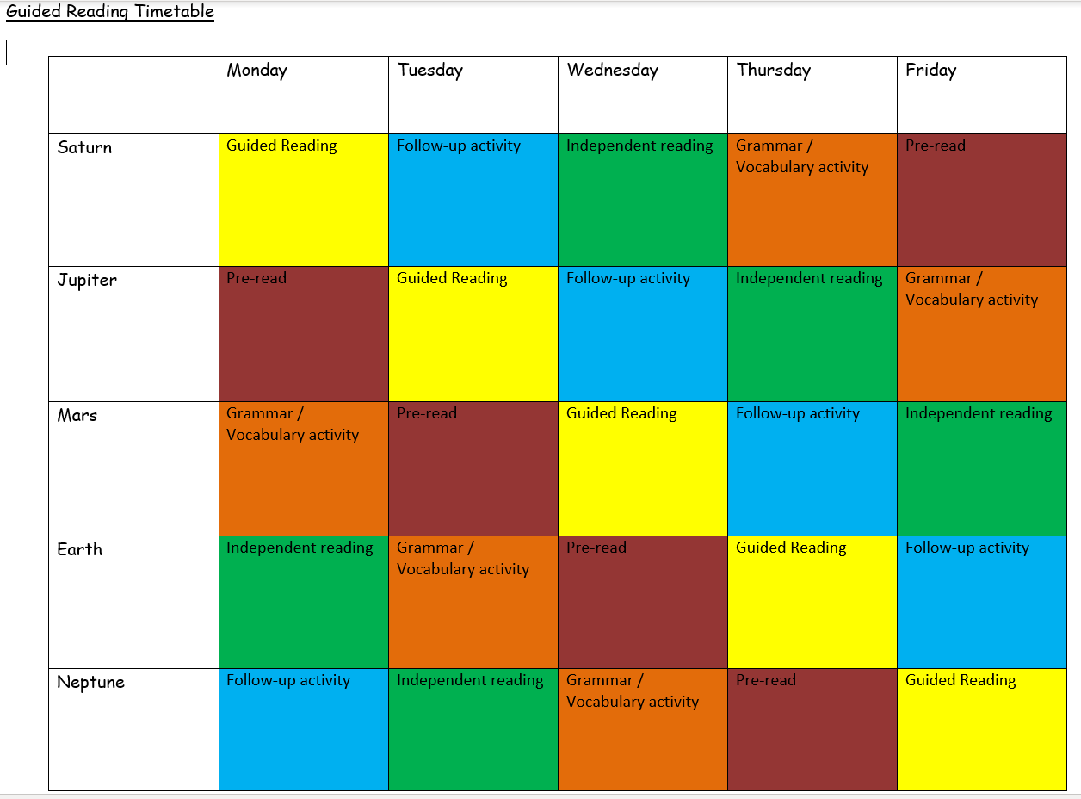
Guided Reading Workshop

Slide 2


Pre-read
To develop active reading strategies
        to engage with the text by making connections
        to identify any unfamiliar vocabulary
        to ask questions about the text
        to think about the author’s use of literary devices
        to develop use of reading journals
        to record ideas
        to make predictions / summaries
        to record thoughts about a character or setting

Slide 3
Making Connections
Text – to -self | Text – to - text | Text – to - world
What does the story remind you of? Can you relate to the characters in the story Does anything in the story remind you of anything in your own life? | What does this remind you of in another book you have read? How is the text similar to other texts you have read? How is this text different to other texts you have read? | What does this remind you of in the read world? Are the events in this story similar to things that happen in the real World? How are the events in this story different from those that happen in the real World?

Slide 4
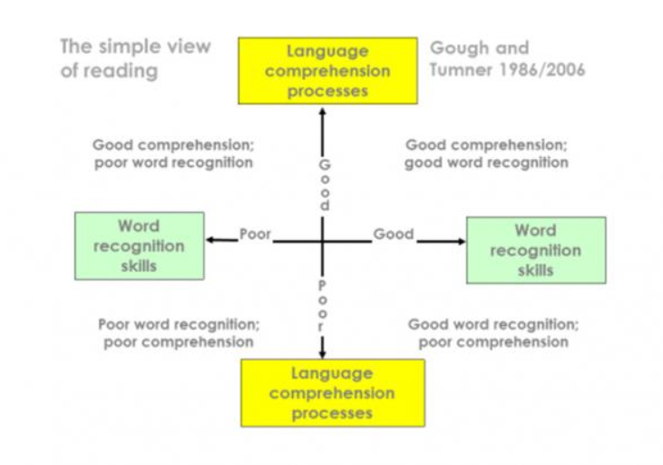

Slide 5
Follow – up activity
Point / Evidence grid to develop understanding of characters
Responding to questions
Using art to develop / evidence understanding
Identify further unfamiliar words
Creating a semantic map to explore the author’s vocabulary choices
Inferring characters thoughts or feelings and supporting with evidence
Feelings graph
Diary entry
Sequencing events activity

Slide 6
Michael’s mother is a natural leader. Support this statement with evidence from the text.
Point | Evidence
Leader

Slide 7
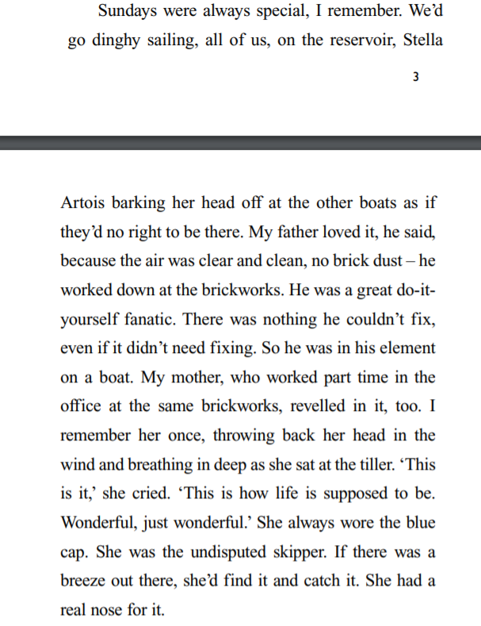

Slide 8
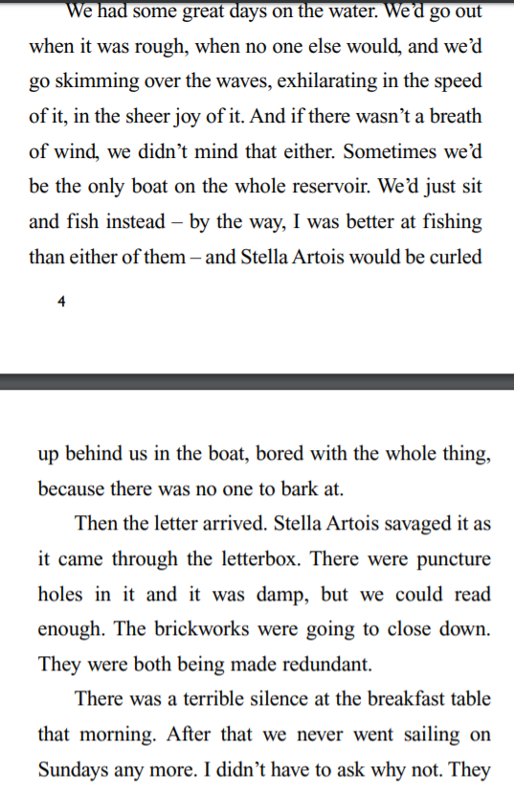

Slide 9
https://www.lovereading4kids.co.uk/

