Slide 1

Aughton
St Michael’s
English Parent Workshop
Jan 2020

Slide 2
Overall curriculum INTENT
To create independent and resilient learners who enquire into the world around them.

Slide 3
Reading Curriculum INTENT
To create resilient readers who chose to read a range of challenging books independently, enquiring about the deeper meaning of the text and how it impacts on their understanding of the world around them.

Slide 4
Writing Curriculum INTENT
To create resilient writers who independently challenge themselves to utilise the skills and styles they have seen in a range of genres and enquiry in the intent of author’s vocabulary and technique and how it impacts on the reader.

Slide 5
What are the key elements to develop from our intents?
Developing the vocabulary accessed, understood and utilised by the children.
To communicate with parents how best to support your child when reading with them.

Slide 6
Reading
Current situation:
Children’s mechanical reading is good but don’t always understand the deeper meaning. This gap is what we would like to close.
Developments for this year:
Increase in the difficulty of the text we use for our English topics.
Specific tasks and lessons to upskill vocabulary within writing.
Home Reading reading bookmarks for book bands up to Lime.
Parent Workshop to explain the teaching methods further.
Drop in sessions for parents to come and learn with their children.

Slide 8
What does reading look like at our school?
Reading for pleasure
Shared Reading
Guided Reading
Reading Scheme
Phonics

Slide 9
What does Reading look like in Aughton St Michaels?
Phonics: Taught to whole class in EYFS and KS1. All classes teach this at he same time of the day so we can stream by ability – Mrs McMenamy will be doing a workshop on this today.
Guided Reading: All year groups but does develop as you move up the school – Workshops today modelling a teacher-led session
Home Readers: EYFS to Y3/4, once they have reached the end of our set book bands the children can choose their own book to read at home. This book can come from the school library or home but will be monitored to ensure it is appropriate and that a variety of genres are being accessed. This will be supplemented by the novels that are used in Guided Reading. Every child who is on a free choice will be expected to record what they have read 3 times a week in their Reading Record.

Slide 10
What is Guided Reading?
Small group session that focus on specific objectives to develop.
Book is chosen to challenge the children as they are supported by the teacher.
Cover a variety of genres and styles.
Sessions work on a rota over a week.
The way it runs develops as you move up through the school
Sessions will be either
  Pre-read
  Teacher-led
  Independent follow up
To make the rota work, some groups will be given focused tasked based on spelling and/or grammar or an independent reading slot.

Slide 11
How does Guided Reading develop?
EYFS: group reading of phonically decodable books with groups as appropriate
Y1: 2 teacher-led sessions per week using phonically decodable books. First session focused on read the words, second session on comprehension.
Y2: 1 teacher-led session with age-appropriate novel, then an independent follow up task in the following session.
Y3: a pre-read, teacher-led session and then independent follow up task every week using a novel.
Y4: Class split in half and swaps each half-term. Half have a novel that they read at home to a certain point each week the other half use an extract. Both groups have a pre-read, teacher-led session and then independent follow up task every week. Swaps at half term.
Y5: have a novel that they read at home to a certain point each week and a pre-read, teacher-led session and then independent follow up task every week.
Y6: have a novel that they read at home to a certain point each week and a pre-read, teacher-led session and then independent follow up task every week. They also have an extract on which they have a pre-read, teacher-led session (with TA) and then independent follow up task every week.

Slide 12
Reading at home
Books given from our Reading Scheme are based on the individual’s ability and they move up through the bands when they are ready.
When listening to children read, checking understanding is vital. To support this we send home a bookmark that links to the book band the child is on and the book may also have questions at the back. On the website we also have example Question Prompt and a Question Matrix. Asking to define vocabulary is also vital – This is the focus of some workshops today.
All children benefit from being read stories that introduce a rich, varied vocabulary. To support this we have develop 110 books to Read Before You Leave Aughton St Michaels.

Slide 13







Question Prompts

Slide 14
The general level of difficulty of question increases… A “What is?” question is normally easier to create and answer than a “How might?” question.

Slide 15
The general level of difficulty of question increases… A “What is?” question is normally easier to create and answer than a “How might?” question.

Slide 16
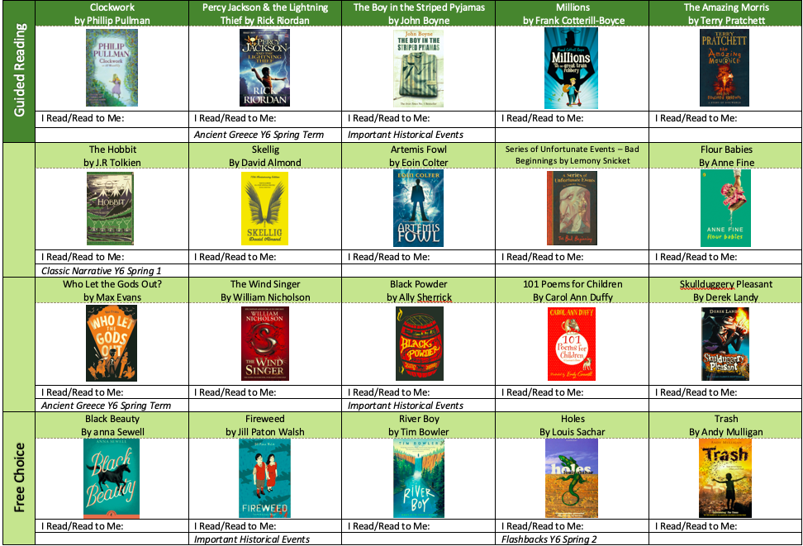

Slide 17
110 Books to Read Before You Leave Aughton St Michaels
Will be stuck inside the front cover of the Reading Record and also on the website.
The first row are books you may read as part of your curriculum, so please only read them when your teacher gives them to you or after the term it is used!
The other 3 rows are a mixture of genres, themes and classic or modern stories. Try to mix up your choices and then post a review on your class’s reading blog.
Each class will have a Reading blog/comments page on the website that children can log into and leave reviews of the books to support their peers in choosing their next book. The best reviews each term will win a prize.
The children can have them read to them, read with them or read independently.
Aim is to increase the variety of books read and it is supposed to be enjoyable not an arduous task.
Each term the class teacher will pick a book from the list that they will read with that term and will join the debate with the children via the blog/comments page.
Any links to our curriculum are also noted.

Slide 18
Workshops
Workshops twice starting at 6:30pm and 7:00pm
WHO WHAT WHERE
Mrs McMenamy A Journey Through Phonics Reception
Mrs Preece Developing Vocabulary for KS1 Year 1
Mrs McCormack Reading for KS1 Year 2
Miss Stone Developing Vocabulary for LKS2 Year 3
Mrs Wainwright Reading for LKS2 Year 4
Mrs Wood Reading for UKS2 Year 5
Mr Clare Developing Vocabulary for UKS2 Year 6

