Slide 1
Learning Objective:
To identify, name and write equivalent fractions of a given fraction

Slide 2
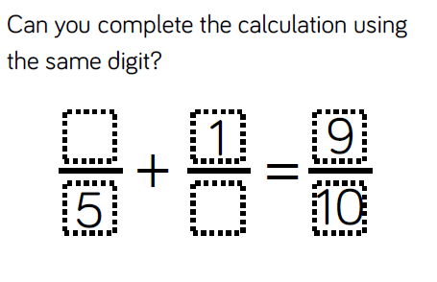

Slide 3
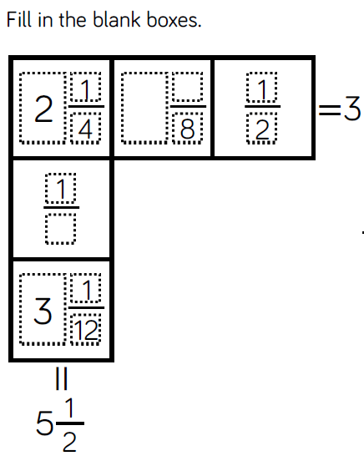
7
8

Slide 4
Learning Objective:
To recognise mixed numbers and improper fractions and convert from one form to the other.

Slide 5
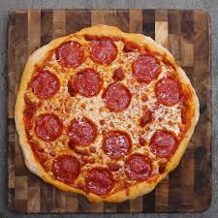
concrete – pictorial – abstract
=
1 3
4

Slide 6
Learning Objective:
To multiply mixed numbers and improper fractions by whole numbers.

Slide 7
Use the multilink cubes on your table to represent the equation 3 x 4
What does x mean?
What is x the same as?

Slide 8
1
4
3 x
1
3
x 5

Slide 9
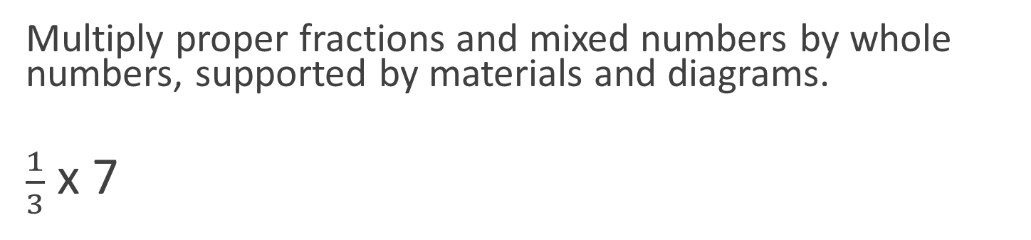
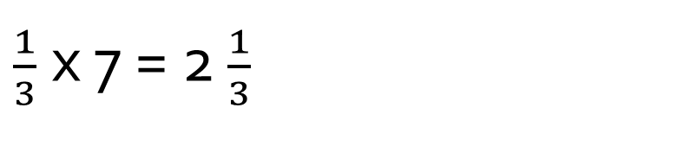
Multiplying Fractions
Multiply proper fractions and mixed numbers by whole numbers, supported by materials and diagrams.
$\frac{1}{3}$ x 7
$\frac{1}{3}$ x 7 = 2 $\frac{1}{3}$
Notes:
1/3 x 7 could also be read as 1/3 of 7, which is the same as 7 divided by 3.

Slide 10
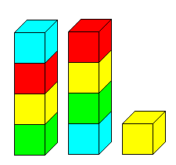



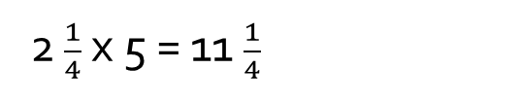
Multiplying Fractions
Now try 2 $\frac{1}{4}$ x 5 using the multilink or squared paper.
2 $\frac{1}{4}$ x 5 = 11 $\frac{1}{4}$

Slide 11
2 ¼ x 3
Success Criteria
Convert to an improper fraction 9/4
Multiply the numerator by the whole number 27/4
Convert back to a mixed number 6 ¾

Slide 12
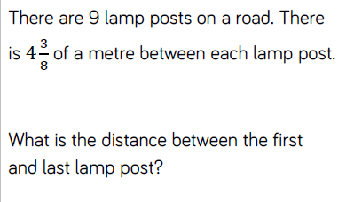

Slide 13
Learning Objective:
To multiply simple pairs of proper fractions, writing the answer in its simplest form

Slide 14
Multiplying Fractions
Multiply simple pairs of proper fractions, writing the answer in its simplest form (e.g. 1/4 × 1/2 = 1/8 )
If 4 x 2 can be interpreted as:
4 multiplied by 2
4 times 2
4 lots of 2
4 groups of 2
¼ x ½ can be interpreted as:
A quarter of a half (or vice versa)
¼ of ½
¼ of ½

Slide 15
