Slide 1

Aughton
St Michael’s Curriculum
2019-20

Slide 2
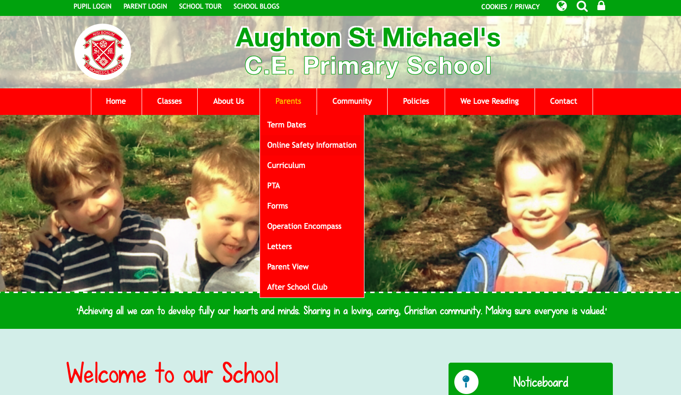

Slide 3
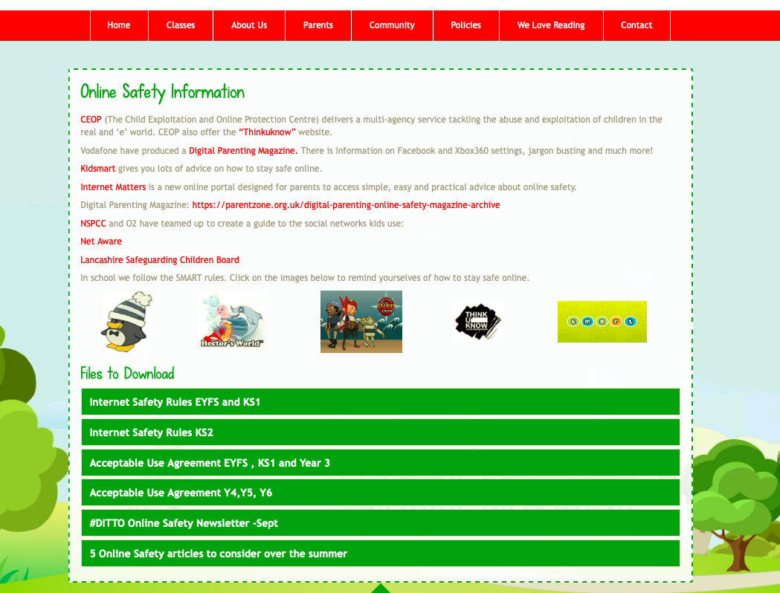

Slide 4
What is the INTENT of our curriculum?
To create independent and resilient learners who enquire into the world around them.

Slide 5
How are we IMPLEMENTING our new curriculum?
Continuing to develop a reasoning based Maths curriculum.
Developing the vocabulary accessed, understood and utilised by the children
Developing the scope of the topics we teach.
Increasing communication and involvement of parents.

Slide 6
Maths
Current situation:
All lessons have an emphasis on explaining or reasoning through mathematical problems, not simply calculating.
Applying knowledge to a variety of situation is the centre of maths learning.
Developments for this year
Parent Workshop to explain the teaching methods further.
Drop in sessions for parents to come and learn with their children.

Slide 7
Reading
Current situation:
Children’s mechanical reading is good but don’t always understand the deeper meaning. This gap is what we would like to close.
Developments for this year:
Increase in the difficulty of the text we use for our English topics.
Specific tasks and lessons to upskill vocabulary within writing.
Home Reading reading bookmarks for book bands up to Lime.
Parent Workshop to explain the teaching methods further.
Drop in sessions for parents to come and learn with their children.

Slide 8
WEEK | AUT 1 | AUT 2 | SPR 1 | SPR2 | SUM 1 | SUM2
1 | Play Script: Shakespeare | Recount: biography Martin Luther King | Persuasion: Argument | Fantasy: Hobbit | Other Cultures: Islam | Discussion
2 | Play Script: Shakespeare | Recount: biography Martin Luther King | Persuasion: Argument | Fantasy: Hobbit | Other Cultures: Islam | Discussion
3 | Novel as a theme: RAVENSGATE | Flashback: Holes | Persuasion: Argument | Fantasy: Hobbit | Other Culture: Islam | Extra Narrative linked to class interest
4 | Novel as a theme: RAVENSGATE | Flashback: Holes | Myths: Greek | Non-chronological report | Discussion | Extra Narrative linked to class interest
5 | Novel as a theme: RAVENSGATE | Flashback: Holes | Myths: Greek | Non-chronological report | MONEY WEEK | Classic Poetry: Macavity the Mystery Cat
6 | Explanation text | Personification Poems: Snow and Snow | Myths: Greek | Non-chronological report |  | Classic Poetry: Macavity the Mystery Cat
7 | Explanation text | Personification Poems: Snow and Snow
8 |  | CHRISTMAS

Slide 9
Wider Curriculum
Current situation:
Cross curricular topics created last year (Sept 18) to increase enjoyment and engagement.
Developments for this year:
Topics have been reviewed and ‘tweeked’ as needed.
Topic overview and cover sheets created and shared with parents so they are better informed about what their children are doing and why.
Every half term has an enhancement day/week to further increase enjoyment and engagement.
Topics continually change/adapt in relation to the cohorts strengths, weaknesses and interests

Slide 10
AUGHTON ST MICHAEL’S TOPIC OVERVIEW

Slide 15
Parental Involvement
Parent Workshops for Maths (Monday 14th October) and English (Monday 20th January.)
English and Topic Overviews shared with parents via the website.
Topic Cover Sheets shared with parents at the start of every new topic.
Drop in sessions for parents to learn with their children.
New end of term progress summaries and end of year report to be developed to replace target sheets and current end of year report.
Better use of the website for communication. For this we need an email address to create a login.

Slide 16
What IMPACT we will see?
Happier, more confident children who can talk knowledgeably about their learning and the world around them.

