Slide 1
What is a fraction?

Slide 2
What is a fraction?
A whole split into EQUAL parts
So ½ is a whole ‘thing’ split into 2 EQUAL parts.

Slide 3
Step 1: what is a fraction?
Practically experiencing the idea of a fraction.
First splitting things into piece
Then EQUAL pieces.
Then accurately drawing halves, (maybe quarters) on simple pictures (circles, squares, rectangle, equilateral triangles)

Slide 4
REASONING and ENQUIRY as the starting point of a lesson
How many different ways can you fold your shape in half?

Slide 5
Step 2: learning that a shape can be split into fractions in more than 1 way
How many different ways can you fold your shape in half?
Practically experiencing the idea of a fraction on more complex shapes.
Finding as many different fractions to ensure they understand the concept fully

Slide 6
Step 3: extending understanding in preparation for equivalent fractions and calculating with fractions.
1
5
1
7

Slide 7
Step 3: extending understanding in preparation for equivalent fractions and calculating with fractions.
1
5
1
7

Slide 8
A bit a calculating
Fold your paper that you folded into ½ into quarters. How many ¼ make a ½?
Repeat for ¹/_{8 .} How many ¹/₈ are there in ½?
What do you notice about the numbers?
Rule: Whatever you do to the numerator (top number) you do to the denominator (bottom number).
E.g
x4
4 | = | 16
5 |  | 20
x4

Slide 9
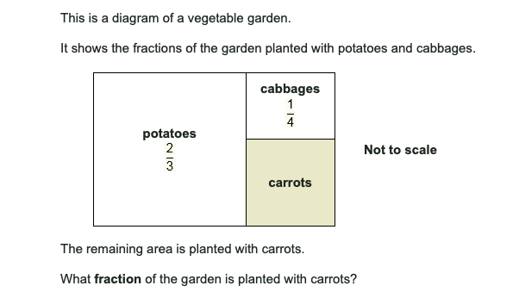
End point: example of an end of KS2 SATs question

Slide 10
End point: example of an end of KS2 SATs question

Slide 11
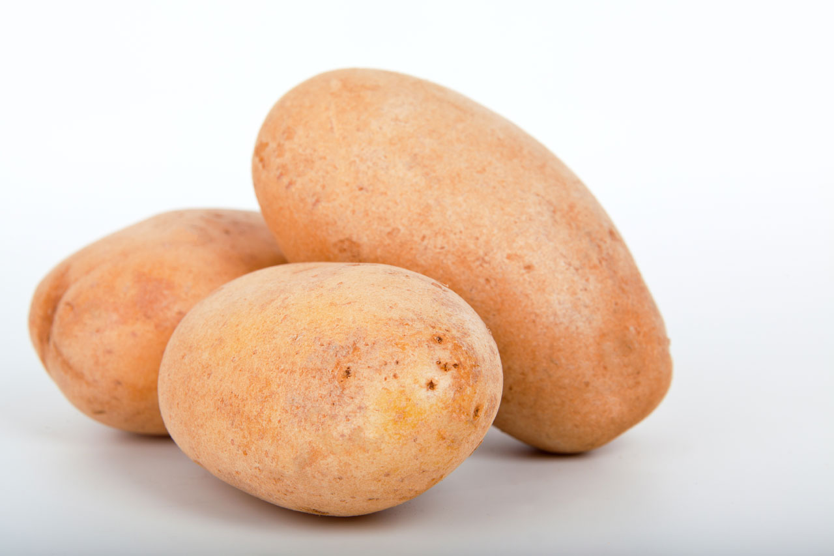
End point: example of an end of KS2 SATs question

Slide 12
End point: example of an end of KS2 SATs question

Slide 13
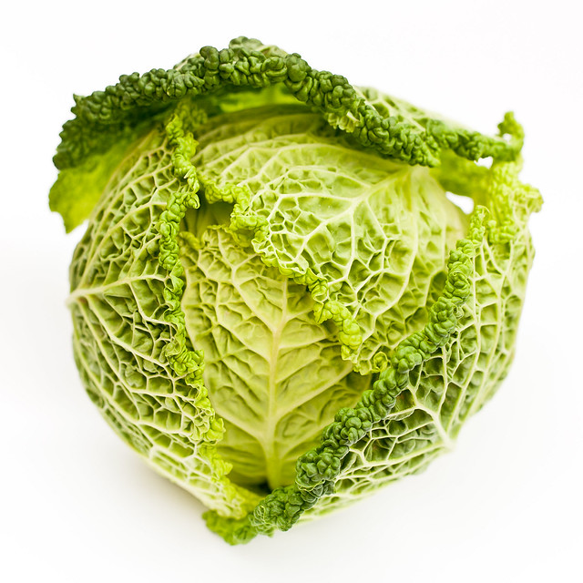
End point: example of an end of KS2 SATs question

Slide 14
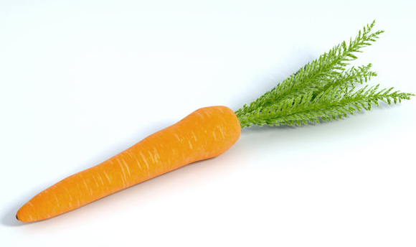
End point: example of an end of KS2 SATs question

Slide 15

Any Questions

Slide 16
What IMPACT we will see?
Happier, more confident children who can talk knowledgeably about their learning and the world around them.

