Slide 1

Aughton
St Michael’s
Maths Parent Workshop
Oct 2019

Slide 2
Overall curriculum INTENT
To create independent and resilient learners who enquire into the world around them.

Slide 3
Maths curriculum INTENT
To create independent and resilient mathematicians who can use reasoning to enquire into problems and use Maths to better understand the world around them.

Slide 4
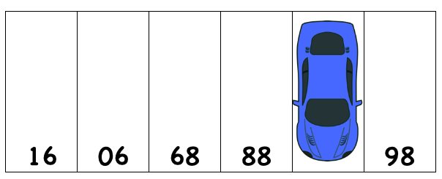
I’ve parked my car at the Trafford Centre and can’t work out the number of the space I’ve parked in. Can you help me out?

Slide 5
I’ve parked my car at the Trafford Centre and can’t work out the number of the space I’ve parked in. Can you help me out?

Slide 6
What does this mean on a day-to-day basis?
Key focus is to develop problem solving – termed REASONING
Still need to have secure methods for calculating but learners need to know why they are doing what they are doing.
E.g.
9 thousand + 1 thousand = 10 thousand
 |  | 4 | 6 | 5
 |  |  | 3 | 2 | x
 | 9 | 3 | 0 | 0
 | 1 | 3 | 9 | 5 | +
1 | 0 | 6 | 9 | 5
1
x 30
x 2

Slide 7
Some examples of the types of questions we would ask
10 – 6 =
10
6
?

Slide 8
Some examples of the types of questions we would ask
10
6
4

Slide 9
Some examples of the types of questions we would ask
4 | 5
3 | 2 | 7 | +
 | 2 | 1

Slide 10
Some examples of the types of questions we would ask
4 | 5
3 | 2 | 7 | +
 | 2 | 1
1 | 1
4
6
8

Slide 11
Some examples of the types of questions we would ask
Mr Clare thinks of two 2-digit numbers and add them together his answer is 203.
Explain how you know he has made a mistake.

Slide 12
Some examples of the types of questions we would ask
The biggest 2-digit number is 99.
99 + 99 = 198
So the largest possible answer he could get is 198.
His answer is 203 which is greater than 198, so he is incorrect

Slide 13
Some examples of the types of questions we would ask
Look at the following statement and decide if it is always true, sometimes true or never true
If I add 2 numbers the answer always gets bigger

Slide 14
Some examples of the types of questions we would ask
If I add 2 numbers the answer always gets bigger
Sometimes
4 + 2 = 6 so it’s got bigger.
4 + 0 = 4 so it’s stayed the same.
4 + -1 = 3 so it’s got smaller.

Slide 15
Today’s Workshops
Early number
Part-Part-Whole/Bar Model
Division: Arrays and Repeated subtraction
Multiplication: Grid Method
Calculating with Fractions
What is a Fraction?
Y4 Times tables
Miss. McMenamy & Mrs. Gordon
Mrs. Preece
Mrs. McCormack
Miss. Stone
Mrs. Wood
Mr. Clare
Miss. Wainwright

Slide 16
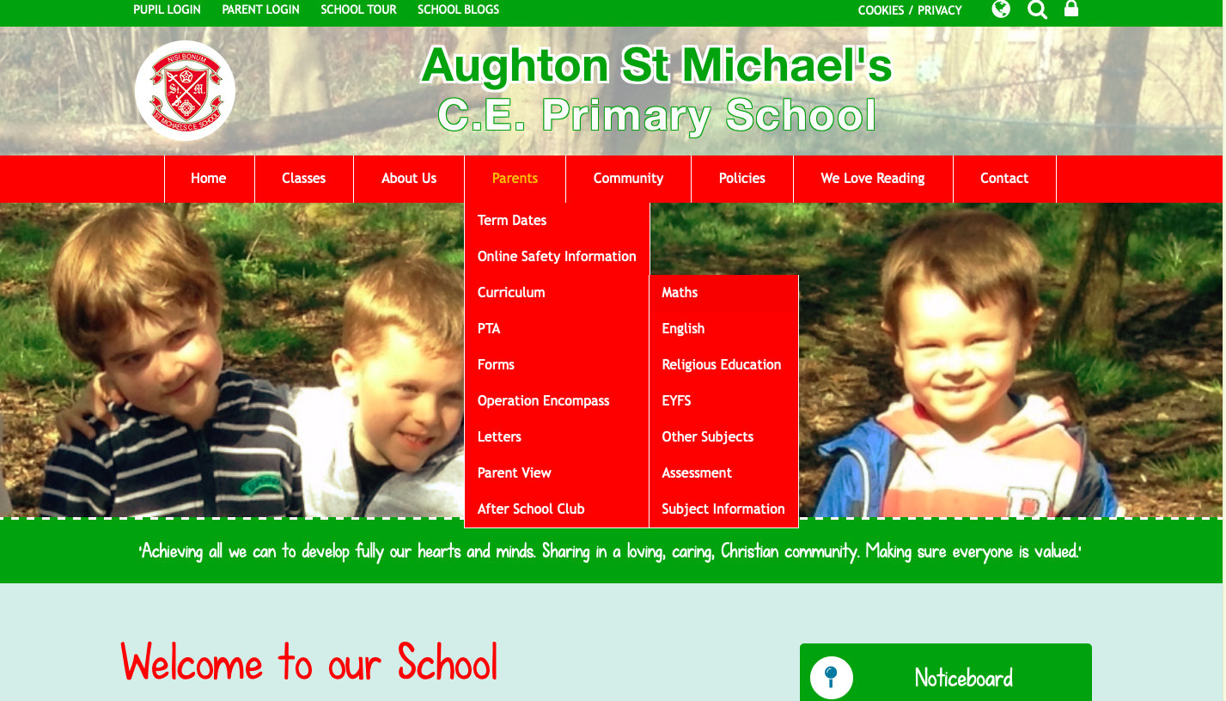

Slide 17
