Slide 1

Welcome!

Slide 2
Year 5 Team
Mr Quirk
Mrs Whitby
Mrs Ira
Mr. Clare(PPA cover Wednesday morning)
Firm
Fair
Fun

Slide 3
Encourage-Guide-Support-Celebrate
All these approaches will be applied into teaching and learning
Provision – targeted support to meet and exceed Age Related Expectation
  Support Groups
  1:1
  Long Term or Short Term Targets
  Actioned response based on assessment
  Examples include: Reading Plus, Nessy, Precision Teaching, pre and post learning tasks.

Slide 4
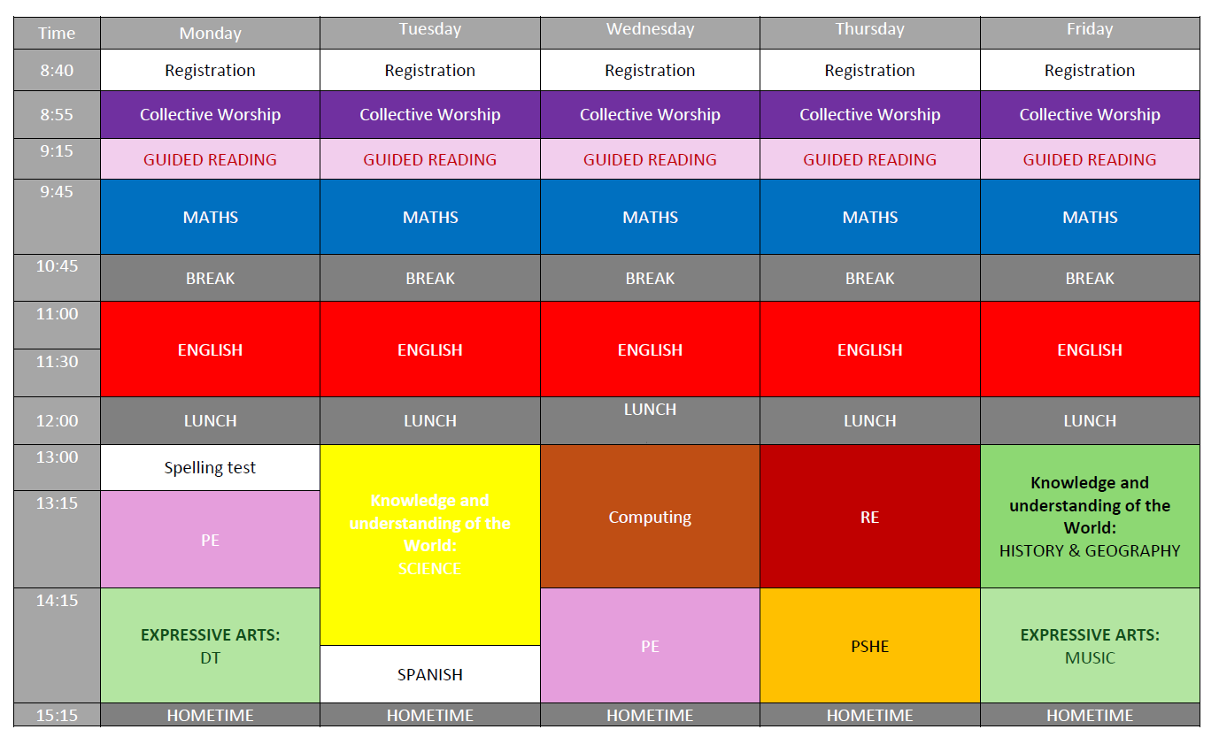
Timetable

Slide 5
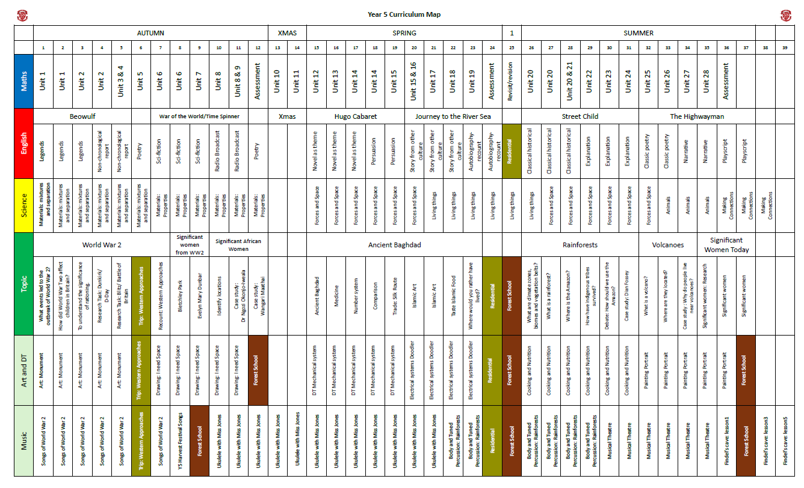
Curriculum Overview

Slide 6
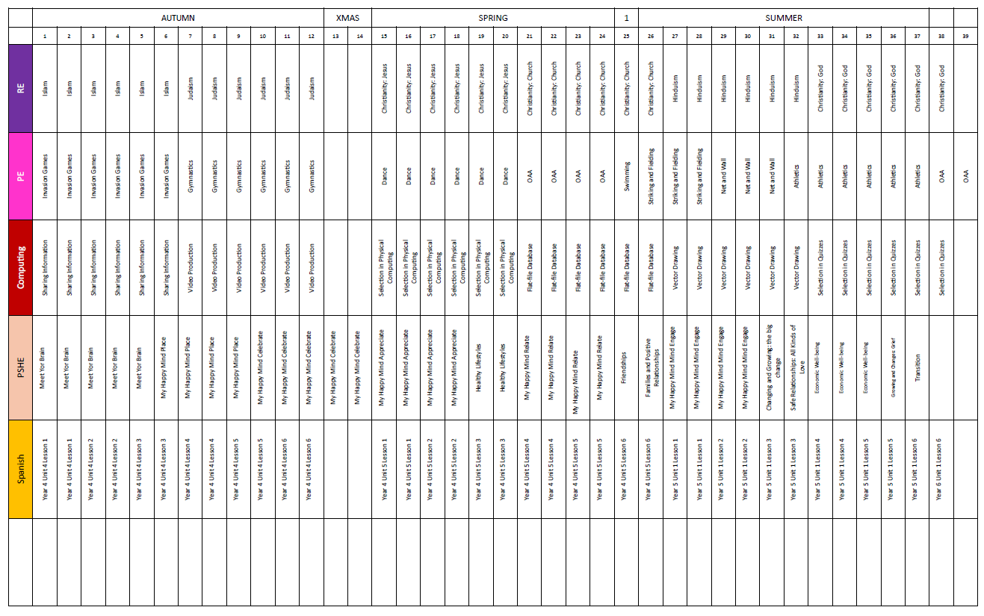

Slide 7
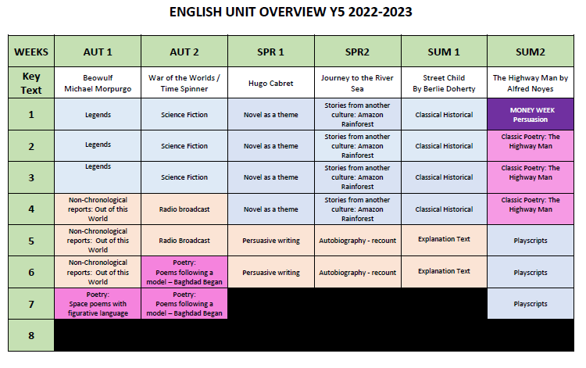
English

Slide 8
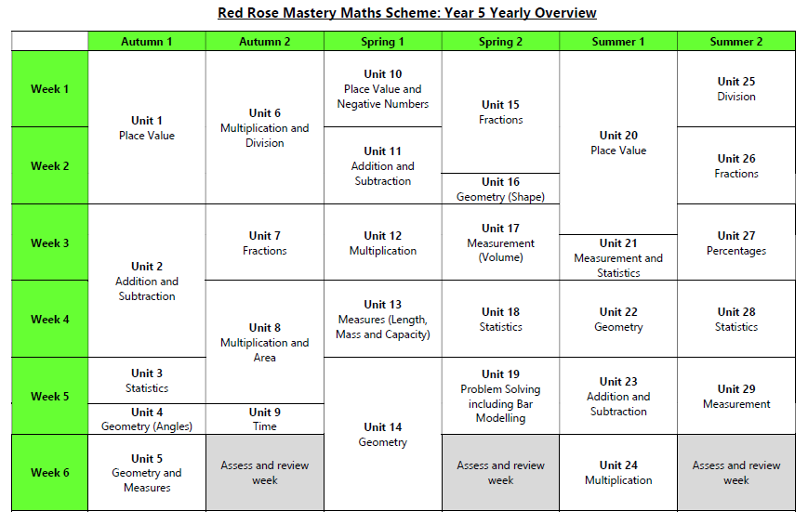
Maths

Slide 9
Guided Reading
 | Yellow | Orange | Green | Blue | Red
Monday | Pre Read | Extract - Comprehension TA Support | Extract Preparation | Follow Up Activity | Guided Session Teacher Led
Tuesday | Guided Session Teacher Led | Pre Read | Extract - Comprehension TA Support | Extract Preparation | Follow Up Activity
Wednesday | Follow Up Activity | Guided Session Teacher Led | Pre Read | Extract - Comprehension TA Support | Extract Preparation
Thursday | Extract Preparation | Follow Up Activity | Guided Session Teacher Led | Pre Read | Extract - Comprehension TA Support
Friday | Extract - Comprehension TA Support | Extract Preparation | Follow Up Activity | Guided Session Teacher Led | Pre Read

Slide 10

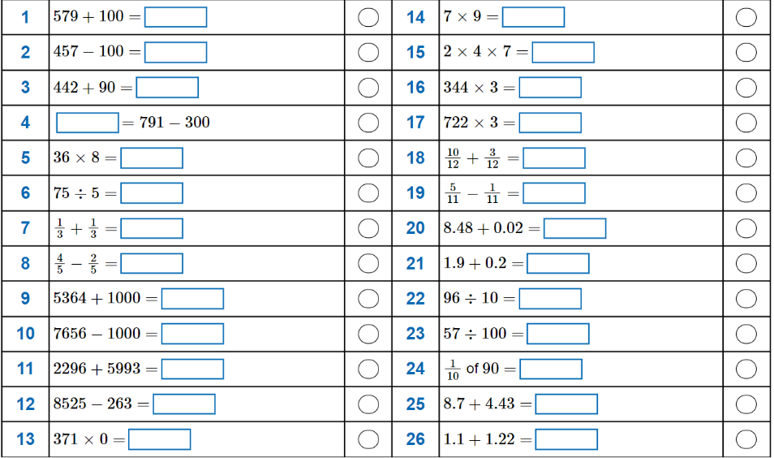
Homework
Set every Monday
Maths – Questions on the school website.
Write, Calculate and Answer
Some print and stick in the book)

Slide 11


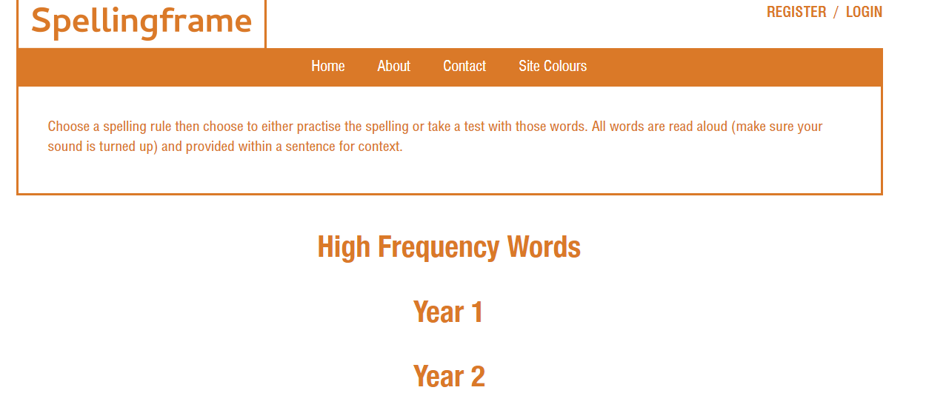



Homework
Guided Reading – read to reflect the task on the reading card
Spelling Frame (5-10)words
Grammar Task
TTrockstars – available for revision
Logins will be stuck in
the their homework book

Slide 12
Other Curriculum Areas
Harvest – Friday 2nd October
Christmas Production – Y5 & Y6
Safer Cycling – Sports Partnership – 9th – 13th March

Slide 13
PE
Monday and Wednesday
PE kit (cold weather jumper and black tracksuit pants) – sent home Friday
Earrings – remove for the lesson
Daily Mile – fitness, stamina, comfort break
Swimming – 2 sessions (Friday 9th & 16th March)
Boxercise – Wednesday 8th -17th June
Extra Curricular Club – register via ‘Spider’
Events – Competition or Inclusion
Inter-House Competition
Sports Day

Slide 14
Music
Recorders to be returned to school as part of the curriculum
Mrs Jones – Music
Ukuleles - begin before Christmas and continue in Spring

Slide 15
Personal Equipment
PE Kit in school every day – home on Friday
Book bag – include Guided Reading Book
School Water Bottles – Water only
Deodorant – NO aerosol cans – roll on
No Fidgets – these will be provided by school according to SEND or Care Plans or Personal Provision.
No additional equipment to be brought , unless requested.

Slide 16
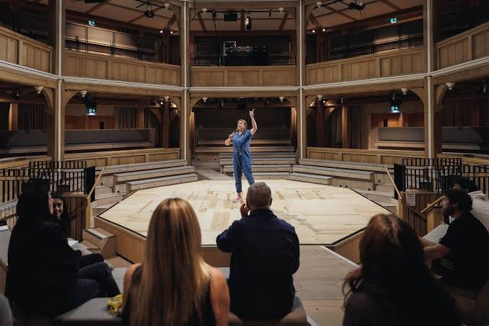
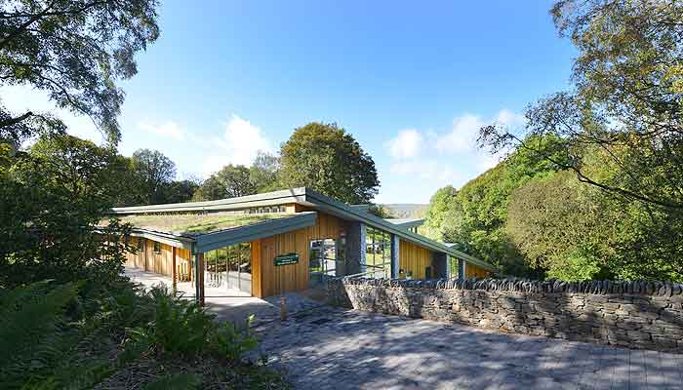
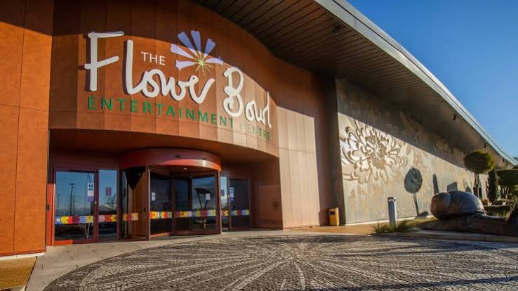
Educational Visits
Shakespeare North Playhouse – 23rd September
Cost approx. £20
  Tower Wood Outdoor Education Centre
February 9th-11th February
Depost of £75
Mosque and Curling TBC

Slide 17
Behaviour
Rewards – House Points, Stickers, Capture the Rainbow
Sanctions
  1 Warning
  2
    Loss of 5 minutes of morning breaktime (am)
    Complete a reflection sheet (pm)
  3 Speak to SLT
  4 Speak to Headteacher

Slide 18
Start & End of the School Day
Start
  All children walk round to the back and enter school
End
  From TOMORROW (Wednesday 9th September)
  Year 5 to exit from Hall at the back of school

Slide 19
Personal Goals
4 key behaviour expectations
  Listen to instructions
  Show respect to one another
  Show respect of property
  Be ready to learn.
Manage themselves
Manage time – toileting
Maximise learning time
Develop as a person: spiritually, socially and academically
Give it a go, try your best and be the best person they can be.

Slide 20
Correspondence
bursar@aughton-st-michaels.lancs.sch.uk
Messages for:
  Absence
  Medical/Dental
  Concerns
Always welcome to catch me at the end of the school day to speak to me.
Personal Details (School Survey)
  Medical details (update medicines)
  Contact details
  Drop off and Collect
  Lunch
  Permissions - photographs/twitter

Slide 21
Thank You
All information found on the school website
http://www.aughtonstmichaels.co.uk/class/year-5

