Slide 1

Meet the Teacher 2025
Mr Singleton – Year 6

Slide 2
Year 6 staff this year…
Mr Singleton
Mrs Judge
Mrs Craven
Mrs Hesketh
Mrs Tabarn
Mrs Wood – PPA Cover Wednesday morning.

Slide 3
Home time
Please complete the form to let us know if your child has permission to leave the classroom at the end of the day.

Slide 4
Mobile Phones
Children bringing a phone to school because they are walking home will hand their phone in and it will be locked in the main office until 15:15.

Slide 5
PE
PE kits must be in every Monday and will be returned on a Friday.
This half term PE will be Monday am and Thursday pm.
Daily mile will take place on a Tuesday, Wednesday and Friday afternoon.
Earrings must be taken out.

Slide 6
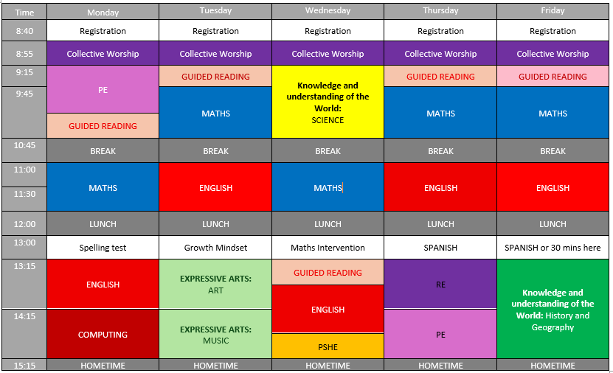
Timetable

Slide 7
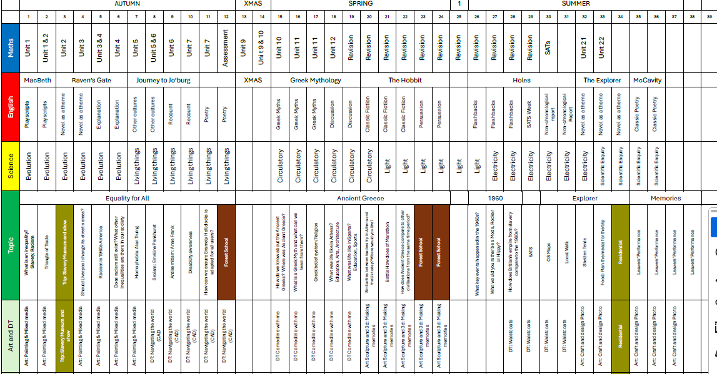

Slide 8
Trips
Thursday 18th September – Liverpool Empire Theatre trip.
Monday 29th June – Wednesday 1st July – Borwick Hall Residential.
TBC – Liverpool Cathedral Service.

Slide 9
Borwick Hall
£240 - £50 deposit due by Monday 3rd November.
2 nights camping
Monday evening BBQ
Borwick Hall food on Tuesday and Wednesday
Dropped off in Bolton-Le-Sands and canoe to Borwick Hall.
Mix of outdoor activities (climbing, orienteering, abseiling, team building…)

Slide 10
Homework
Maths and English will be set on a Monday and due for the following Monday.
Homework will be set through the website.
We will be using: Arithmetic papers (20 mins), TTRockstars, SPAG.com and Spellingframe.
There will also be weekly reading to do.

Slide 11
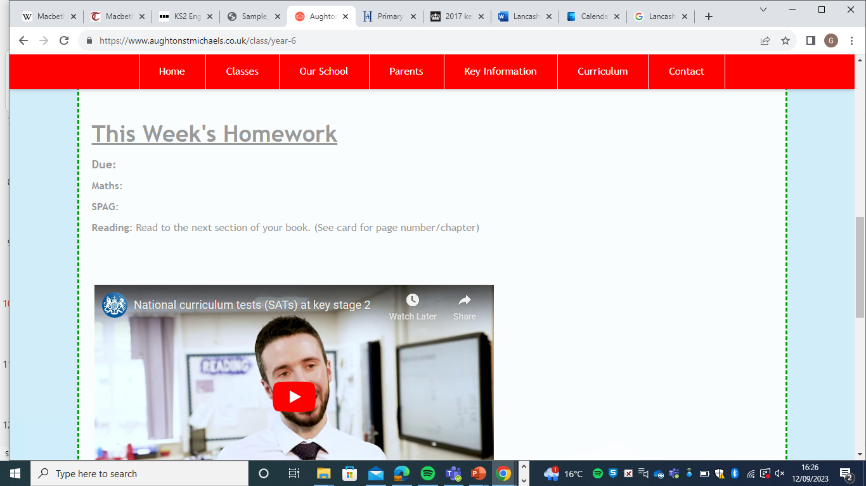
Homework will be set here.

Slide 12
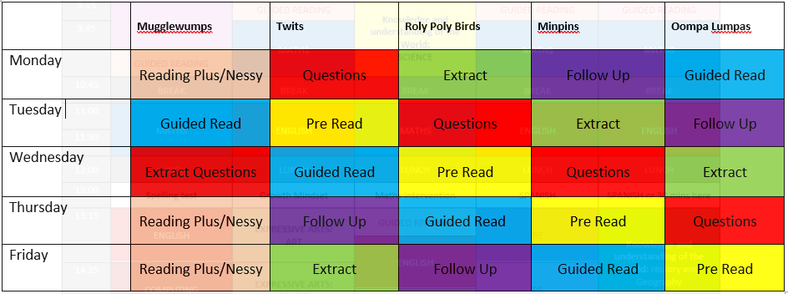
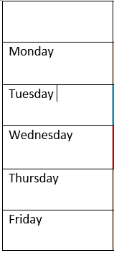
Guided Reading Timetable

Slide 13
Assessment
School
Home
2022 - Sep
2023 - Dec
2024 - Feb
2025 - Apr
2015 (sample)
2016
2017
2018
2019

Slide 14
Responsibilities
School Citizens
Librarians
Playground Leads
School Council

Slide 15
SATS
Monday 11th May – Thursday 14th May.
More information will be sent at the time.
Best week of the year!!!

Slide 16
High School
You must have applied for a high school place by the 31st October.

Slide 17
Any Questions?

