Slide 1

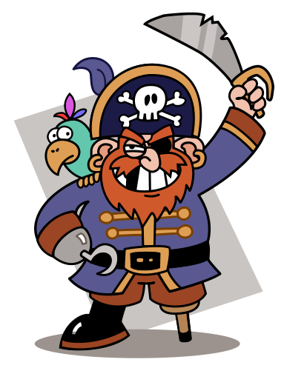
Arrrrrrgh! Where’s me treasure?! Can you help me find it?
Notes:
Pirate Pete came to visit me today and told me that he can’t find his treasure! He’s left all of you some treasure maps to help him – do you think we can do that?

Slide 2
(4, 3)
(2, 4)
(3, 1)
(6, 1)
(5, 8)
Notes:
Pirate Pete has also left you all a bag of coins, but they have these numbers on them… has anyone ever seen these before? What are they called? Coordinates. Does anyone know what coordinates are? They are special numbers that help us to find objects or places. Can anyone think when we might use coordinates for in real life? What do we use to find places? Have a quick chat to your partner. SatNavs, maps.

Slide 3
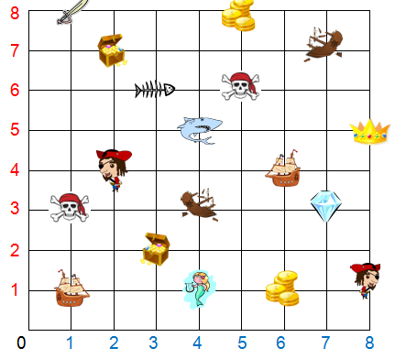
(4, 3)
(2, 2)
(6, 1)
Notes:
This is the map that Pirate Pete has left you. Your gold coins have different coordinates on to help you find the treasure – but sometimes they will take you somewhere else! Let’s look at the first coin – it says (4,3). Does anybody know which number we should start with, the 4 on the bottom or the 4 from the side? Start from the sea and go up to the sky! Find 4 on the bottom, follow up and find 3! What have we found? A shipwreck! (Continue with other coins, ask children to come up and follow with their fingers)

Slide 4

Start from the sea and go up to the sky!
Notes:
Explain activity: In pairs, you are going to try and find Pirate Pete’s treasure using the coordinates on your gold coins. Let’s play a quick game now so you know how to play! (Choose child to pick a gold coin) Ah, [child] has picked (x,y), so can you follow the line with your finger to see where you land? Where do you start? Start from the sea and go up to the sky! Now, [child] will mark a cross where they have landed. My turn! Who wants to pick for me? [Choose child to pick another gold coin] Ooh, I have got (x,y) – who can come up to the board to follow that with their finger? I’m going to mark mine with a circle so I don’t get confused with my partner. Now, who can explain exactly what they have to do when they go and start the activity?

