Slide 1

Year 6 Week 6 – Home Learning

Slide 2
Challenge 1
Before you left school in March we sent you home with 6 CPG books to complete. We are sure you have lots to still complete in those books so make sure you are completing work in them to keep your brains working.

Slide 3
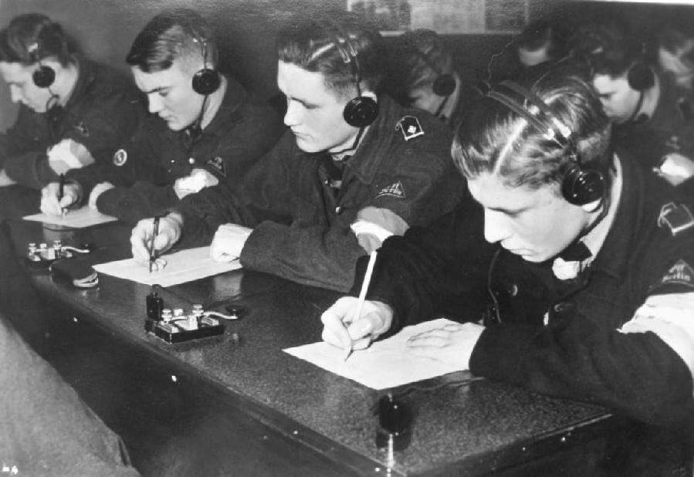
Morse Code
Morse code is a way to send messages without using words. During World War 2 Morse code was used to communicate with naval bases and warships as radio frequency was poor.

Slide 4
Challenge 2
Using the Morse code alphabet provided can you translate the messages on the following slides. Maybe you could time yourself to see how long it takes you - if you are feeling brave!

Slide 5
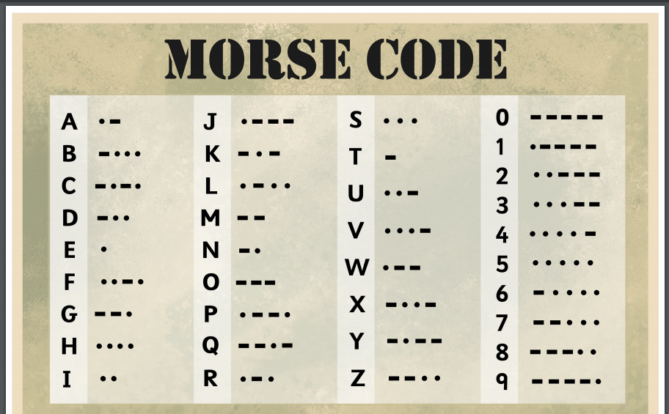

Slide 6
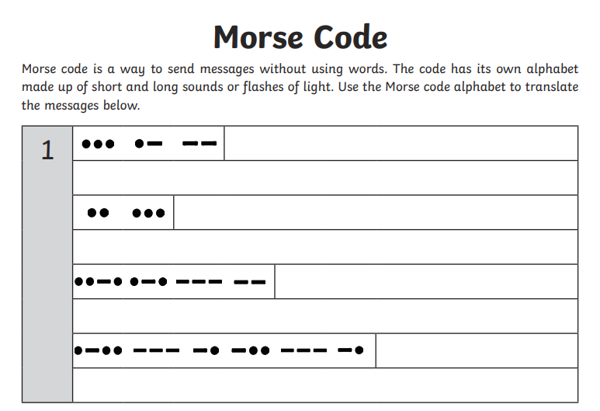

Slide 7
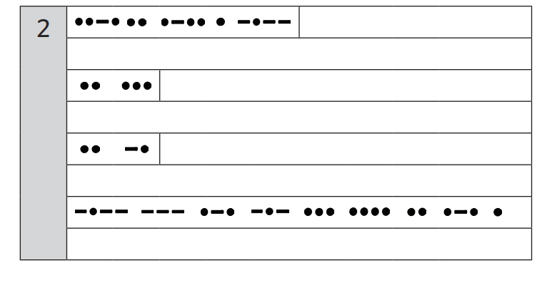

Slide 8
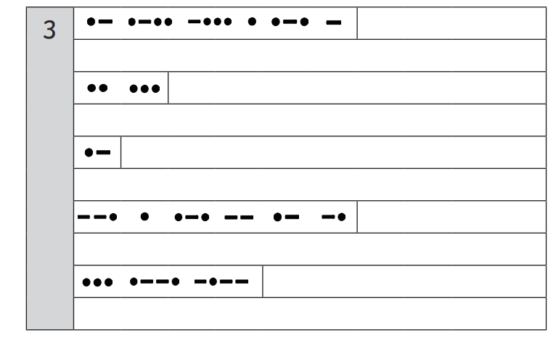

Slide 9

VE Day Board Game
During the Second World War, board games were a popular form of entertainment. Games like draughts, chess and dominoes all helped to keep people’s spirits up.

Slide 10
Challenge 3
Design and create your own Maths board game to play with a member of your household. Use the example on the following side as a template.

Slide 11
