Slide 1
Year 4 - Week 6
Home Learning Tasks

Slide 2
Task 1

Slide 3
Design your own chocolate bar wrapper
What is the name of your chocolate bar?
What colours are you going to use?
Who is your chocolate bar aimed at?
What’s going to be in it?

Slide 4


Slide 5
Task 2

Slide 6
Create your own chocolate bar recipe!
What ingredients are in your chocolate bar?
What amount do you need of each ingredient?
Can you use adjective to describe your ingredients?

Slide 7

Ingredients
100ml of marvellous milk
50g of delicious cocoa
3 tablespoons of tasty chocolate powder
2 cups of sweet sugar
25g of crunchy caramel
1 handful of strawberry laces

Slide 8
Bonus Task
Can you write a list of equipment you’ll need to make your recipe?
List every single thing someone would need to make it!

Slide 9
Task 3

Slide 10
Create your own Charlie and the Chocolate Factory Character!
Who is your new character? Draw them!
  What’s their name?
  What’s their age?
  What do they like?
  Who did they bring to the factory with them?
What are they like?
What room do they go in?
What happens to them?
How is it resolved?

Slide 11
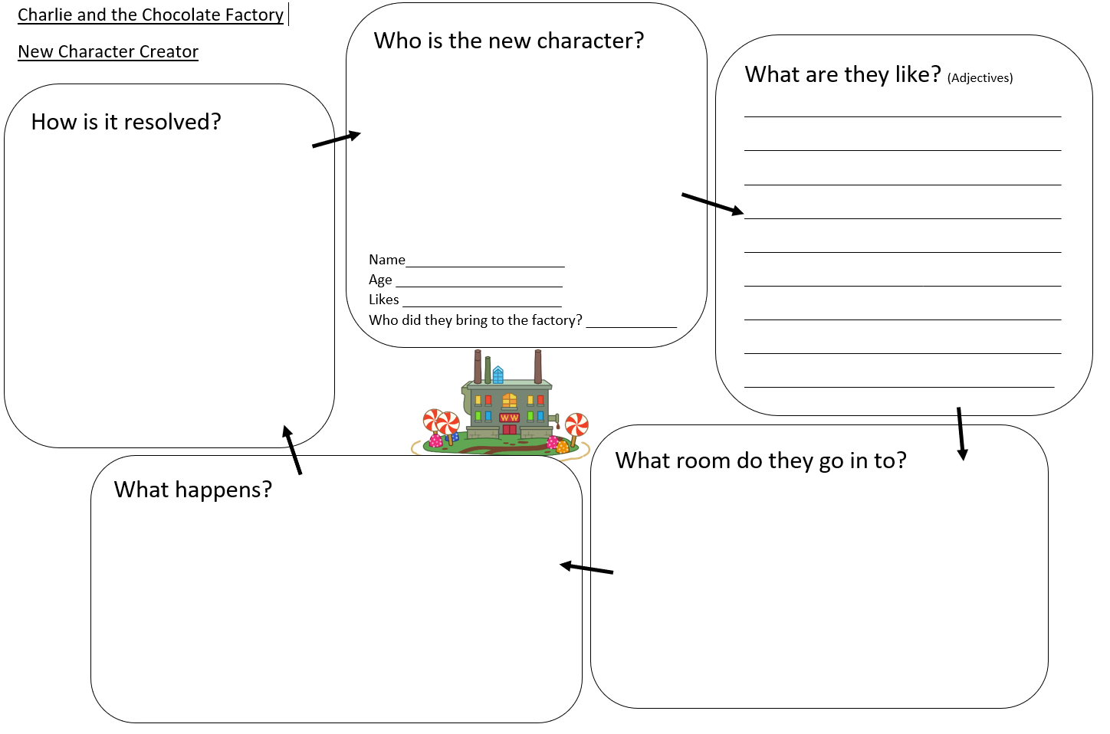

Slide 12
Task 4

Slide 13
Write a new chapter!
Using the information from Task 3, can you now write out a new chapter of the book where your new character goes into one of Wonka’s rooms and something bad happens to them!

Slide 14
Task 5

Slide 15
Check out Oak Academy!
Start using the amazing Oak National Academy website for home tasks every day!
Videos, lessons and worksheets each day, approved by the Government.
https://www.thenational.academy/online-classroom/year-4#schedule

