Slide 1
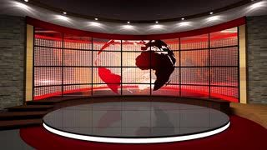

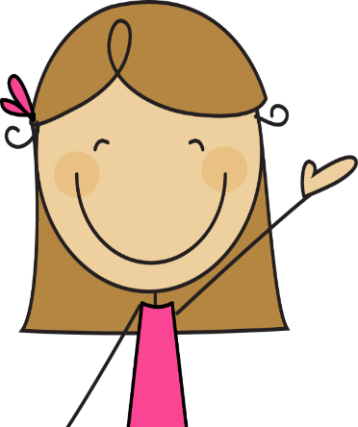

The Happy News
Week 4

Slide 2


Slide 3
Another week in lockdown is over!
Challenge 1
Your first activity this week is to start a scrapbook of what you have been up to during lockdown. You could include pictures of things you have made, what you have been up to, you could write a short diary entry of what you have done each day and you could even include some newspaper cuttings from recent articles. We thought
this would be a keepsake for you to look back on in years to come. It may even give you some laughs!

Slide 4
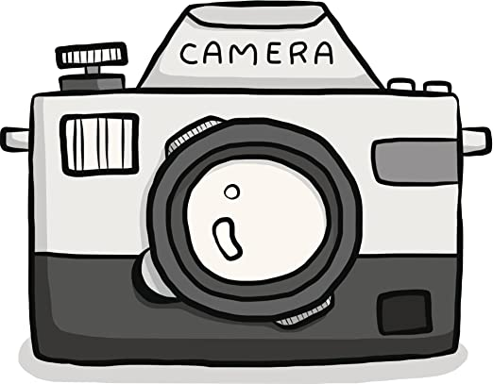
Lights, Camera, Action
Challenge 2
If we were in school we would be looking at different landscapes by a range of artists and you would create your own. We thought it would be a nice idea when you are on your daily walk to take pictures of a landscape in your local area. When you get home you could try and draw one of your pictures using a range of materials e.g. pencils, crayons, paint etc

Slide 5
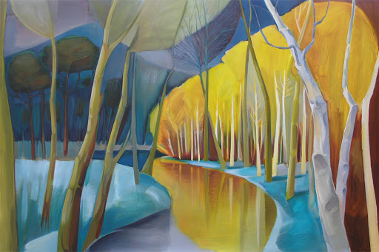
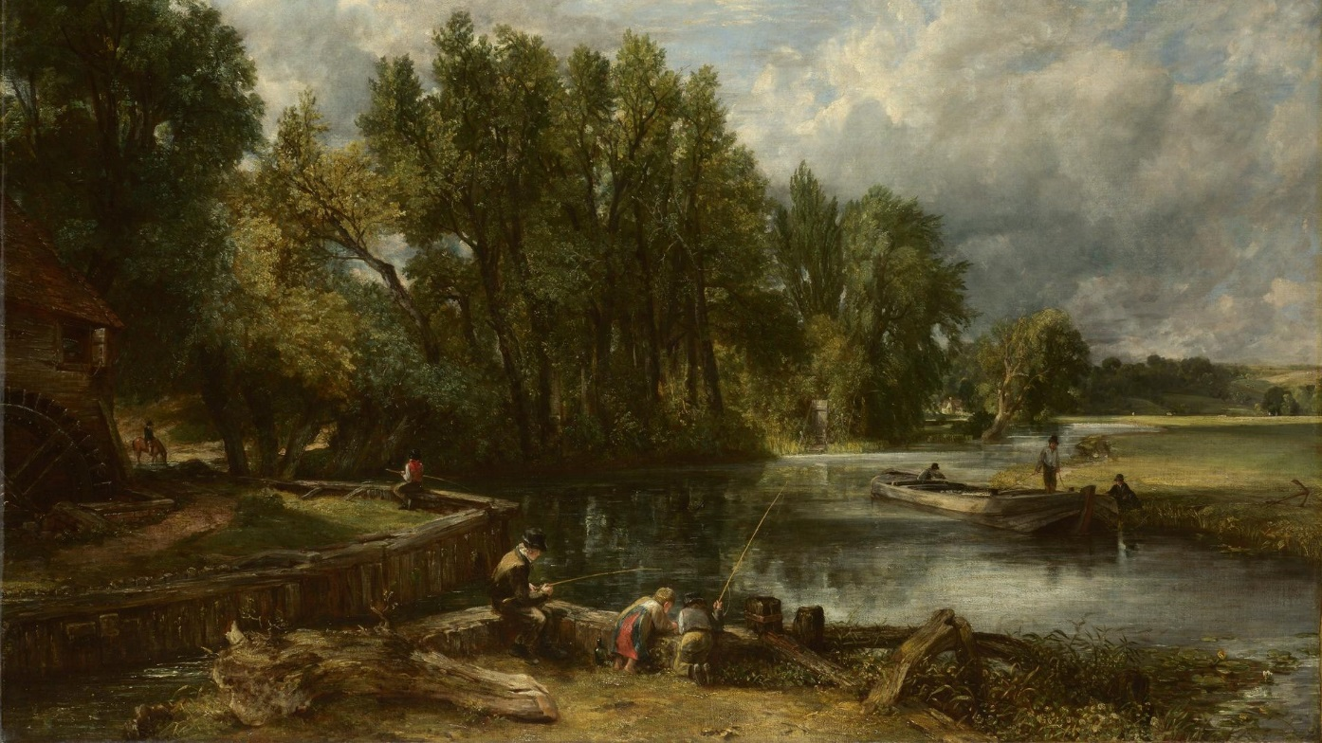
Lindsay Hambleton
John Constable
http://lindseyhambleton.co.uk/

Slide 6

A BIG THANK YOU!!
Challenge 3
We have recently clapping every Thursday for key workers all around the United Kingdom. We have been thinking about all the amazing work our key workers have been doing during this difficult time. We thought it would be a nice idea to create a poster to say a big thank you to our postal workers and delivery drivers and then you could stick it in your front window for them all to see.

Slide 7
