Slide 1




The Happy News
Week 2

Slide 2
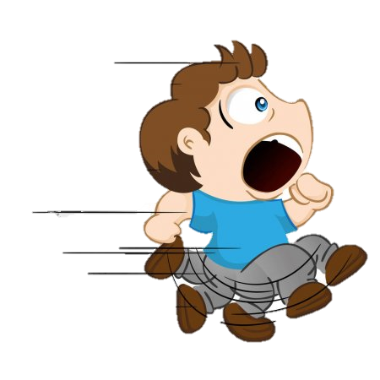
The Happy News
Mr Sandam what are you running from?

Slide 3
The Happy News
Dddddinosaur…
I can hear him!! BYE!!!

Slide 4
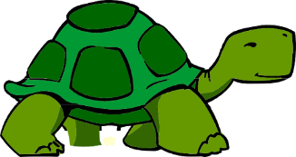
The Happy News
ALAN!!!

Slide 5


Slide 6
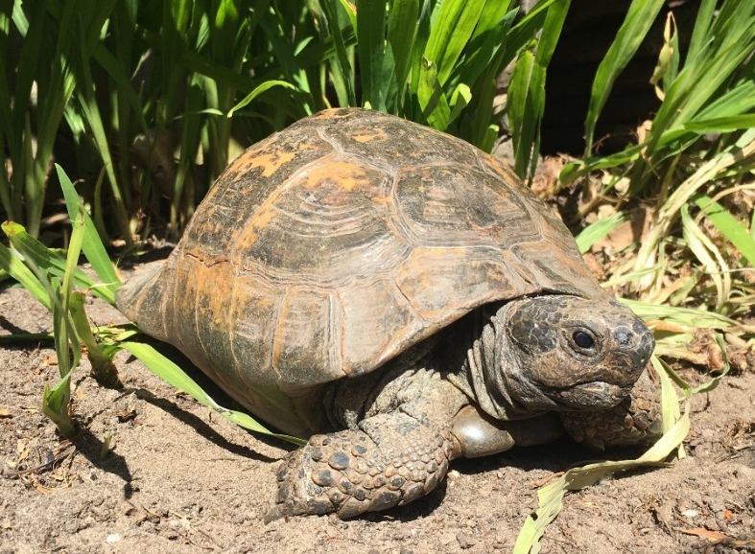
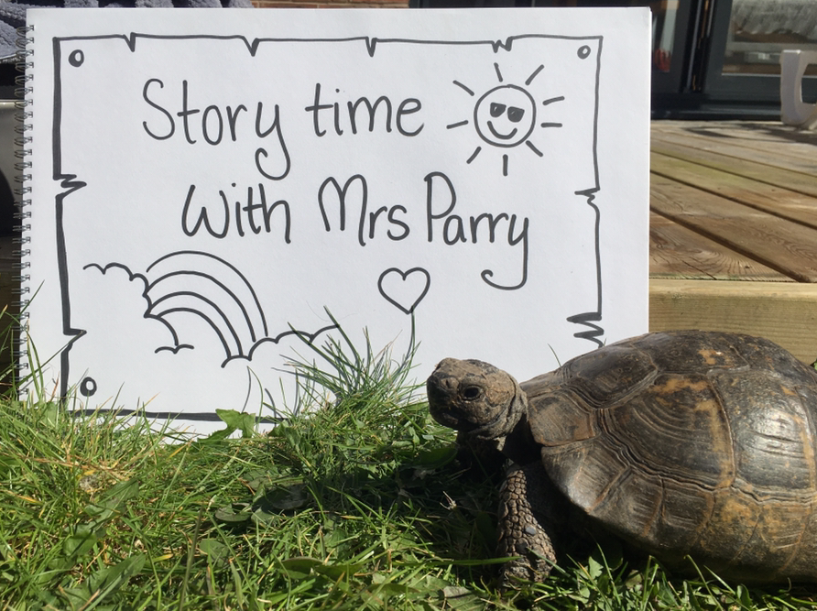
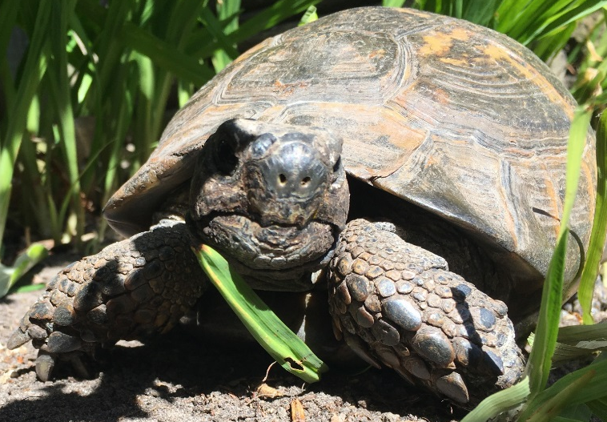
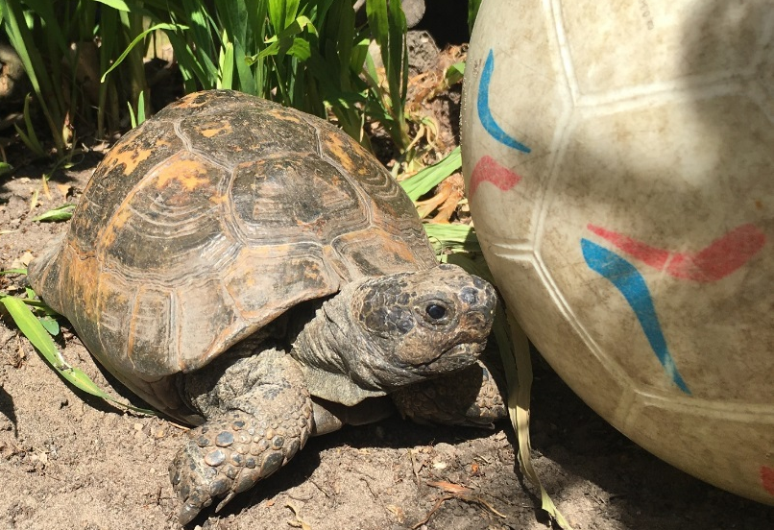
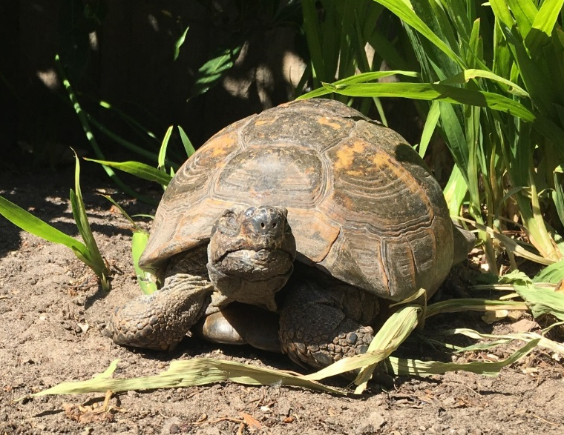
Hibernation Is Over People… It’s Alan Time
If you haven’t checked them out yet then have a watch of Mrs Parry’s story time videos

Slide 7
Sun’s out fun’s out
Challenge 1
Create an information leaflet, power point or poster on a creature that has left hibernation.
Think about all the learning you did for the Chester Zoo project!

Slide 8
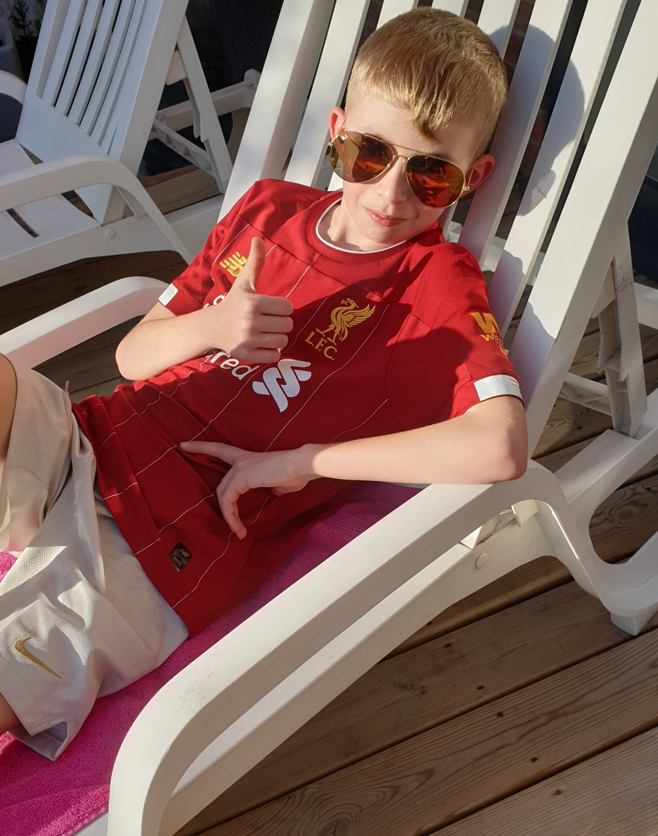
Sun’s out fun’s out

Slide 9
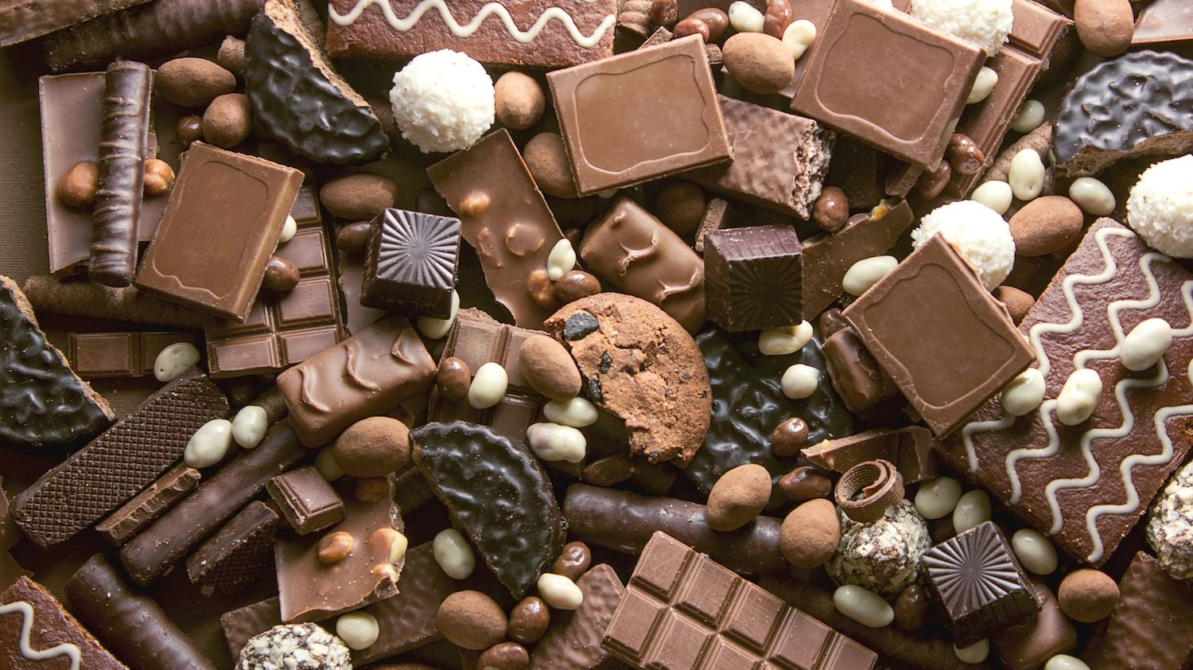
Chocolateeeee !!!

Slide 10
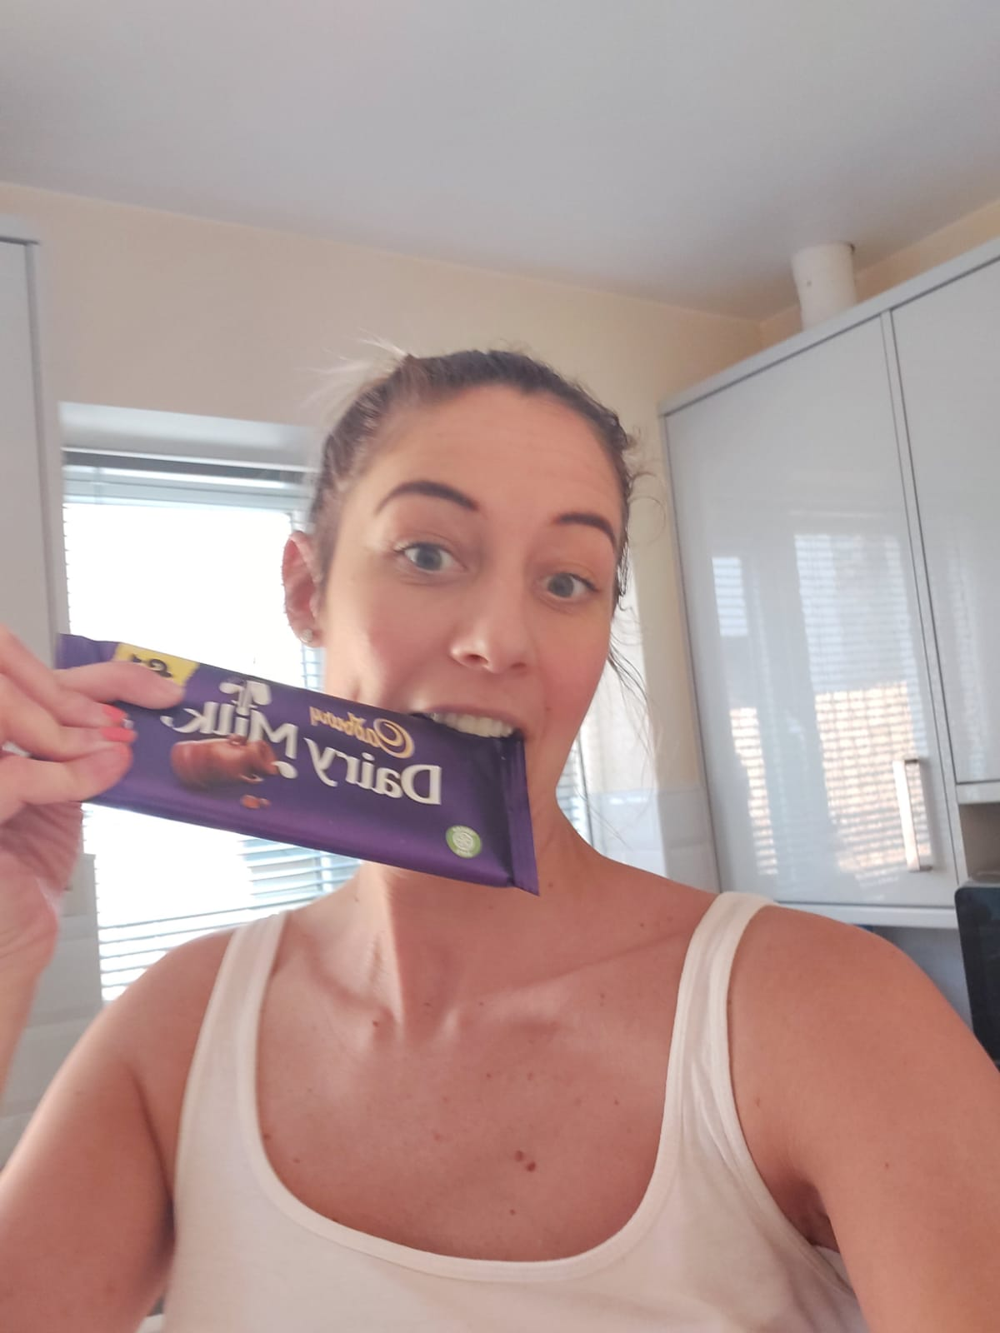
Mmmmm nice recipe!!!

Slide 11
Where is our Chocolate from?
Challenge 2
Do you know where our chocolate all comes from and how it is made into the chocolate we see on our shelves?
Research the journey of chocolate and then try a new recipe that includes chocolate.

Slide 12
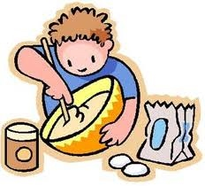
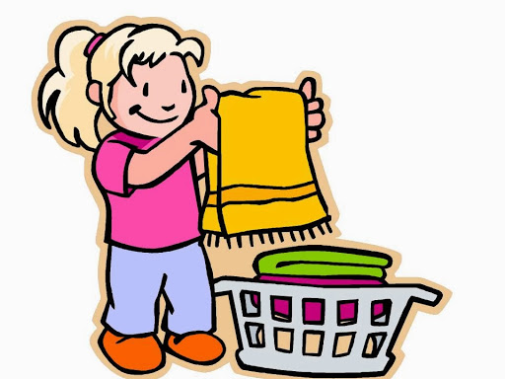
Housework voluntarily … are you ok children?

Slide 13
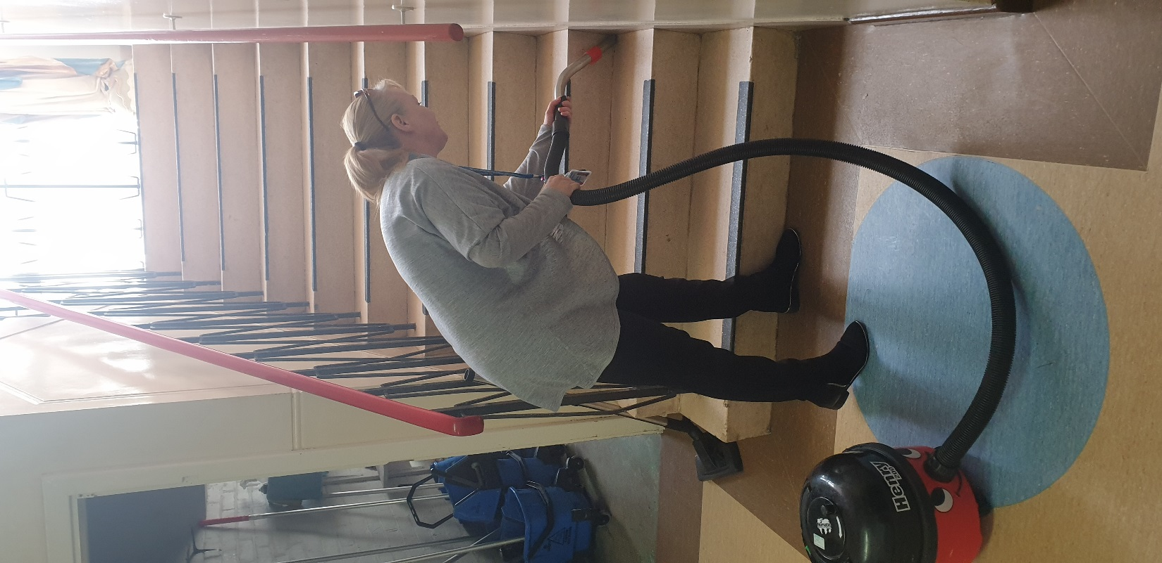
New Skills – Mrs Scarisbrick

Slide 14
Learn a new Life skill
Challenge 3
In just a few small months you will all be moving to KS3. Whilst this is sad it is also exciting……..Now you have an opportunity to increase your independence and learn a new life skill. Think about what you could learn – how to turn the washing machine on, how to make a cup of tea, how to make your own bed – the list is endless! So, rope in your adults at home and ask them to help. Send us some pictures of what you have achieved!

Slide 15
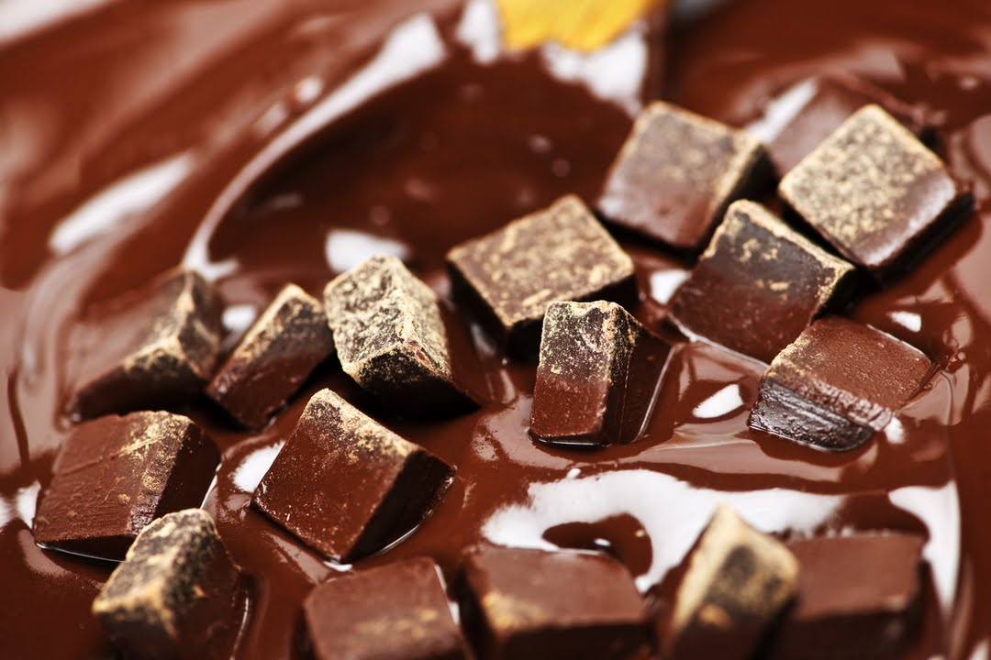
Now let’s dance!!!

Slide 16
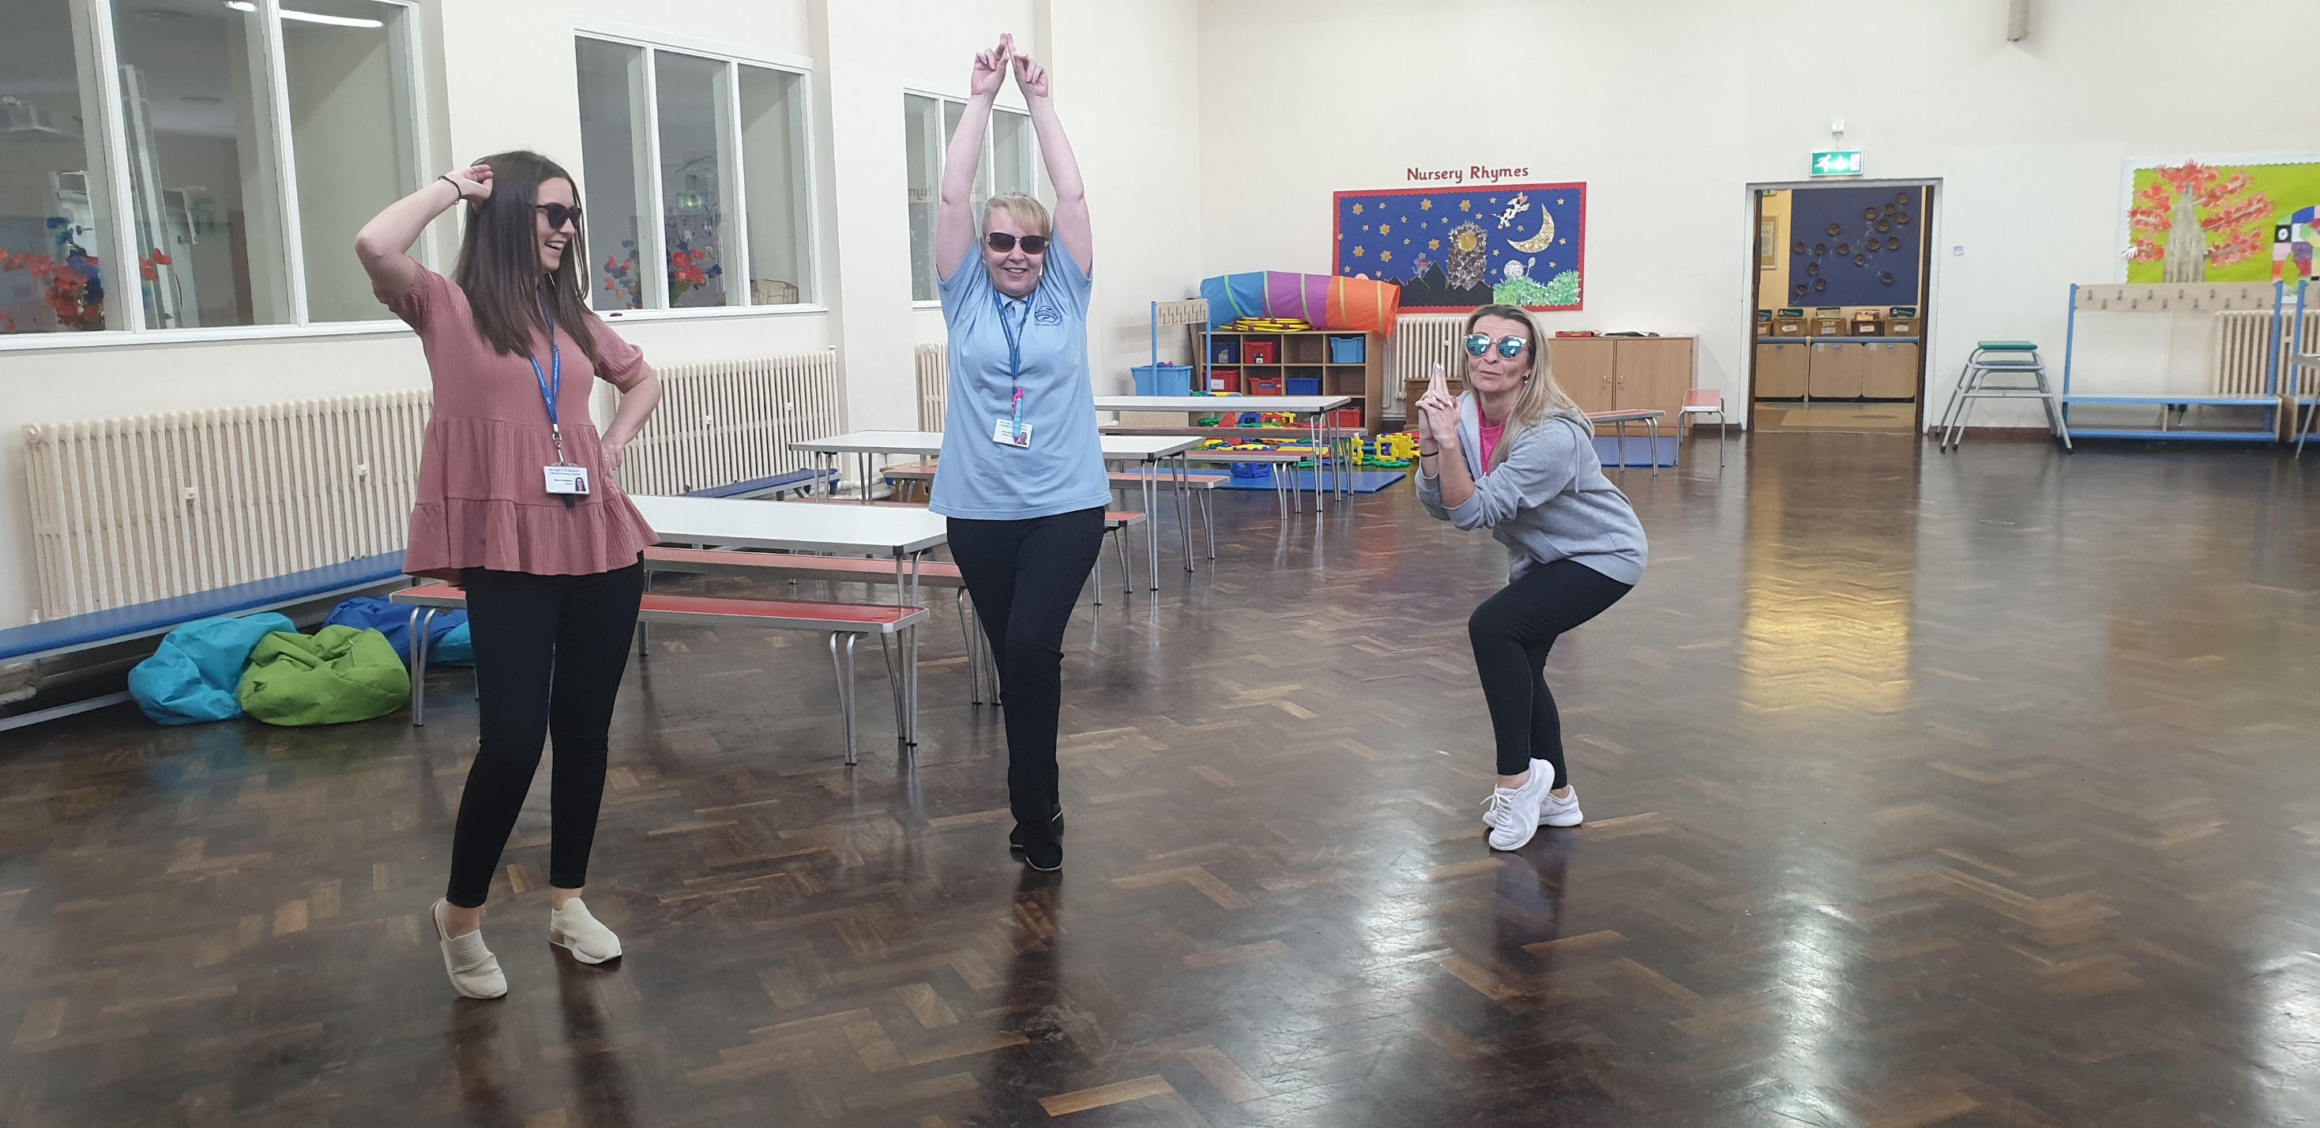
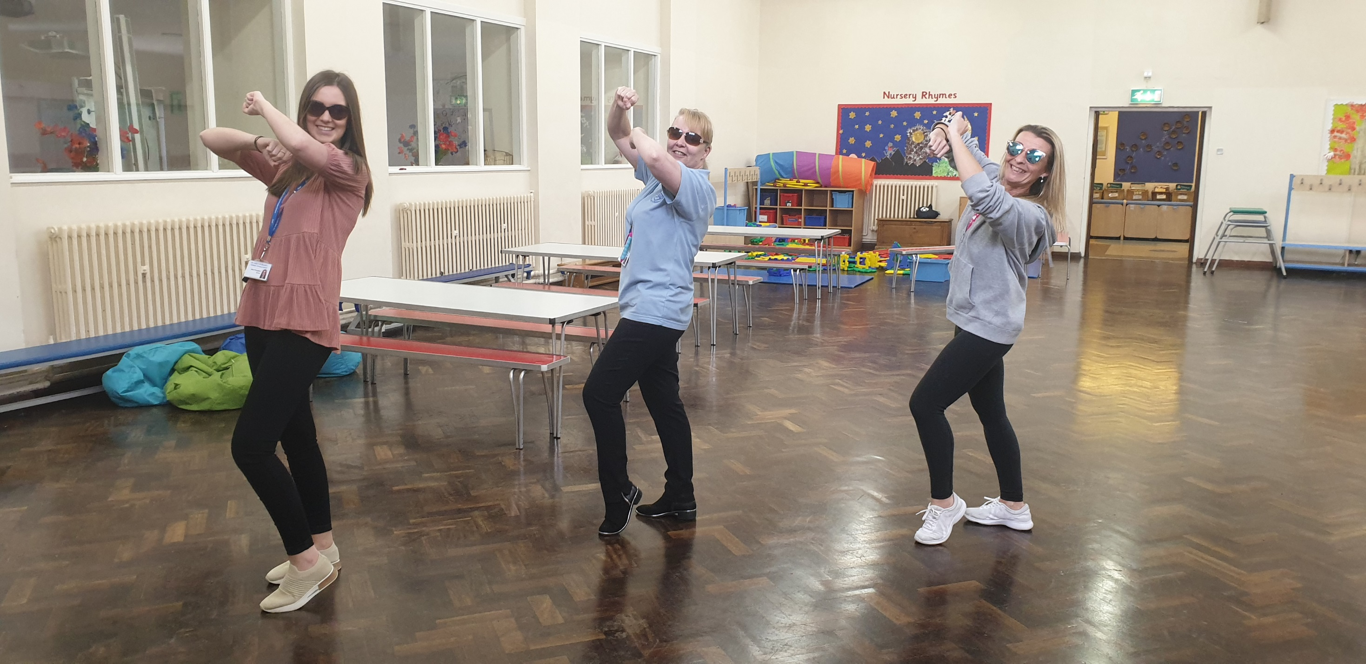
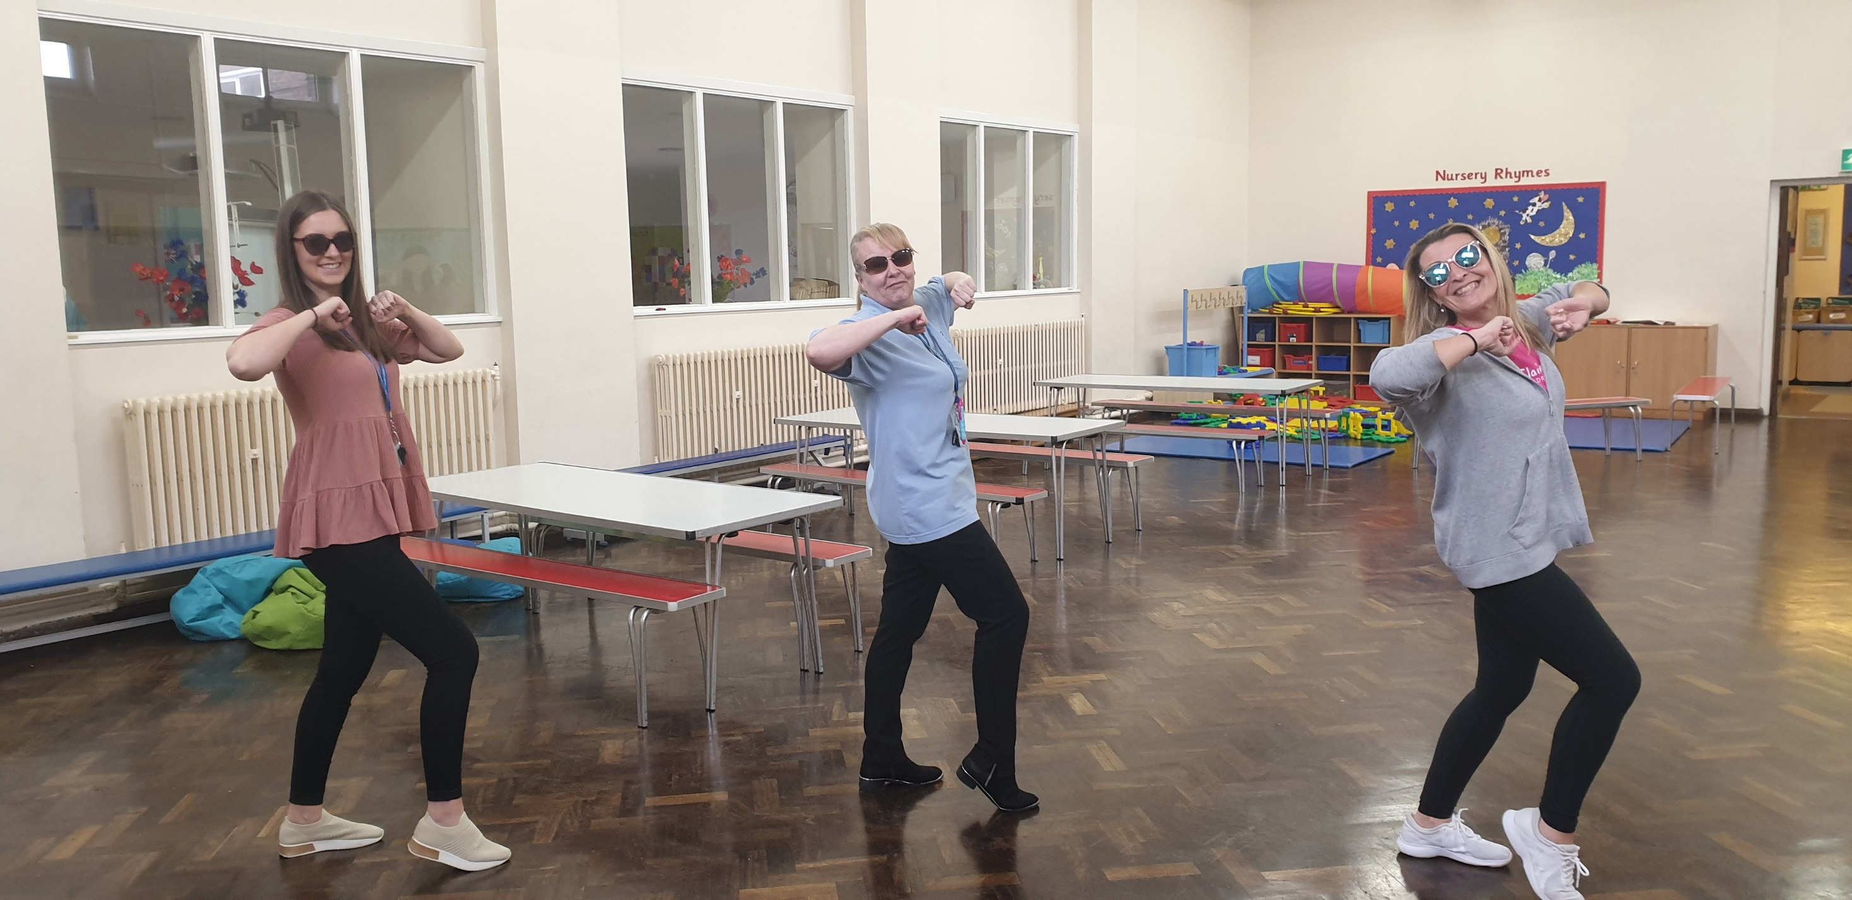
Now let’s dance!!!

Slide 17
Now let’s dance!!!
Challenge 4
Now it’s your turn to get moving. Follow the link and learn the chocolate dance. If you do it properly it’s a great way to burn off the calories you have consumed over the Easter holidays. Maybe you can encourage anybody in your house to join in with the dance.
https://www.youtube.com/watch?v=lFWysdCgVNg

