Slide 1
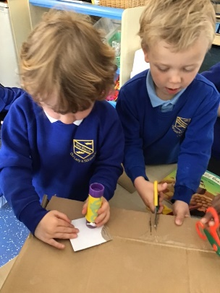
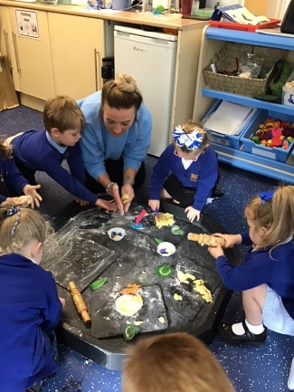
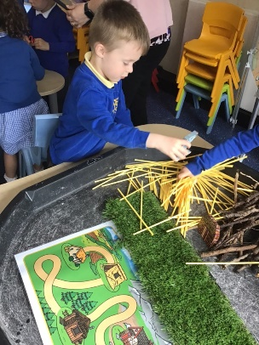
Welcome to Our Lady and St Edwards
OUR MISSION STATEMENT
The school is committed to safeguarding and promoting the welfare of children and young people and expects all staff and volunteers to share this commitment.
Our school is more than a building, it is a community where we learn, grow and achieve. It is a welcoming and joyful place where everyone feels happy, safe and protected.
We are valued as individuals and our talents are shared and celebrated.

Slide 2
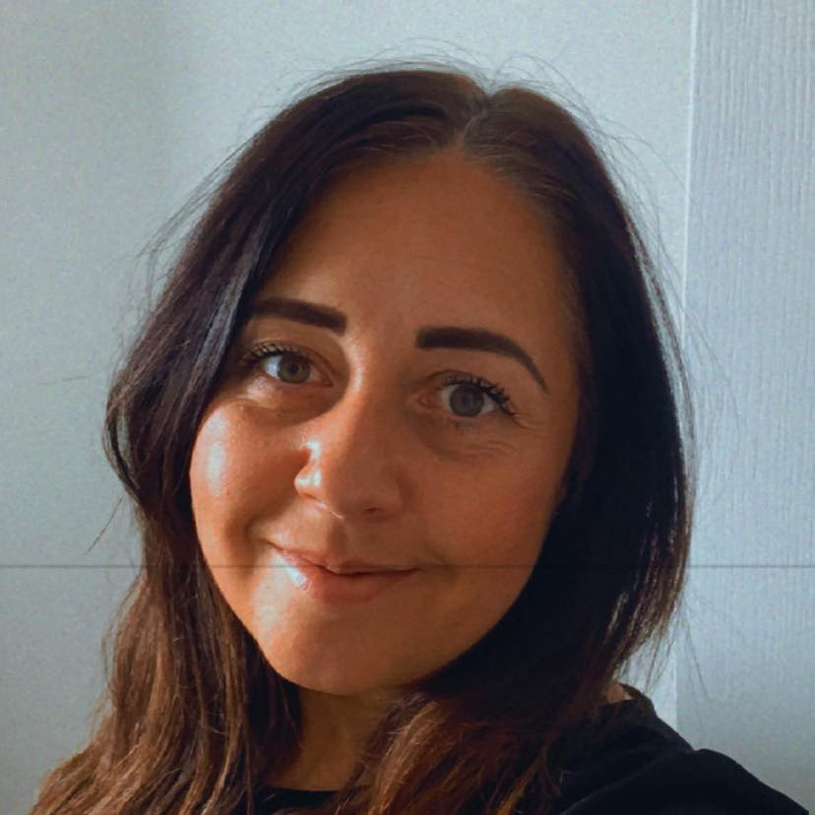
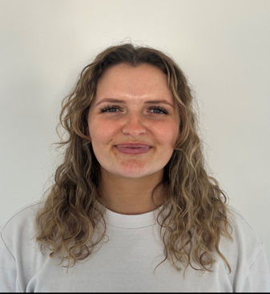
Meet the team
Mrs McLaren Miss Butler
Welcome to F2
We will be your children’s new teachers.
We are excited to welcome you to Our Lady and St Edward’s.

Slide 3
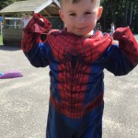
Starter Packs
In your starter packs you have
the name of your child’s teacher
Their start date
Request form for after school and toast club please send an email ASAP to the school office about the days you would need your children to attend toast and after school club.
If you have not brought your packs back then please do as this informs the staff of your children’s needs and helps with a smoother transition into foundation 2. spare packs are available if you can complete today and hand in.
Notes:
Start date: children will be in for a full day from their start date.
We feel that this supports our children to become confident to come in to class. Allows them to develop good routines.
Free school meal form: if you can all fill this in, it allows us to check eligibility for FSM.
All about me booklet

Slide 4
On Your Child’s First Day
We have staggered starts to ensure all children are given time to settle into their new setting.
Wednesday 3rd September 2025
Monday 8th September 2025
Wednesday 10th September 2025
On the start date your child will be coming in for the whole day.

Slide 5
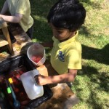
Clothing and Items needed
A drinks bottle clearly labelled
Wellies (to stay in school)
Spare clothes, including underwear
Suitable coat for outdoor play in the winter time.
Children have a set uniform for F2.
All information can be found in the information pack in your starter pack.
In the Foundation Stage our children are encouraged to explore all areas of the outdoors. We also use a lot of sensory trays. So if your child does go home a little messy then you know they have had a fun day.
Please ensure that all clothing that your child wears or brings into school, is clearly named.

Slide 6
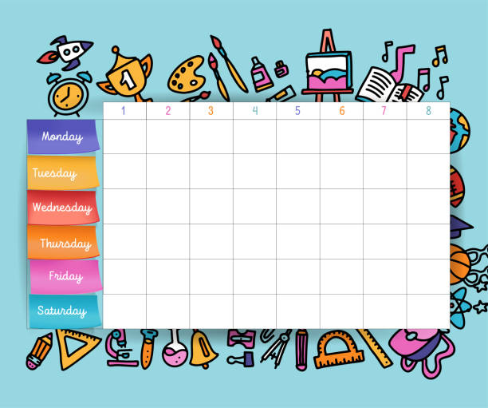
A day in the life of your F2 child
AM. Children will be registered in their class with their class teacher.
Phonics (Little Wandle)
Literacy
11:30
Lunch
PM Mathematics (white rose)
Understanding the World focus
Expressive Art and Design focus
All of the areas of learning are taught through key texts.
Children will take part in PE sessions. Children will need to come to school dressed in their PE kit and wear this for the whole day.

Slide 7
Start of the day
Our school day starts at 8:45am
Please ensure that your child is in school on time.
We have a focus on attendance and it is key to your child’s progression that your children attend school daily and arrive on time.
One way that this is encouraged is through an attendance passport that the children get stamped weekly if they have 100% attendance and arrive on time.
They also have an attendance Mr Potato head where they can win parts for their attendance each week. If the class has an attendance of 96% and over they get a piece for their potato. By the end of the half term if they have filled their potato they get a treat afternoon.

Slide 8
Food and Drink
Lunch: Lunchtime is between 11:30 and 12:30, when the children can eat lunch and then play with their friends.
All early years and key stage 1 children are entitled to a free school meal each day. There will be a selection of different meals available each day for your child to choose from. Vegetarian options are always available. Please let us know if your child has any other dietary restrictions or requirements.
Snacks: Children will receive a FREE PIECE OF FRUIT/HEALTHY SNACK during the day.
Drinks: Water is available throughout the day. Children can also bring a drink to school – remembering that no fizzy drinks are allowed. Children are also offered free milk up until the age of 5. After that children who wish to have milk can pay for the school milk.

Slide 9

End of day
If you know you are going to be late picking up please phone the office and let them know.
We are aware that plans can change throughout the day. If the person picking up your child changes, please make us aware of this change before they arrive. If it is a person that we have never met before then we will not be able to let your child out until we have phoned the main care giver. If you would like to give the person picking up a password, let us know at the door and we will make sure we are aware of the password before pick up. We suggest you change the password each time.
At the start of the year, end of day routines will be a lot slower as the teachers are just getting to know your children.
Please be patient with us.
Important Dates:
Important dates for your diary will be sent to you via your email. They will also be placed on the school website and the facebook page. So please always keep a look out. We also have dates for diaries that are sent out at the start of each term.

Slide 10
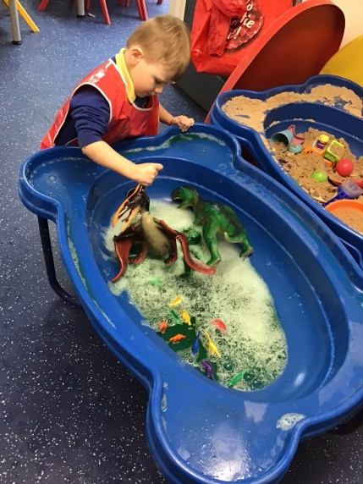
Curriculum
Within F2 we ensure that children are gaining excellent experiences.
Our aim is to introduce children to a wide and varied curriculum.
We support our children to explore and investigate.
We believe that through our curriculum, children will develop independent skills.
We deliver both indoor and outdoor learning to support and develop all children’s learning styles.
At the start of the year, our focus is on the Prime areas of Communication and Language, Personal, Social and Emotional Development and Physical Development.
We also teach children the Specific Areas which include
literacy, mathematics, understanding the world and expressive art and design.
You are able to see our full curriculum overview on our website.

Slide 11
Health
Health:
Staff need to be aware of your child’s medical background, in particular any allergies (e.g. bee stings, dairy food), any dietary restrictions (e.g. vegetarian or Halal) and any medical conditions that are important for us to know (e.g. asthma or eczema).
Allergy bands
If children do have an allergy they will be assigned a bracelet band that will be given to them at lunch time to ensure they are not given any food that could cause a reaction.
Sickness
Children can suddenly become ill and therefore it is important that we know we can contact you or another adult relative/friend at all times. We are aware that contact numbers may change. Please ensure we have your up to date contact details.
Please ensure that the school is kept up to date with your contact details. If your child is unable to attend school due to illness, please telephone the school office to let us know.

Slide 12
Helping Your Child to Settle
These are a few ways that you can prepare your child for the first few weeks at school:
Ensure that they can dress and undress themselves - especially on PE days.
Help them to master basic cutlery skills.
Encourage your child to be independent with their toileting skills. (if they are still in nappies please make us aware. Please put spare clothes in and please put them in pull ups if possible or put some in so that we can start the process of toilet training.
Encourage them to sit and listen to stories.
Help them to develop the confidence to communicate
with new people.
Practise sharing and taking turns.

Slide 13
Reception Baseline Assessment
This is a statutory assessment for all reception children in the country, covering Literacy, Communication & Language and Maths. It comprises short, practical activities for the children to complete with their teacher. The children will not be aware that they are completing an assessment and it is not something that they can prepare for in advance, so please do not worry!
It is used to measure progress between entering reception and leaving year 6.
Your child will not be aware of taking part in an assessment as we try to make it a fun experience. It also allows the class teacher to get to know your child better through one to one interactions.
Early Years Foundation Stage Profile
At the end of the year the f2 teachers will complete an assessment overview of your child’s progress throughout the year. This will be based on how secure your children are in the prime and specific areas of learning. This will inform the year 1 teachers of your child’s progress.

Slide 14
Home Learning
We understand and value the support you provide for your child at home. Early years staff would love to hear about what you and your child have been doing at home.
We encourage you to share your child’s learning, achievements and experiences with staff, as this helps us to build a more complete picture of your child.
Homework – Your child has tasks that they can complete throughout the year and this can be found on the website and will be given out to you when your child receives their book bag.
In September your child will be given a reading pack. This will be explained to you in a separate reading meeting.
Please attend this meeting as it is vital that we are all working as a
team to support your child.

Slide 15
We hope that this presentation is useful. Should you have any questions, please feel free to speak to a member of staff.
We aim to ensure that your children’s experience at Our Lady and Saint Edward’s is a happy and rewarding one. We look forward to working with both you and your children.

