Slide 1


Slide 2


Slide 3



Slide 4

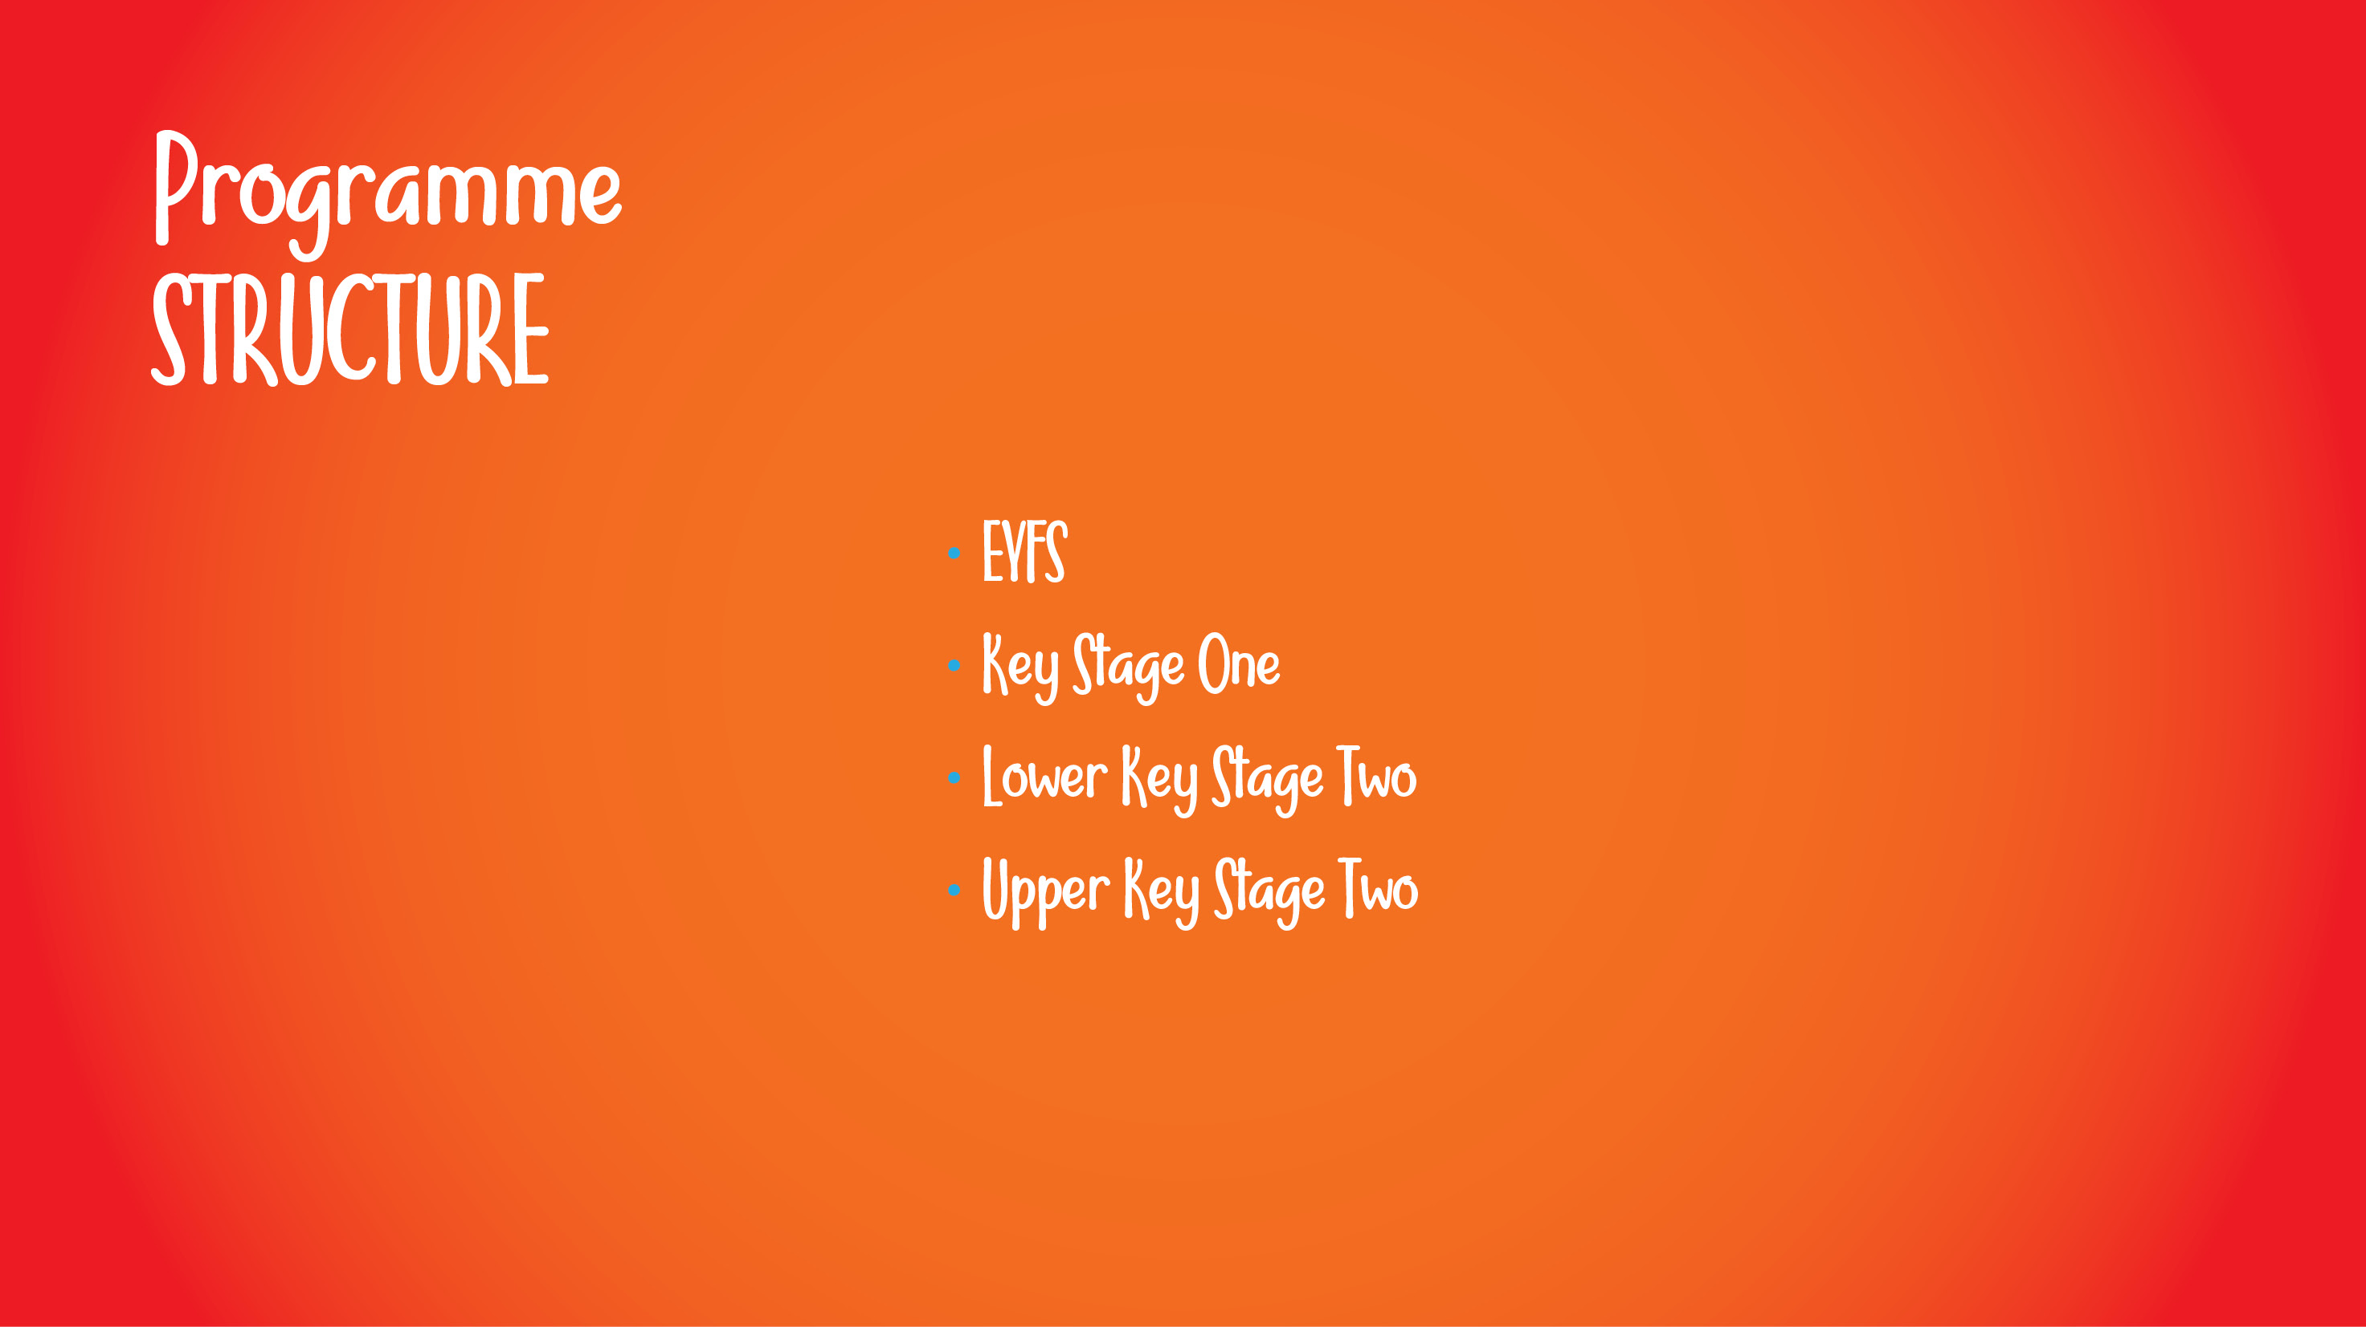
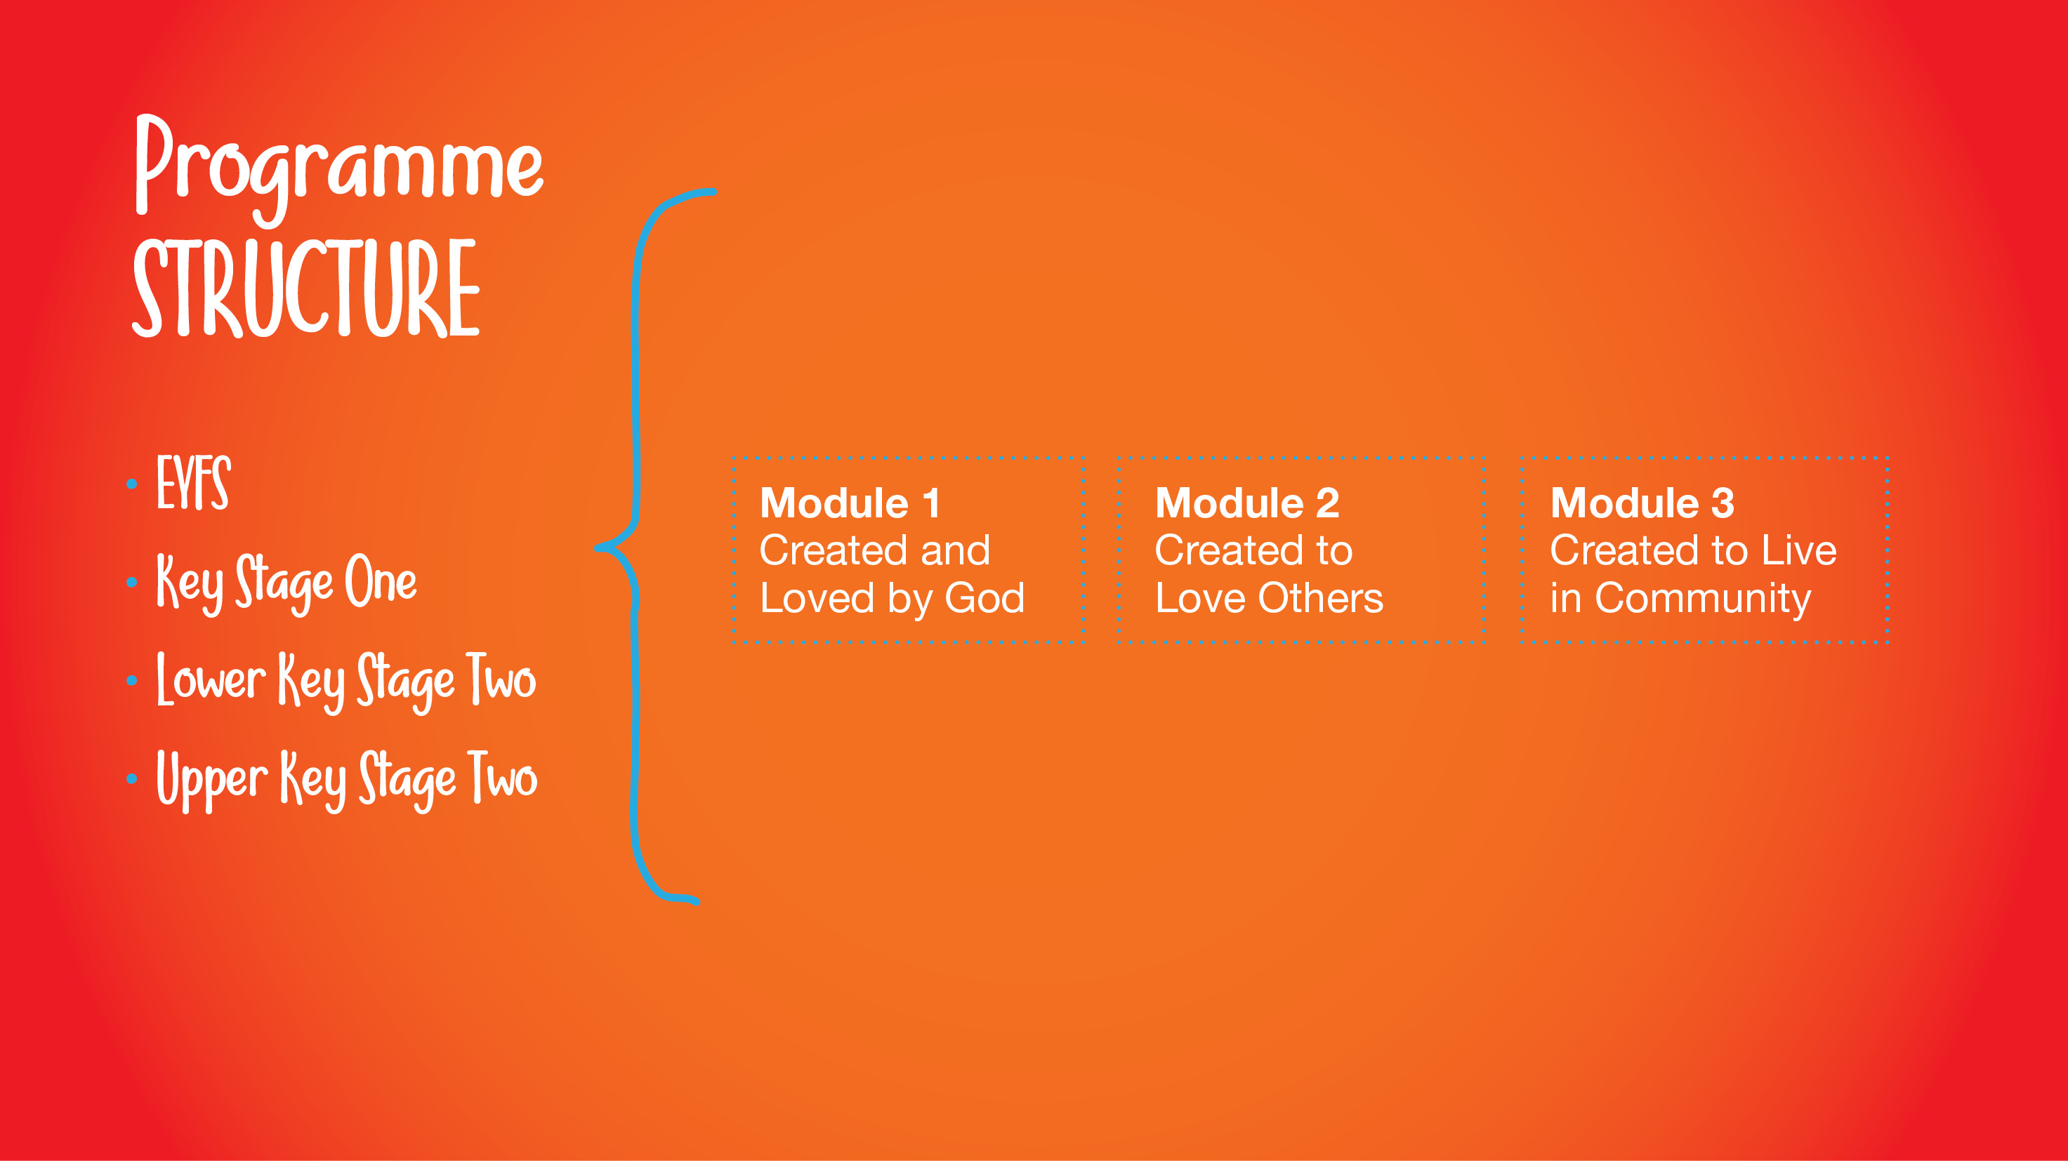
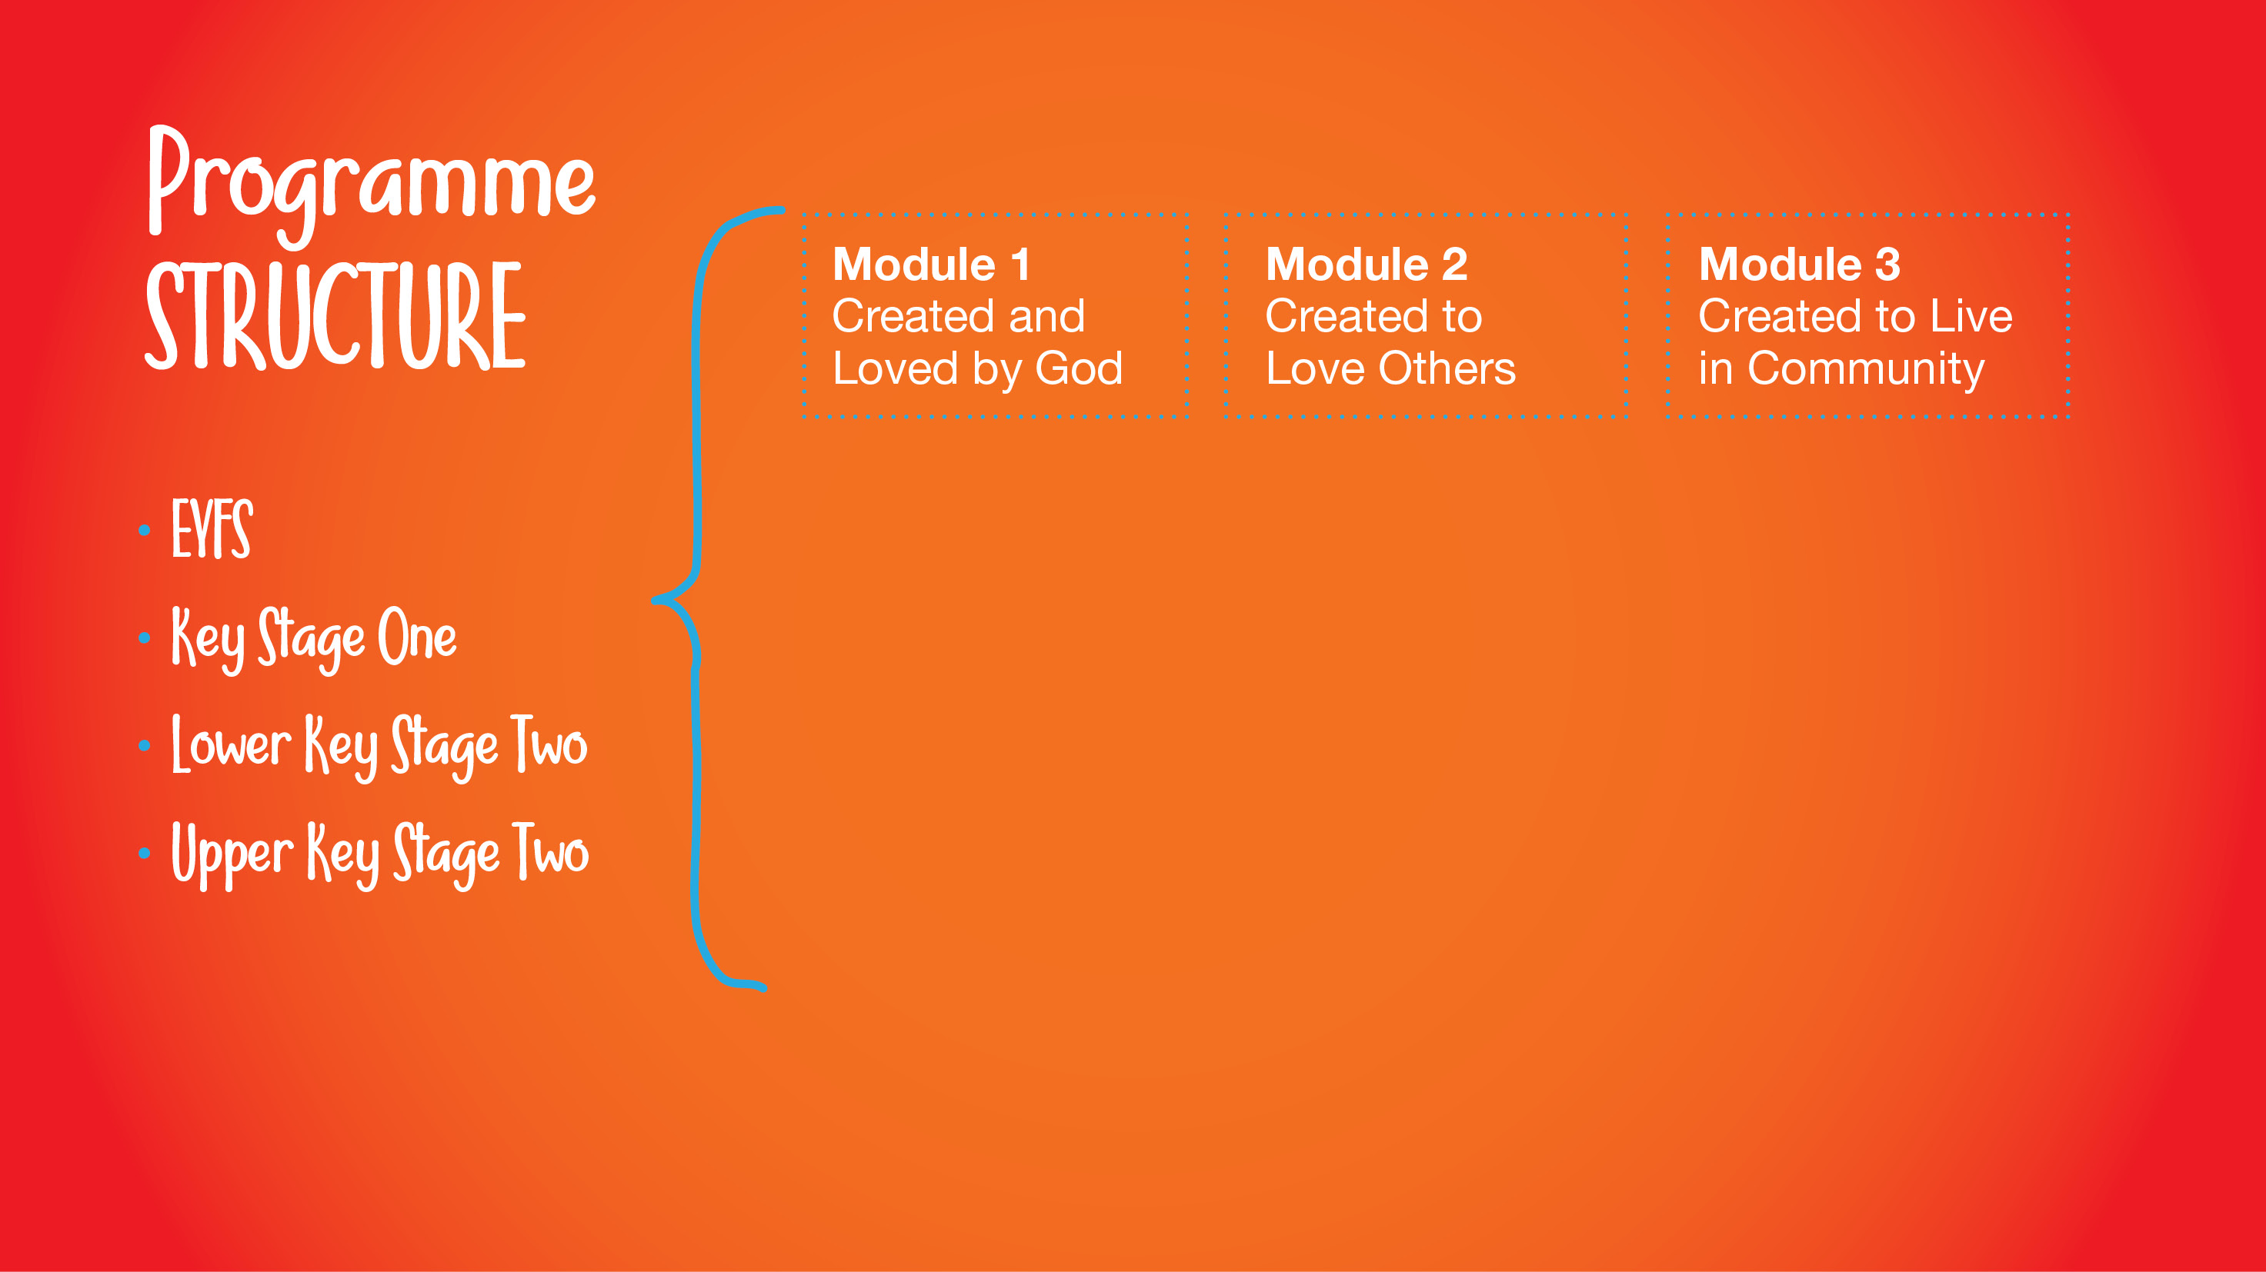
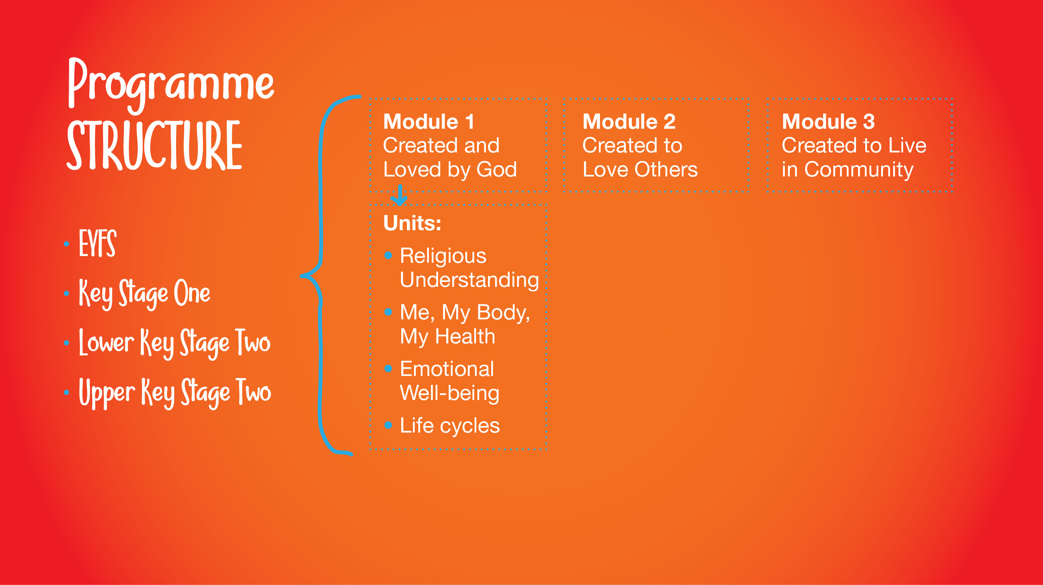
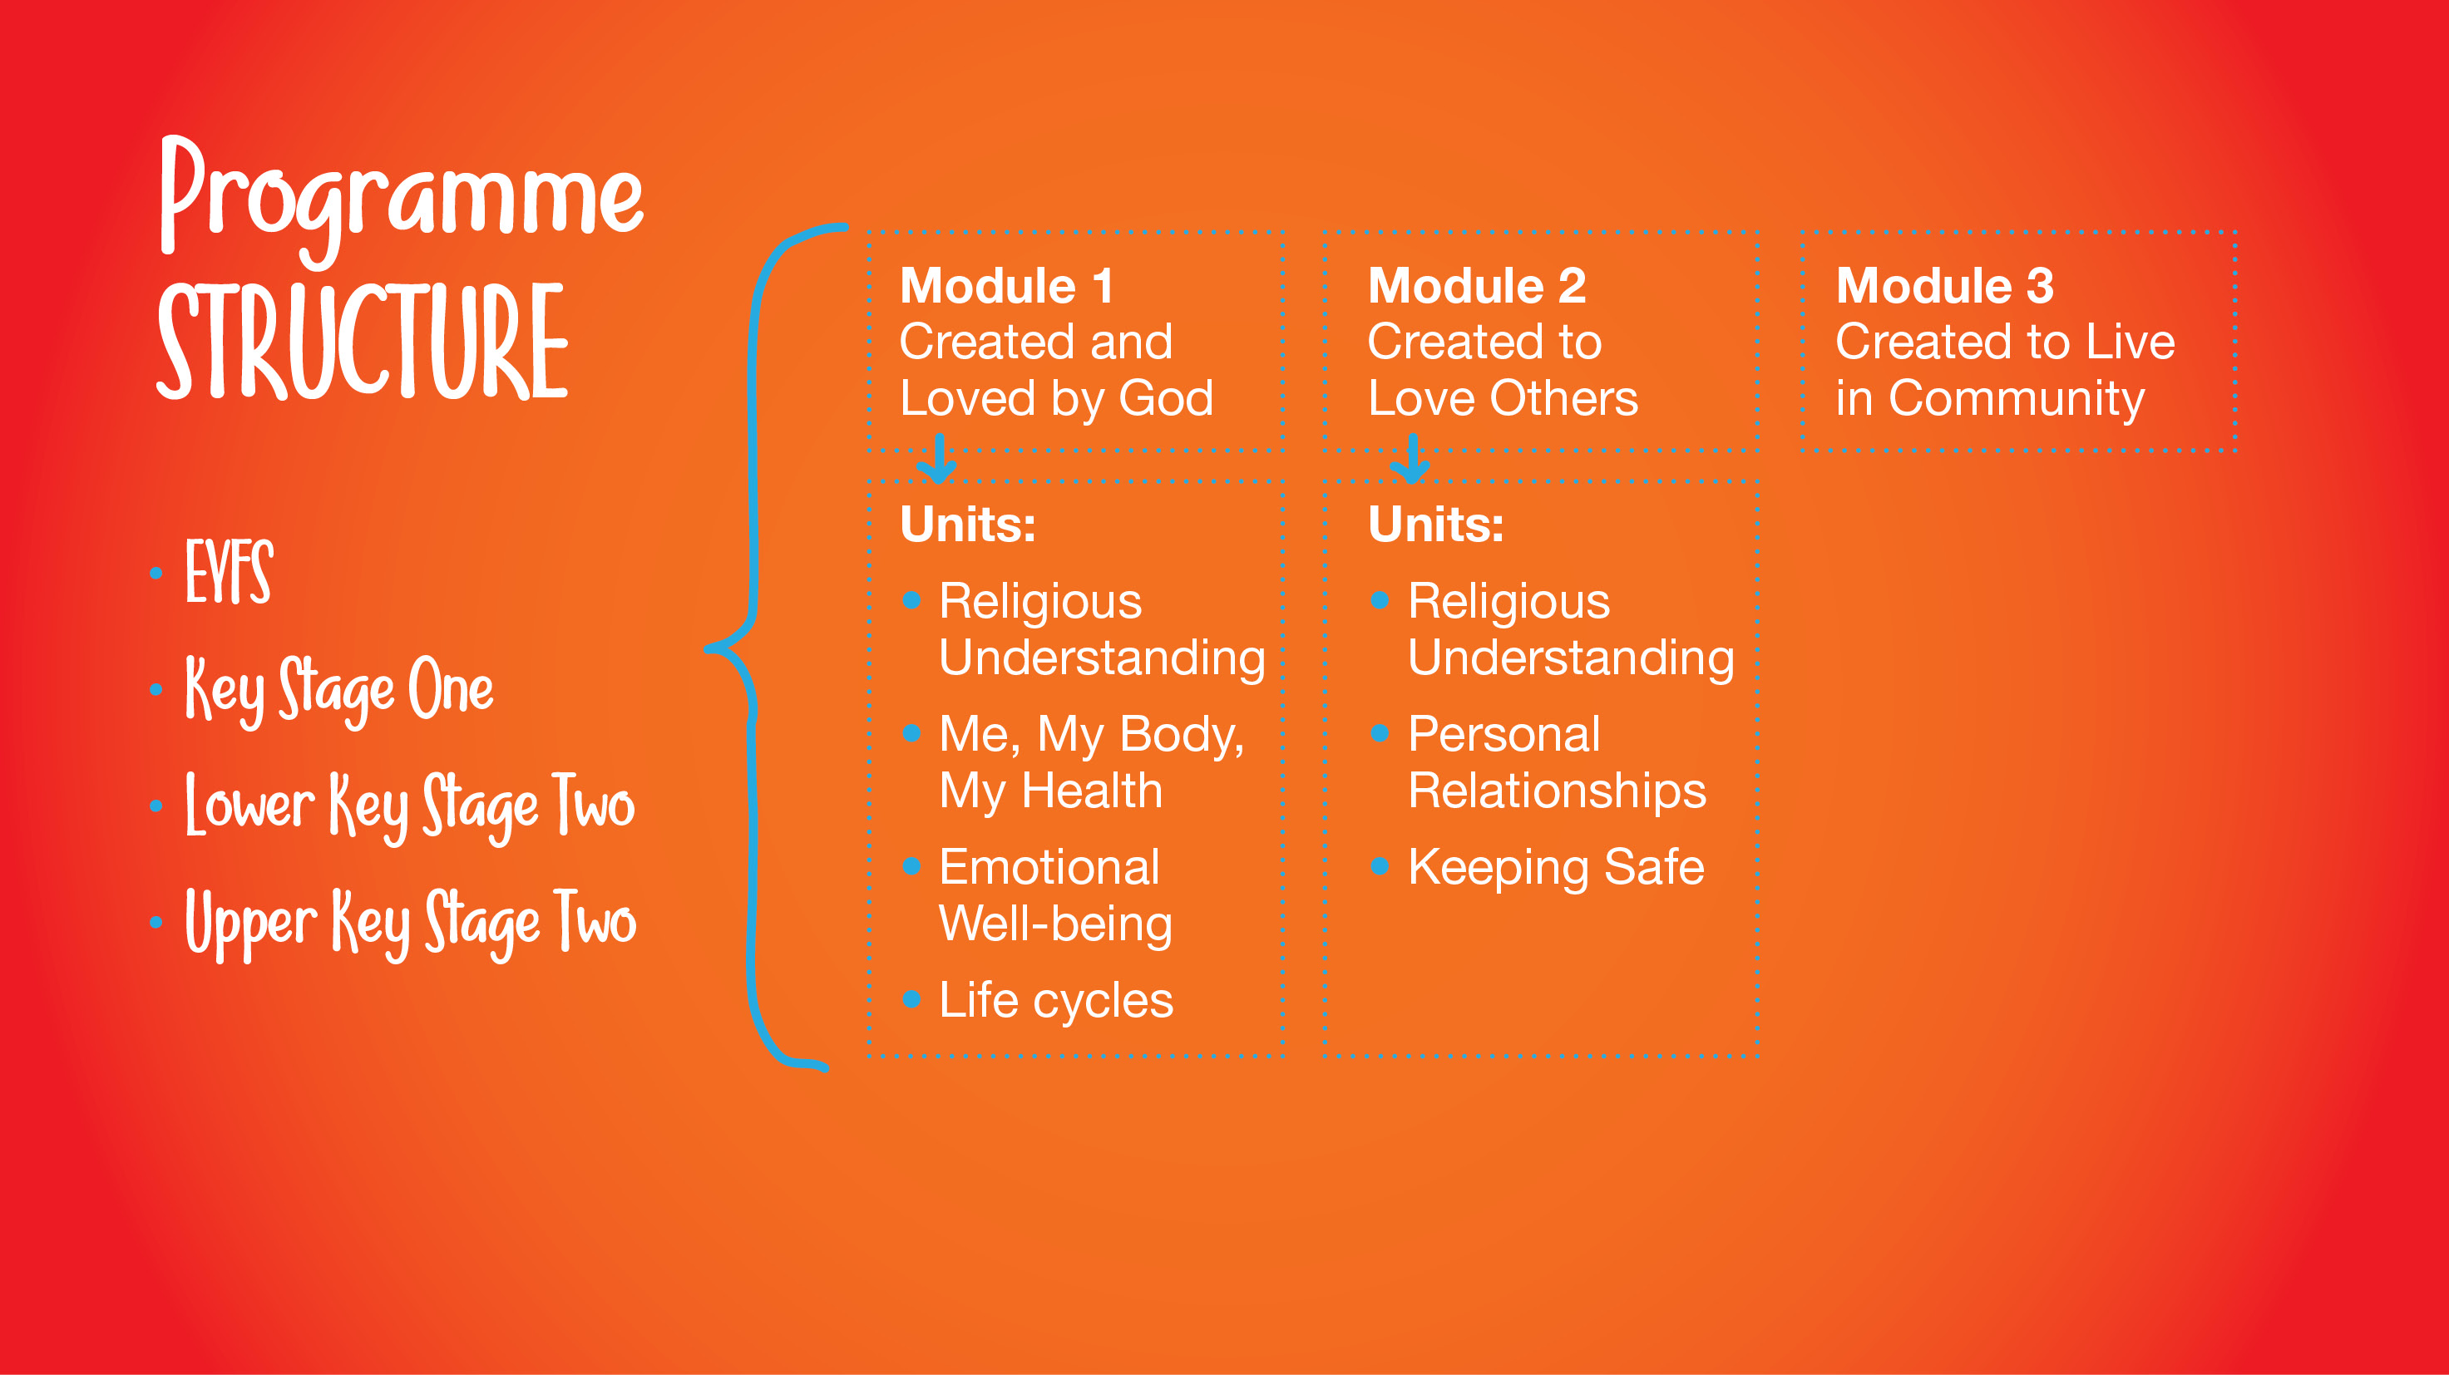
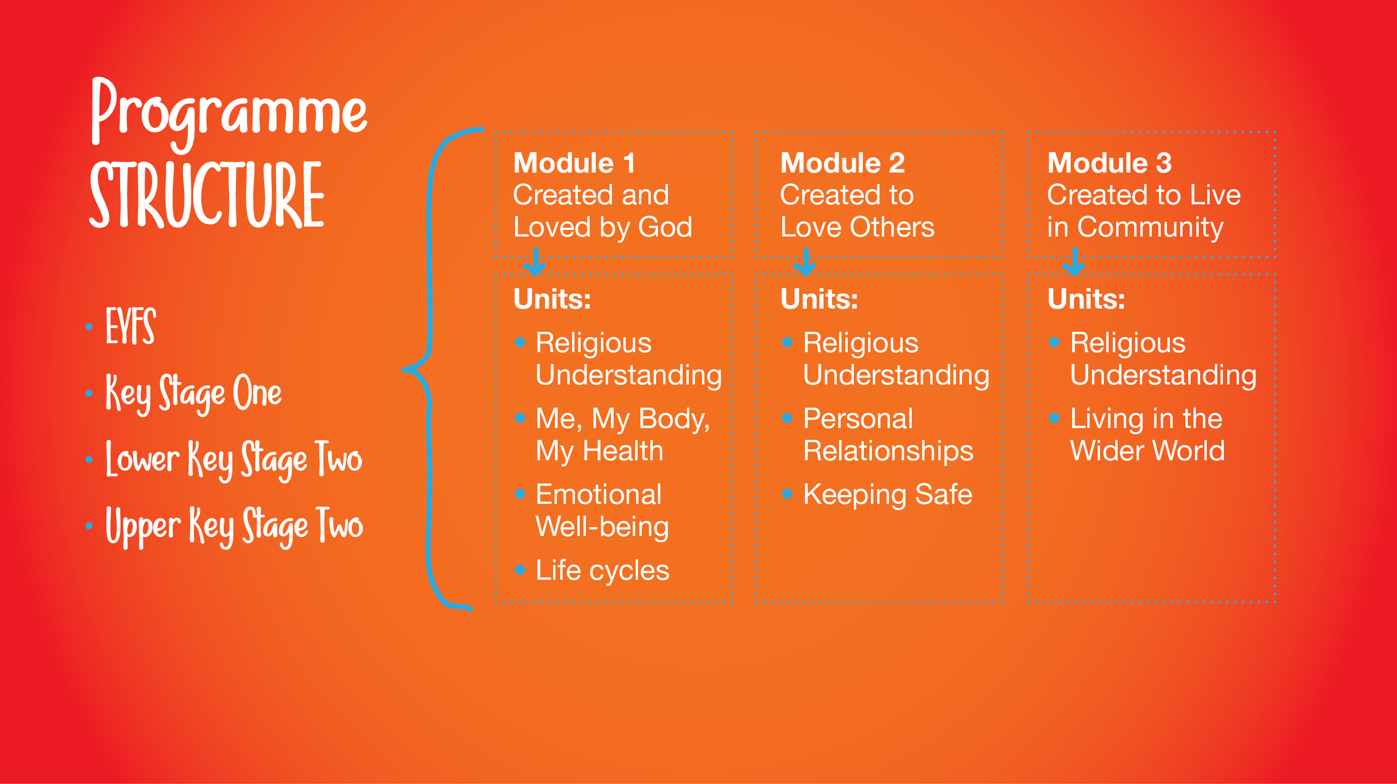
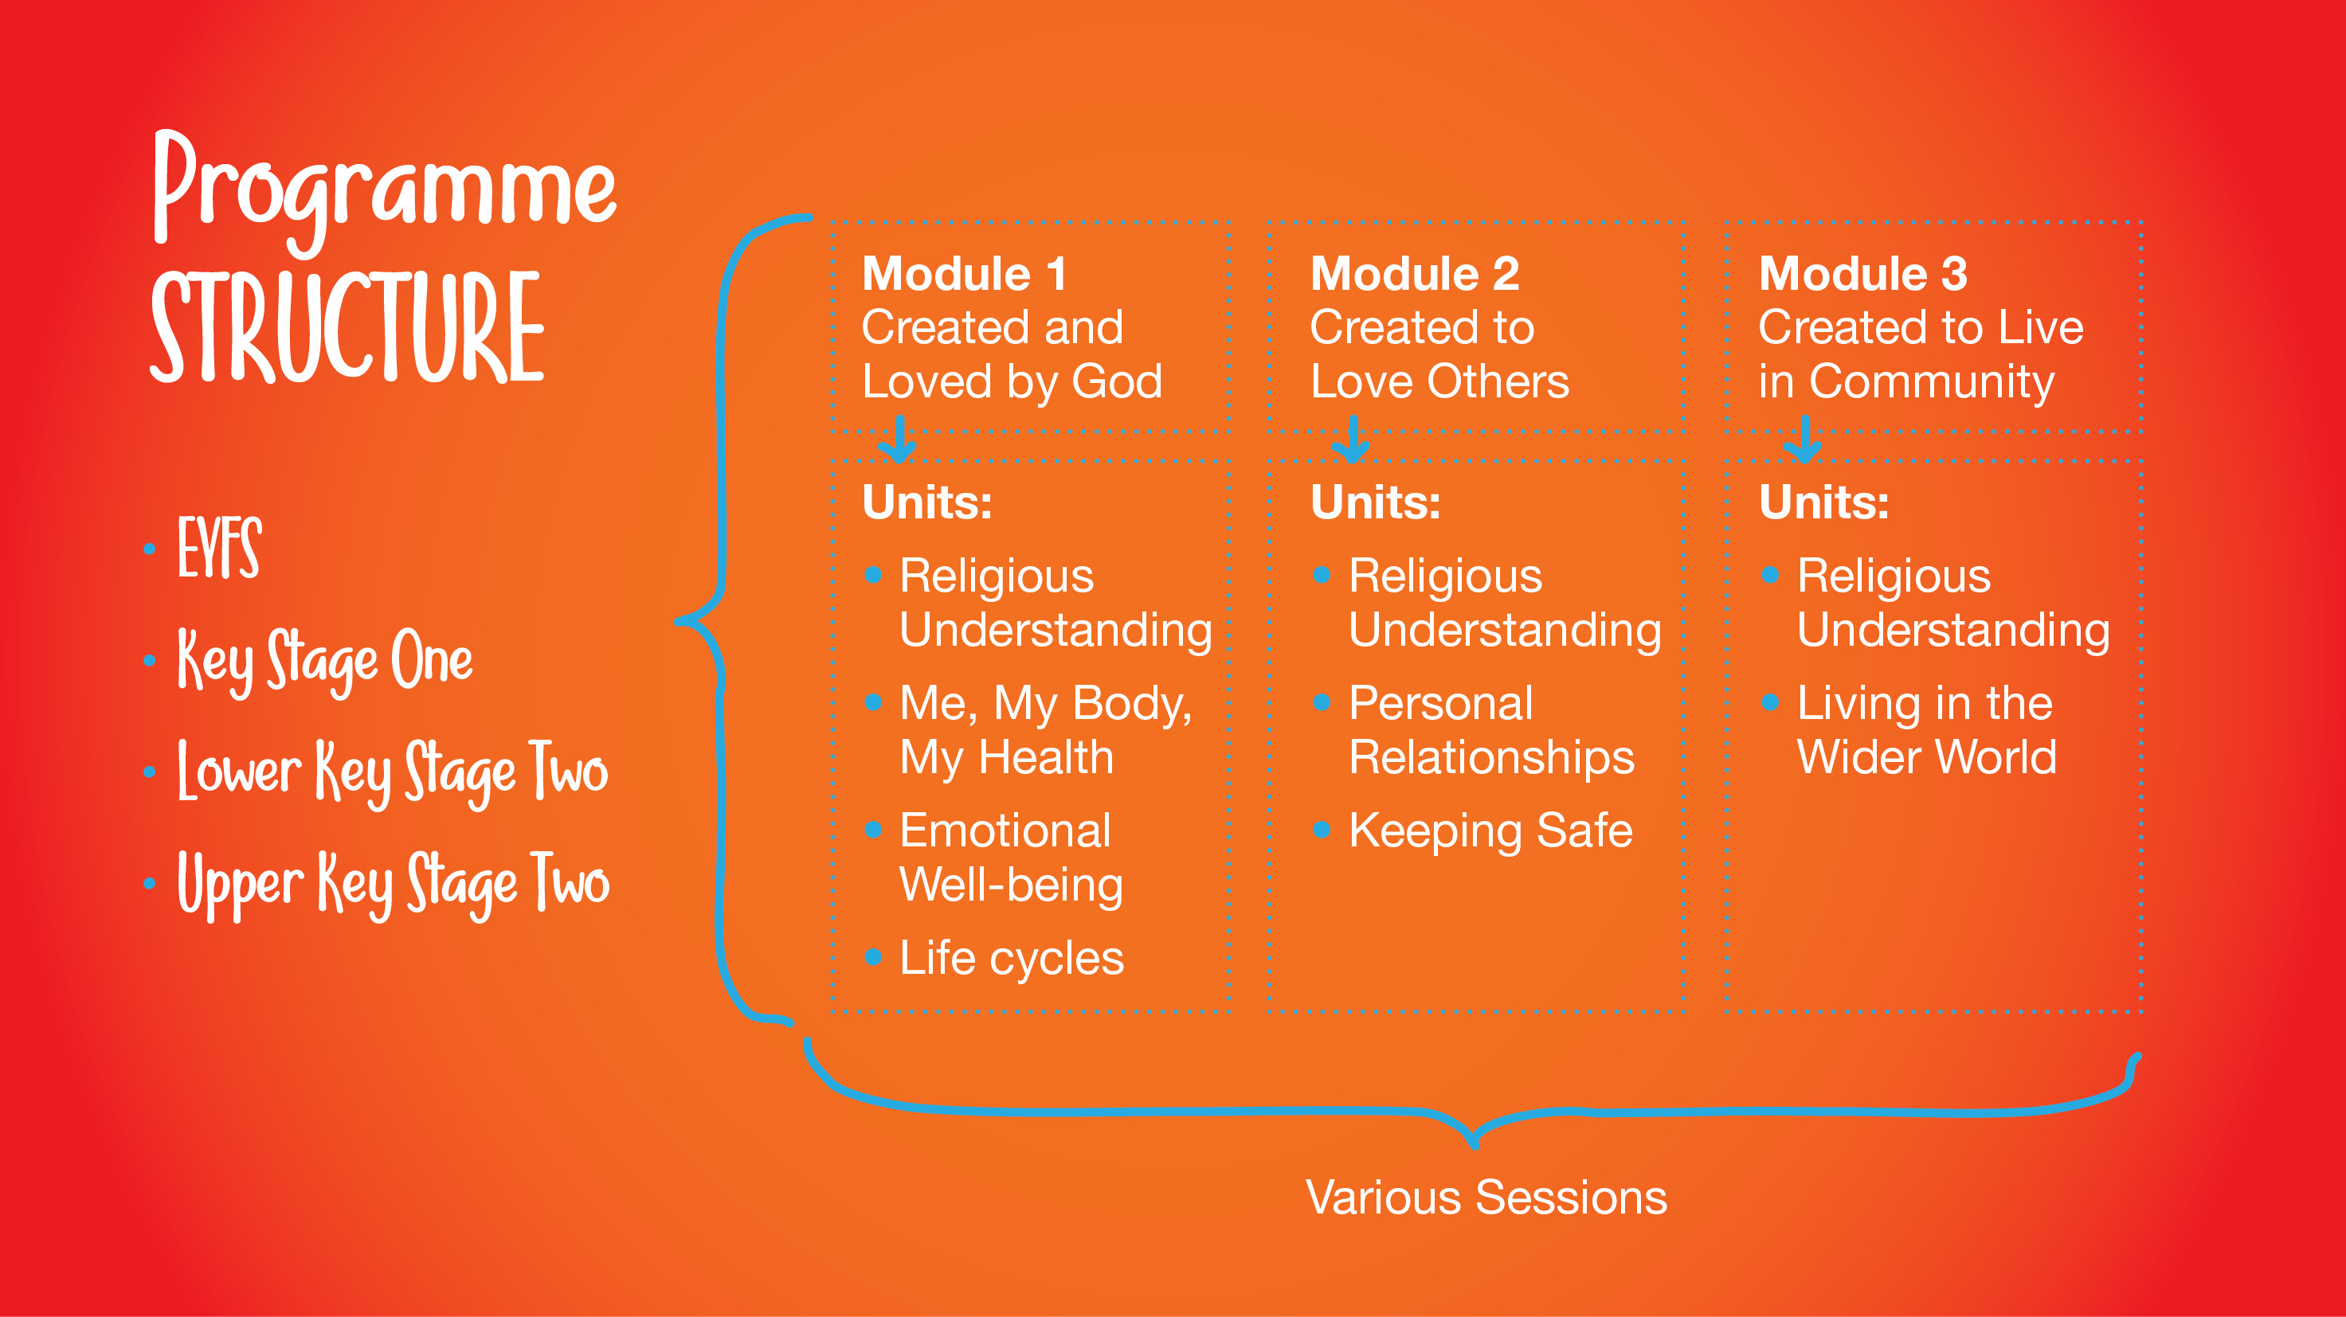

Slide 5


Slide 6


Slide 7


Slide 8
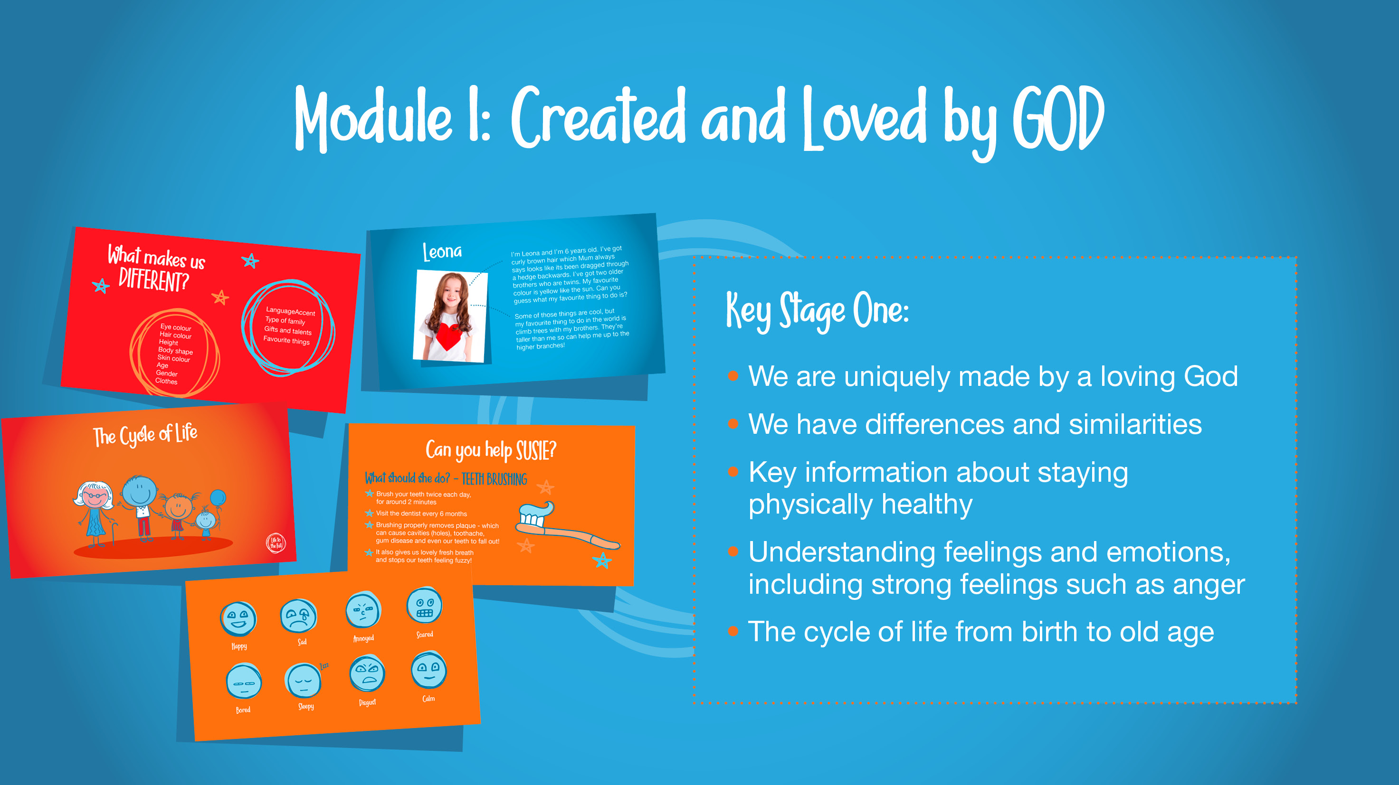

Slide 9
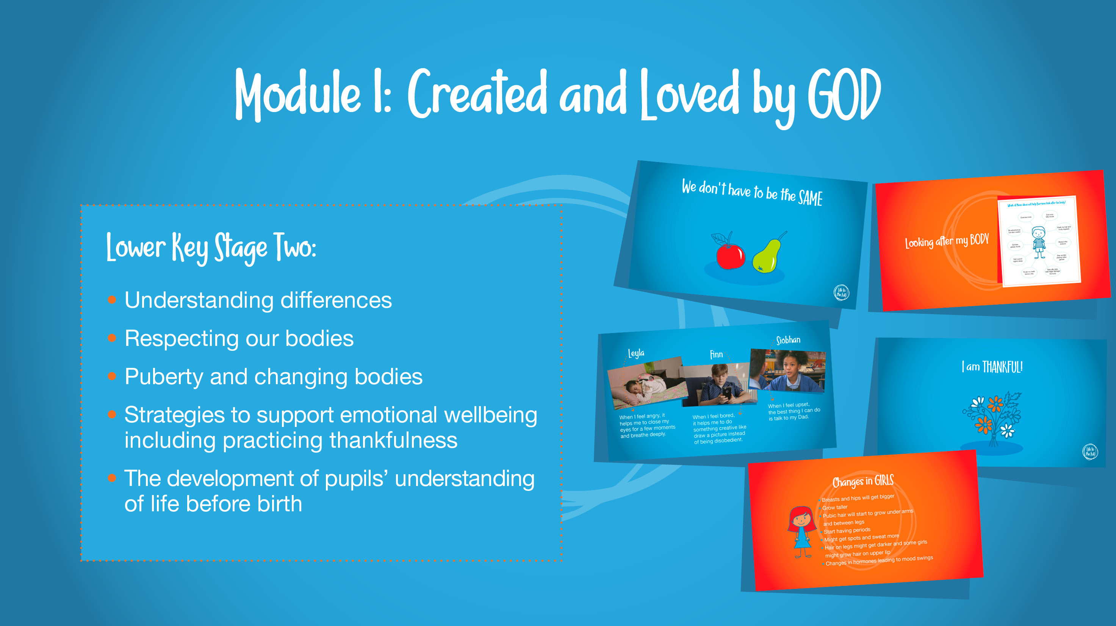

Slide 10
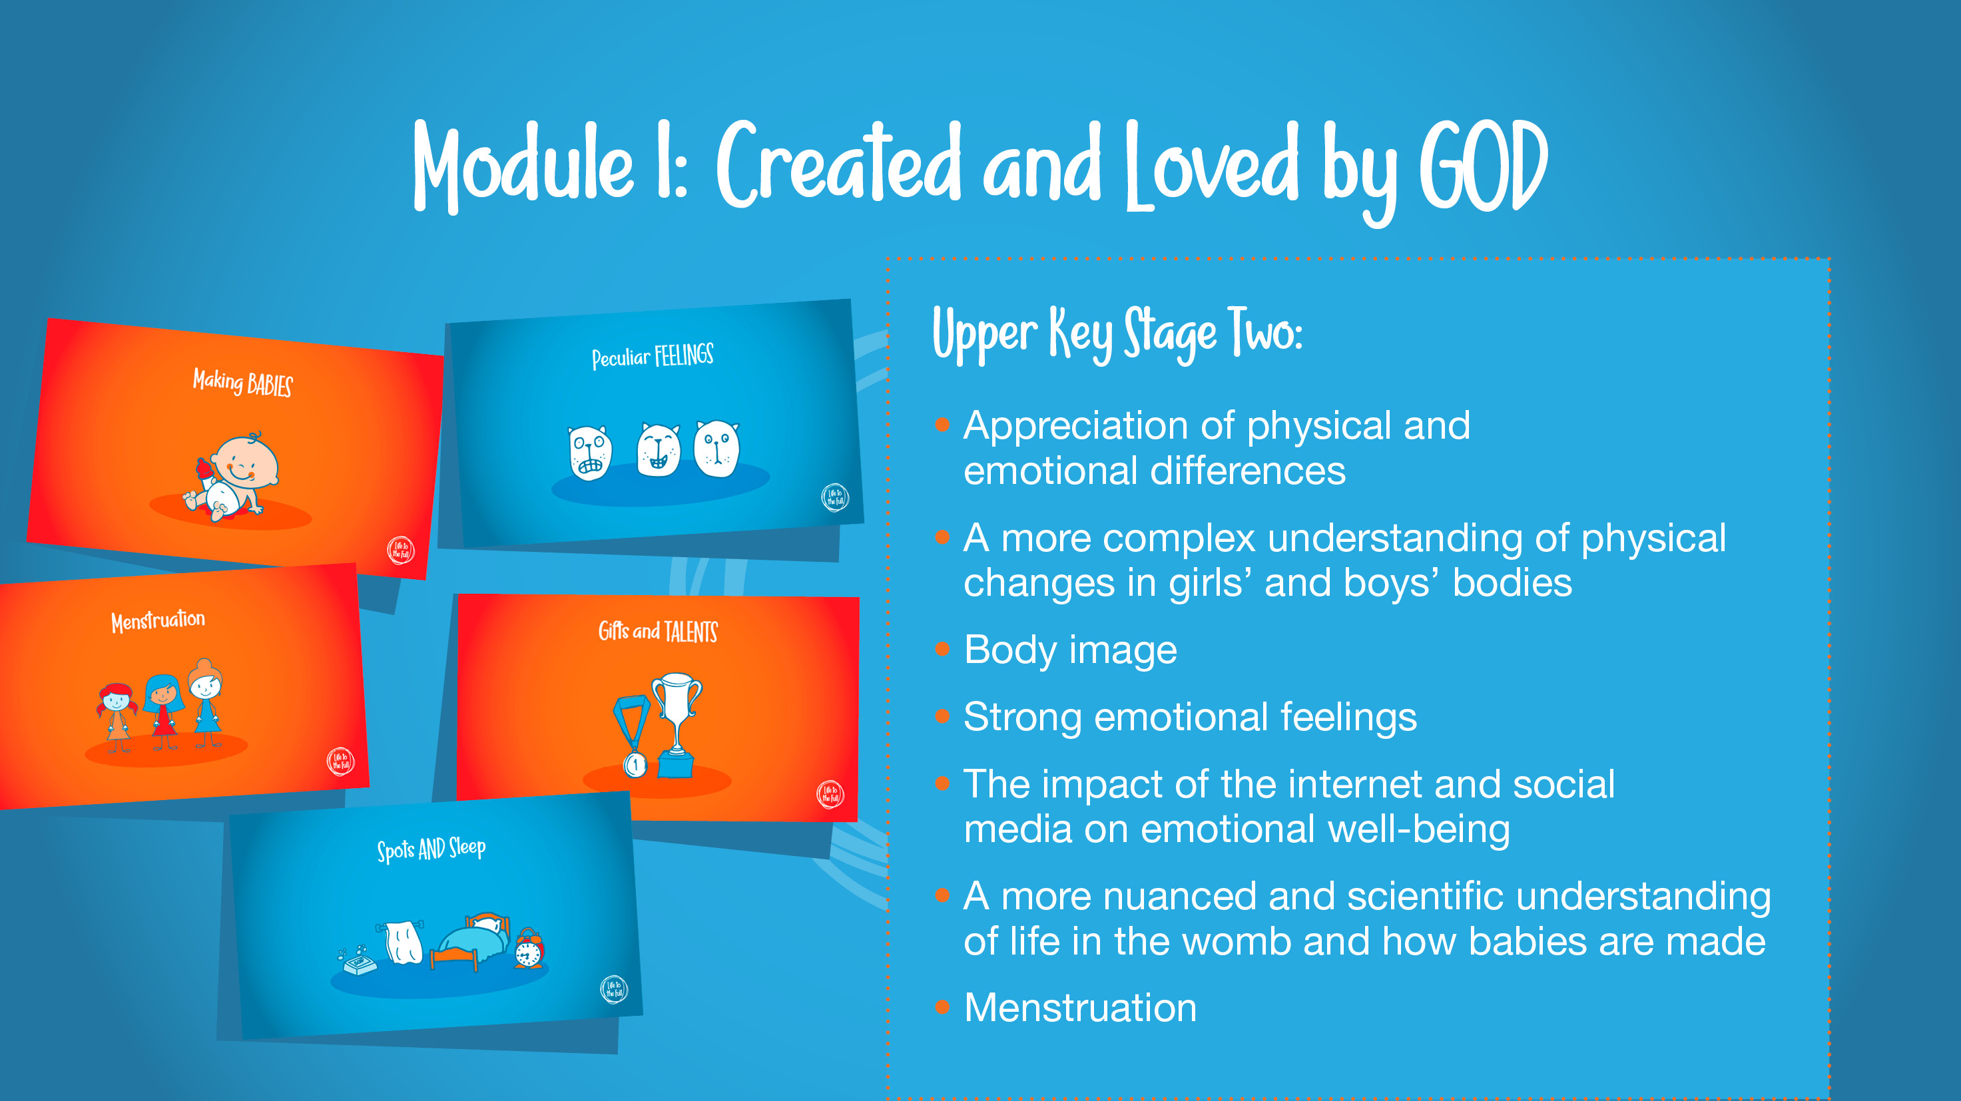

Slide 11


Slide 12
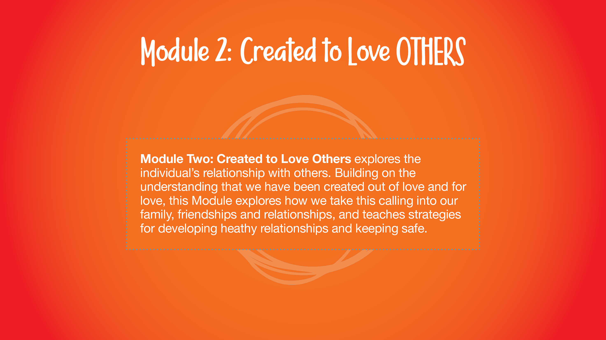

Slide 13


Slide 14
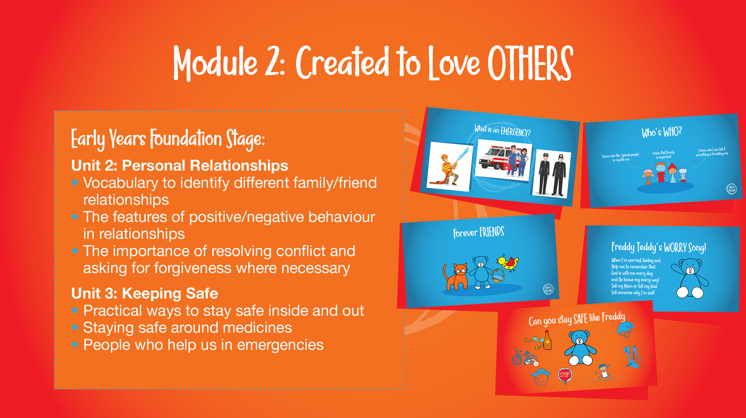

Slide 15
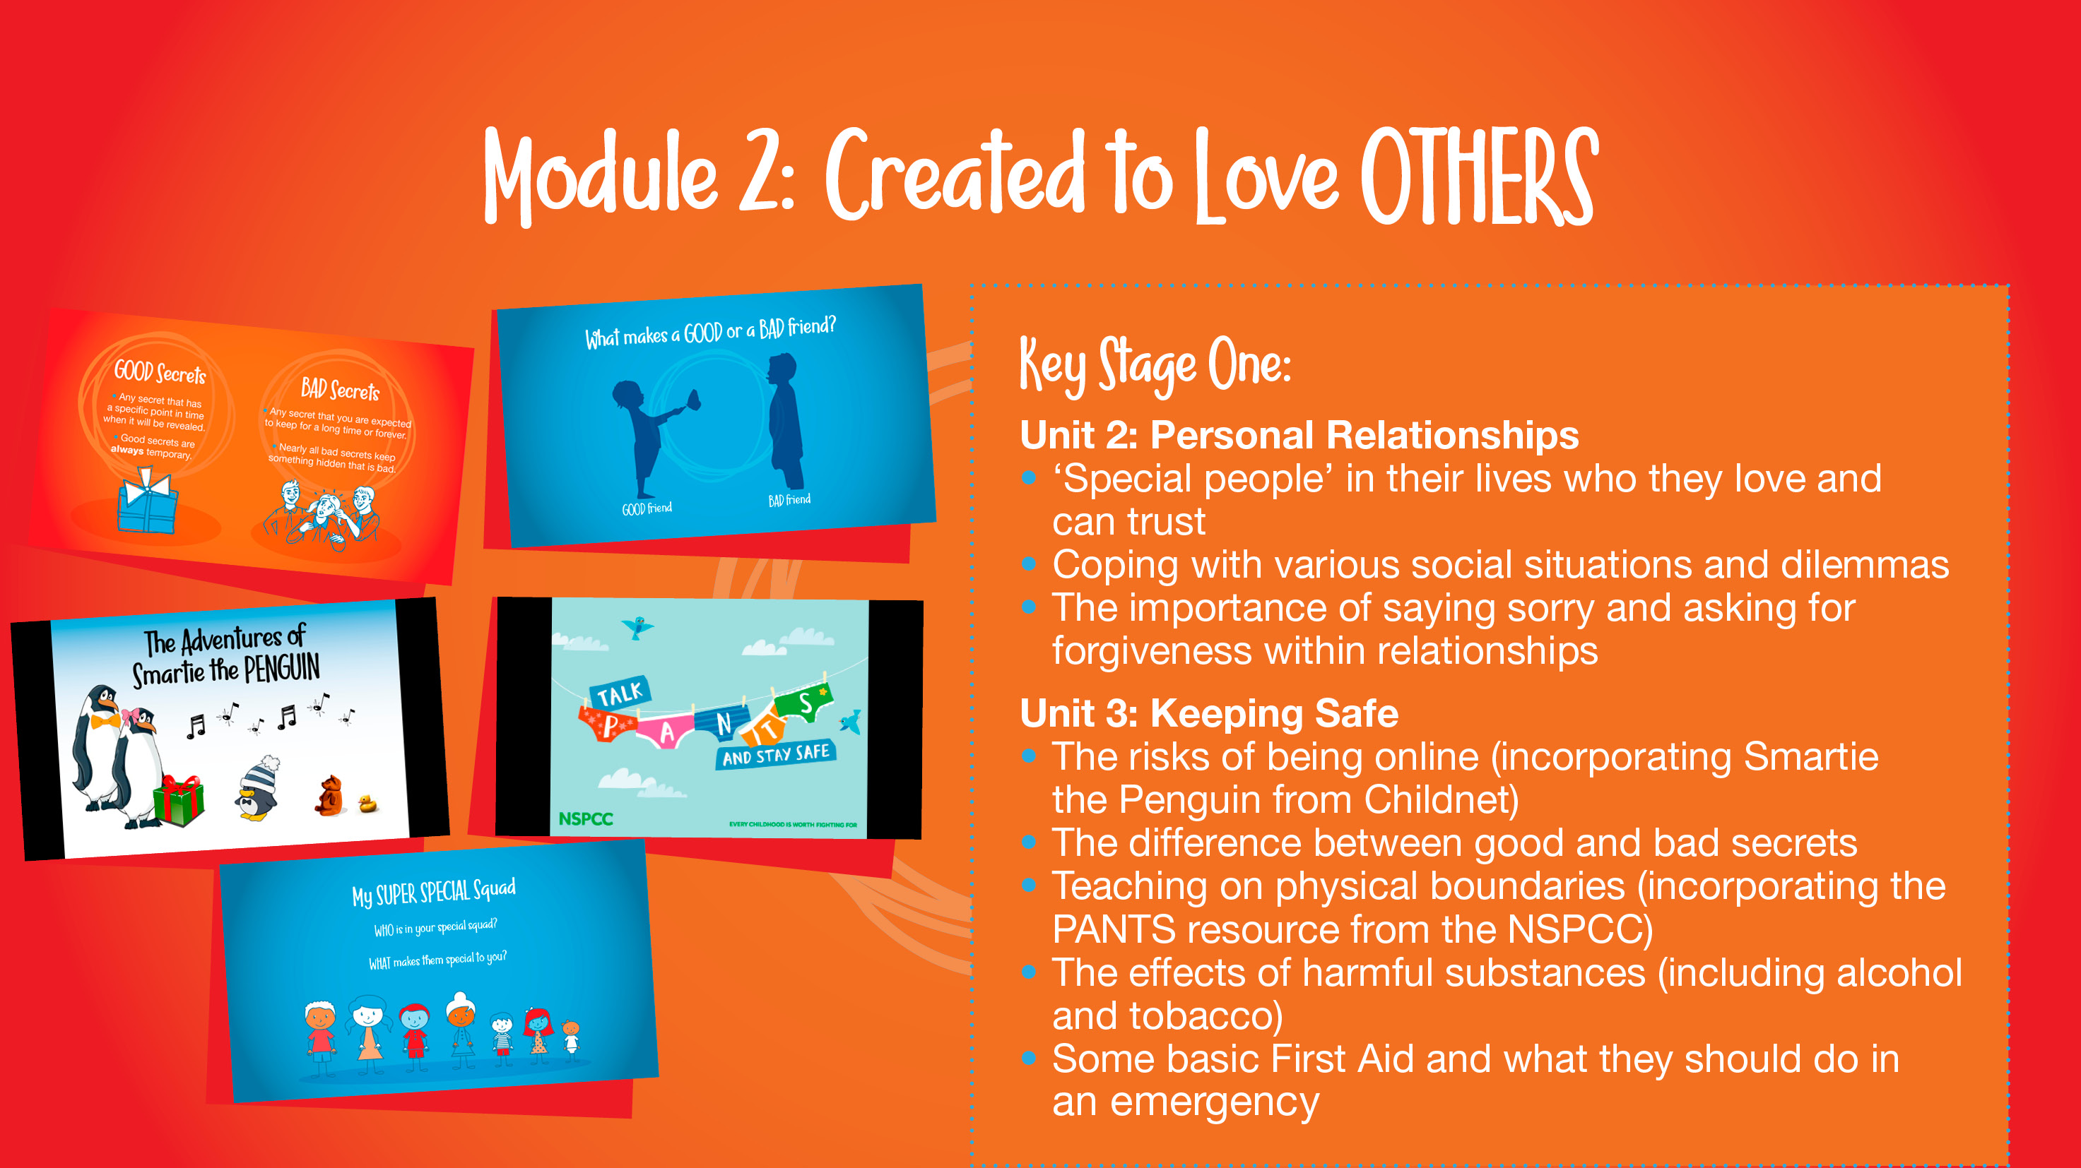

Slide 16
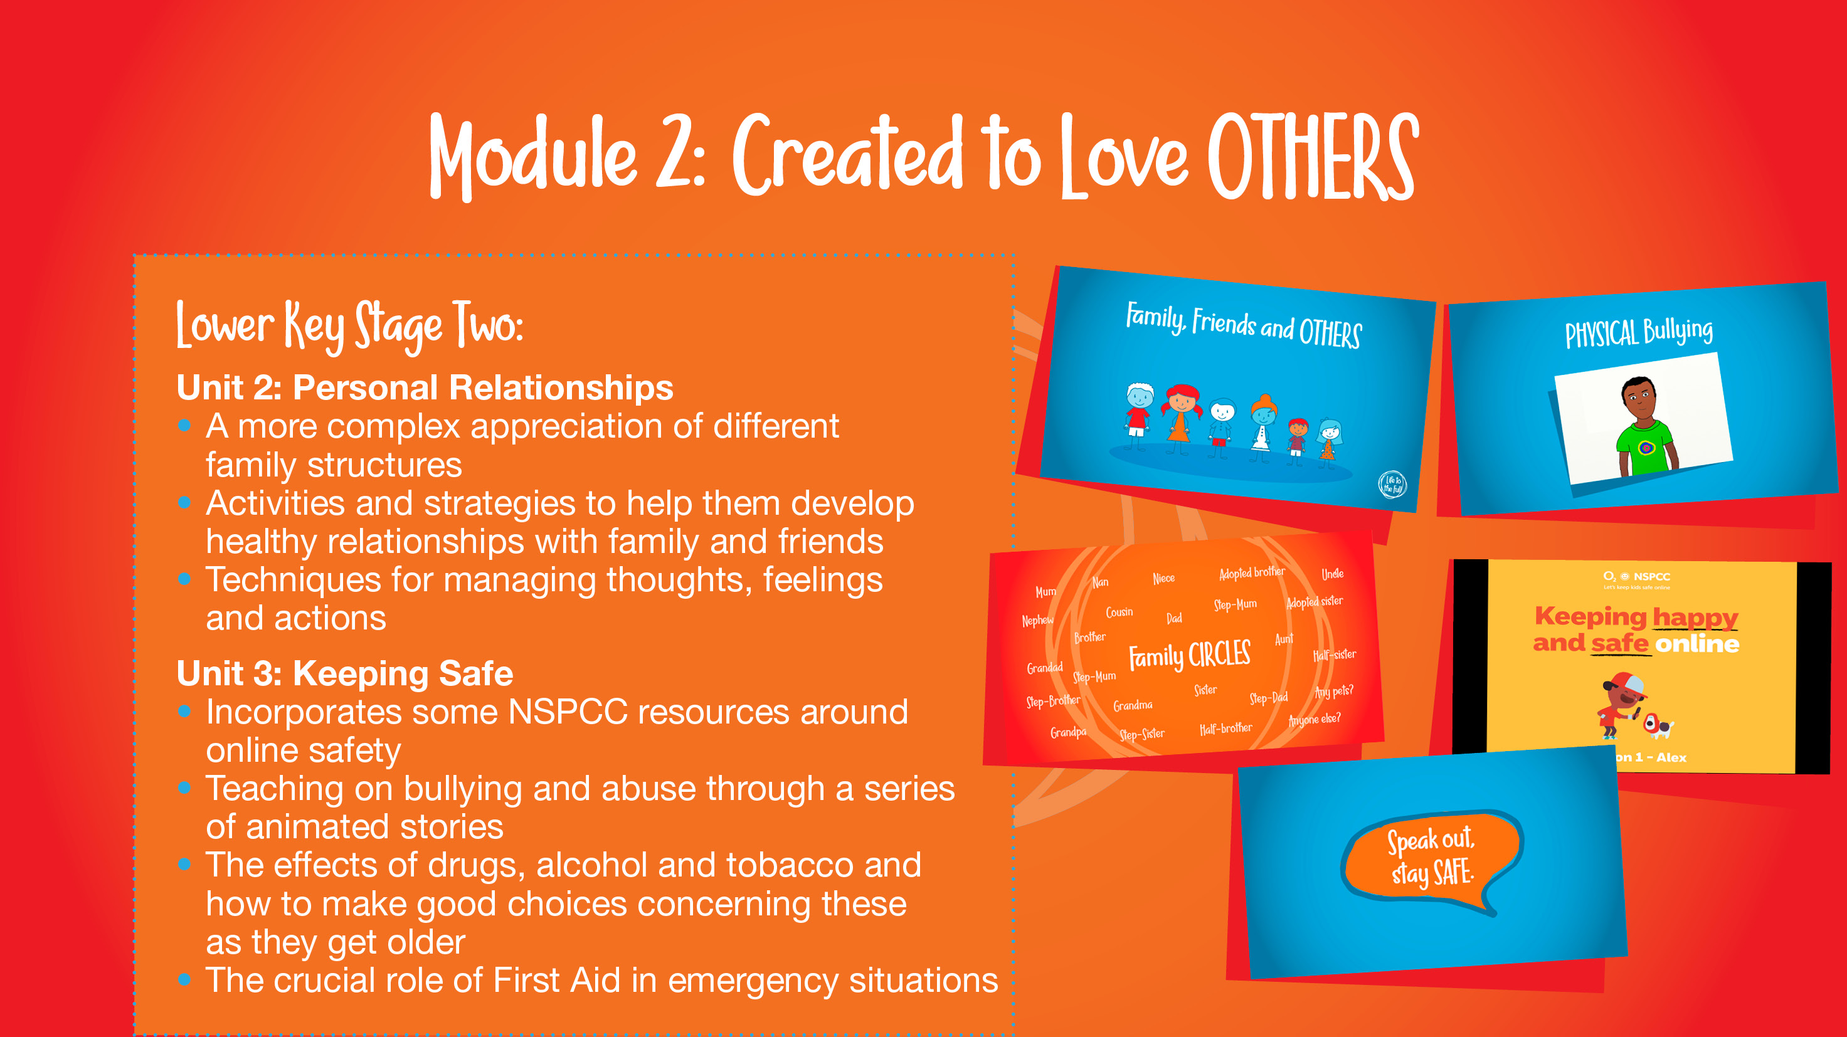

Slide 17
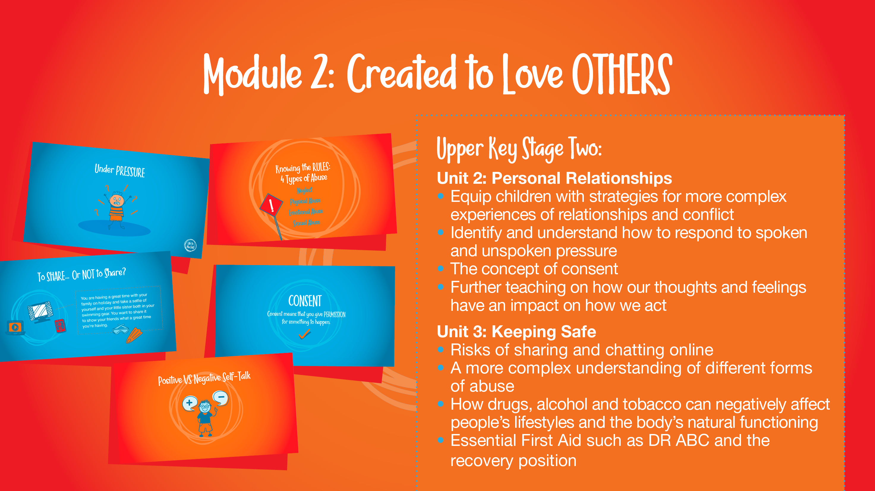

Slide 18
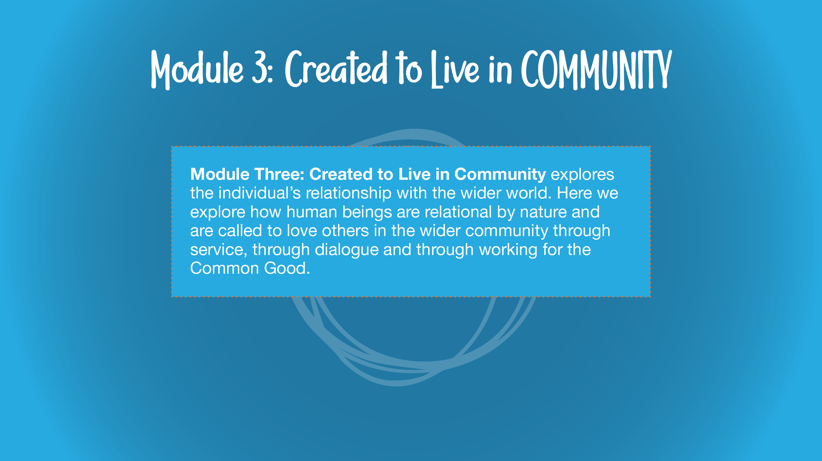
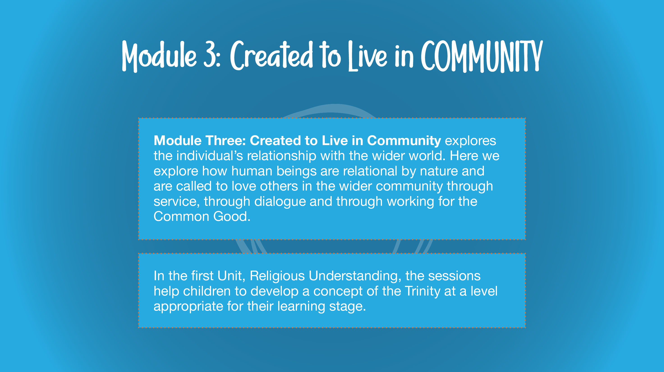

Slide 19


Slide 20


Slide 21


Slide 23


Slide 24

Key Decisions Regarding the Scheme
Key Decision 1- Genitalia names to be taught from Year 1
Key Decision 2- Puberty to be moved from Year 4 to be taught from Year 5
Key Decision 3- ‘Talking About Sex’ session to be omitted, as this is non-statutory. This session will be available on the Parent Portal. You are then able to deliver this session yourselves, with your children, if you wish to.
Key Decision 4- ‘Talking About Pornography’ to be omitted as this is also non-statutory. All statutory aspects of E-safety will be covered in both Computing and RSHE as an important part of their learning.

Slide 25
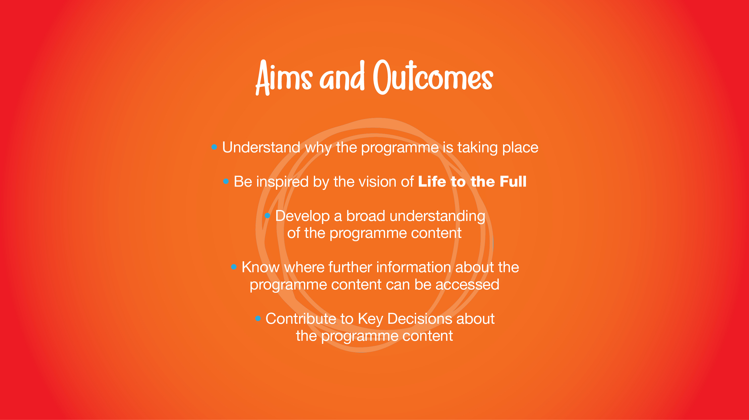

Slide 26


