Slide 1
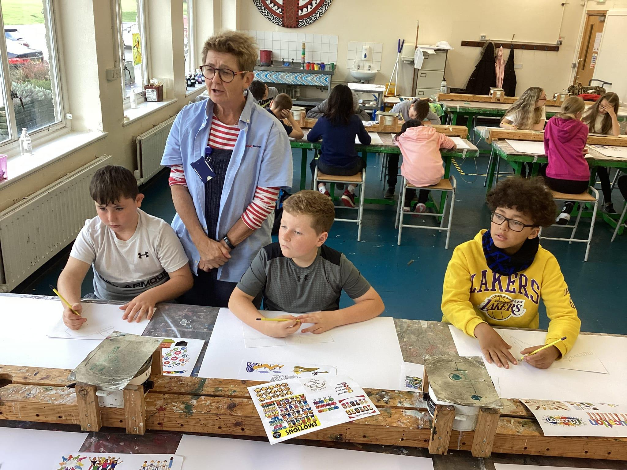
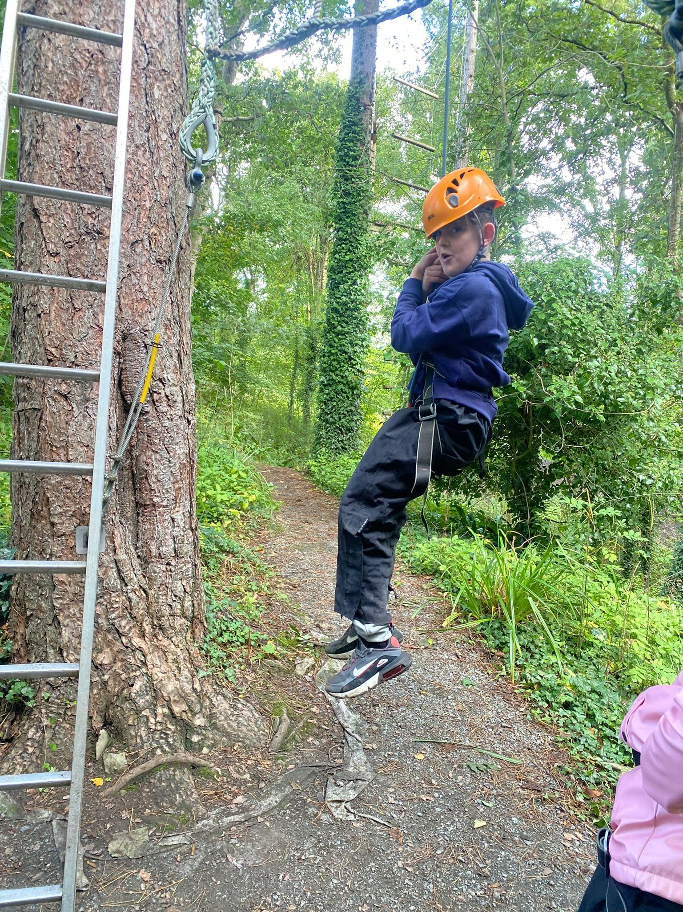
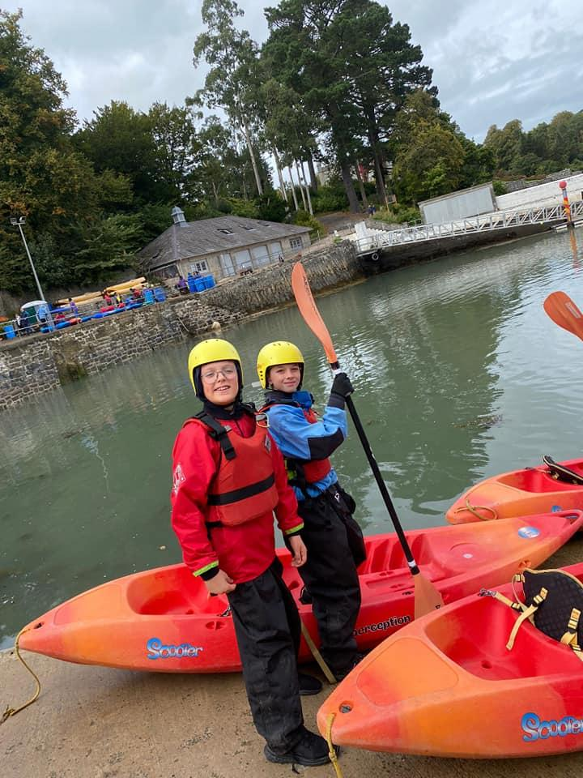
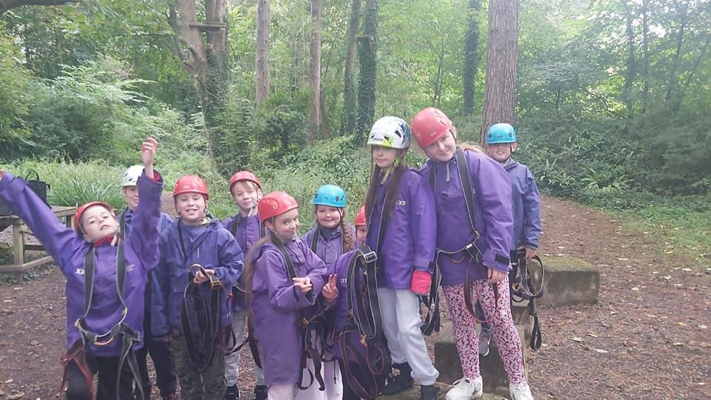


Our Lady and St Edward’s Catholic Primary School
Year 6 Residential Trip to Conway Centre Anglesey

Slide 2
The dates for the residential are Wednesday 1st July- Friday 3rd July. We believe that by holding the residential at this point in the year is a lovely way of celebrating the hard work they have put into their final year with us at Our Lady & St Edward’s. The residential plays an important part of your child’s journey through Year 6 and the transition to secondary school.
During our time at the Conway Centre the children will be taking part in a number of activities such as high ropes, kayaking, woodland survival, art activities and evening campfires.
If you wish for your child to attend the residential ParentPay has been set up so that you can reserve their place with a £30 deposit which is to be paid by 27 February 2026.
Consent forms and kit lists will be sent home with your child after all deposits have been received.
Cost: £285 (subject to change, due to the number of uptakes) - Children in receipt of free school meals are entitled to half price trips. We will confirm exact amount after 27 February and another payment item will be set up for you to pay the balance in installments.

Slide 3
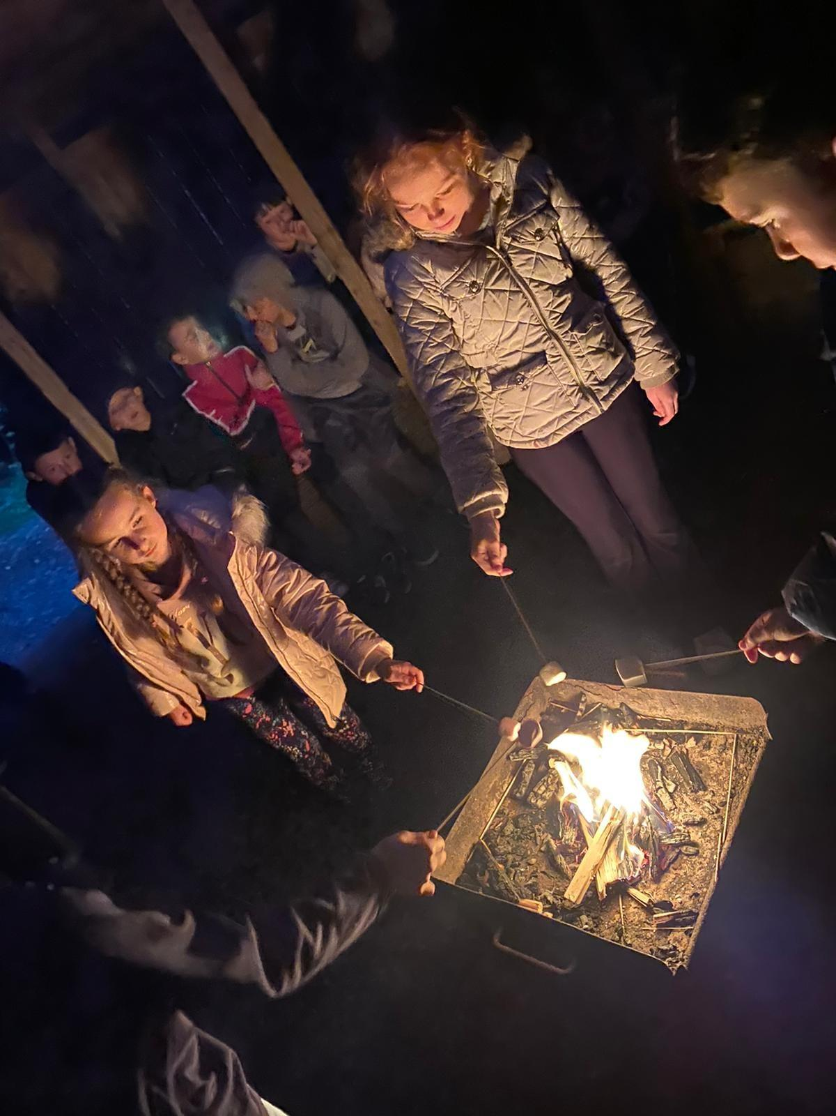
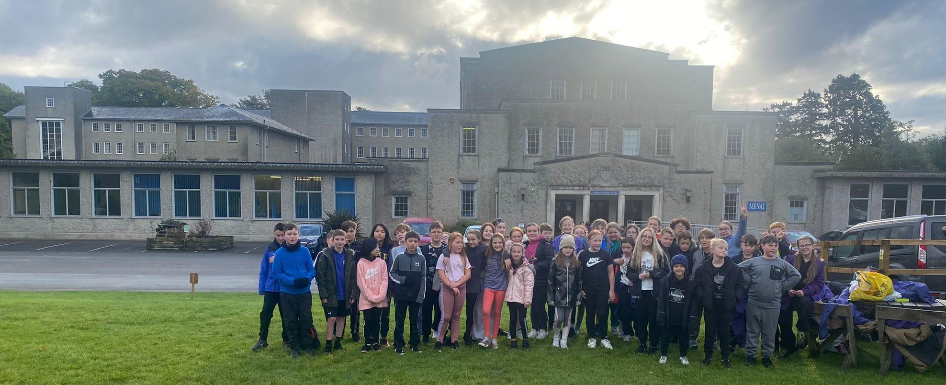
Conway Centres, Anglesey is perfect for schools looking for an immersive residential experience.
Situated adjacent to the Menai Strait within 169 acres of National Trust parkland, they are ideally placed for children to enjoy all that the wild outdoors has to offer.
Venue: Conway Centre
Llanfairpwll
Anglesey
LL61 6DJ

Slide 4
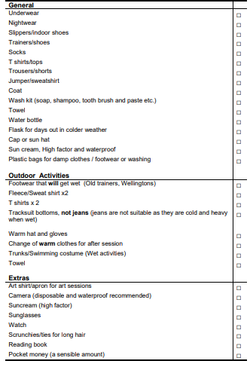
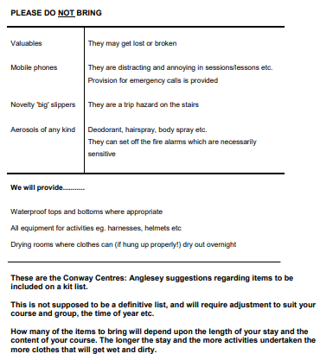
Check
List

Slide 5
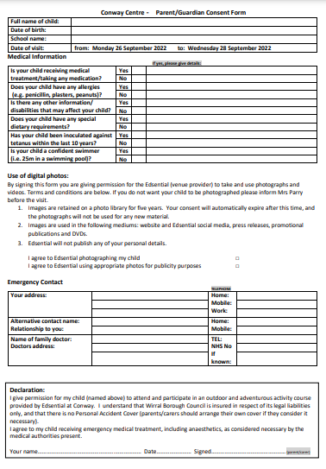
Consent Form

Slide 6
We will leave school at 9:15 on Wednesday, 01 July 2026
We will arrive back at school at approximately 15:00 on Friday, 03 July 2026
This is a list of all the items required to wear/bring on a visit to the centre.
On top: t-shirt & jumper/fleece/hoody (must be long sleeved)
Trousers: joggers/tracksuit/leggings (NO JEANS)
Shoes: old trainers or wellies (could get wet/muddy)
Coat
Hat & Gloves (cold weather)
Sun cream (warm weather)
Hair Tie (if necessary)
All other necessary health and safety equipment will be provided.
Please DO NOT bring any valuable personal items, clothes/phones/tablets etc, We/The Centre will not take responsibly for lost/damaged property.
Please see the School Office about any medication your child may need. Forms will need to completed and medication must be handed to the office on Monday 29 June.
Children will come to school wearing clothes appropriate for their first activity.
We recommend active wear and sensible shoes.
You will need to provide a packed lunch for Wednesday lunch.
Please provide a refillable drinks bottle for your children for the visit.
*Children are allowed to bring a small amount of sweets/snacks for the journey/evening time*
**No energy drinks**

Slide 7
Example
Food
Menu
Wednesday | Thursday | Friday
 | Fruit Juice Choice of Cereals (Weetabix, Cornflakes, Rice Krispies) Bacon (2), Baked Beans, Hash Brown (1) Fruit Toast with a selection of Jams | Fruit Juice Choice of Cereals (Weetabix, Cornflakes, Rice Krispies) Bacon (2), Baked Beans, Hash Brown (1) Fruit Toast with a selection of Jams
Own Packed Lunch | Choice of Sandwich (ham or cheese) Sausage or Cheese Roll Crisps Vegetable Batons Homemade Biscuit | Choice of Sandwich (ham or cheese) Sausage or Cheese Roll Crisps Vegetable Batons Homemade Biscuit
Fish (1), Chips and Peas OR Pasta Bolognaise with Garlic Bread & salad Chocolate Sponge and chocolate sauce or Jelly and ice-cream | Homemade Cheese and Tomato Pizza with Potato wedges and Salad OR Sausage (2) and Mash with Vegetables and Gravy Ice Sponge Cake and Ice-Cream or Jelly and Ice-Cream
Children will choose from the menu.
All dietary requirements will be catered for.
Please include any allergies/dietary requirements on your consent form.

Slide 8
Accommodation
Sheets, duvets and pillows are provided for all guests.
Children will be in dormitory rooms of 8 children.
We will try to cater for friendship groups to the best of our ability

Slide 9
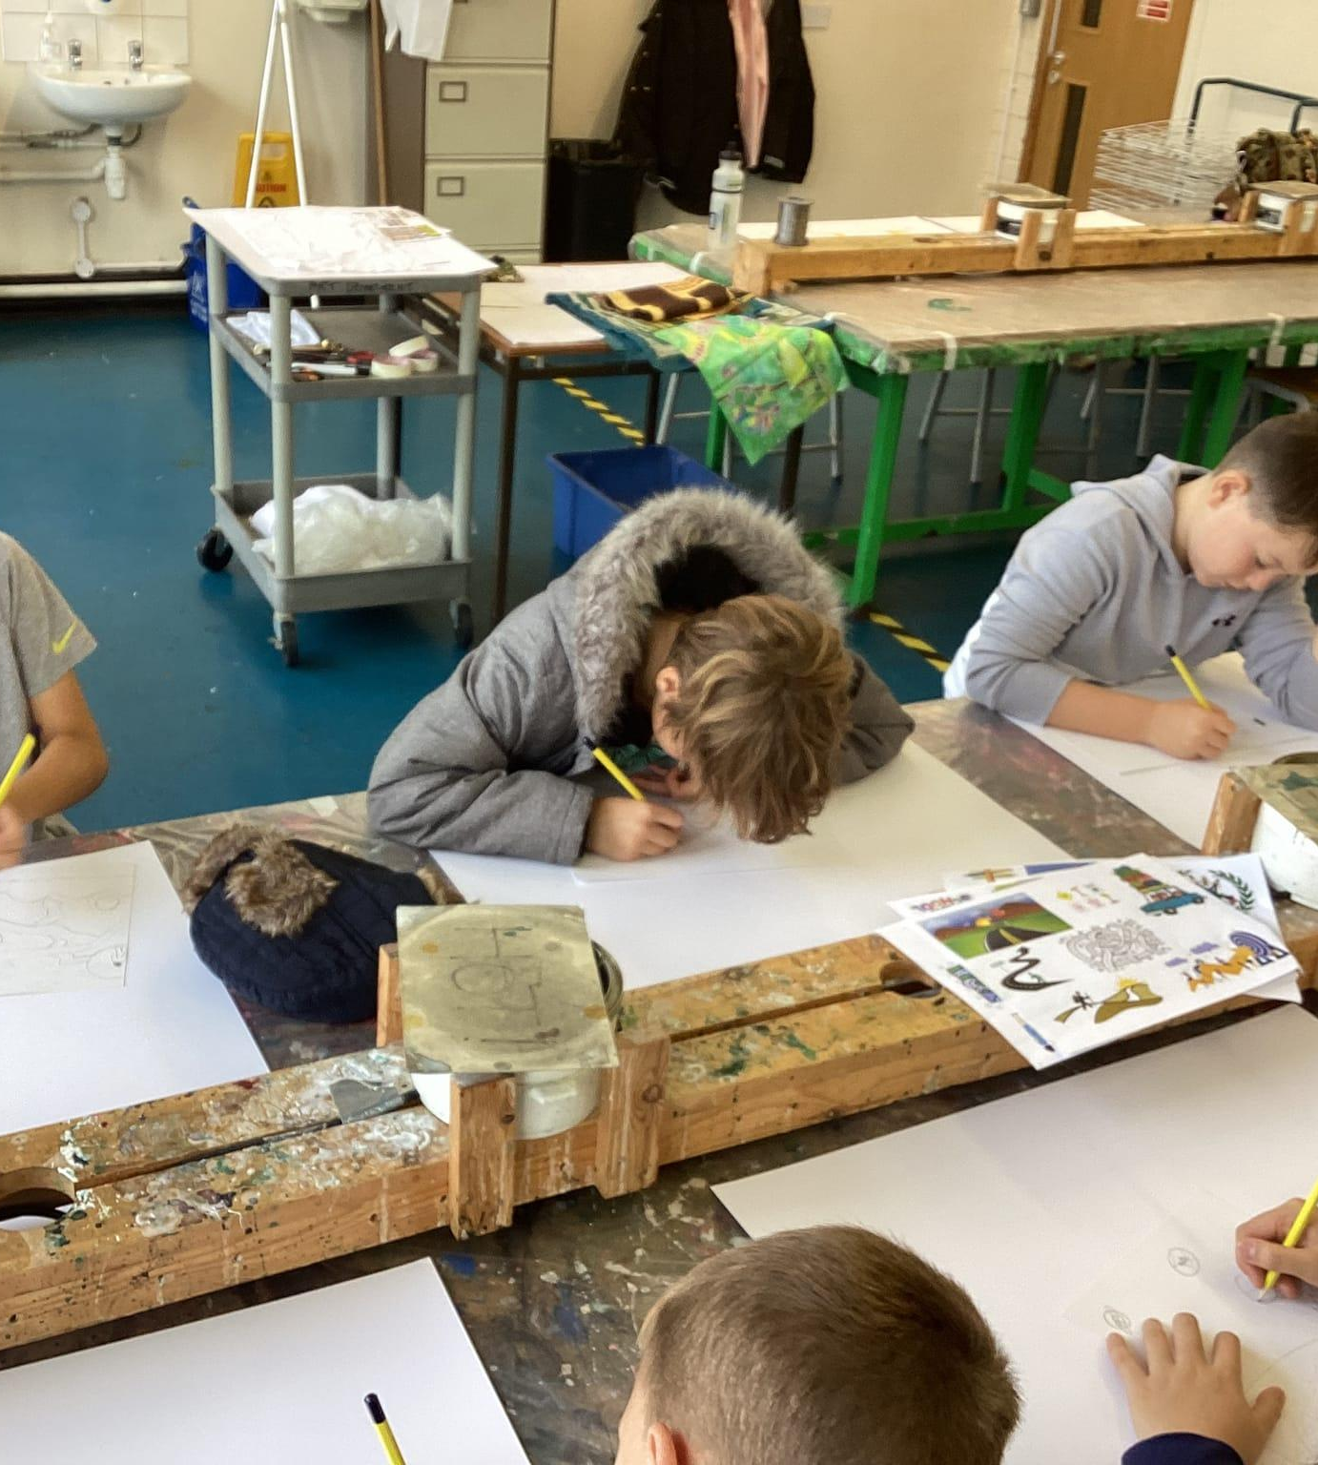
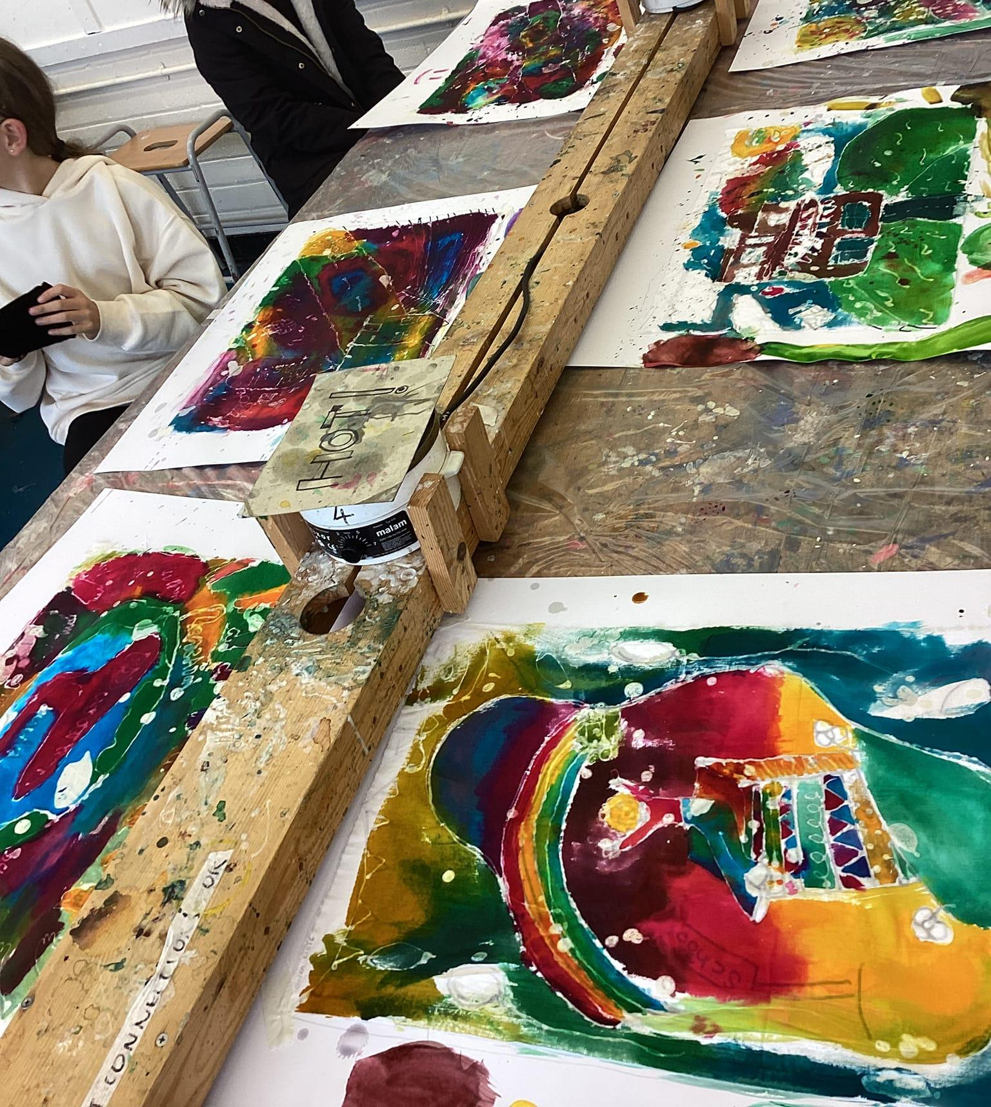
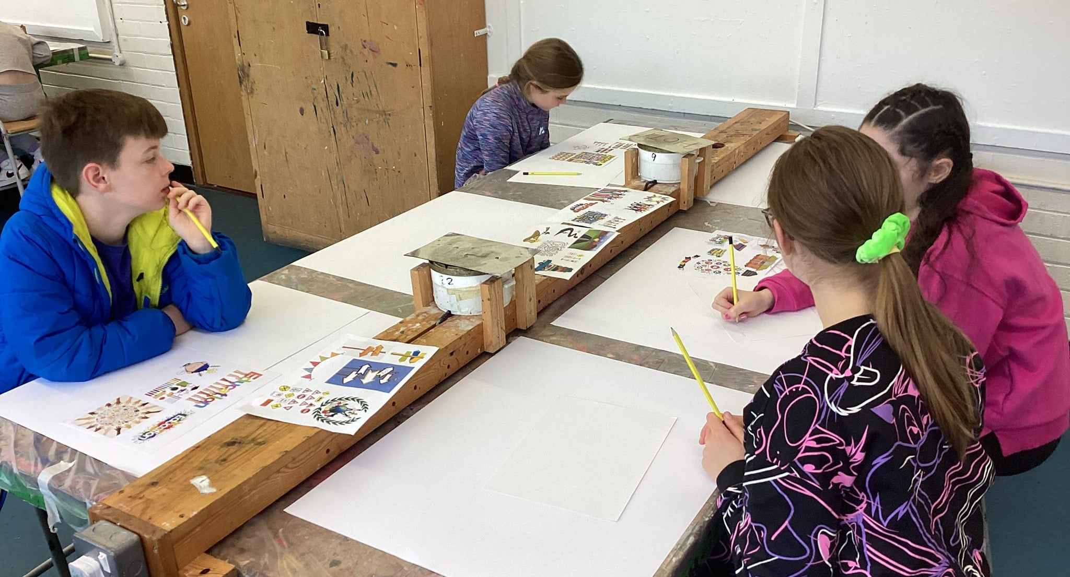
Art
Children will have a range of art activities to choose from:
Batik(a technique of wax-resist dyeing applied to the whole cloth) , Mosaics, Oils, Watercolours, Pencil / Pastel, Recycled Materials
3D & Sculpture

Slide 10
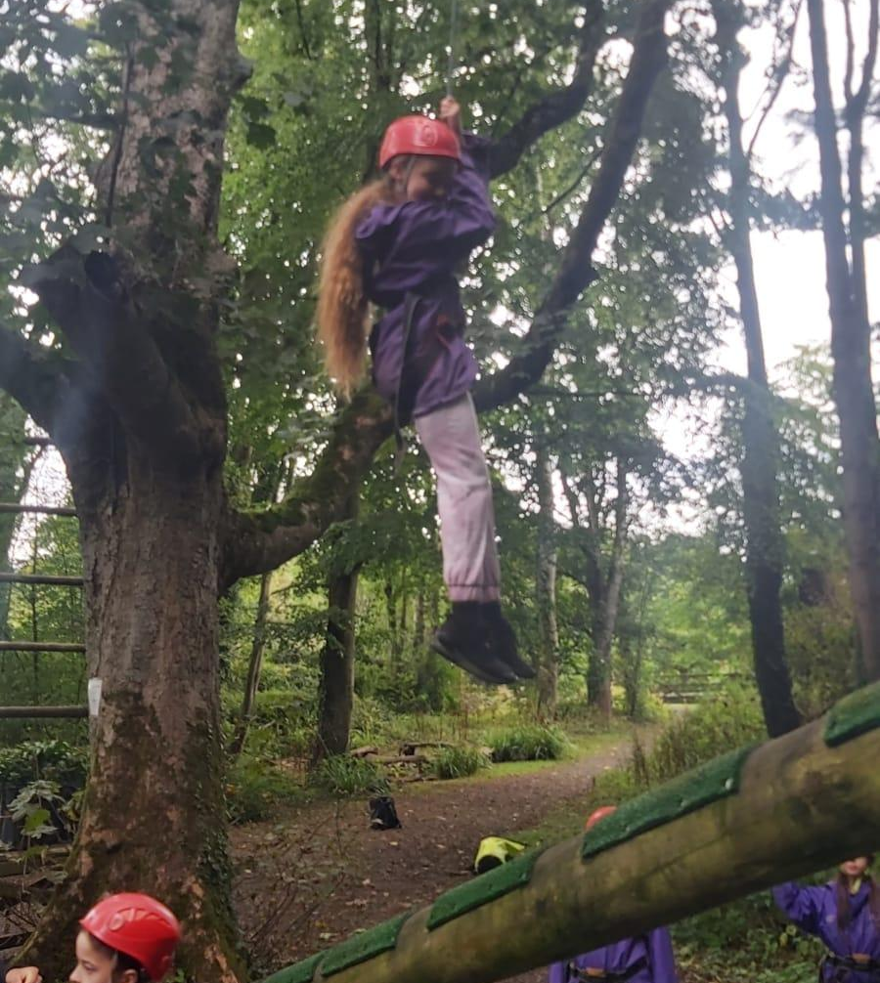
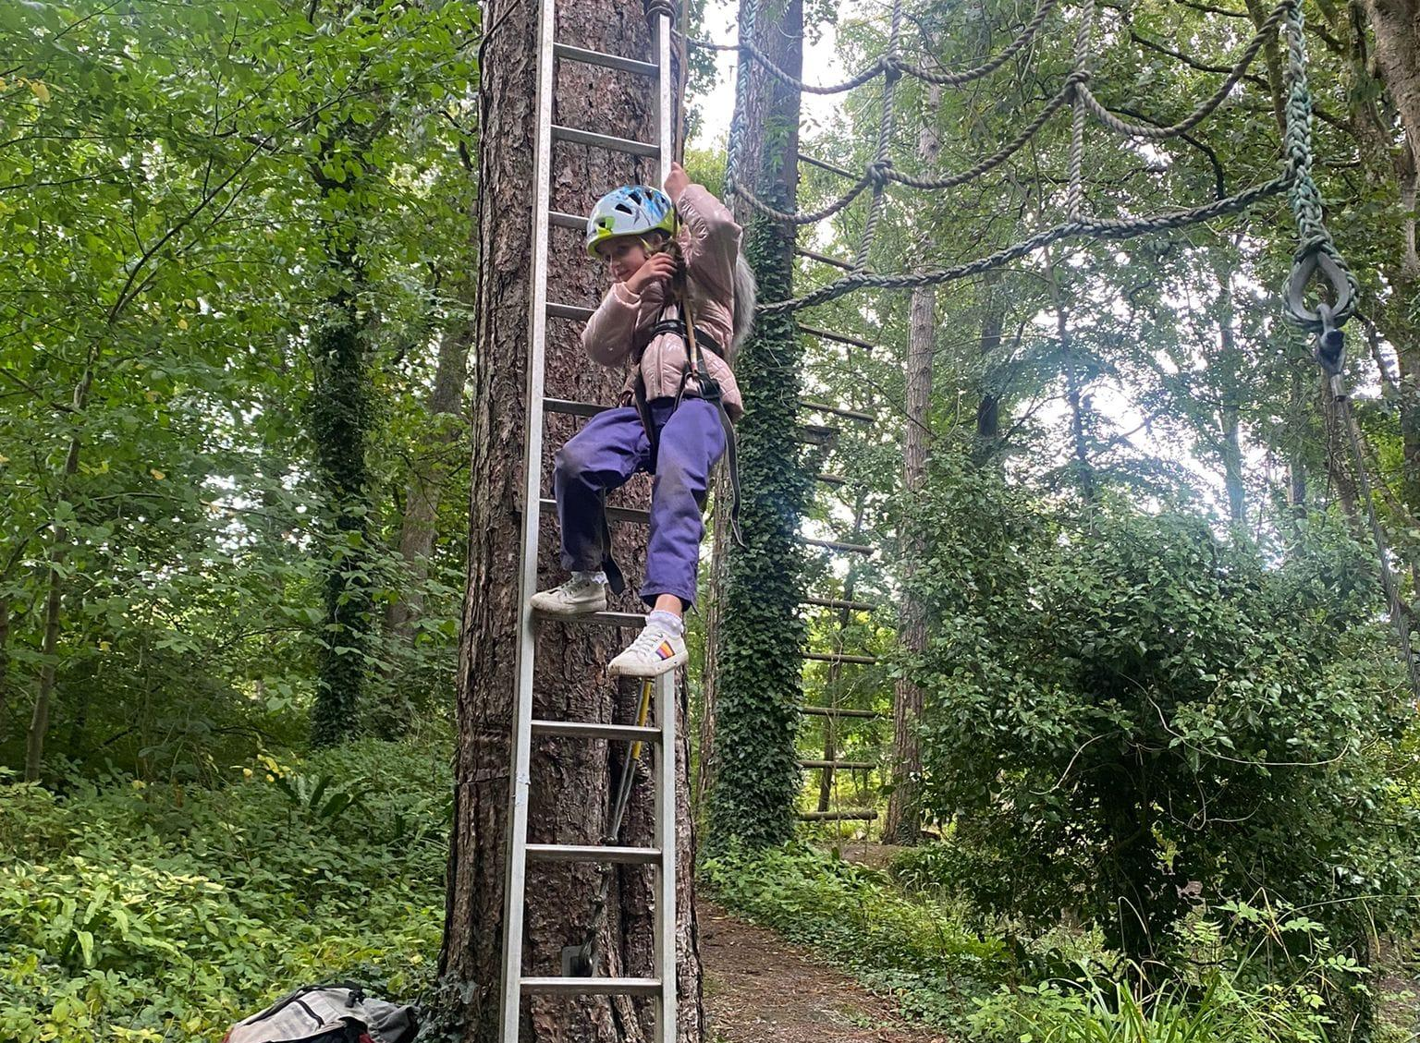
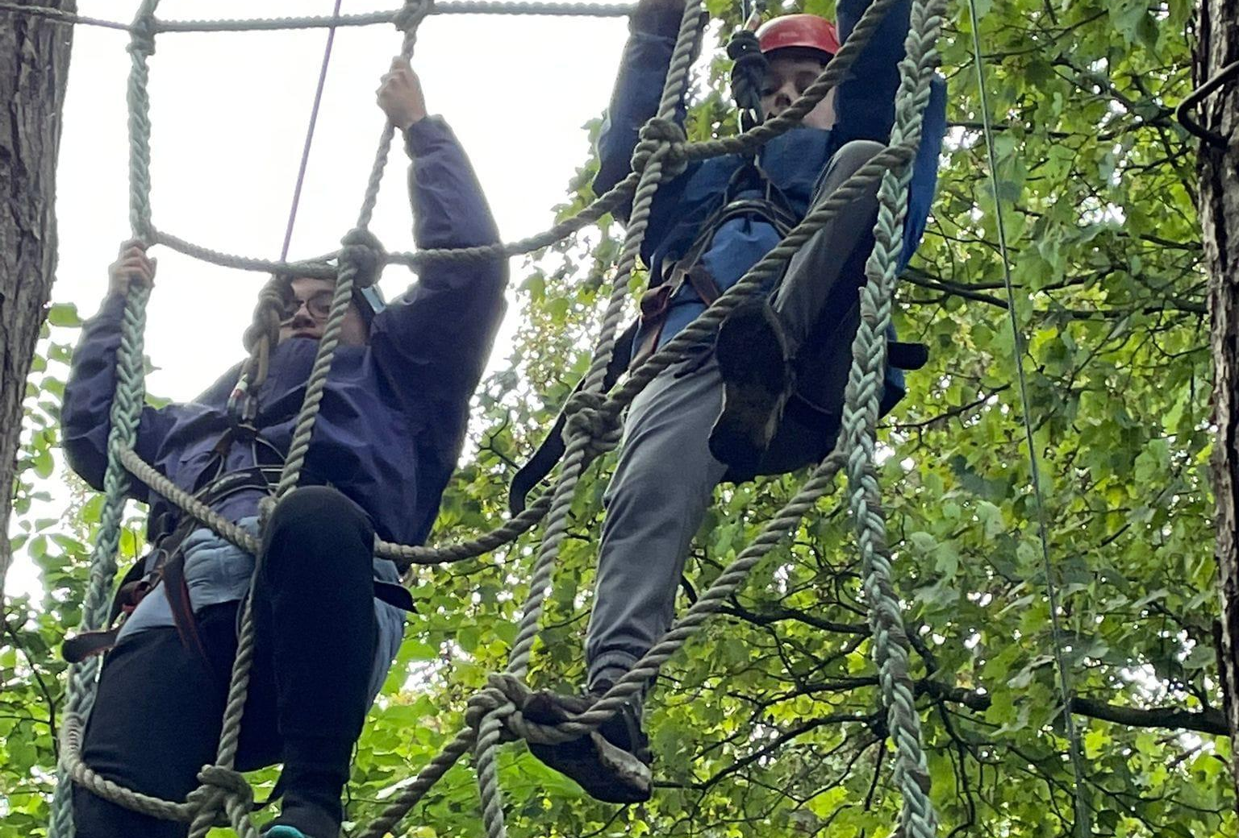
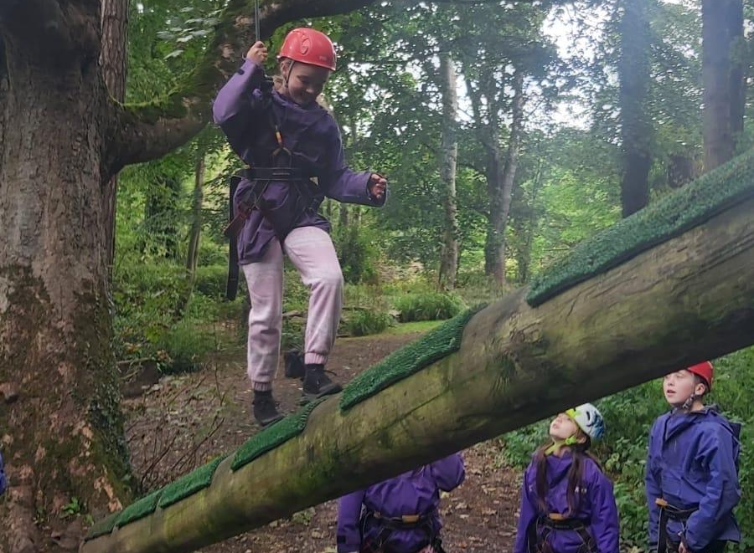
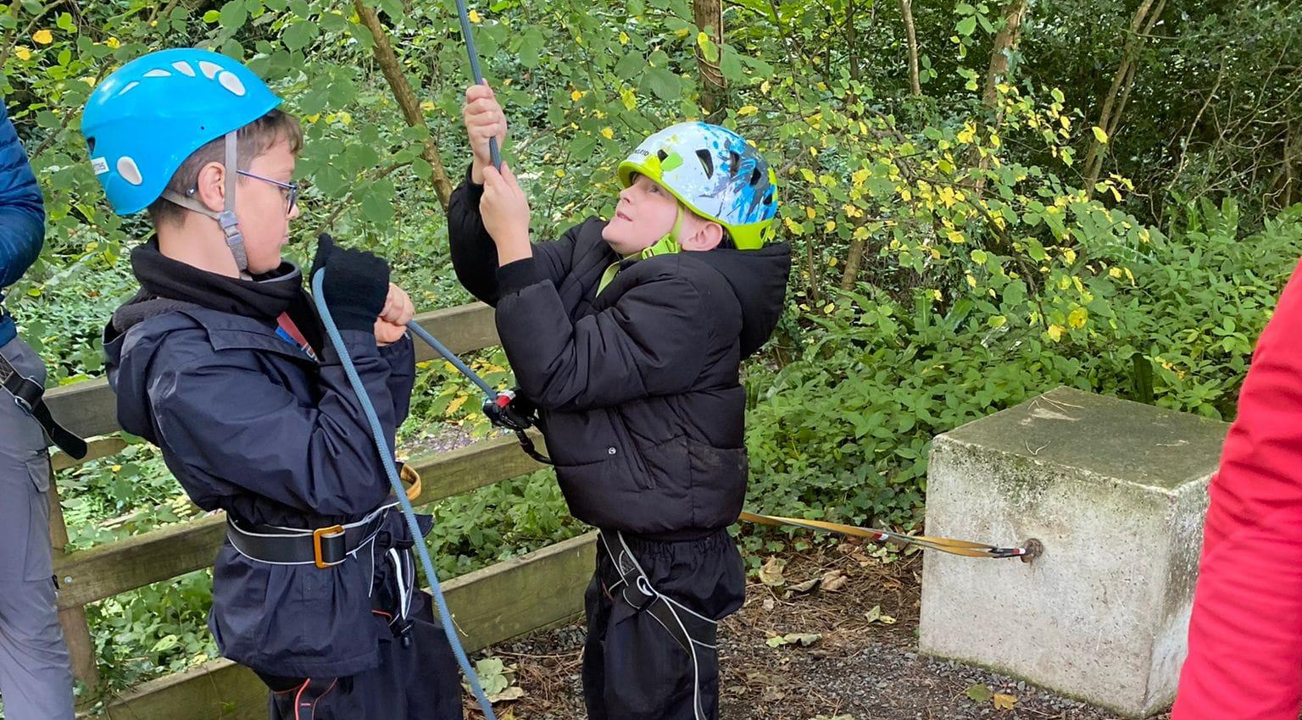
High Level Ropes
Pupils are encouraged to embrace the heights of the trees and climb up to challenge their perception of risk and self-confidence. Climbing ropes are used for safety and pupils have to trust their peers as they control the rope and keep the climber safe. There are a range of progressive elements in the high ropes that can offer different challenges and heights dependent on the individual's aims. A huge amount of determination and courage are needed, along with support from fellow team mates in order to achieve.

Slide 11
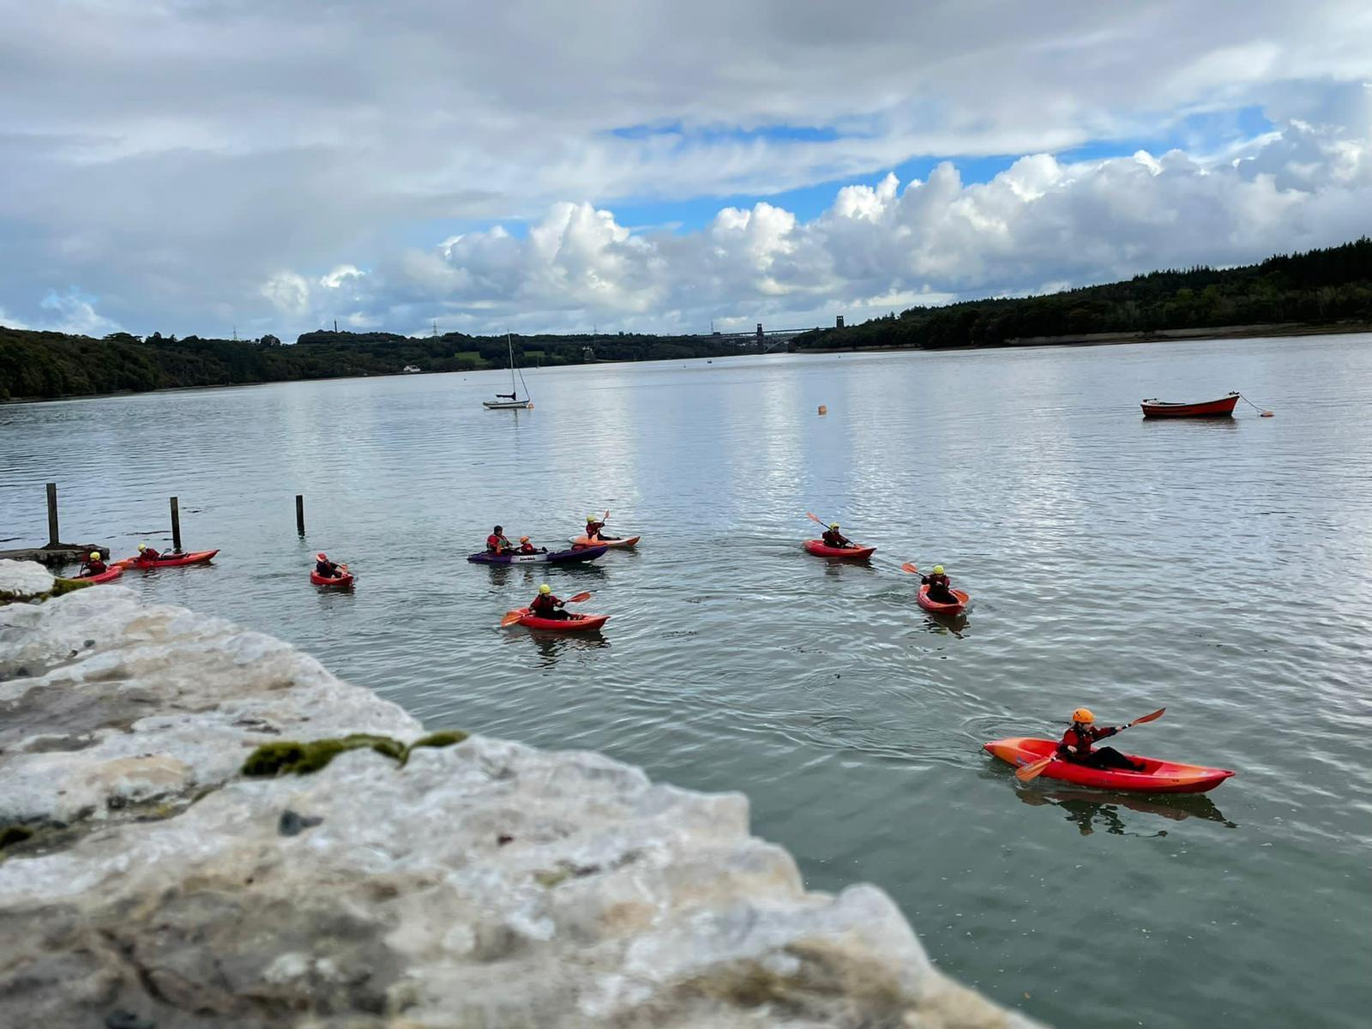
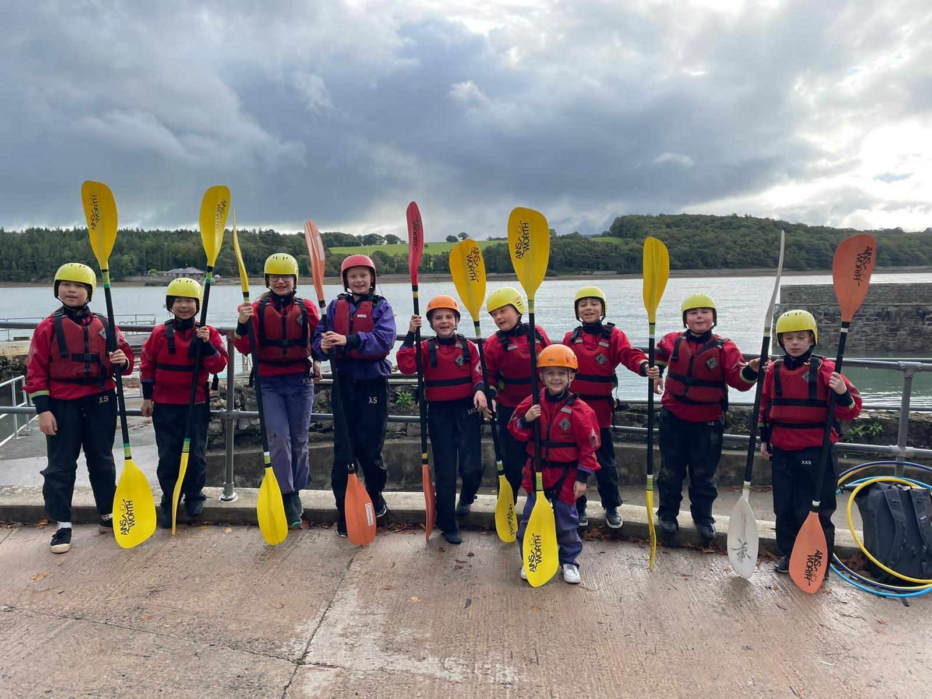
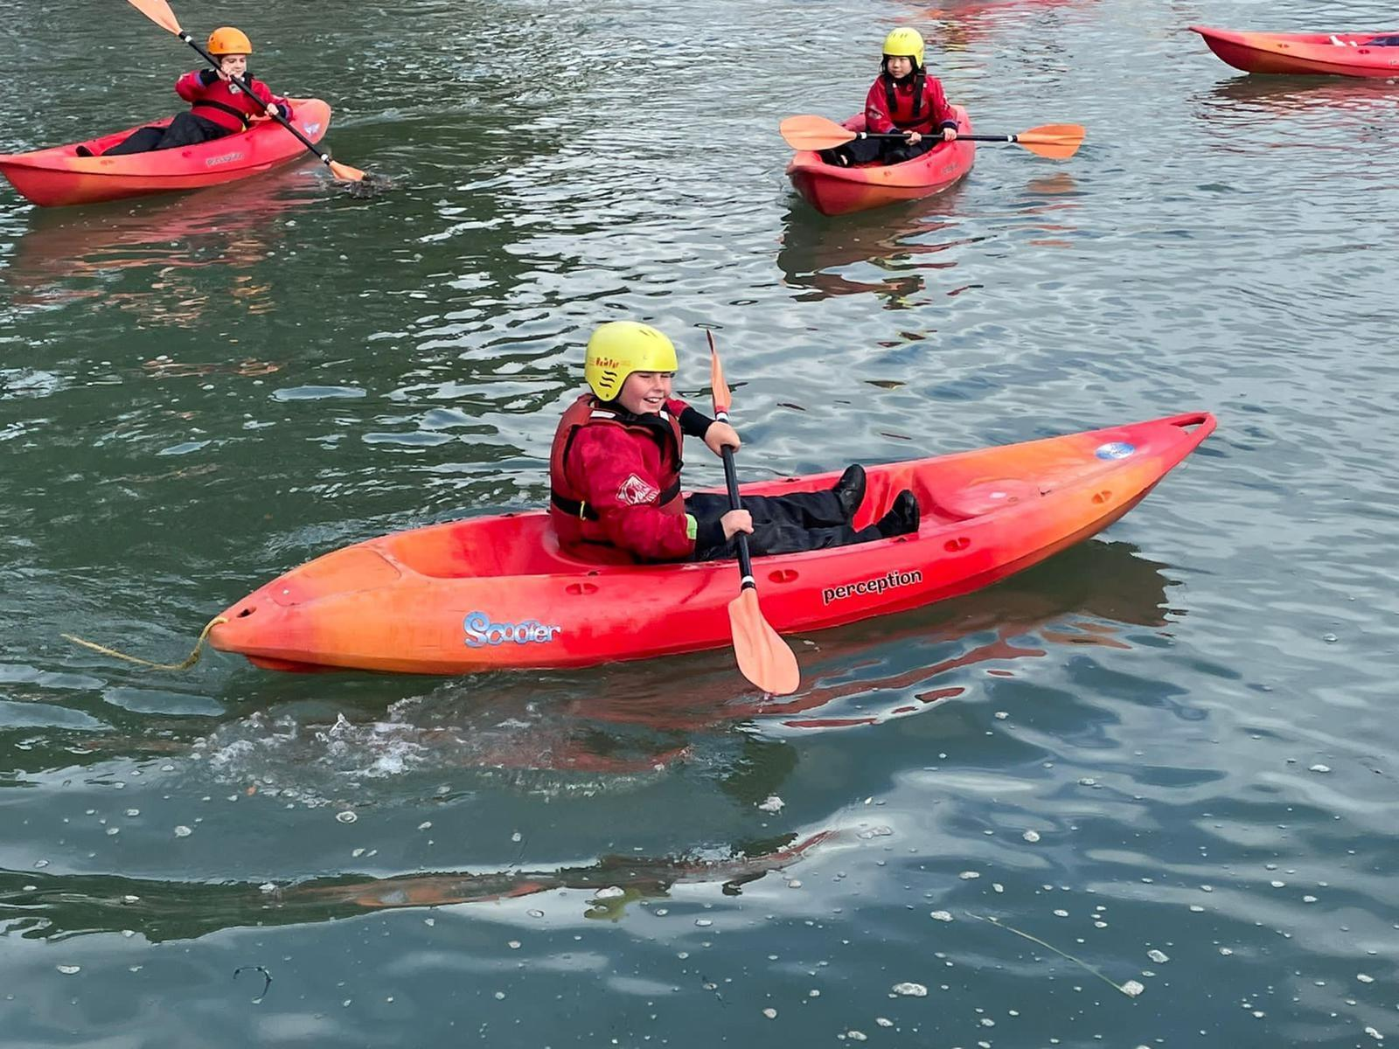
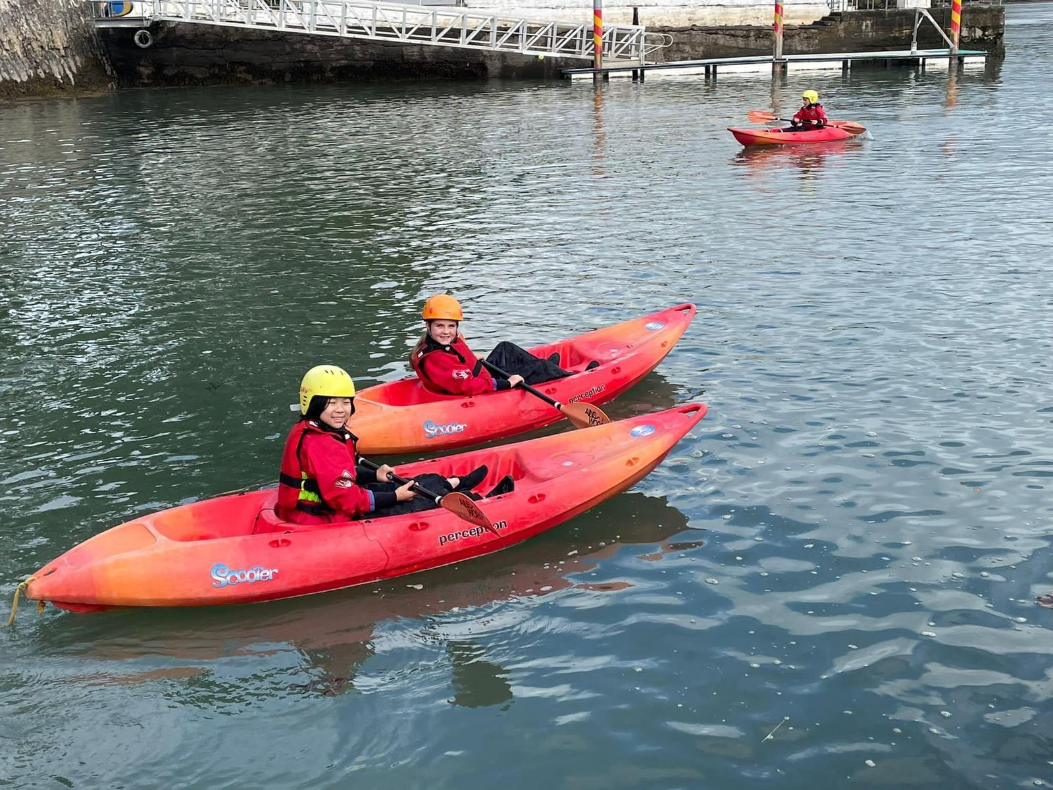
Kayaking
As an independent activity you sit inside your own kayak and use a paddle with two blades to power you along. However, there is an element of team cohesion needed as you stay as one group and help each other to develop the skills and confidence required!

Slide 12
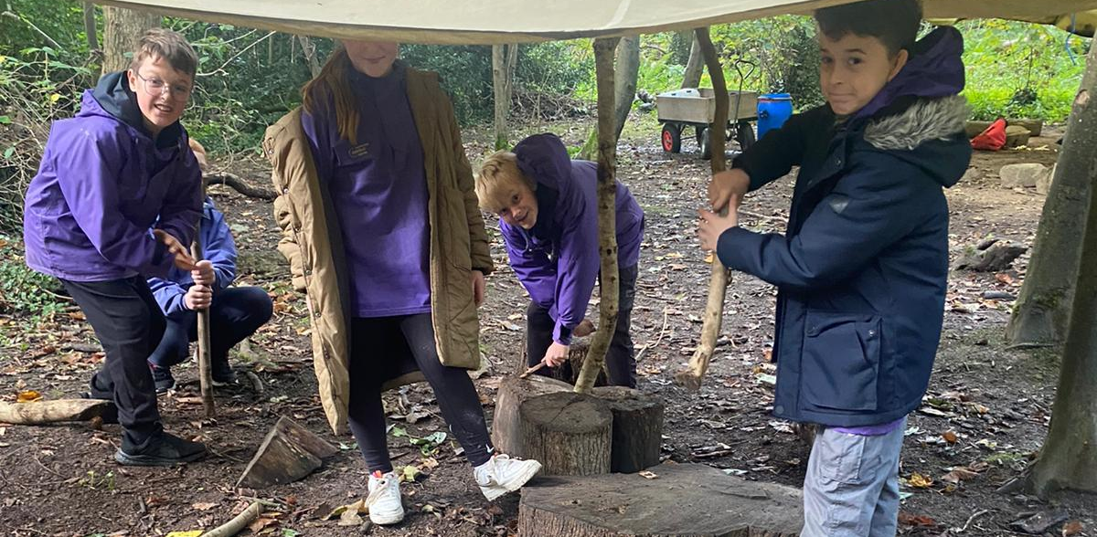
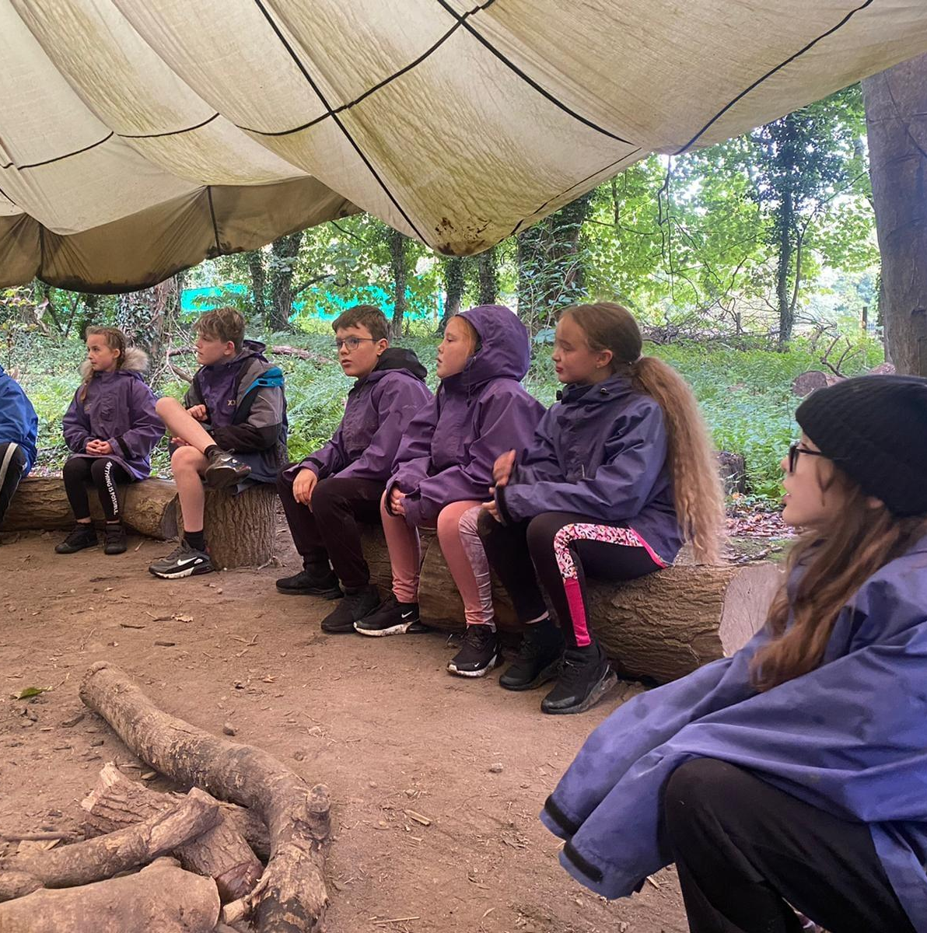
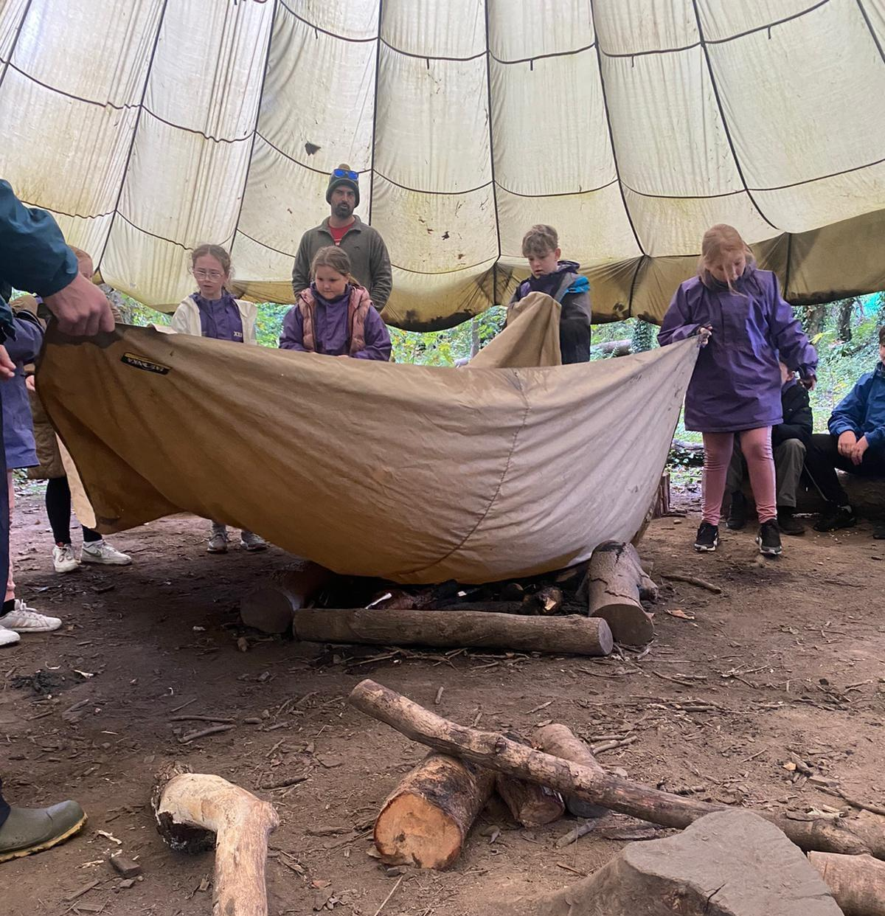
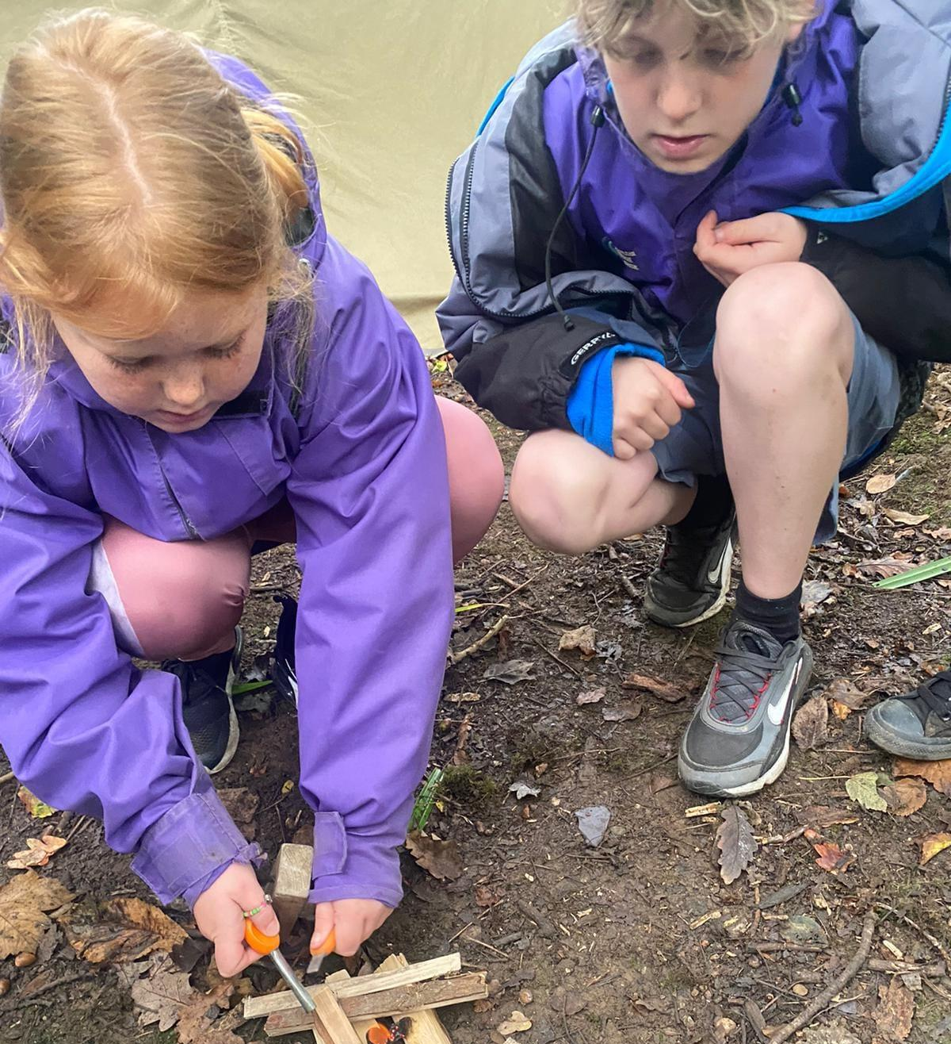
Woodland Survival
Woodland survival is about preparing yourself for adventure in the natural environment. We build on skills to help you navigate, find natural resources and learn how to look after the environment we live in sustainability.

Slide 13
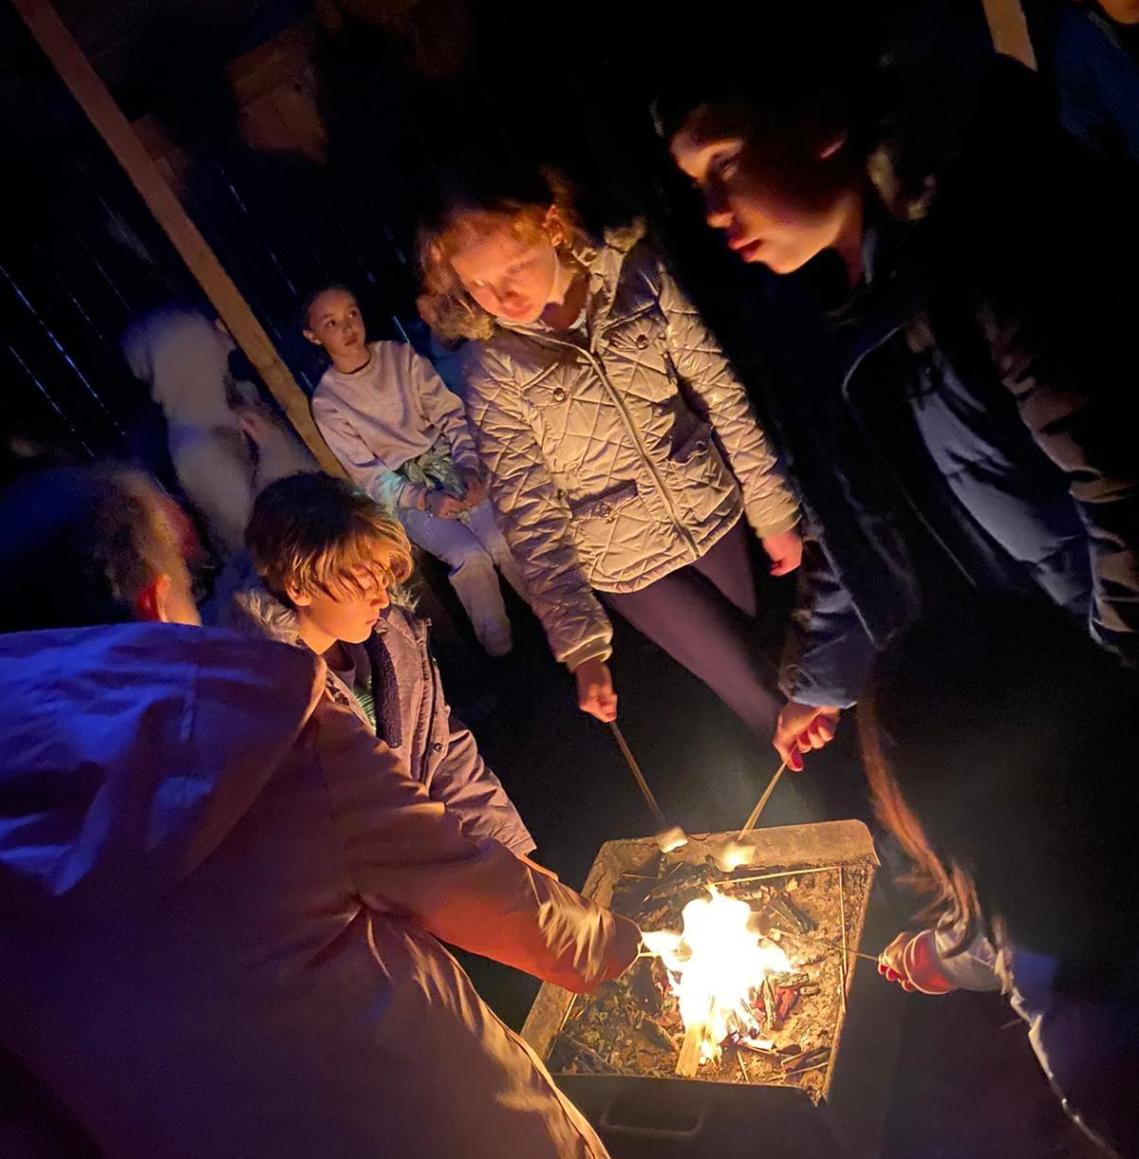
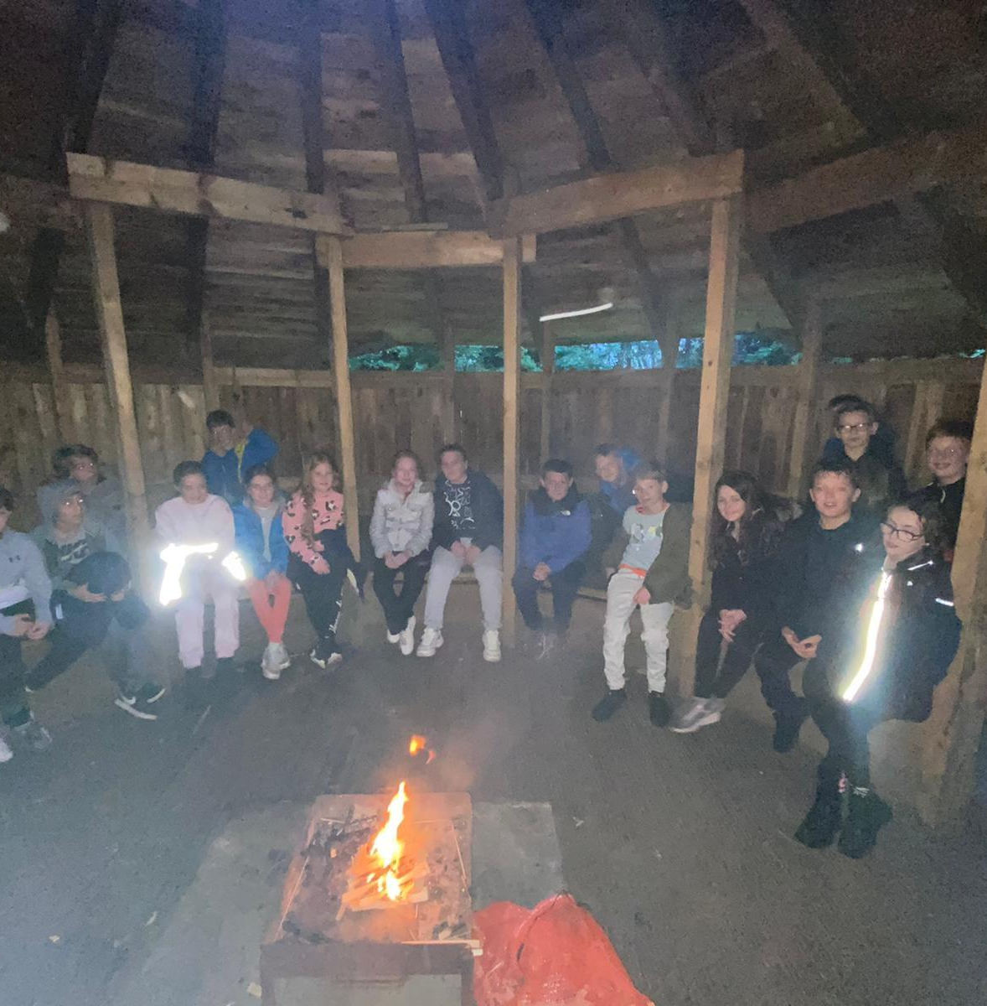
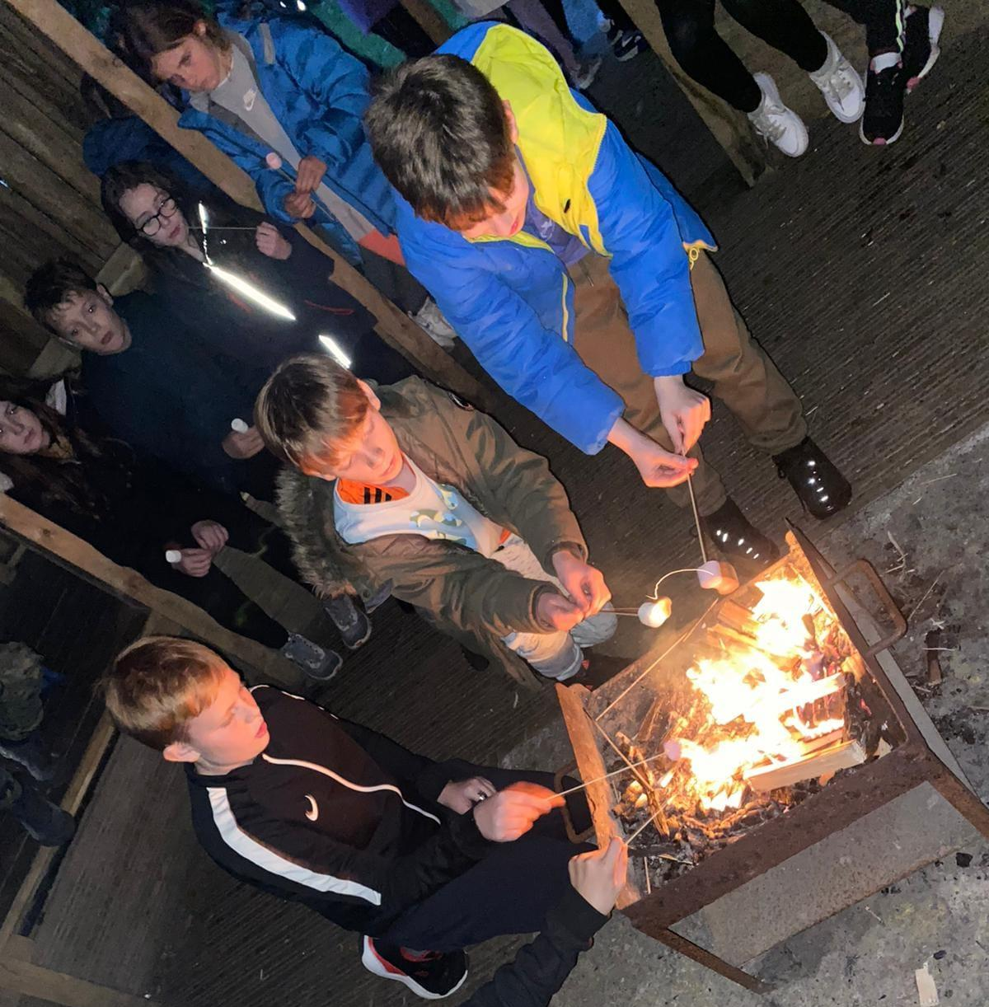
Evening Campfire

Slide 14
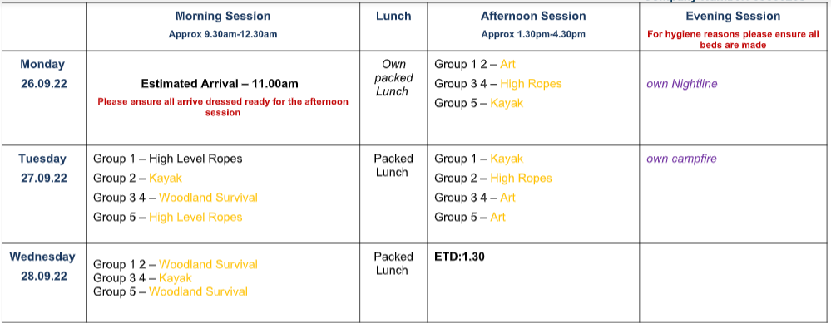
Disco
Campfire
We will arrive back to school within school hours.
Please collect your child at the regular time.
There will be around 10-12 children in each group.

Slide 15
Any Questions?
If you have any further question please do not hesitate to contact the school office.

