Slide 1

Transition Lesson 2
Organisation

Slide 2
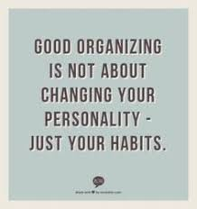
Why is organisation important?

Slide 3
Lottie’s Story - Part One
Lottie has woken up on a Thursday morning; she has started getting ready for school.
During the day she needs to post her grandma’s birthday card, empty the dishwasher, buy some milk and walk the dog.
These all need to be finished by the end of the day!

Slide 4
Task One: To-do Lists
Lottie has lots of things to do! One thing we can do to help us remember is make ourselves a to-do list.
What does Lottie need to put on her to-do list?
Notes:
Write on to to-do list sheet.

Slide 5
Lottie’s Story - Part Two
On her way to school, Lottie starts thinking about the day ahead of her. She has lots of different lessons: Double Science, English and History. Probably not in that order though.
She felt quite happy, because History & English were her favourite subjects.

Slide 6
Task Two: The Timetable.
So she can remember the order of her lessons, Lottie has a timetable. You will have a similar timetable. Have a look at the timetable and discuss it. Can you complete the rest of it for her, so she knows what she is doing today?

Slide 7
Lottie’s Story - Part Three
At school, Lottie is given 3 more pieces of homework. She already has some she hasn’t started at home! She lists them in her planner to look at when she gets home.

Slide 8
Task Three
Lottie’s homework needs to be prioritised so that it is all done in time.
Look at the deadlines and prioritise when she needs to get it completed by.
Which should she do first?

Slide 9
Lottie’s Story - Part Four
Now she’s home, Lottie needs to pack her bag for the next day.
In DT, she is making pizza. And she needs lots of other things too. It looks like quite a lot to sort out and she’s feeling really tired! But she knows she needs to do it now rather than in the morning.

Slide 10
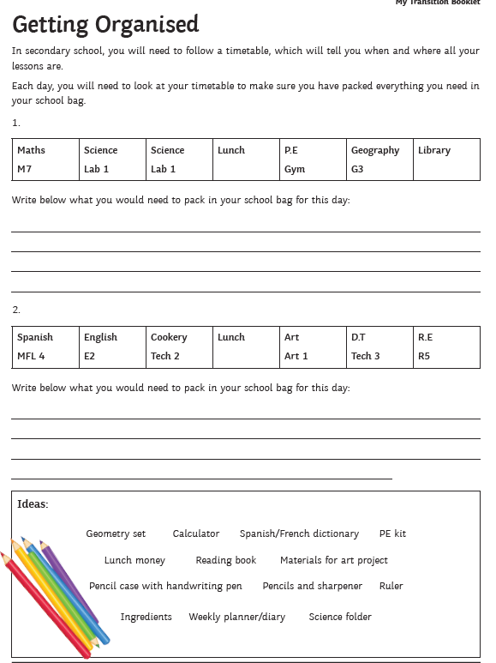
Task Four:

