Slide 1
LG: To identify and create a diagram of a star constellation.

Slide 2
What is a constellation?
A constellation is a group of stars that make an imaginary shape in the night sky.
They are usually named after mythological characters, people, animals and objects.
In different parts of the world, people have made up different shapes out of the same groups of bright stars.
It is like a giant game of connecting the dots.

Slide 3
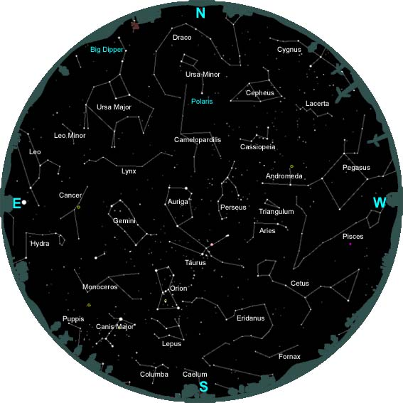

Slide 4
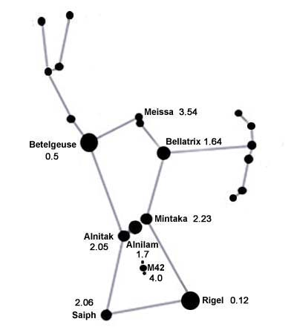
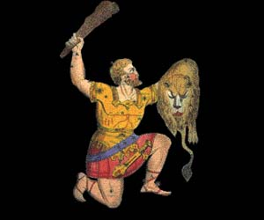
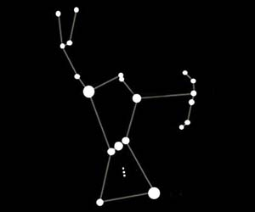
Orion Constellation

Slide 5
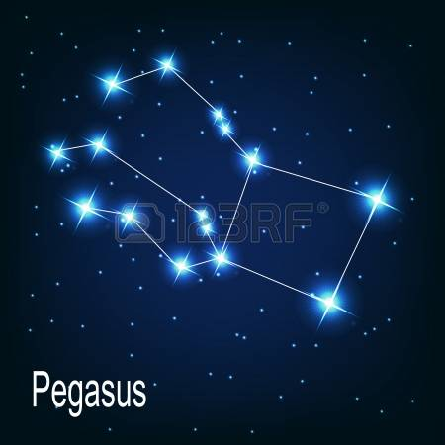
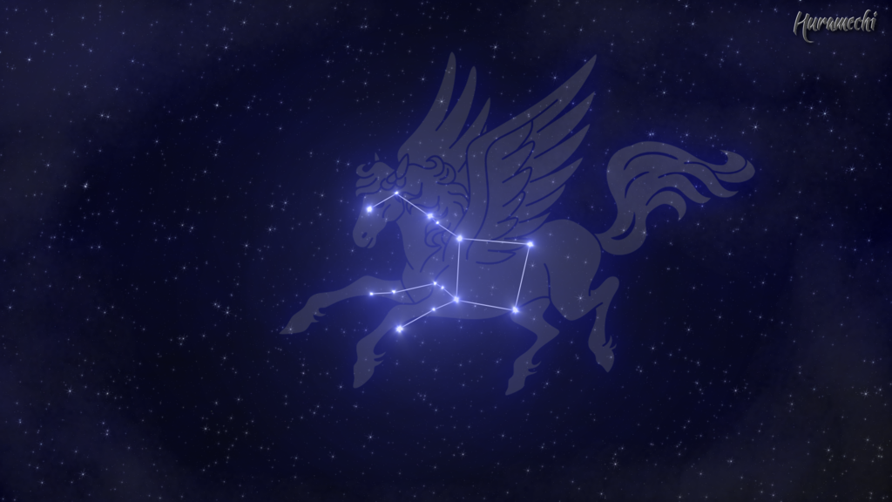
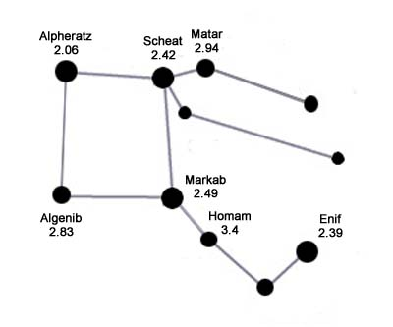
Pegasus Constellation

Slide 6
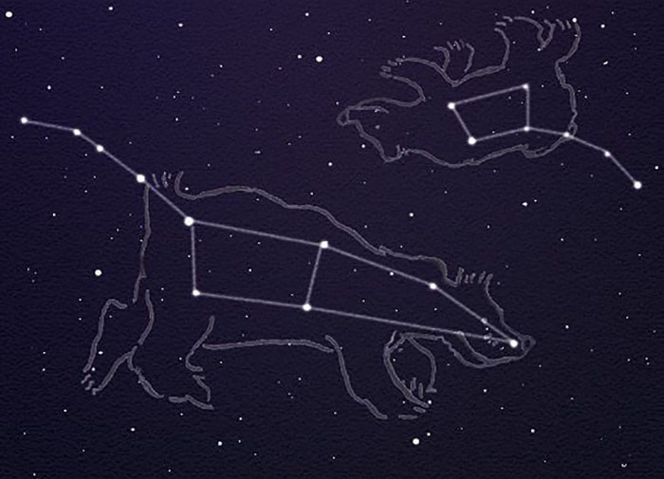
Big Bear and Little Bear

Slide 7
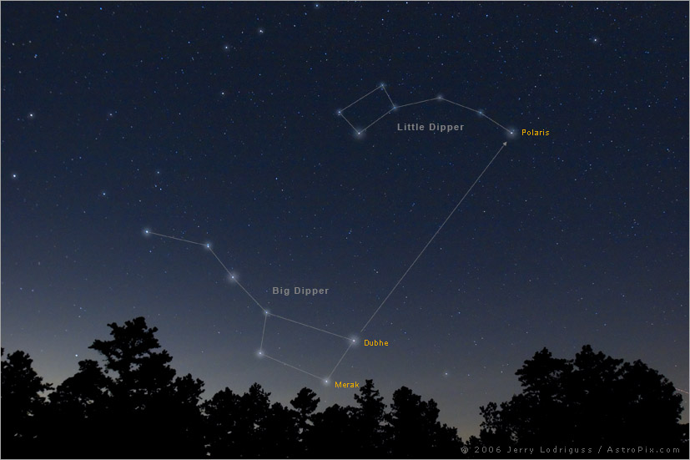
The Plough or Big Dipper

Slide 8
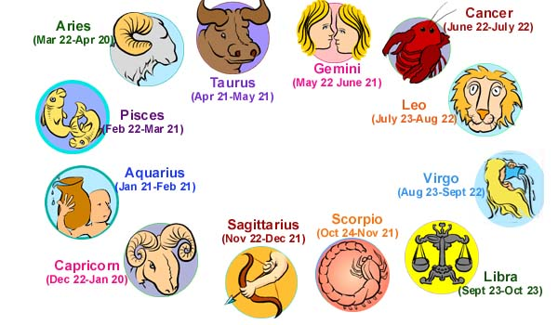
What is your star sign?

Slide 9
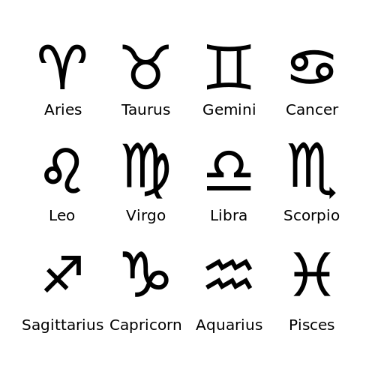
Star Signs

Slide 10
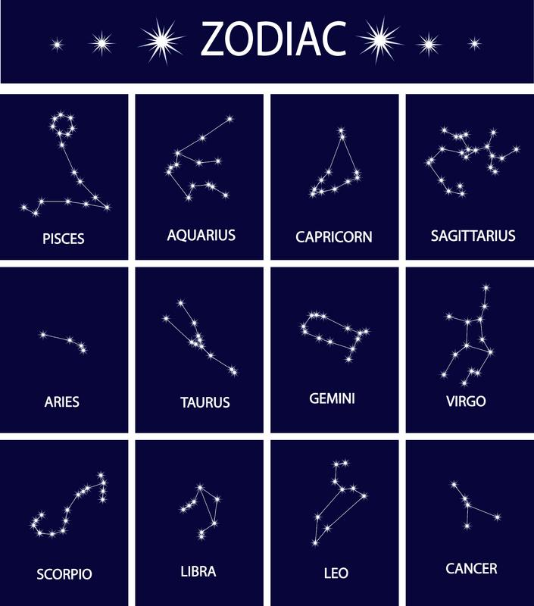

Slide 11
