Slide 1


Slide 2



Slide 3
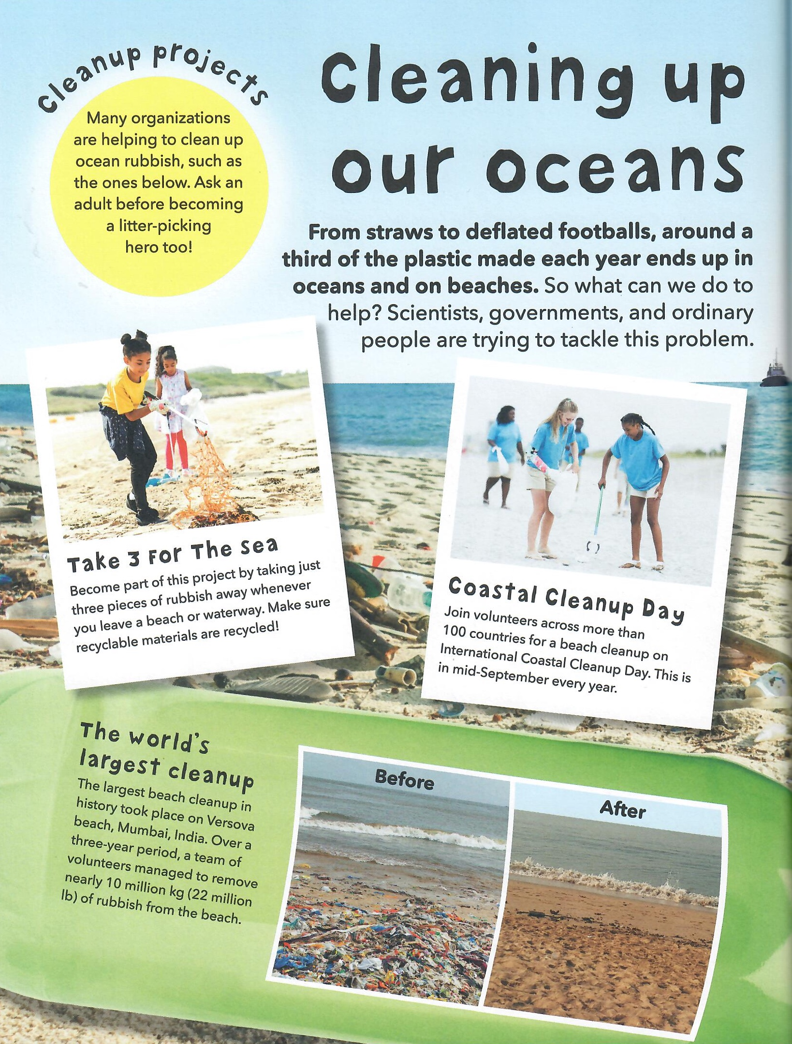
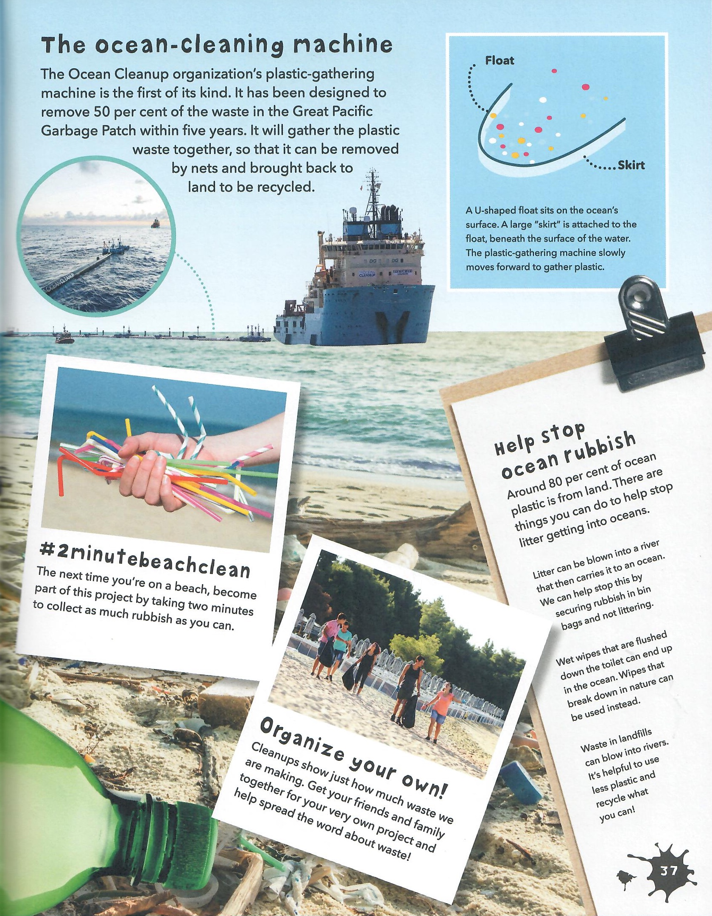

Slide 4
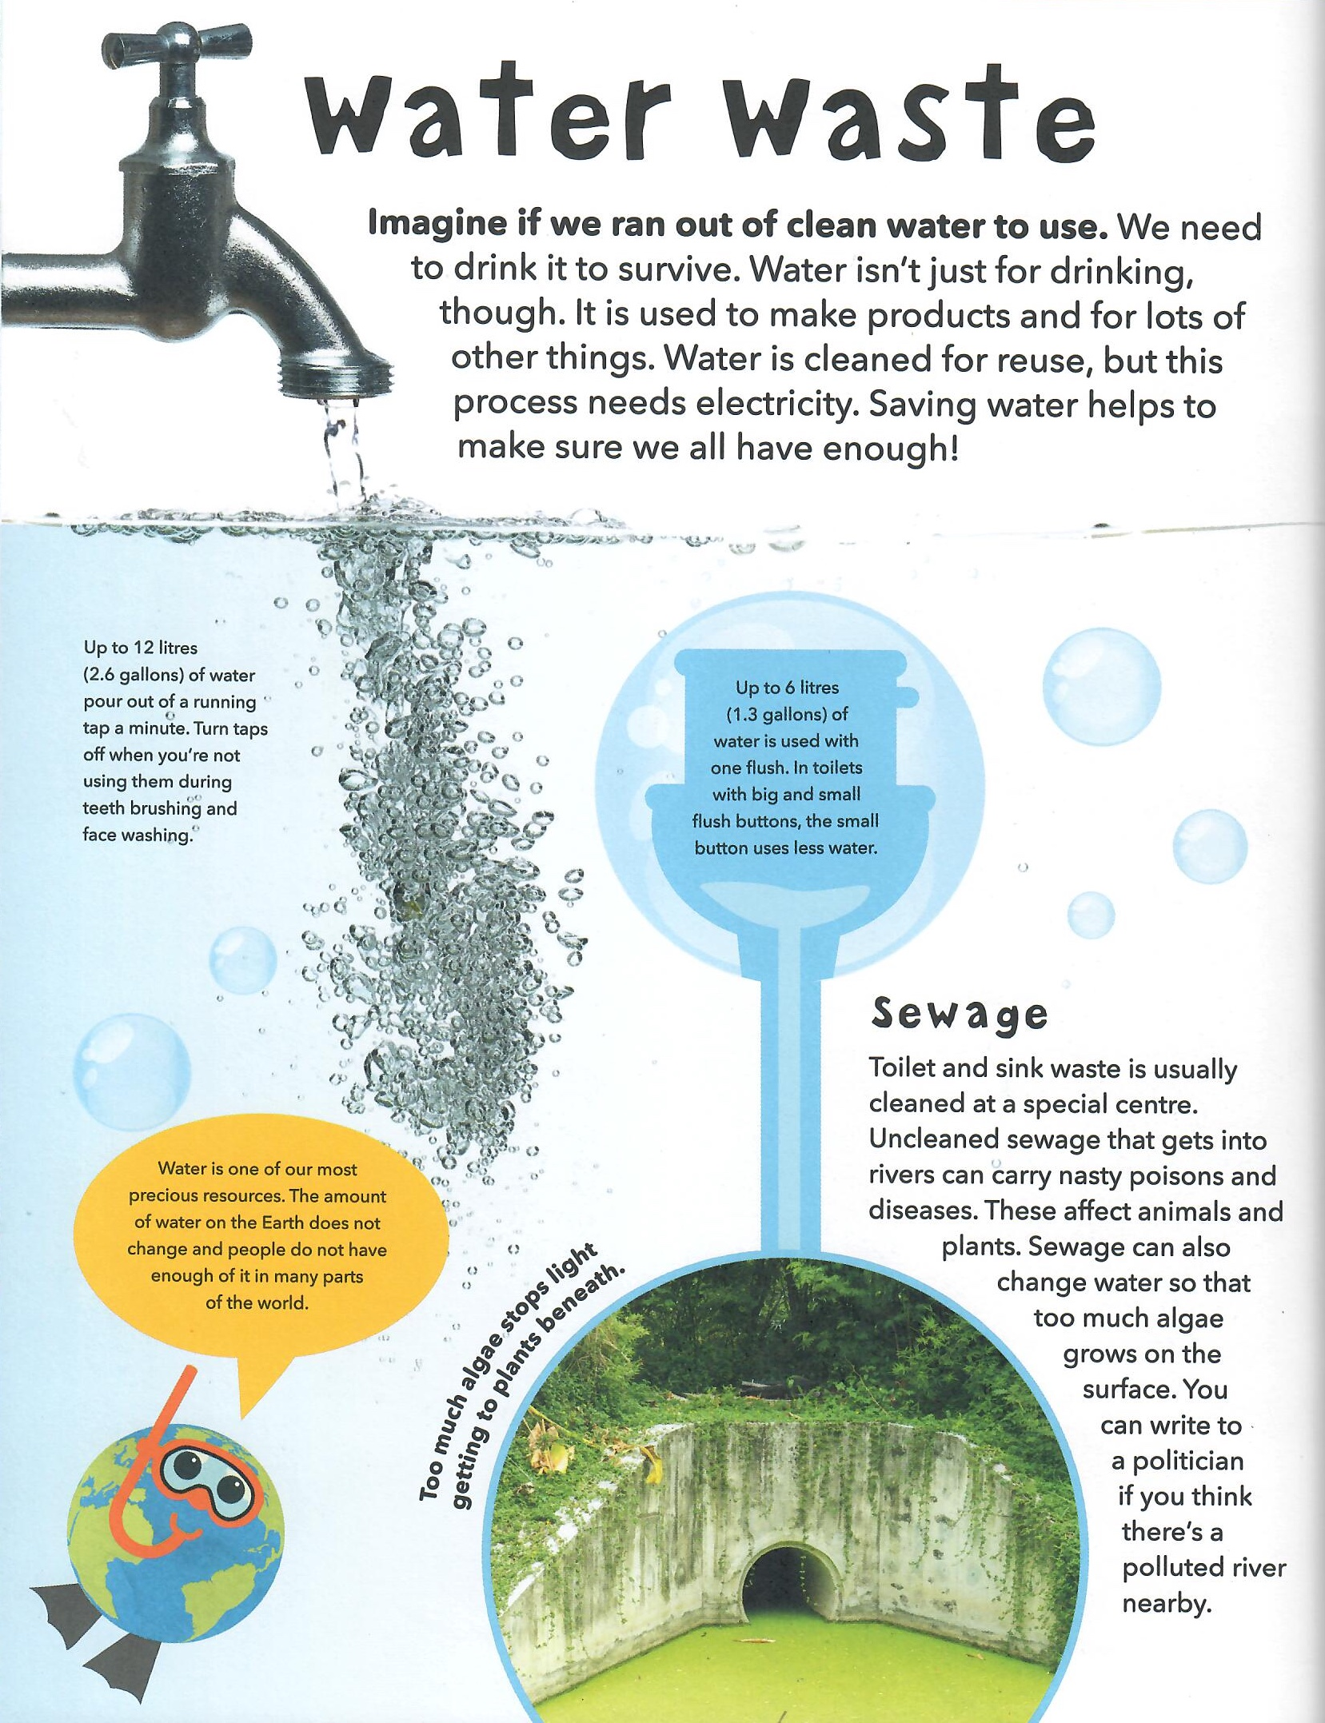
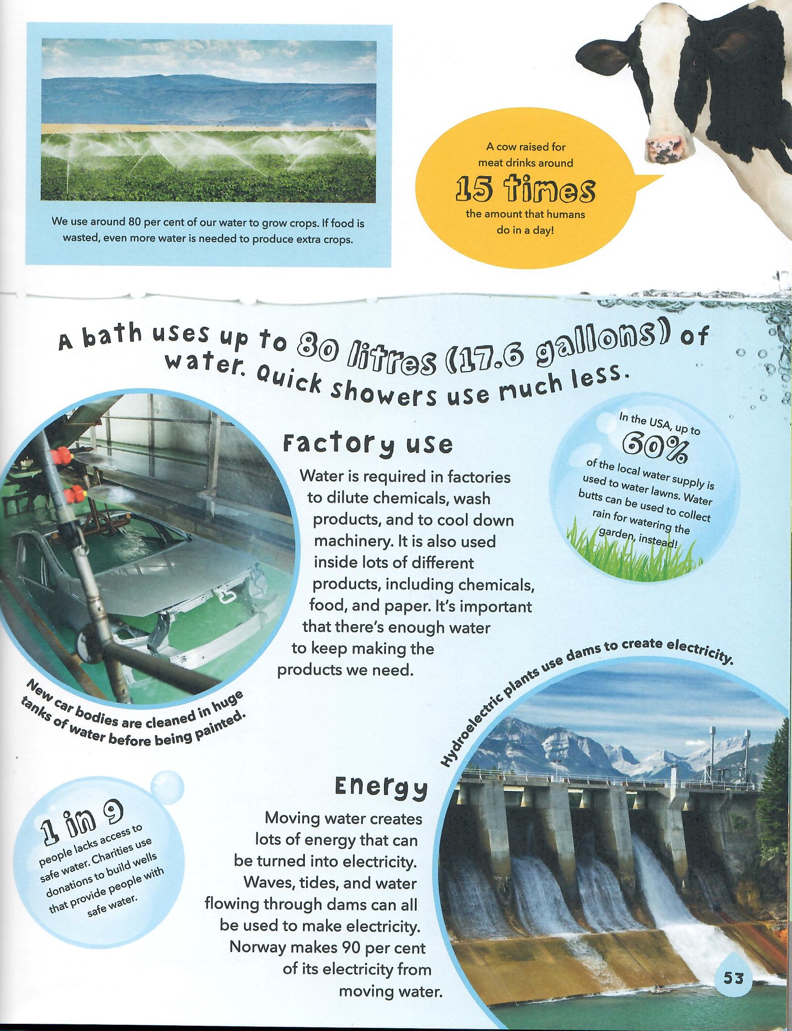

Slide 5
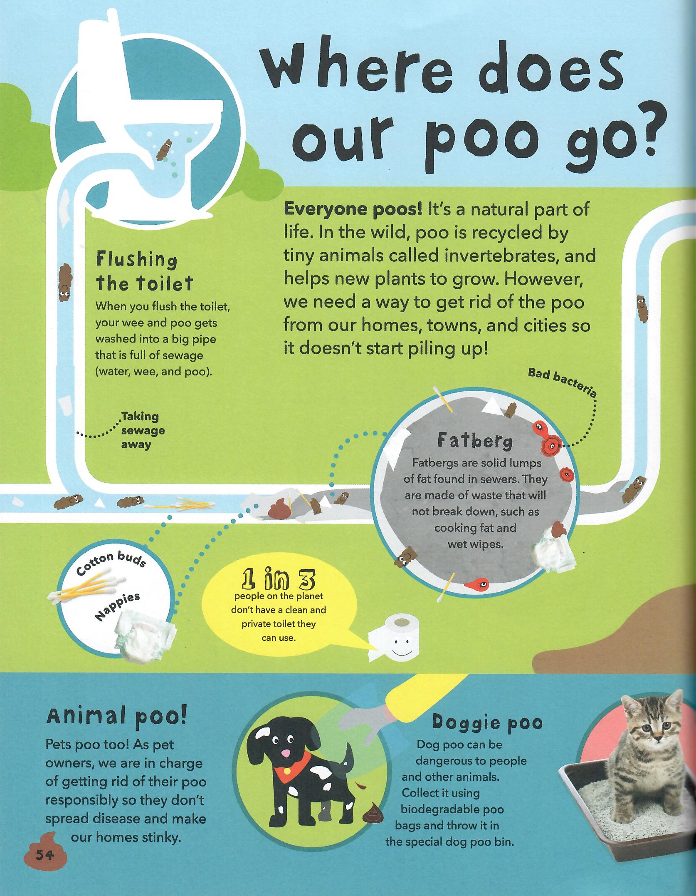
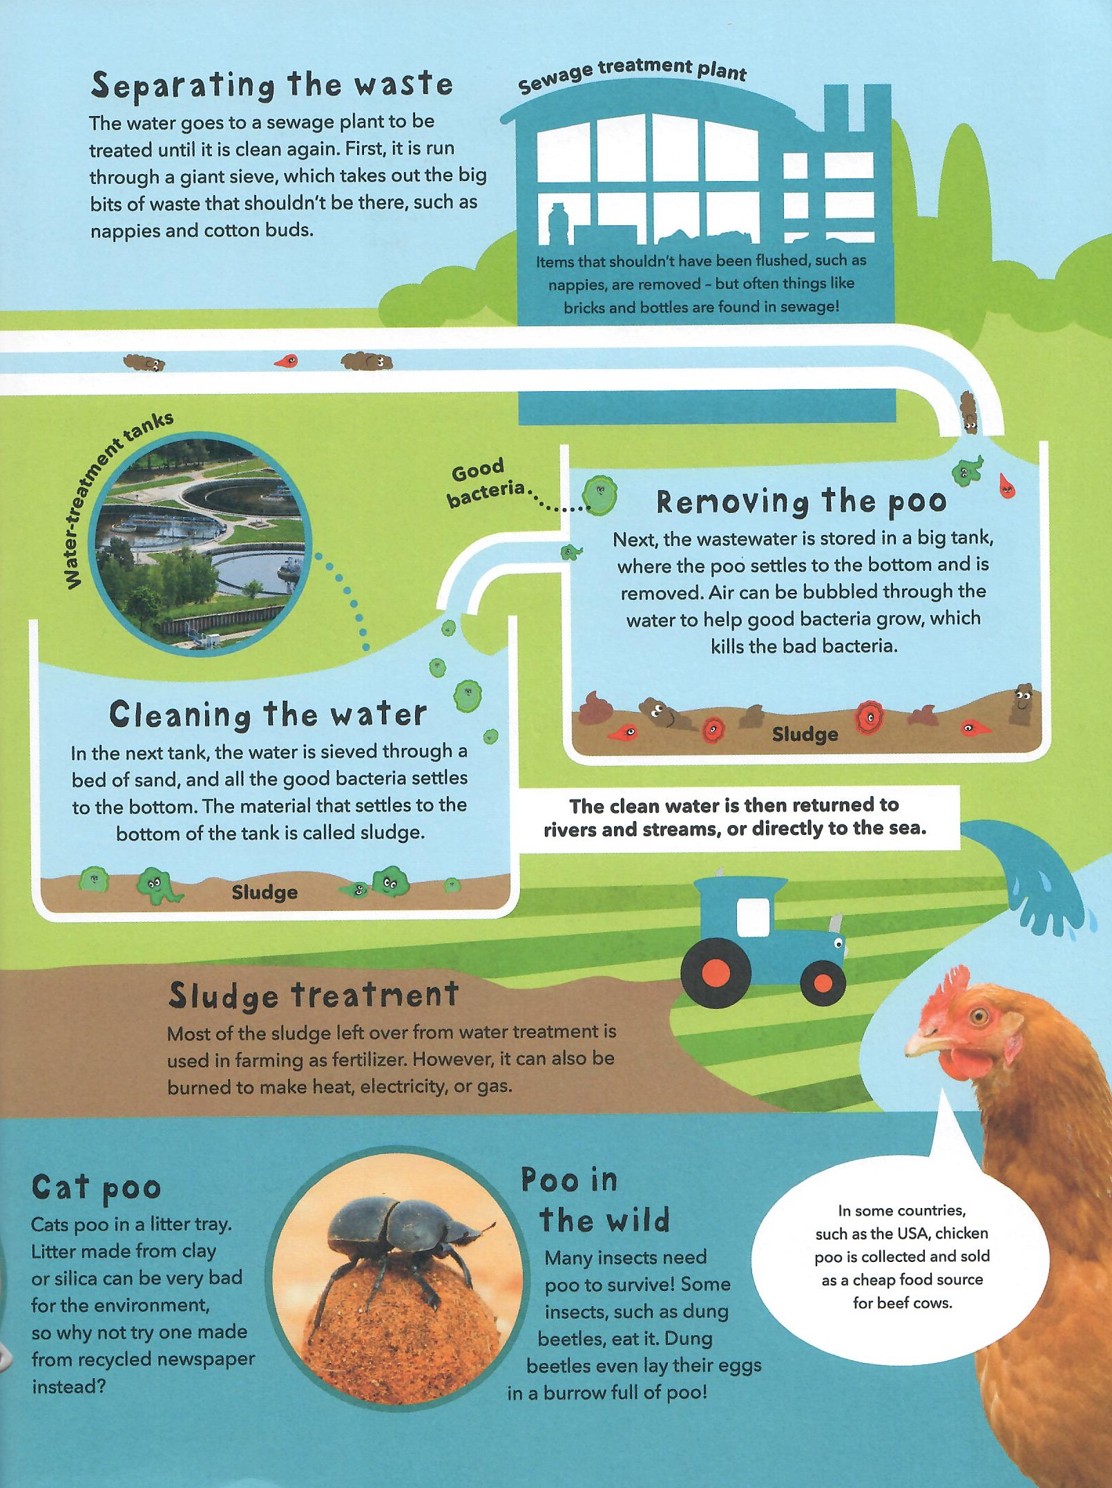

Slide 6
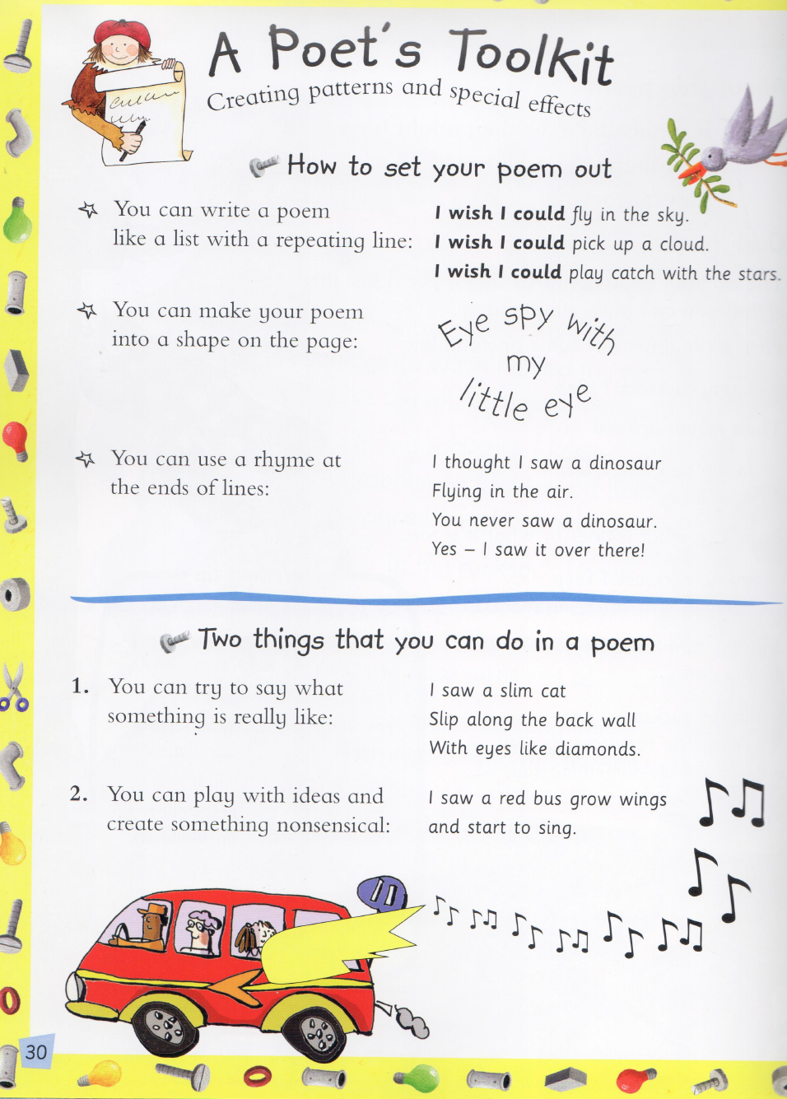
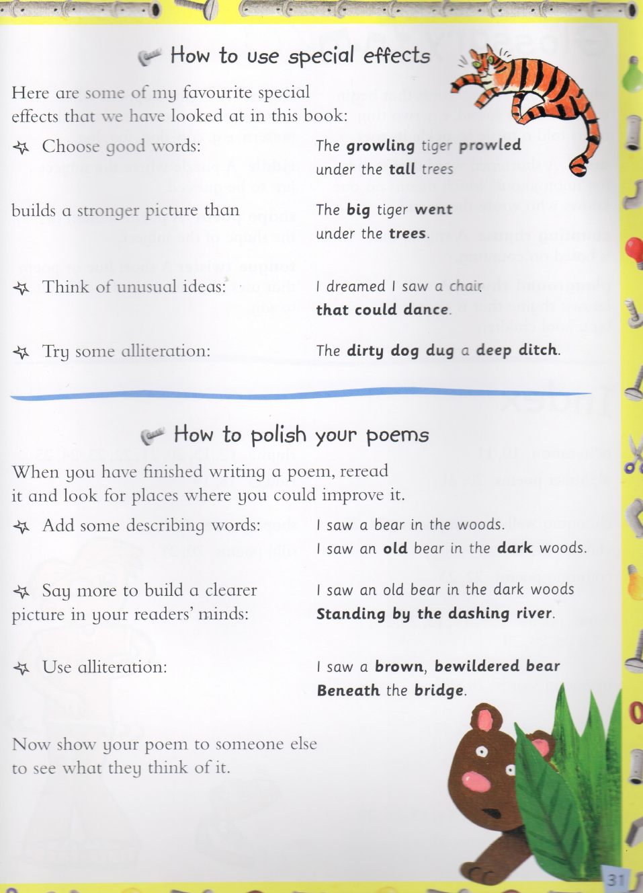

Slide 7
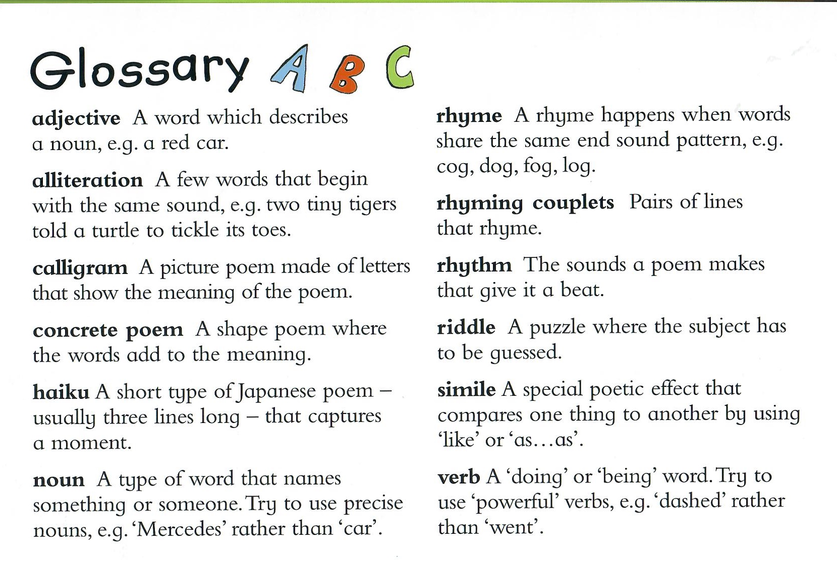

Slide 8
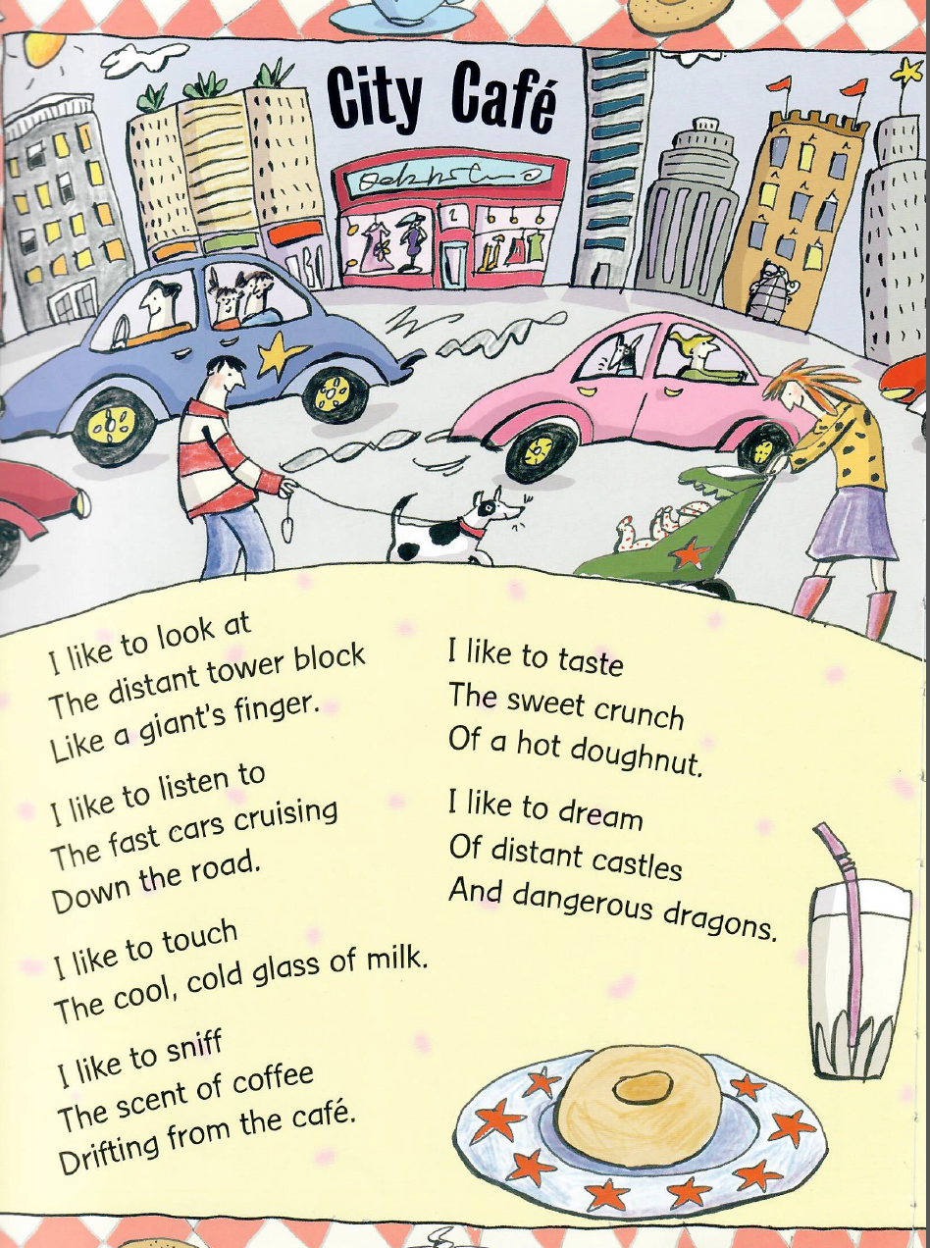
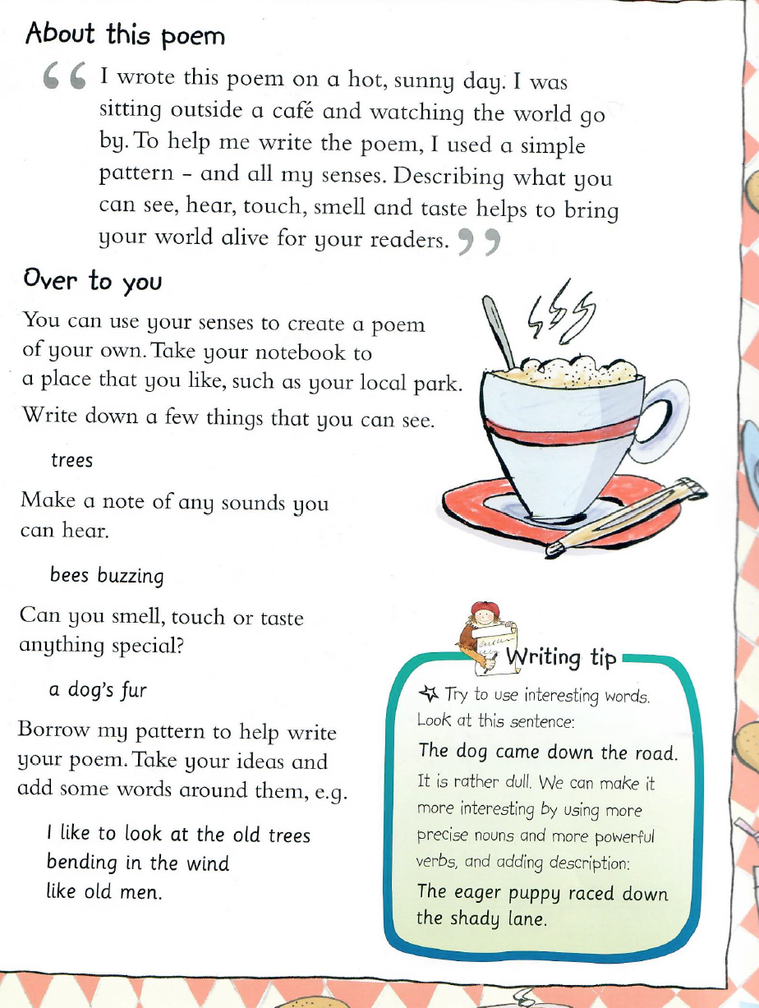
Monday Writing Activity

Slide 9
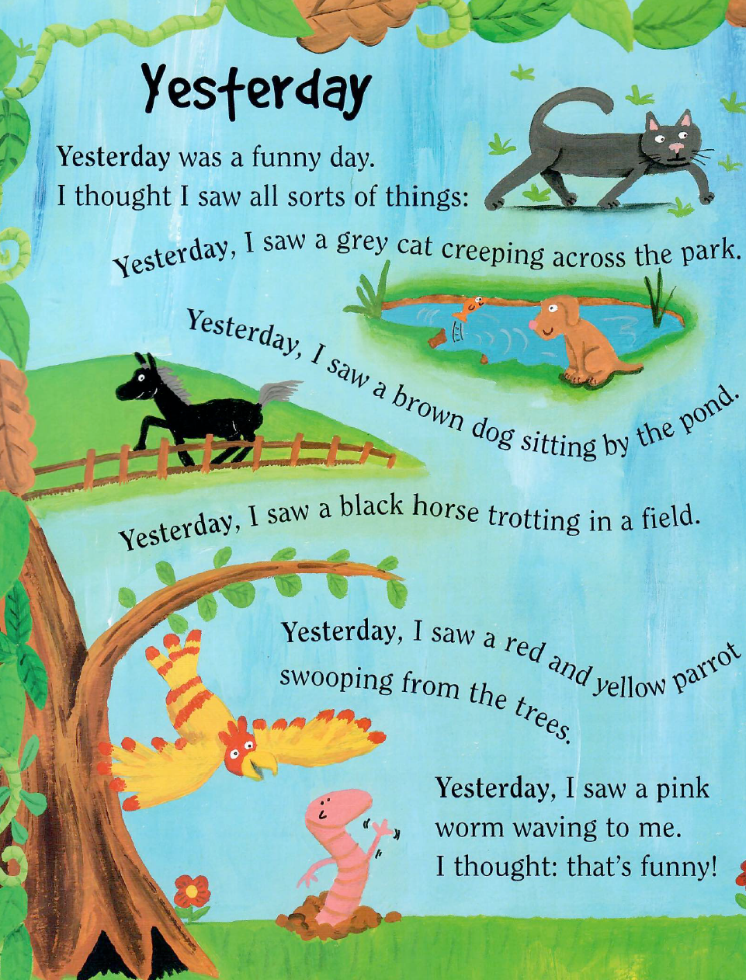
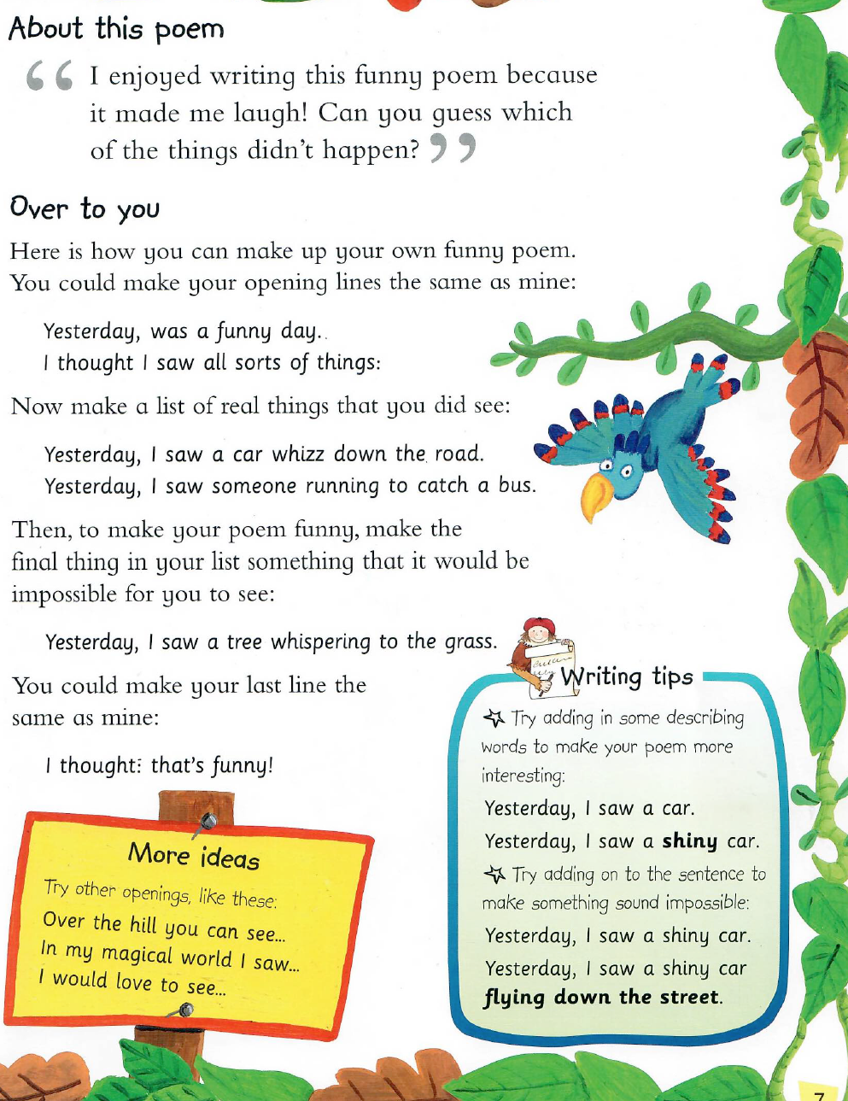
Tuesday Writing Activity

Slide 10
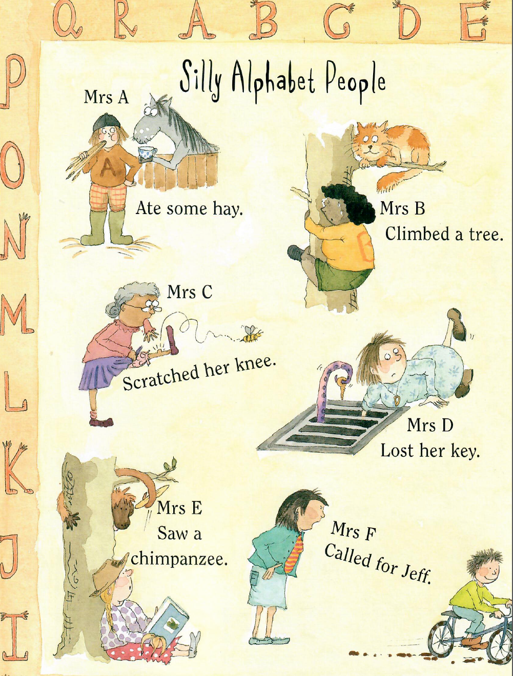
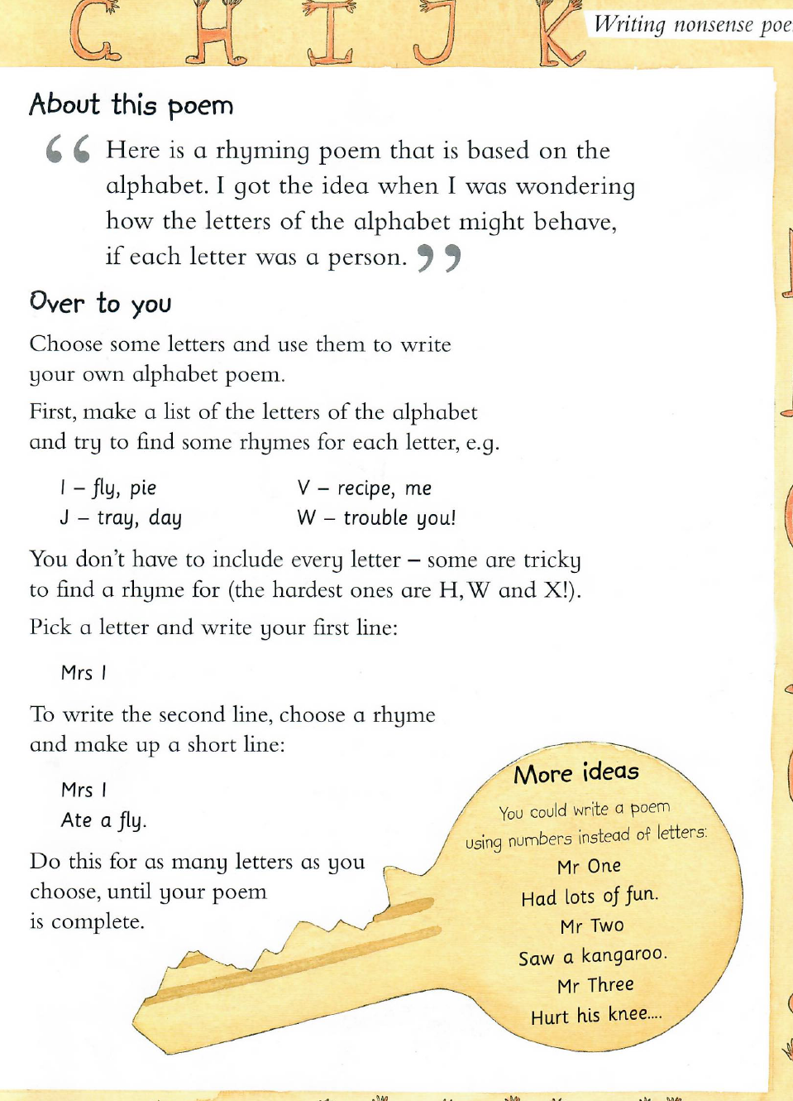
Wednesday Writing Activity

Slide 11
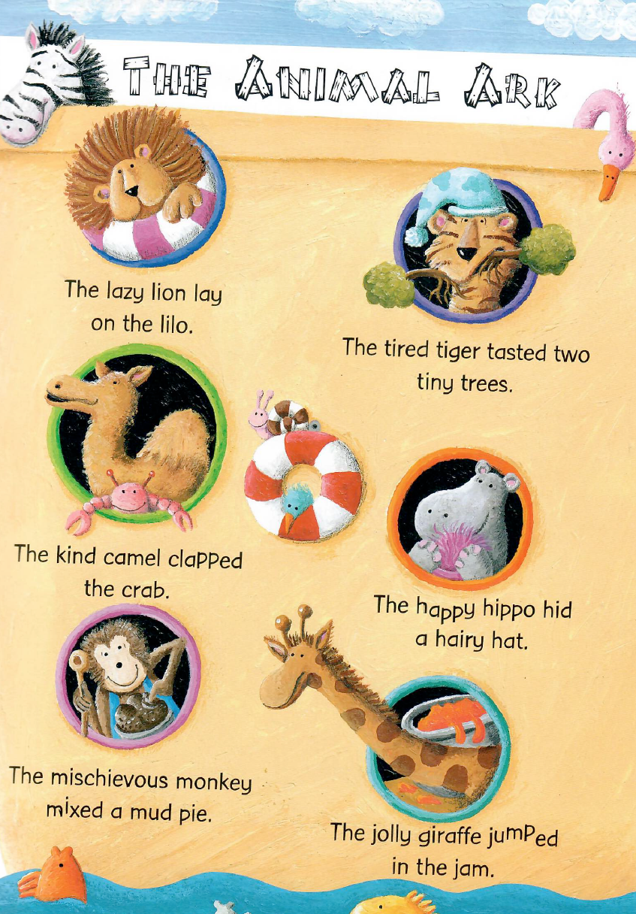
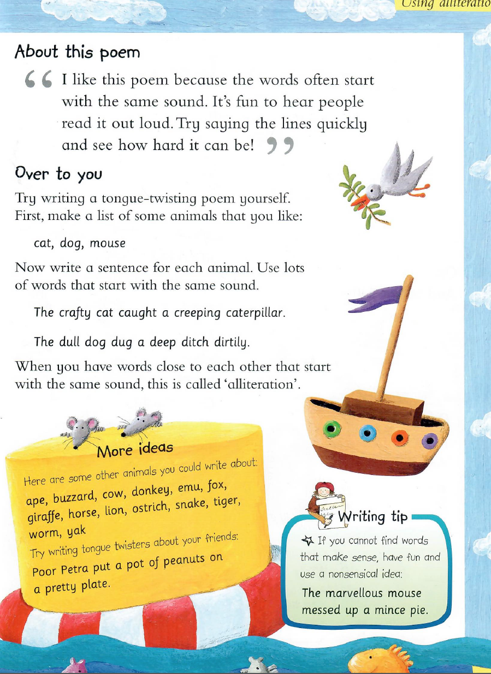
Thursday Writing Activity

Slide 12
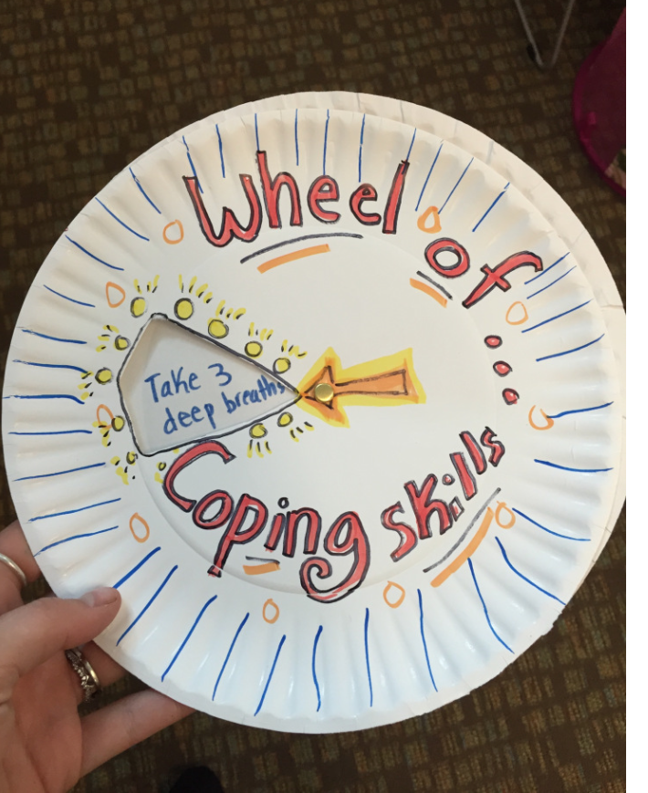
Friday Afternoon Activity
Well Being -Wheel Of Coping Skills
Take two paper plates and cut out a small triangle towards the middle of one plate.
Spin the plate and write the skills in each section of the second plate that is exposed in the section that was cut out.
Insert a paper fastener so the plate can spin and reveal the skills.
Decorate any way you like!
These work great to have available in a calm down area or in a coping skill box at home or in the classroom.
Another way to use the wheel is to act out situations with puppets or role-play and use the wheel to choose which skill to use given the situation. This helps children learn to choose skills that best suit the setting and get more practice using them!

