Slide 1


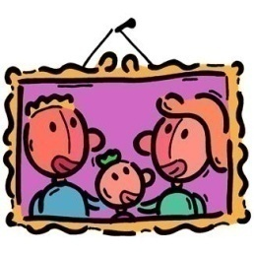

Tips for pronouncing French
The sounds we have learnt are the ones which most frequently can cause problems, so if you can remember how each word sounds, you are a lot closer to having good French pronunciation!
To sum up…
The letter c with an accent underneath – ç – sounds like the letter s in English.
A c without this accent, and followed by the letters o, a or u, is a hard sound – café, code, vécu (vaykoo)
A c followed by an i or an e is soft – cinq (sank), cent (son)
an and en make the same sound in French = ON (a nasal sound) - anglais, enfant
in in a French word sounds like AN – intéressant, intelligent, enfin
If a French word ends in a consonant these are usually SILENT e.g t, d, s, n or x, with the exception of CRFL – Be CaReFuL with these!
If the last letter is an e, you can pronounce the letter just before it – carte, anglaise, allemande.
In French, the letter e can cause lots of problems:
At the end of a word, it isn’t sounded out.
If it as an acute accent – é – then it sounds like ay. - café
If it has a grave accent – è – or a circumflex - ê - then it sounds like eh – e.g père, tête
The rest of the time, it sounds like uh – menu (muhnoo)
Try saying these out loud:
café | français | famille | cinq | enfant
5
4

Slide 2
Saluer | Greetings
Bonjour ! | Hello!
Bonsoir ! | Good evening!
Bonne nuit ! | Good night!
Salut ! | Hi!
Au revoir ! | Goodbye!
À bientôt ! | See you soon!
S’il vous/te plaît | Please
Merci | Thank you
Comment ça va? OR Ça va ? | How are you?
Comment allez-vous ? | How are you? (formal)
Ça va bien | I am well
Ça va très bien | I’m very well
Fantastique ! | Fantastique!
Comme ci, comme ça | Ok
Ça va mal | I’m bad/ not well.
Ça va très mal ! | I’m awful!
Je suis malade/ fatigué | I’m ill/tired
5

Slide 3
Saluer
Fill in the gaps and practise saying all the words with a partner using ‘look, cover, say, check’ to memorise the words.
B_nj_ ur !
S_l_t !
A_ r_vo_r !
A b_ en t _ t !
B_nn_ n_i_ !
Ç_ v_ bien
Ç_ va
Je suis _al_de
T_ès b_ _ n
Ç_ v_ ma_
C_mm_ ci, com_e ç_
Tr_s m_l
6

Slide 4
Les numéros 1 - 31
1 | un | 16 | seize
2 | deux | 17 | dix-sept
3 | trois | 18 | dix-huit
4 | quatre | 19 | dix-neuf
5 | cinq | 20 | vingt
6 | six | 21 | vingt-et-un
7 | sept | 22 | vingt-deux
8 | huit | 23 | vingt-trois
9 | neuf | 24 | vingt-quatre
10 | dix | 25 | vingt-cinq
11 | onze | 26 | vingt-six
12 | douze | 27 | vingt-sept
13 | treize | 28 | vingt-huit
14 | quatorze | 29 | vingt-neuf
15 | quinze | 30 | trente
 |  | 31 | trente-et-un
Combien ? |  | How many?
plus |  | plus
moins |  | minus
9

Slide 5
Les numéros 1 – 31
A Write the numbers in words in the table. Use the squares to help you.
d | f | c | u | ui | i
n | or | ou | é | q | en
x | in | ei | eu | tre | t
a | qu | tr | g | oi | h
e | è | on | v | un | ze
4 = quatre | 13 = | 1 = | 8 =
10 = | 9 = | 20 = | 12 =
5 = | 11 = | 14 = | 2 =
B Do the calculations and write the answers as a French word.
dix+ dix= vingt
vingt + six =
douze+ douze =
trente + un =
dix + dix + dix =
vingt + huit =
trente – trois =
trente – cinq=
trente – huit=
Make up your own!
10

Slide 6
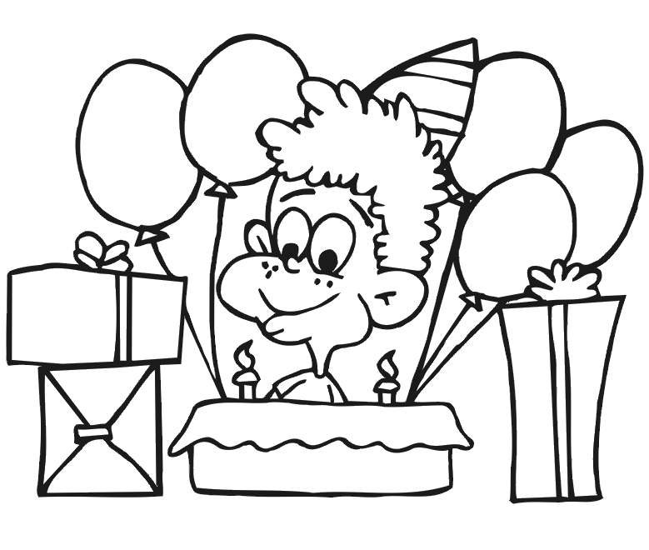
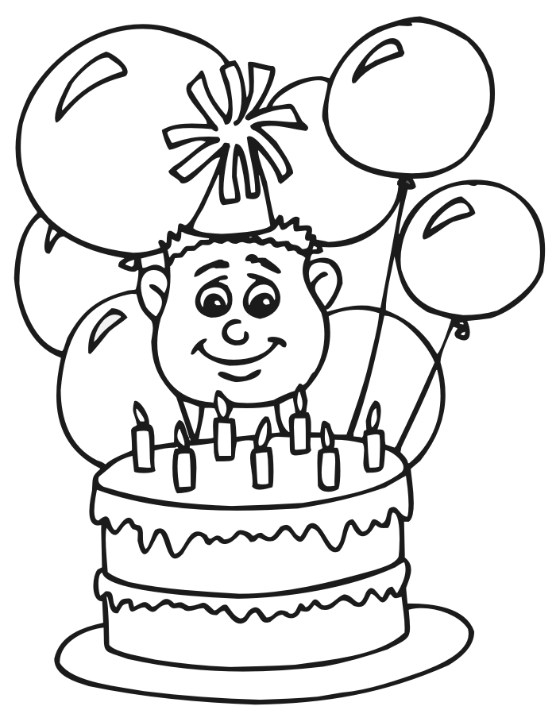
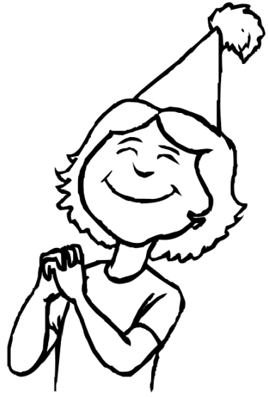
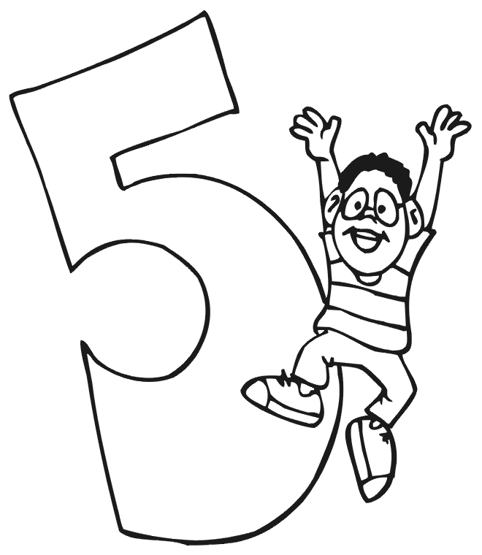
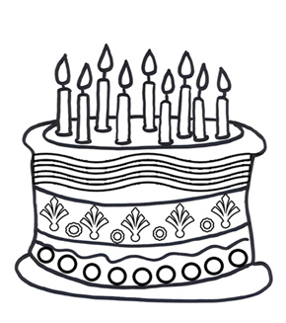
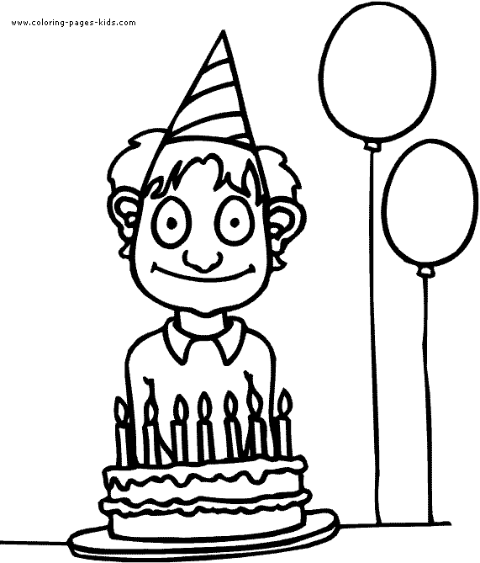
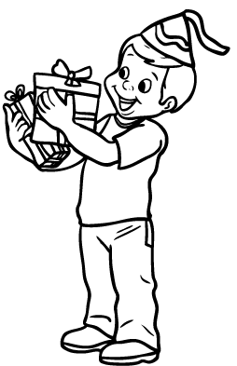
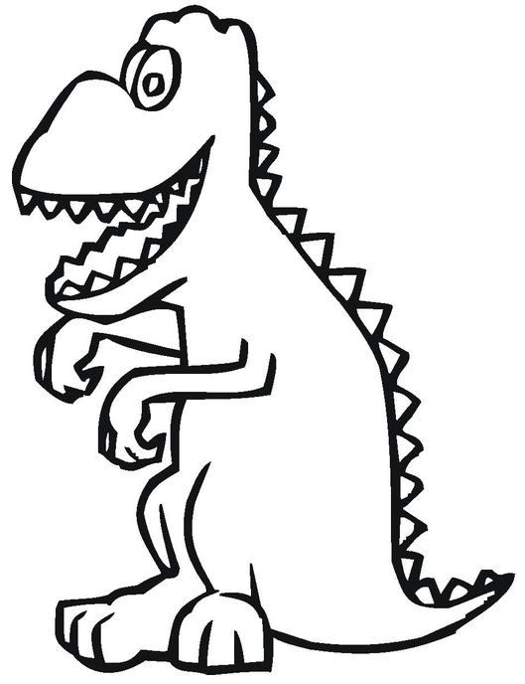
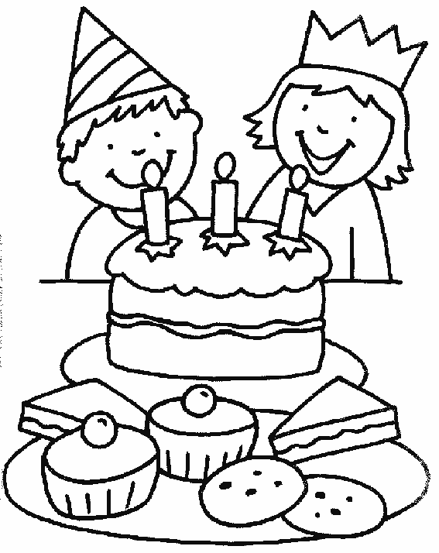
Quel âge as-tu?
Write a sentence for each person.
J’ai deux ans.
…..………………….
…………………………….
12
…..………………….
…..………………….
15
…..………………….
…..………………….
6
…..………………….
…..……………….
17
Et toi?
……….…..……………….
11

Slide 7
Les mois de l’année | The months of the year
janvier | January
février | February
mars | March
avril | April
mai | May
juin | June
juillet | July
août | August
septembre | September
octobre | October
novembre | November
décembre | December
Les jours de la semaine | The days of the week
lundi | Monday
mardi | Tuesday
mercredi | Wednesday
jeudi | Thursday
vendredi | Friday
samedi | Saturday
dimanche | Sunday
12

Slide 8
Les jours de la semaine et les numéros
Complete the crossword with the French words.
 | 1 |  |  |  | 2 |  |  |  |  |  | 3
 |  |  | 4 |  |  |  |  |  | 5
 |  |  |  |  | 6 |  | 7
 | 8
 |  |  | 9 |  |  |  |  |  |  | 10
 |  |  |  |  |  |  |  |  |  | 11 |  | 12
 |  |  |  |  |  | 13
 | 14
 |  |  |  |  | 15
Vertical
1 fourteen
2 Monday
3 eighteen
5 five
Wednesday
9 four
11 six
12 seven
Horizontal
4 twelve
6 Sunday
8 eleven
10 ten
13 Thursday
14 Tuesday
15 sixteen
13

Slide 9
Les dates
A Write the correct dates in numbers next to the French date.
15.2 le premier juillet = 1.7
10.10 le dix octobre =
27.11 le douze septembre =
4.3 le quinze août =
22.5 le quinze février =
15.8 le deux mai =
1.7 le vingt-deux mai =
8.12 le vingt-sept novembre =
31.1 le trente avril =
2.5 le trente-et-un janvier =
12.9 le quatre mars =
30.4 le huit décembre=
1. 25.3 _________________________________________
2. 4.10 _________________________________________
3. 11.2 _________________________________________
4. 3.8 __________________________________________
5. 27.4 _________________________________________
6. 16.9 _________________________________________
7. 11.1 _________________________________________
8. 17.12 ________________________________________
9. 21.6 _________________________________________
10. 13.5 ________________________________________
11. 7.7 _________________________________________
12. 23.11 _______________________________________
B Write the dates out in words.
le vingt-cinq mars
15

Slide 10
Les dates
Complete the sentences with the correct dates in French.
1) Write when your birthday is:
Mon anniversaire c’est le _______________ __________________.
2) Write when your friend’s birthday is:
L’anniversaire de (name)______________c’est le ___________ ______________.
3) Write when your family member’s birthday is:
L’anniversaire de (name)______________ c’est le ___________ ______________.
4) Write when Christmas is:
Noël c’est le _________________ _______________________.
5) Write when Halloween is:
Halloween c’est le ___________________ _____________________.
6) Write when Bonfire Night is:
Guy Fawkes c’est le ____________ ______ ___________________.
16

Slide 11
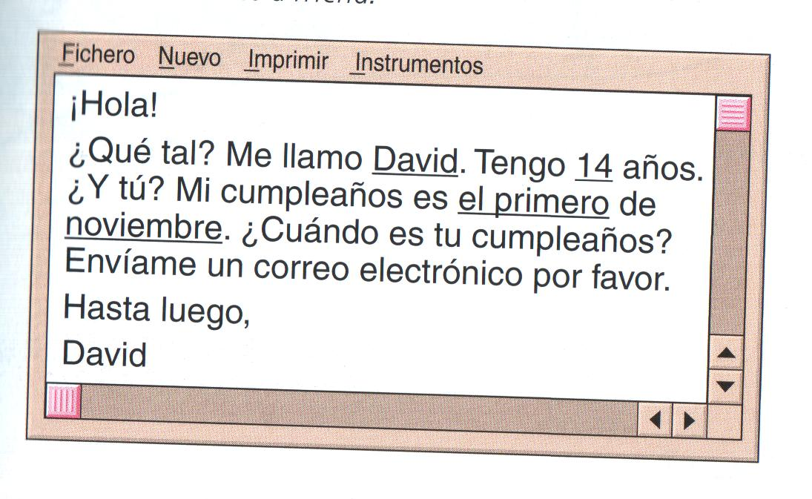
Quelle est la date de ton anniversaire ?
A Write out the dates below in full in French.
05/06 | Le douze février
12/2
10/3
2/10
15/07
25/09
B Read the email from David. Write a reply with your name, your age and your birthday.
Salut !
Ça va ? Je m’appelle David. J’ai 11 ans. Et toi ? Mon anniversaire c’est le cinq novembre. Quelle est la date de ton anniversaire ? Envoie moi un e-mail s’il te plaît.
À bientôt,
David
……………………………………………………………………………………………………………………………………………………………………………………………………………………………………………………………………………………………………………………………………………………………………………………………………………………………………………………………………
19

Slide 12
Les couleurs
Les couleurs | The colours
bleu | blue
vert | green
marron | brown
gris | grey
noir | black
blanc | white
rouge | red
jaune | yellow
rose | pink
orange | orange
violet | purple
Quelle est ta couleur préférée ?
Ma couleur préférée est le bleu comme tes yeux.
22

Slide 13
Les couleurs
Colour the boxes and write the names for the secondary colours.
rouge
+
blanc
=
rose
noir
+
blanc
=
____
bleu
+
jaune
=
____
rouge
+
bleu
=
____
rouge
+
jaune
=
____
bleu
+
jaune
+
=
____
vert
+
rouge
23

Slide 14


Les formes
A Colour each shape and write its colour in French after the noun.
 | un cercle …………. |  | un point ………….
 | un triangle ……………. |  | une ligne ………….
 | un carré ……………… |  | une étoile …………….
 | un rectangle …………… |  | une spirale …………....
 | un ovale …………. |  | un œil ………….
B Draw a quick picture made up of different shapes and label it in French.
24

Slide 15
Les parties du corps | The parts of the body
la tête | head
le dos | back
la main | hand
la jambe | leg
le genou | knee
le nez | nose
les oreilles | ears
le ventre | stomach
le bras | arm
le doigt | finger
le pied | foot
les dents | teeth
les yeux | eyes
le coude | elbow
les épaules | shoulders
29

Slide 16
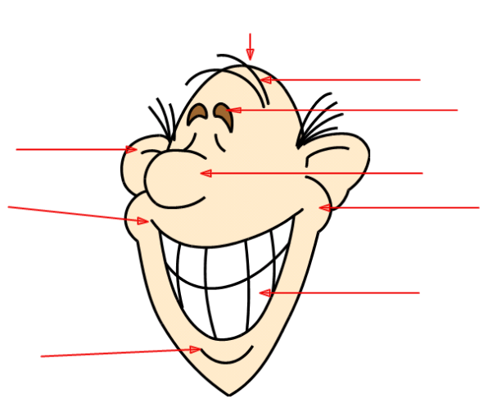
Le visage
A Label the face with the correct French words.
le sourcil
la joue
le menton
le nez | les cheveux | les dents
l’oreille | la bouche | la tête
B Which part of the face is missing? Write the French word here. ___________________
26

Slide 17
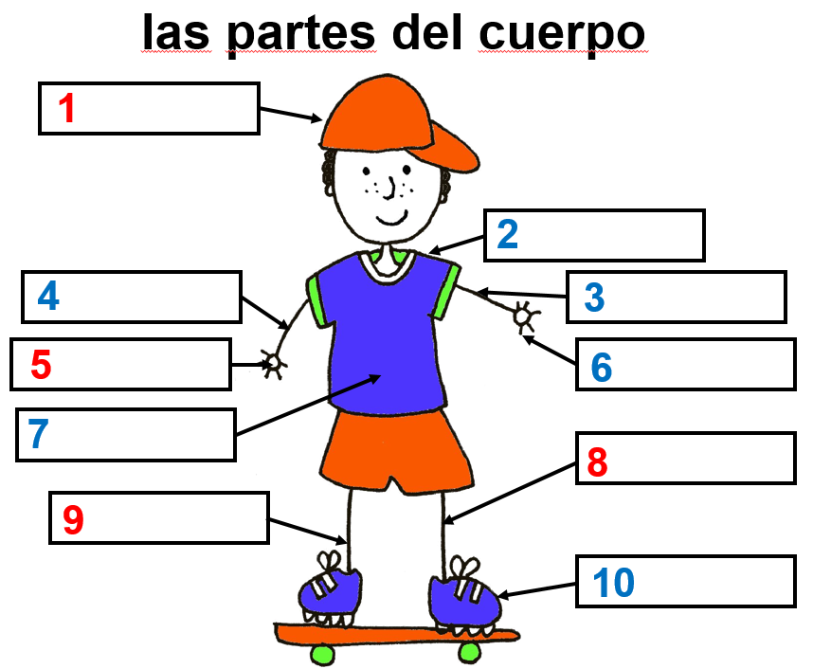
Les parties du corps
Complete the labels with the correct words. Don’t copy…Look, cover, write and check.
Les parties du corps
le pied | le bras | la jambe
la main | les épaules | la tête
le coude | le doigt | le ventre
 | le genou
28

Slide 18
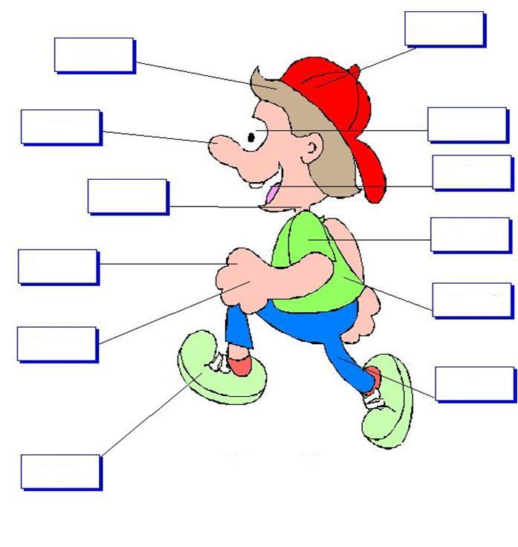
Les parties du corps
Try to write as many of the parts of the body words from memory as you can. Check for any you cannot remember and write them in with a different colour pencil.
30

Slide 19


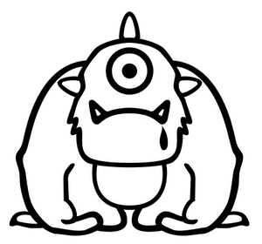
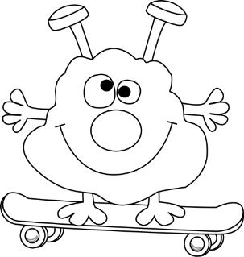
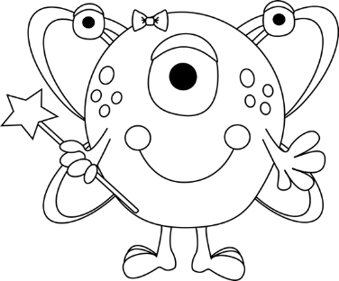
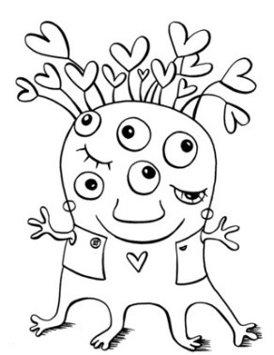
EXTRA CHALLENGE!
Colour in the aliens and write two or three sentences about each one.
Il a = He has….
Elle a = She has..
1 | 2 | 3
4 | 5 | 6
e.g
Il a huit yeux blancs.
Il a six jambes.
Il a _______dents.
Il a ______pied.
Il a _____yeux.
Elle a ______œil.
Elle a ___oreilles.
Elle a ____dents.
………………………………………………………………………………………………………………………………..
………………………………………………………………………………………………………………………………..
………………………………………………………………………………………………………………………………..
32

Slide 20
Mon vocabulaire
46

