Slide 1
This week, in Art, you are going to create a Sun/Moon (light and darkness) picture.
Have a look at the images over the next three slides. Look at the colours that have been used and the detail in the patterns. I have also included some Year 5 art work as examples.
You will need a piece of A4 paper, a pencil, a black biro pen and some colouring pencils.
If you decide to do a piece of art similar to slide 2, first draw a diagonal line from corner to corner on your piece of paper. Use a pencil to draw a circle for the Sun near one corner and a crescent moon near the opposite corner. If you choose to do a design similar to slide 3, start with a large circle in the centre of the page.
Using just a pencil (no ruler), begin to draw the main straight or curved lines, before filling each section in with a different pattern. Take your time. This piece of art should take two lessons to complete. Your patterns should show plenty of detail. If it takes longer, that’s fine too.
When you are happy with your drawing, go over each line/pattern with the black biro. This will make your patterns stand out once colour has been added.
Now, select the colours you are going to use for each section. Remember, hot shades for the Sun and cooler shades for the Moon.
Good luck, I am really looking forward to seeing what you create.

Slide 2
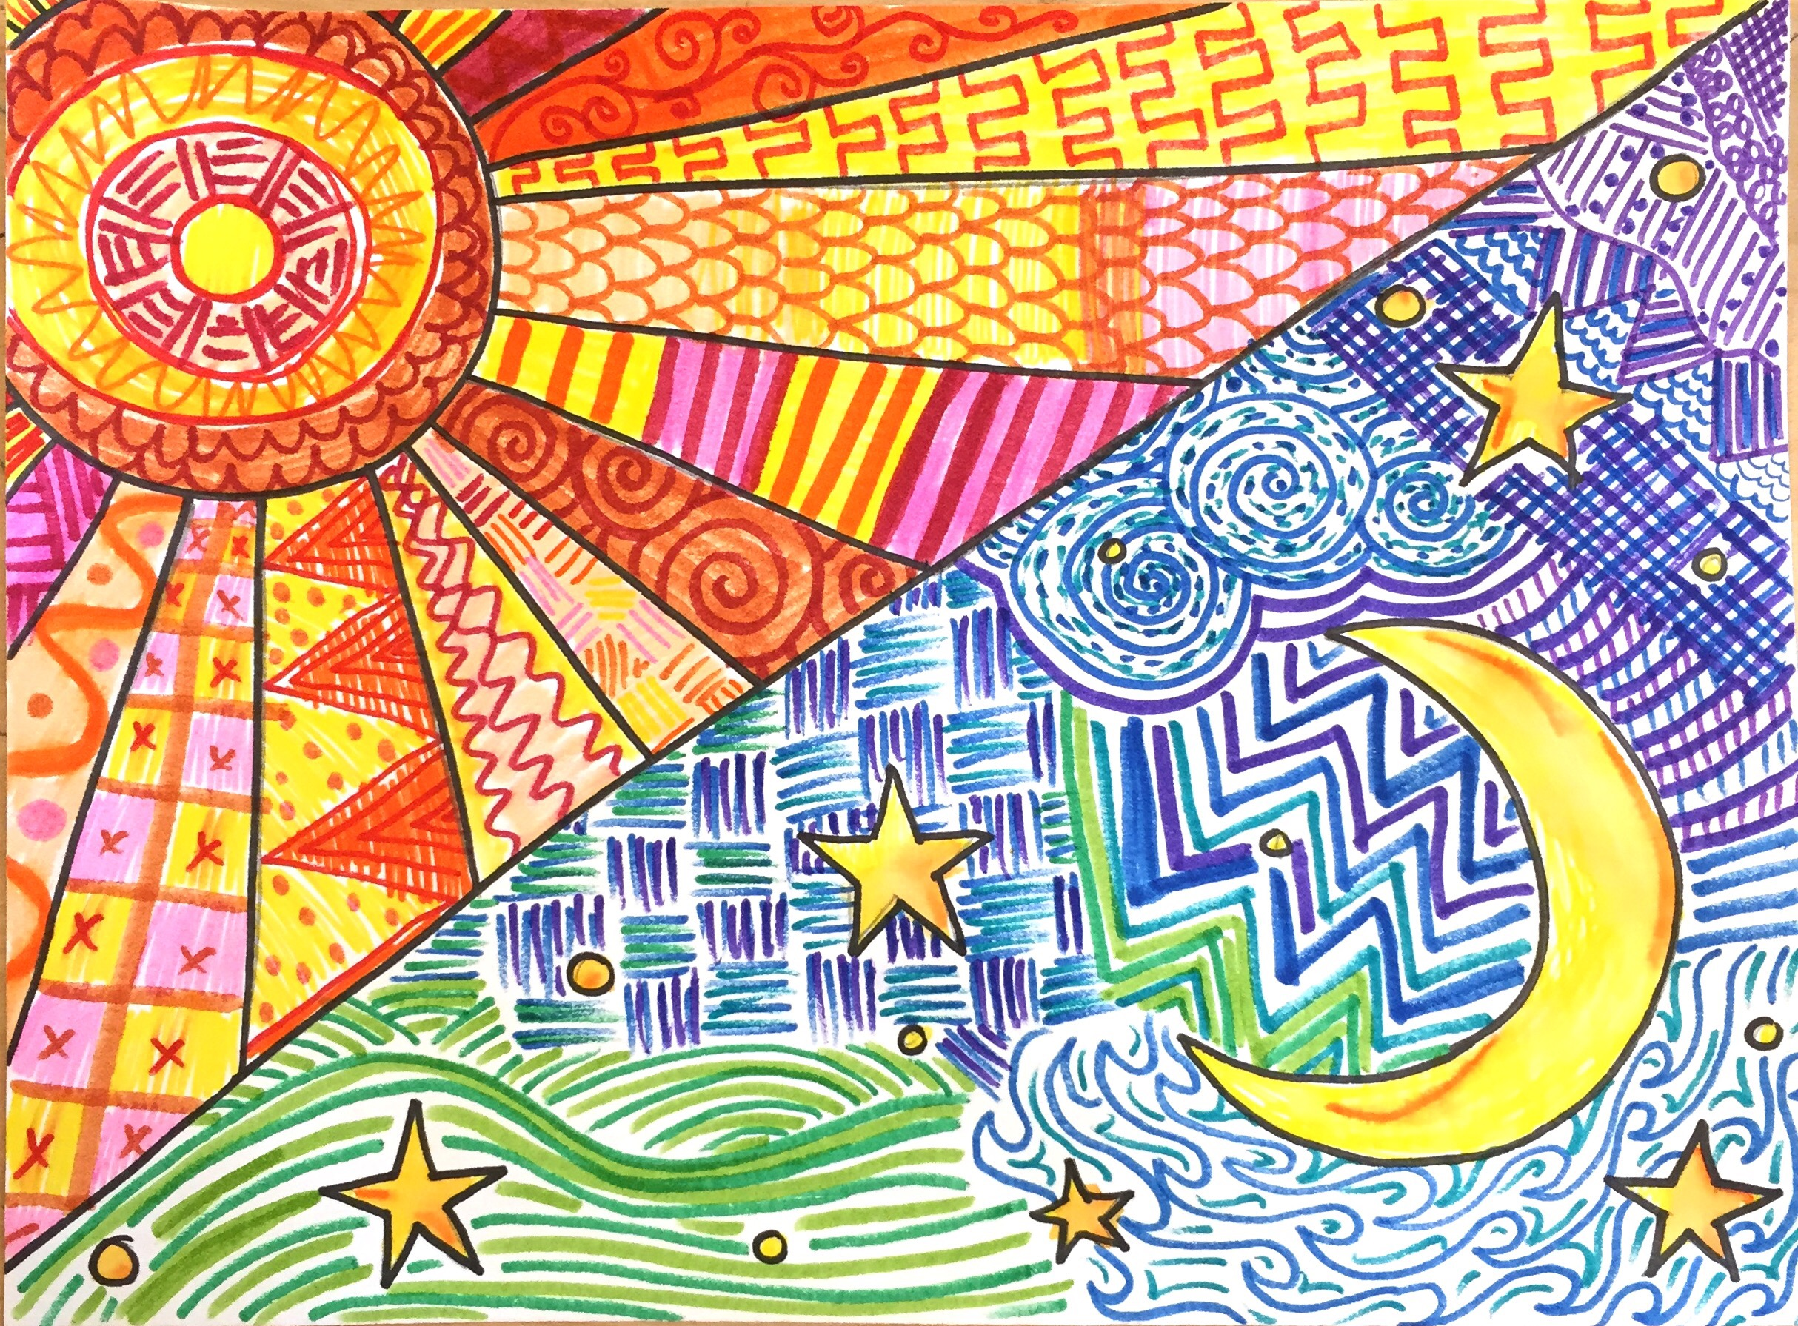

Slide 3
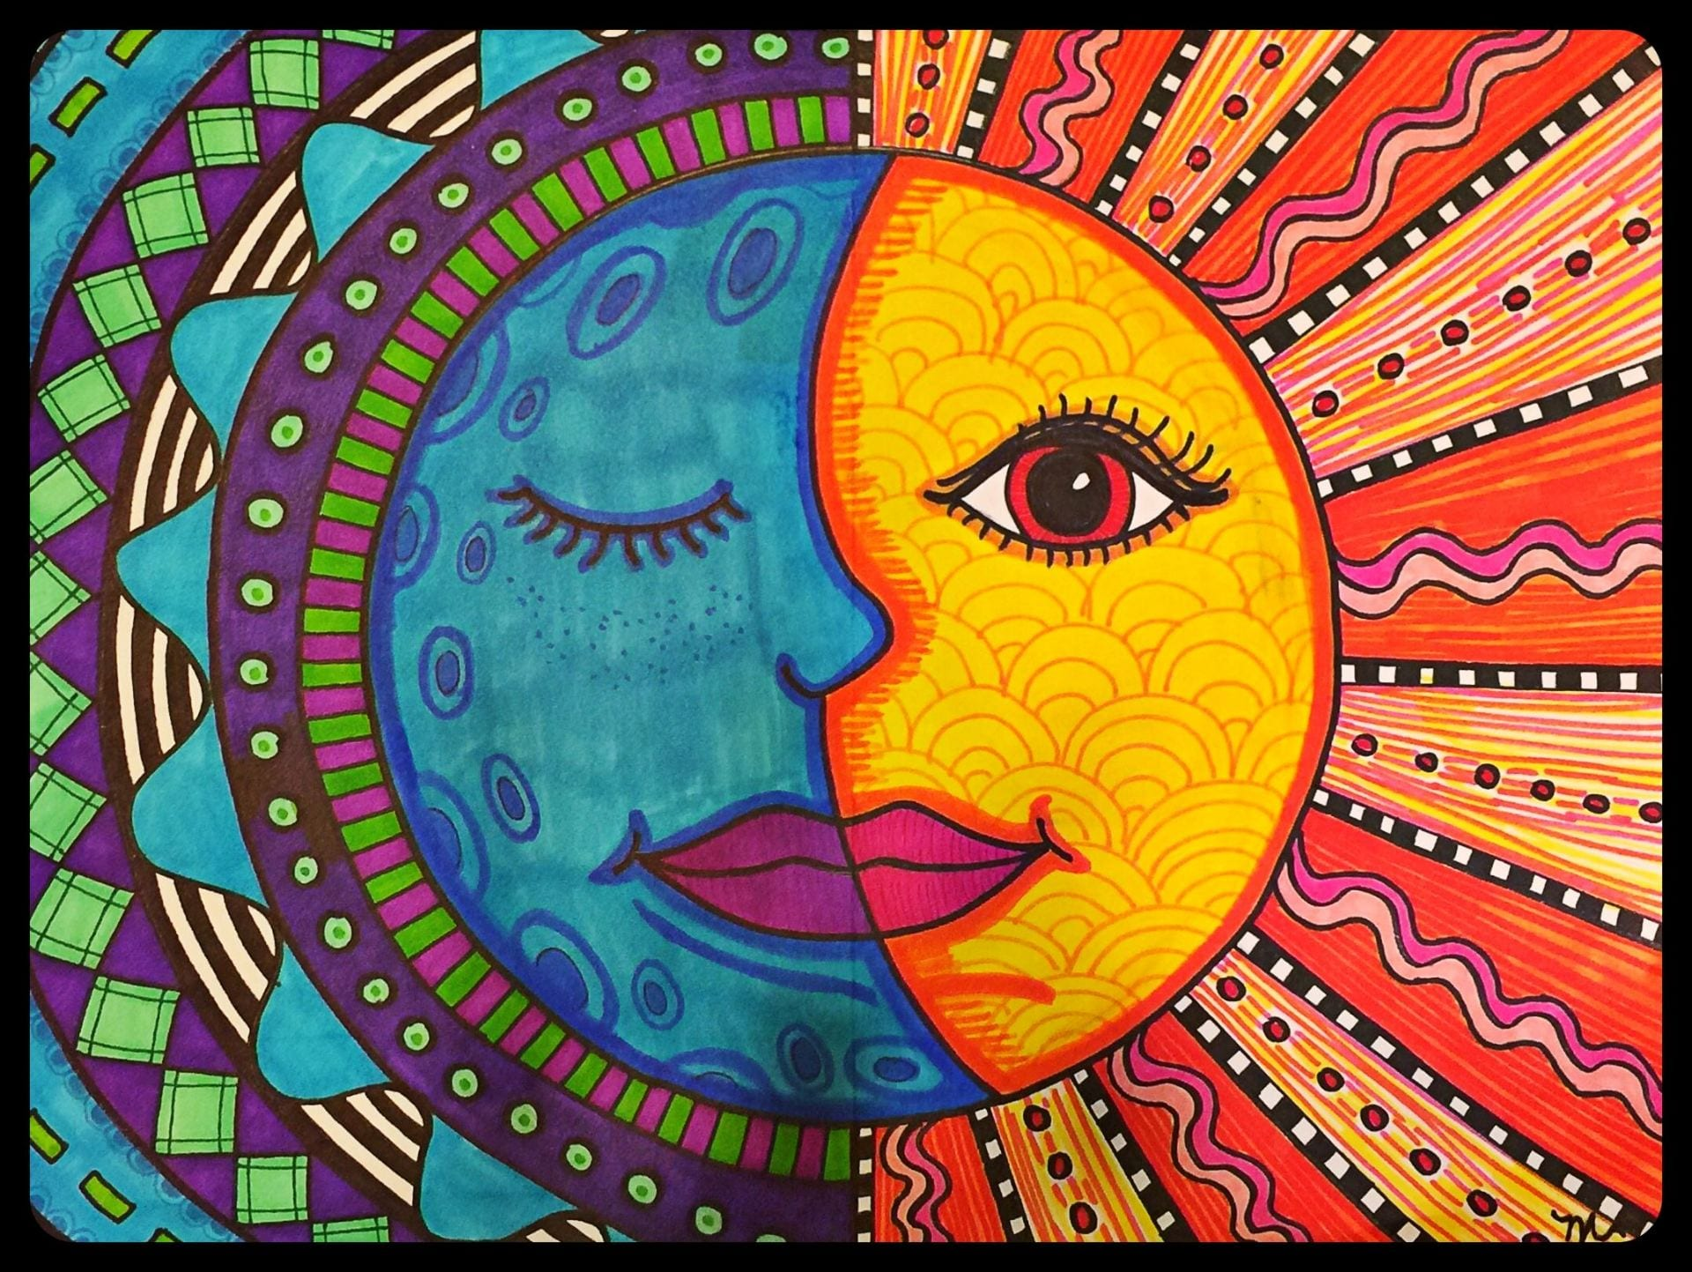

Slide 4
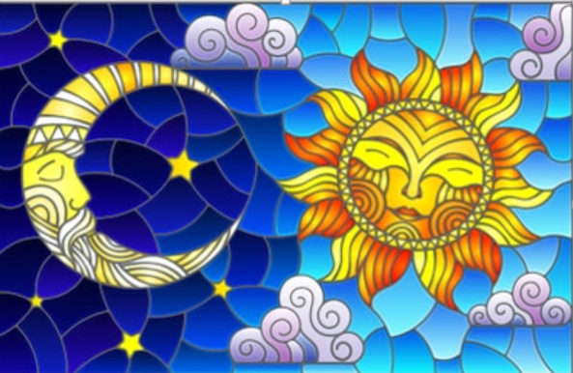
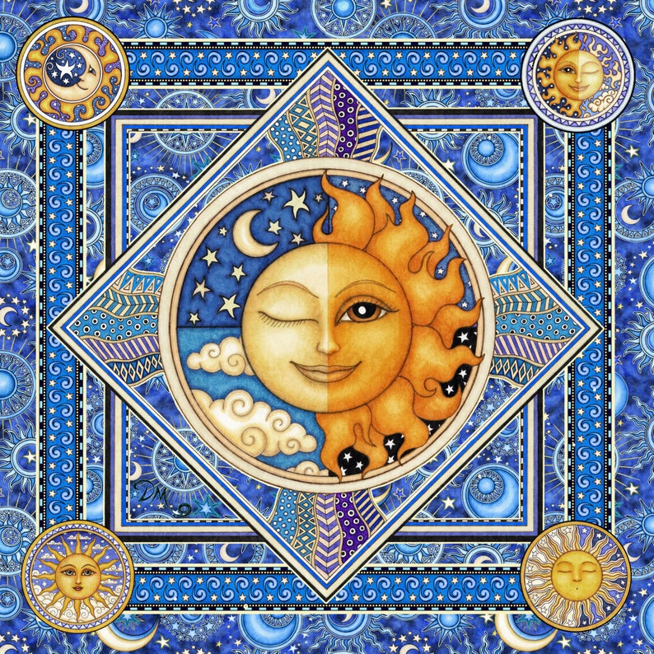
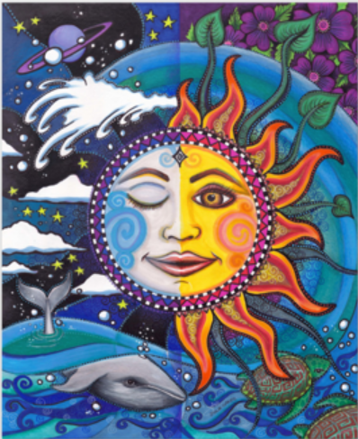
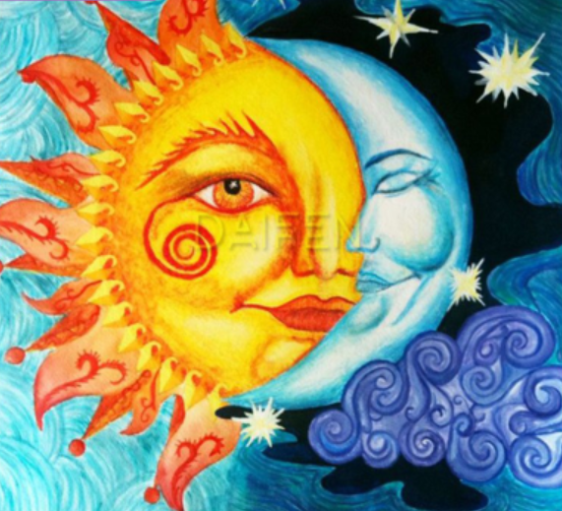

Slide 5
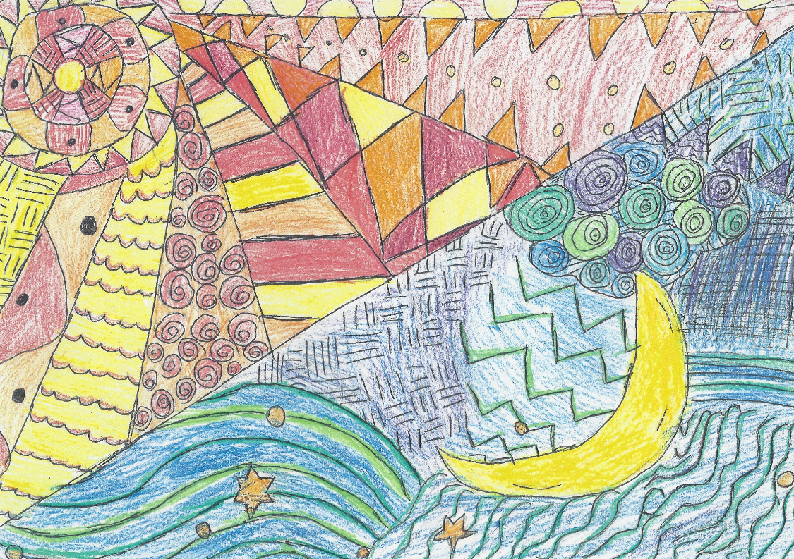
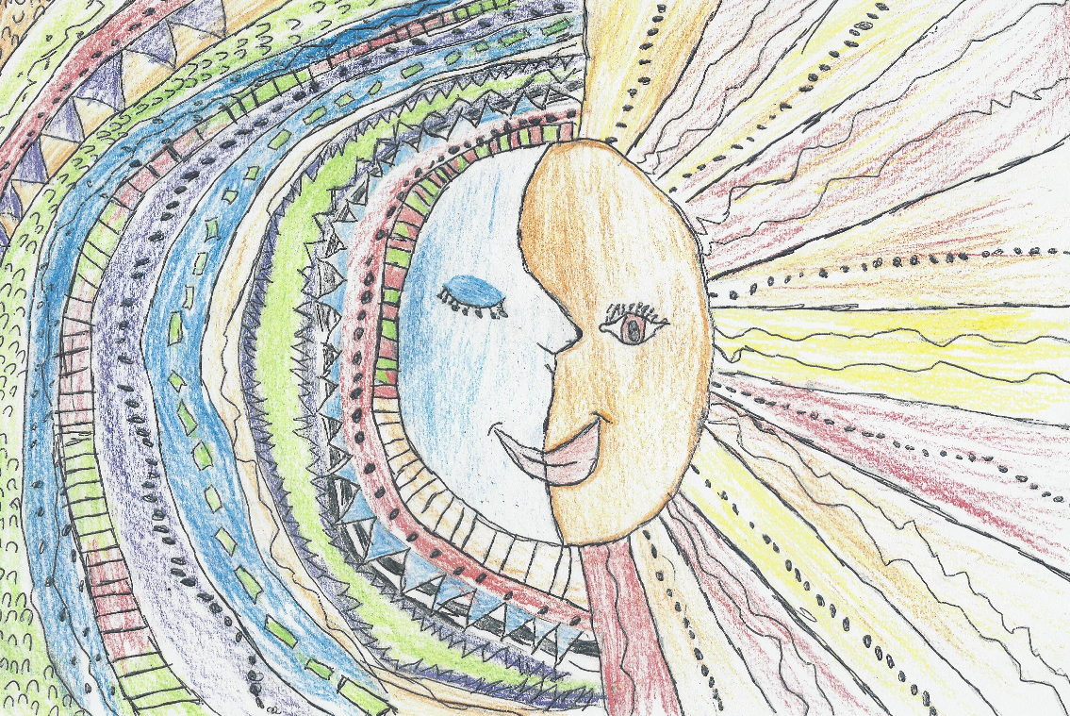
Some Year 5 examples

Slide 6
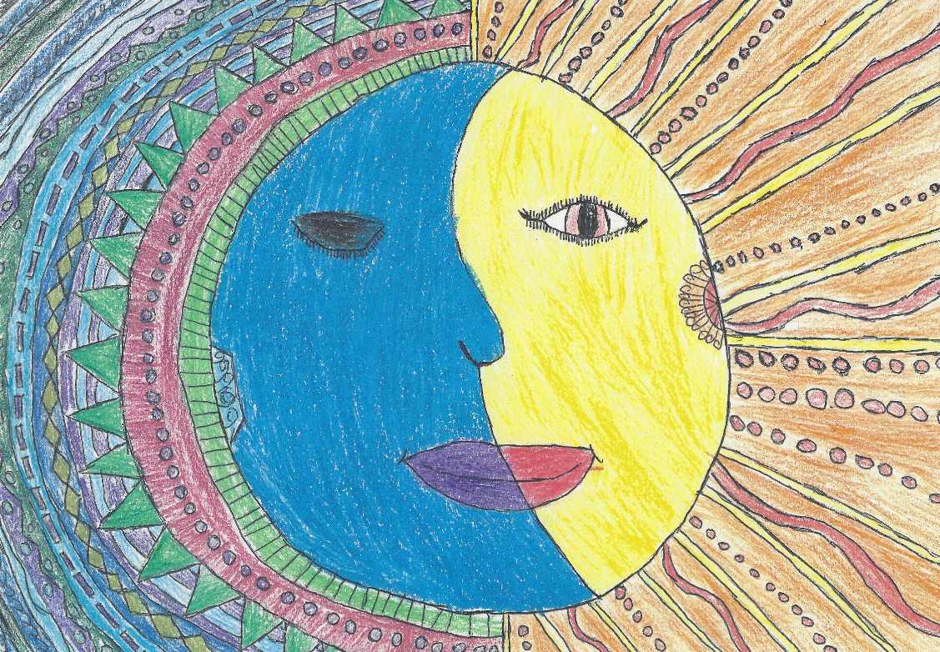
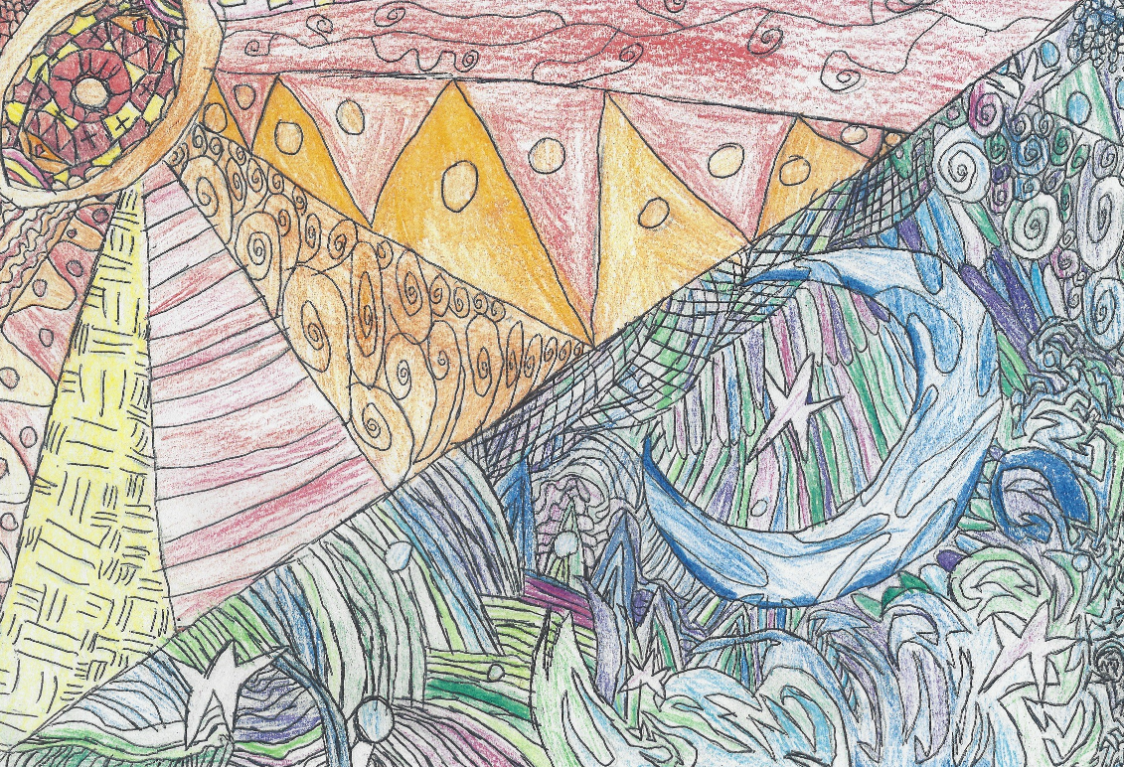

Slide 7
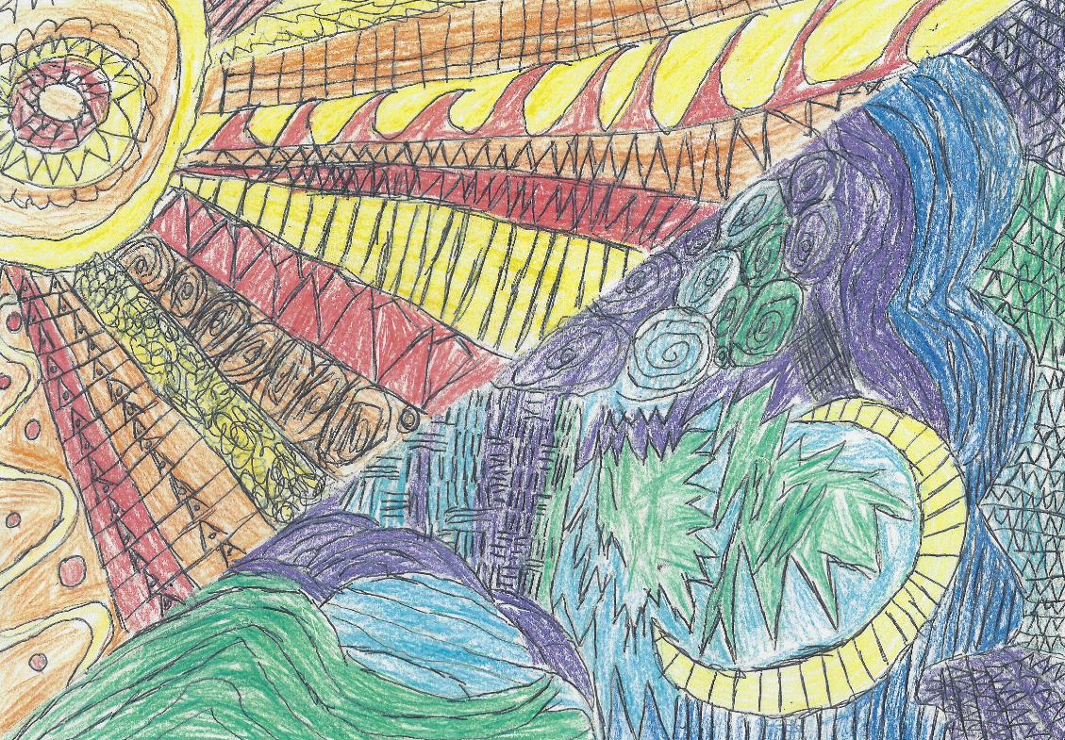
Look at the choice of colour for both the Sun and Moon sections
Think about hot and cold colours
Look at the detail in the patterns

