Slide 1

Y5 Knowledge Organiser
Autumn B - Vikings
Key People
Alfred | Saxon king who decisively defeated the Viking army in 878 and earned the reputation as ‘great’
Cnut | Ruled England from between 1026 and 1035 as well as Norway and Denmark
Guthrum | One of the leaders of the Great Army who was successful before Alfred beat him. He was later baptised as a Christian and retreated to East Anglia in 879
Sweyn Forkbeard | Ruled Denmark and was Warrior King from 986 until 1014 and for a few weeks was King of England
Key Facts
The word Viking means raider. However, they were also traders and settlers, especially later in the period. They attacked England from Scandinavia carrying out raids on monasteries which is why the monks criticised them. The Vikings fought hard against the Saxons for control of England but were stopped by Alfred. They then settled in the East with some becoming kings of England at the end of the Saxon period. They were highly skilled shipbuilders, taking them vast distances across dangerous seas. They did not worship a single god but made offerings to a large number such as Odin (Wednesday named after him) Thor ( Thursday )and Freya (Friday)
Curriculum End Points
To develop knowledge of the Vikings presence in England during the time of Edward the Confessor, their beliefs and way of life and legacy in the present day.
Prior Knowledge
Knowledge of the Roman Empire and its impact on Britain including significant events and people and how these shaped future Britain. The Anglo-Saxon invasion and settlement of Britian including how they lived, key events, places and people and the legacy they left. Locate key features and places in Northern Europe, explaining the impact of climate and location on people movement of the past.
Key Vocabulary
Danegeld | protection money paid by Saxons to bribe Vikings not to attack their lands
Danelaw | large part of Eastern England where the Danes settled in the late 9th century with their own laws and culture
Heathen | person who does not accept a religion that says there is only one god
Hoard | hidden collection of treasure
Pagan | person who believes in more than one god
Runes | Viking writing
Saga | long story about Viking heroes, spoken at first but later written down

Slide 2
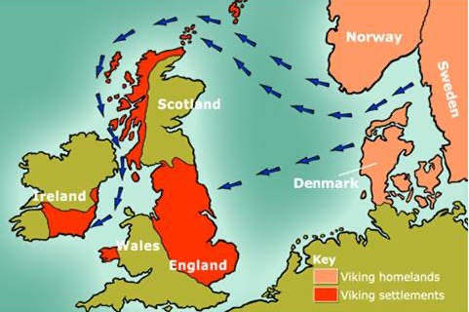
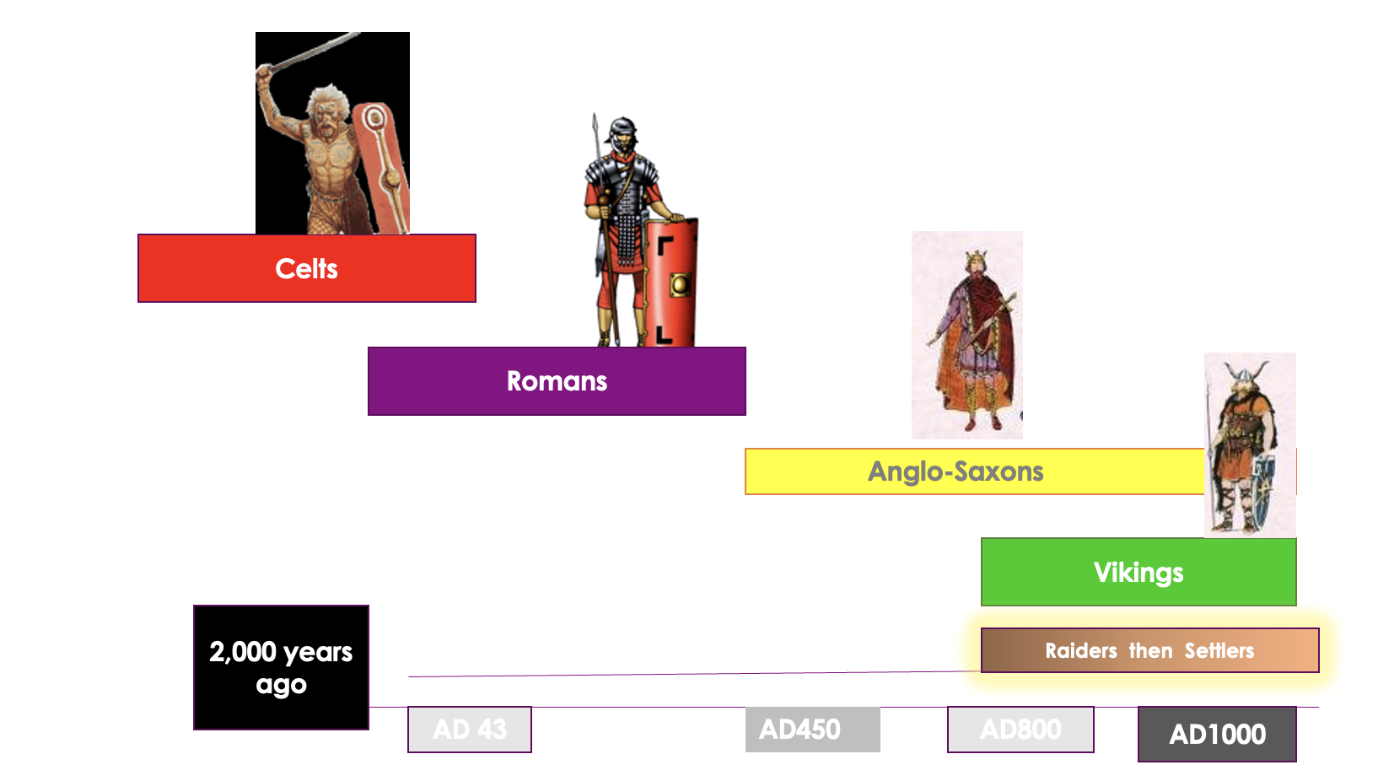
Pictures and diagrams

