Slide 1


Ethos
By Year 6 members

Slide 2
Living out Bunbury’s Vision
Mission: ‘A Caring Christian Family Where We Grow Together’.
Vision: Let Your Light Shine (Matthew 5:16)

Slide 3
Members
Year 6- Harriet, Florence, Megan, Elsie, Evelyn
Year 5 - Charlotte, Alexa
Year 4- Flynn, Eliza, Martha, Anya, Ellie, Ella
Year 1- Ivy

Slide 4
Weekly meeting
In our weekly meetings, we plan our worships, which we do every week, as well as thinking about how we can improve the school with a better understanding of our Ethos.
We also decide the ethos activities.
We talk about which activity we do on a Monday so children can do it through the week.

Slide 5
We also have an activity every week so that the pupils in the school can have a nice time colouring in and having fun with their friends and reflect.
We also talk about in the meeting how we can improve the school like the reflection area and so many other great things too.
This weeks activity is with magnifying glasses and for example the last activity was using pipe cleaners to make people as well as the hand prayers.

Slide 6
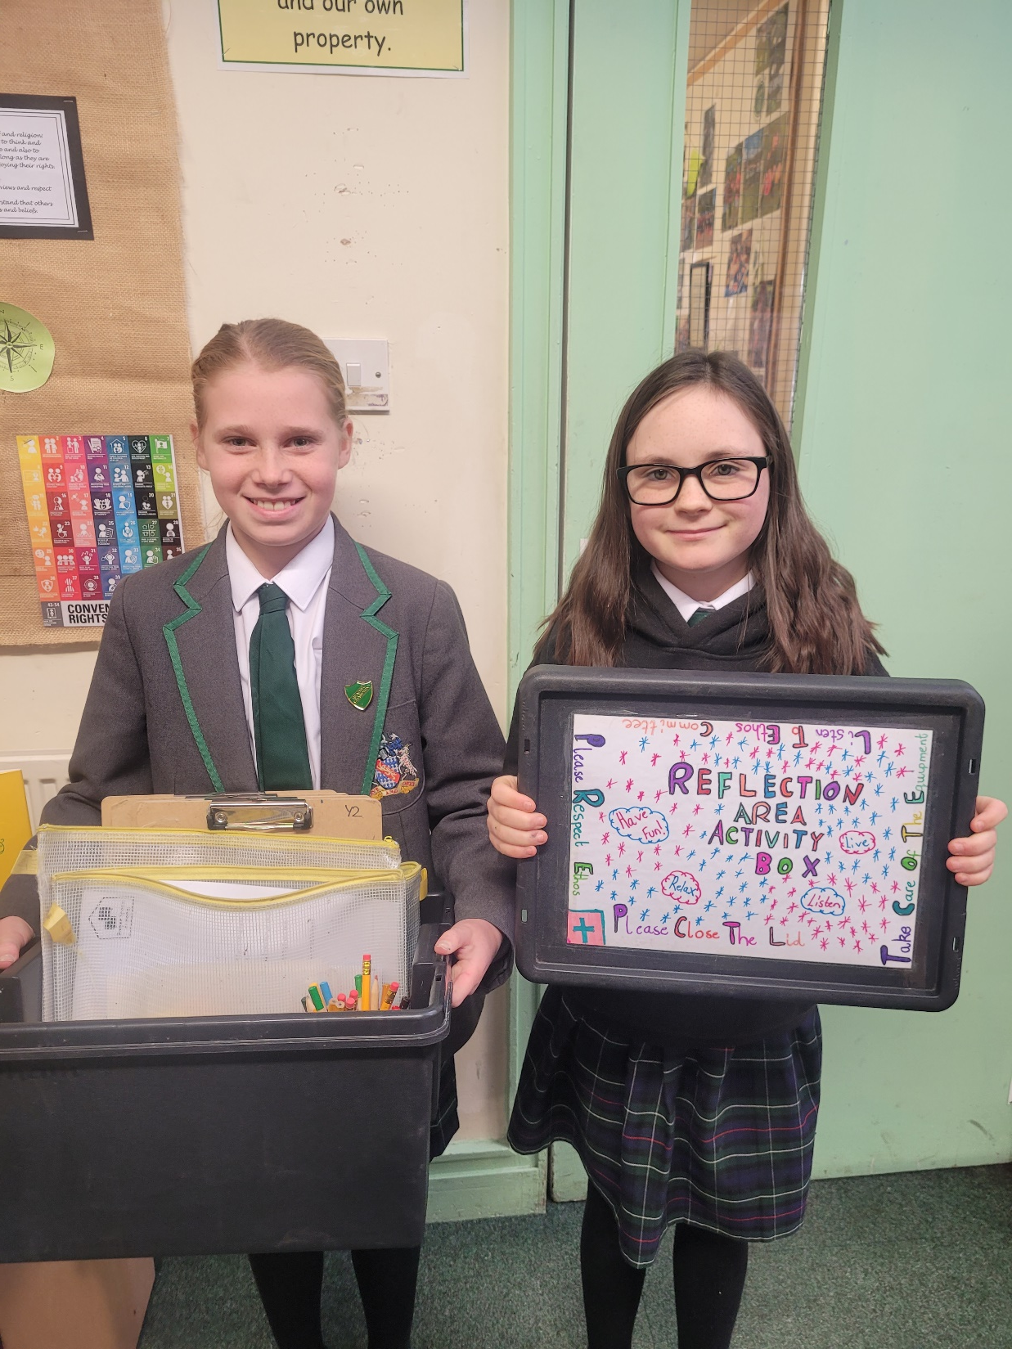

Slide 7
School Prayer
Dear God,
Thank you for everything we have learnt today. Thank you for our school, friends, food, water and play. Help us to always 'let our light shine.'
Amen

