Slide 1

BUNBURY ALDERSEY
C OF E PRIMARY AND NURSERY SCHOOL
Meet the Teacher
Year 3
Miss Dainty
“Let your light shine”
Matthew 5:16

Slide 2



Our Senior Leadership Team
Mrs Nic Badger - Executive Headteacher
Mrs Cath Smith - Deputy Principal
Mrs Emily Ehlen - SENCo

Slide 3
Class Teacher- Miss Dainty
Teaching assistant- Mrs Bason
Who will be working in your child’s class this year….

Slide 4
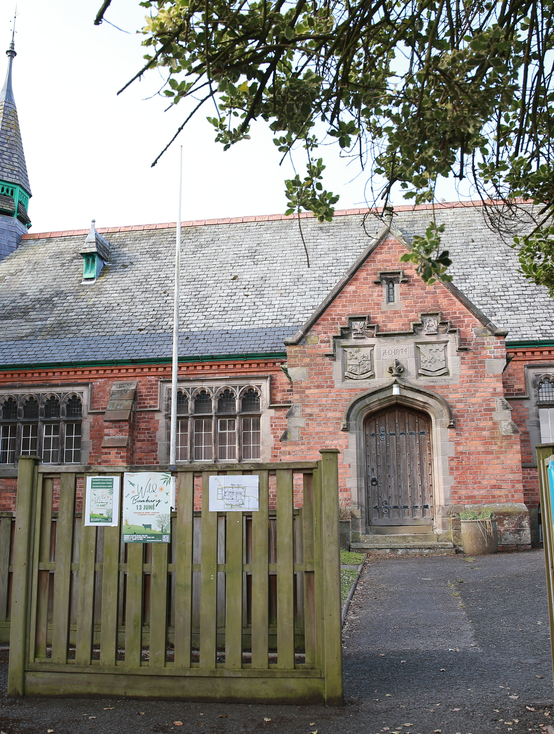
We strive to provide a primary education your child will never forget. Rich with diverse opportunities and experiences set within a
Christian context.
“Let your light shine”
Matthew 5:16

Slide 5
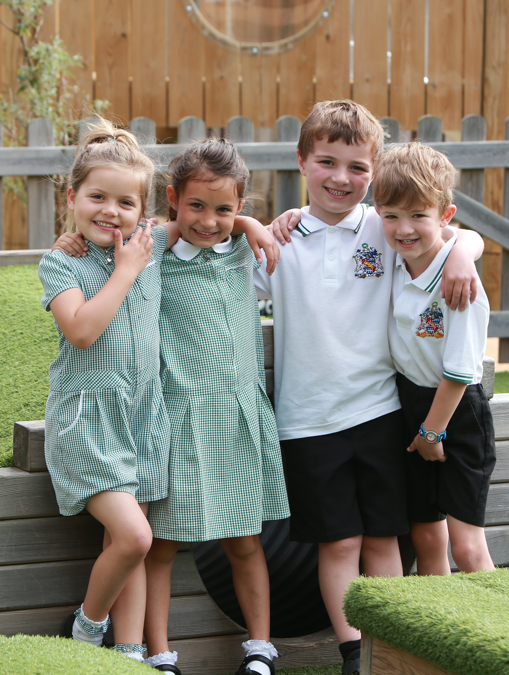
Our Christian values underpin all we do:
* Our children are happy, caring and empathetic to others
*Our children learn and develop as moral individuals within the context of Christian values
“Let your light shine”
Matthew 5:16

Slide 6

As a Rights Respecting School children’s rights are also at the centre of our ethos.
We are currently aiming to become a Gold Rights Respecting School.
The children learn about their rights through a variety of different activities and about the importance of children’s rights in the world through themed days.
At the start of this year, our class completed our class charter.

Slide 7

OUR SCHOOL RULES
“Let your light shine”
Matthew 5:16

Slide 8

Autumn A: What was is really like to live through WW2?
Our first topic this year is One Little Drop.
Our class Autumn 1 topic is based around 'Seal Surfer' by Michael Foreman. Seal Surfer is a beautifully illustrated story about a young boy who develops a special friendship with a seal and its pup. Set against the dramatic backdrop of the sea, the story explores themes of friendship, nature, family and the changing seasons.
Through this book, children will develop their understanding of the natural world and learn about the importance of caring for animals and their environment.
“Let your light shine” Matthew 5:16

Slide 9
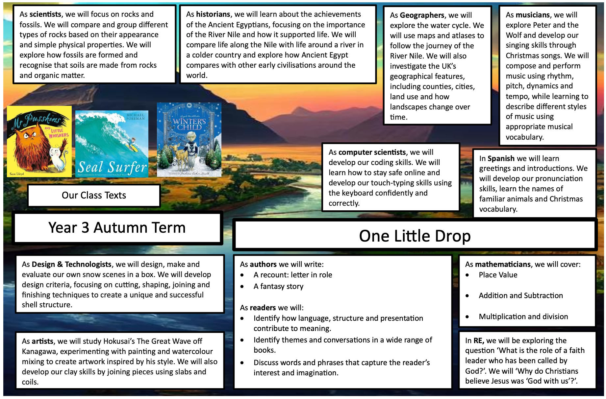
Topic Web
Our topic web, which details what we will be learning across the connected curriculum, can be found on the Year 6 webpage.
“Let your light shine” Matthew 5:16

Slide 10
HOMEWORK
Each child will receive a reading diary/journal and homework journal in which to complete homework tasks.
Reading – daily reading is given a high priority from reception to year 6. Children across the school will be expected to read at least 5 times per week. In KS2, once children become free readers, they will be provided with a journal in which they will review the books they have read.. Each half term, class teachers will also issue a list of recommended reading both fiction and non-fiction linked to the connected curriculum theme.
Spelling – Children will receive a spelling list of age-appropriate high frequency words at the start of each term to learn. Using our booklet ‘Helping your child to spell’ the children need to work on learning around 8-10 words per week. This will be in addition to spelling patterns from staged spelling groups where words are tested weekly. Children in KS2 will receive these on a Friday and will be tested the following Thursday.
MyMaths – Children will receive a weekly online maths task related to learning which has taken place that week in school.
Times tables – Children will receive specific times tables to learn in each year group. Year 2 – 2x,5x,10x with an awareness of 3x and 4x, Year 3 – as in year 2 plus 3x,4x,8x, Year 4 –all times tables plus an awareness of related division facts, Year 5 and 6 all times tables with related division facts.
Home learning projects – As part of our inclusive connected curriculum, all classes will be asked to complete a home learning project once a half term. These projects, Take away homework, are linked to the class learning theme and children have a choice of which task they wish to complete at home. We believe that these projects are a great opportunity for parents/carers to work alongside their child, enhancing their learning experience. The projects are shared and celebrated with other classes.
“Let your light shine” Matthew 5:16

Slide 11
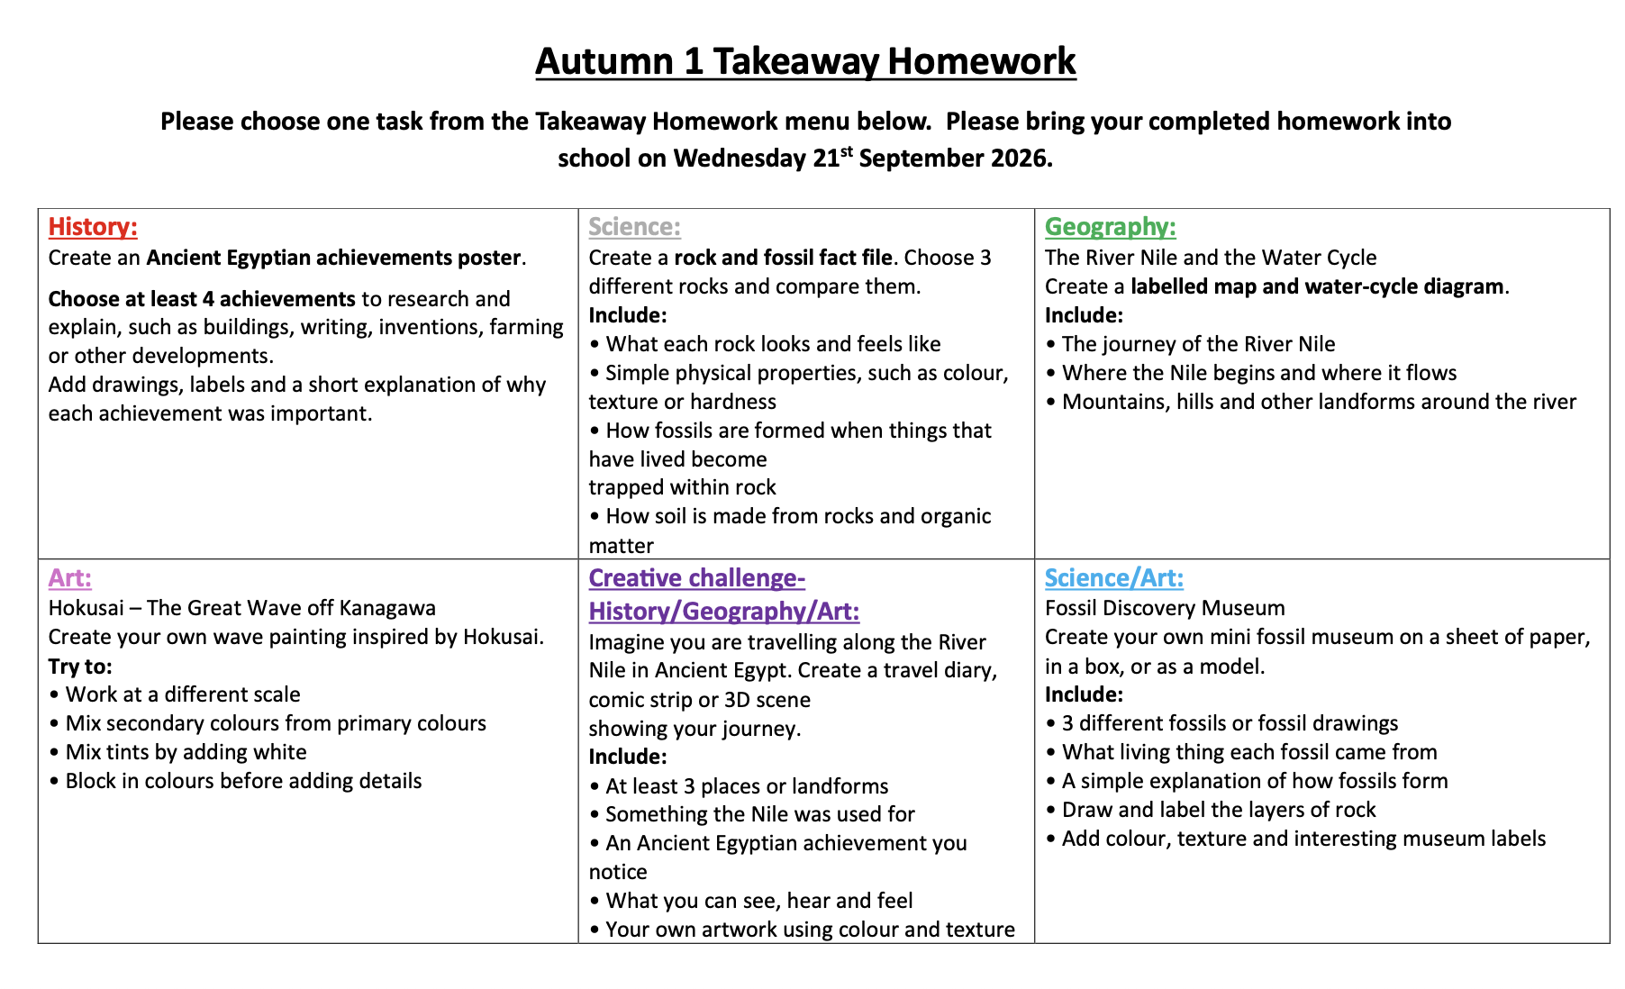
Y3- Takeaway Homework

Slide 12
https://www.bunburyaldersey.cheshire.sch.uk/class/year-3
HOMEWORK
The link above will take you to the main Year 3 webpage. If you scroll to the bottom of this page, you will find useful documents for Year 3.
At the top of this page there is a Homework Tab. Here, you will find all the documents your child needs to complete their homework.
Alternatively, the link below takes you straight to the Autumn A Homework Page.
https://www.bunburyaldersey.cheshire.sch.uk/page/y3-homework-autumn-a/120740
Homework for this half term is due the week commencing 19th October 2026.
This half term’s takeaway homework is due Wednesday 21st October 2026.

Slide 13
Handwriting
Kinetic Letters® is a handwriting programme that supports all learners. Using four main strands:
Making bodies stronger
Holding the pencil
Learning the letters
Developing flow and fluency
it enables children to develop legible handwriting that can be produced quickly and automatically. As handwriting becomes automatic, it becomes a valuable tool for learning rather than a hindrance.
The Kinetic Letters® font covers all the letters in the alphabet and is based on a set of rules that have been made a simple as possible to enable fast learning.
The order in which letters are taught recognizes the cognitive development of children.
Initially reading and writing are taught separately and later on, reading and writing are combined.

Slide 14
Strength: Writing is a fine finger operation; children must have core body and arm strength to be able to control their fingers precisely.
Pencil hold: The pencil/pen grip must be comfortable to allow writing for long periods (eg exams often last for hours). Pens and pencils with a triangular cross-section assist in developing the correct hold.
Letter formation: The movements to form the letters begin with whole body movements and progress through writing in sand trays to writing on whiteboards and finally writing on paper.
Flow and fluency: Letter movements are minimized to help a fast writing style to develop. There are no lead-in strokes (a waste of time and effort).

Slide 15


MATHS IN SCHOOL
Last academic year we began using First4Maths and Magma Maths, which have effectively improved our outcomes across the majority of school and allowed for the effective use of concrete resources and practical activities, and digital platforms which help to fully consolidate learning and enable the children to develop independence and confidence.
Equally it allows teachers to understand the progression in every small step, which is exemplified to us as teachers to effectively adapt learning to meet the needs of all children, including those with SEND.
By using a mixture of both First4Maths and Magma we are able to diversify our Maths curriculum, and aim to meet the needs of all of our learners as well as get children engaged and excited about maths!
So please be assured that if you don’t see as much work in their maths books as you feel you have previously, it’s because we are using both books and tech to teach.

Slide 16

MATHS AT HOME
MyMaths is an interactive online teaching and homework subscription website for schools that builds pupil engagement and consolidates maths knowledge. Teachers will set weekly lessons for children to complete, this will, wherever possible be linked to our learning within school. There are step-by-step explanations to break down the lesson content into bite-sized pieces. This will help children to recap a concept and also help you, as parents/carers, to understand the method taught. There are also games to complete should children wish to.
There are also maths parent guides which have been uploaded onto each year group’s class page. This document provides calculation method examples.

Slide 17
PE KITS
Children need to come to school in their PE kit
PE is on the following days: Tuesday and Wednesday.
PE kit should be named.
Plain black tracksuit, black shorts or skort, green polo shirt and black canvas pumps/trainers in line with the new uniform, PE black hooded sweatshirt.
NO FOOTBALL TOPS or STRIPS please.
Dark sport trousers may be worn in the colder months.
“Let your light shine”
Matthew 5:16

Slide 18
SCHOOL COMMUNICATION
If there is anything you would like to talk to us about, no matter how small it may seem, please do!
Unless I have a club or other commitment straight after school, I will be on the playground each day at 3.15pm, or please make an appointment through the school office. Unfortunately, I cannot speak with anyone in the morning unless it is an emergency.
You can email the office on: admin@bunburyaldersey.cheshire.sch.uk
“Let your light shine”
Matthew 5:16

Slide 19
Thank you for your support.
“Let your light shine”
Matthew 5:16

