Slide 1

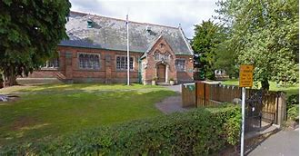
Welcome to Bunbury Aldersey C of E Primary School and Nursery School

Slide 2
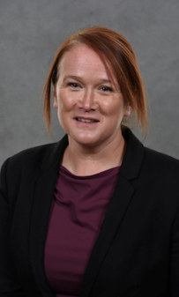
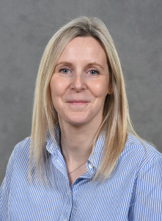
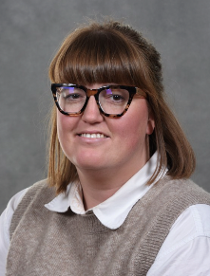
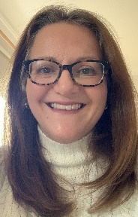
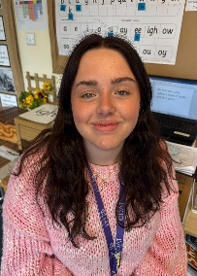
Staff at Bunbury
Mrs Badger – Executive Headteacher/SLT
Mrs Smith – Deputy Principal/SLT
Mrs Ehlen – SENCO/SLT
Mrs Hunt –EYFS lead/ Reception Class Teacher
Miss Clarke – Reception Teaching Assistant

Slide 3

https://www.cdat.co.uk/

Slide 4
Early Years Curriculum
Planning for each half term is carried out using a topic based approach, following the children’s interests, specific events and times of year.
There are 7 areas of learning in the Early Years Foundation Stage (EYFS), which activities are planned around.
Personal, Social and Emotional Development
Physical Development
Communication and Language
Literacy
Mathematics
Understanding the World
Expressive Arts and Design

Slide 5
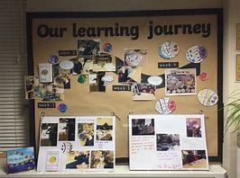

Learning Journeys
Throughout the year, staff will record your child’s learning . We use an online journal called Tapestry.
This is a unique record of their learning and development.
This will include samples of their work, photographs and staff observations.
Parental contributions can also be added throughout the year.

Slide 6


Read Write Inc.
Daily Phonics lessons are taught using the Read, Write Inc. scheme.
Each letter is linked to a picture to support recognision.
Reading books are based on this scheme and are matched to the sounds that the children know. This ensures children can segment and blend all the words in the book.

Slide 7
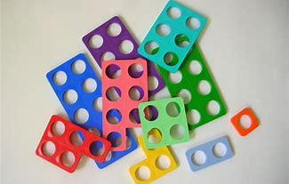

Mathematics
We follow the First for Maths Planning
Planning focuses on 6 areas:
Cardinality and counting
Comparison
Composition
Pattern
Shape and space
Measure

Slide 8
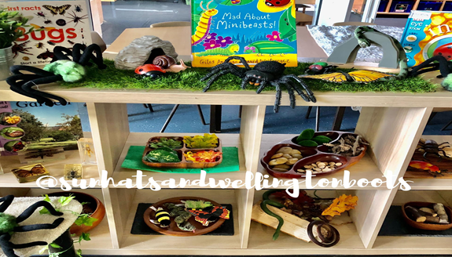
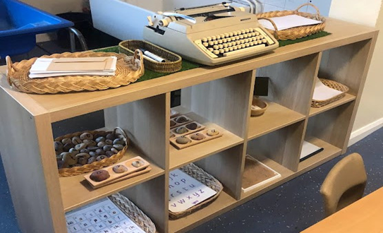
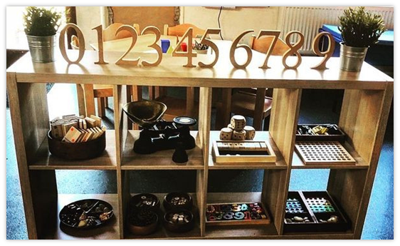
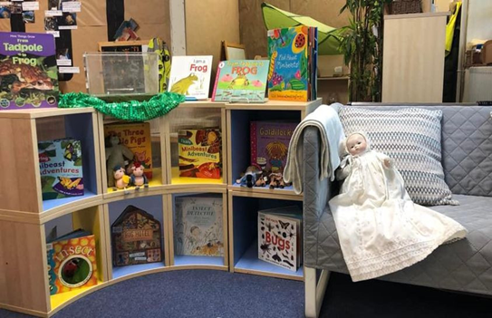
Continuous Provision
The purpose of continuous provision is "to continue the provision for learning in the absence of an adult".
We have a range of continuous provision areas in the classroom including:
Cookery table
Atelier
Writing area
Maths area
Funky fingers
Small world
Story telling
Construction
Malleable
Role play

Slide 9
First week Routine
Autumn term starts on Wednesday 2nd September
Children can attend half days for the first two weeks, if required.
First week routine
8:30 am – Children are to be taken to the Reception gate where they will be greeted by their class teacher.
3:05 pm - The class teacher will accompany children onto the playground where they will be handed back individually. Staff will not allow a child to leave with an unknown or alternative adult without written permission.
Please email the school office if an alternative adult will be collecting your child.
Normal drop off and collection times are:
8:30 am
3:15 pm

Slide 10
Uniform
Supplied by Badged Sandbach
Boys
Winter- Black trousers, school logo polo shirt, school logo sweatshirt (green), black socks, black Velcro shoes
Girls
Winter- Tartan skirt, school logo polo shirt, school logo sweatshirt/cardigan (green), black tights, black trousers (no leggings) black Velcro shoes
PE kit
Black shorts or jogging bottoms, Green t-shirt, black school logo hoodie, trainers or pumps
School Logo book bags and PE bags are also available

Slide 11



Food and Drink
Lunch: Packed lunch from home or a school packed lunch
Snacks:
Morning - A healthy snack from home or a hot snack from school
Afternoon- Fruit and a cup of milk (until their 5th birthday)
Children can bring in a water bottle, which can be refilled at school.

Slide 12


Slide 13
Health
Absence requires a telephone call or an email to explain why.
Any vomiting or diarrhoea must be followed by 48 hours absence.
Head lice are common, please check regularly and treat as recommended.
If your child requires an inhaler, please ensure a spare one is left in school.
If your child requires medication in school hours a permission form will need to be completed in the office.

Slide 14
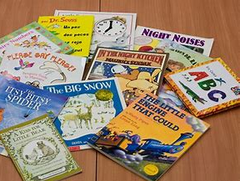

Home Learning
Reading books will be changed once a week, please write a comment in the reading record after you’ve read at home.
New tricky red words will be sent home when your child starts red books, please help your child to learn to read and spell these words.
Maths tasks will be set weekly (from January) on the class webpage under the homework tab
Purple Mash – you will receive a log in code during the autumn term.

Slide 15
We hope that this meeting has been useful.
Please remember, if you have any queries, concerns or questions, please phone or email school.
We aim to ensure that your child’s experience at Bunbury is a happy and rewarding one.
We look forward to working with both you and your children in September.

