Slide 1

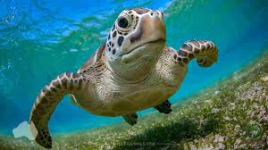

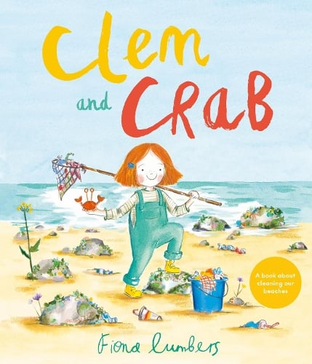
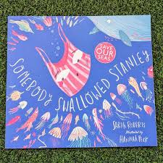
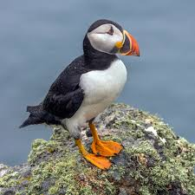
Reception Knowledge Organiser
Planet Protectors
Pictures and diagrams
Key Facts (curriculum end points)
To recognise a whale, puffin and turtle. To know that plastic in the ocean is dangerous to sea creatures. To know that some materials can be recycled. To know that we can help the environment by reducing and reusing non-recyclable materials. To know that sanctuaries and charities support injured animals. To use the correct vocabulary to describe the environment around them eg material names, ocean, coral reef etc
Vocabulary
ocean | puffin
pollution | turtle
environment | aquarium
recycle | tide
reuse | conservation
reduce | habitat
litter | protect
Coral reef | glistened
Prior Knowledge – Key Facts
Know the names of some sea/coastal animals. Know the names of some materials. To be able to identify litter and what littering is.

Slide 2



