Slide 1

Bunbury Aldersey
C of E PRIMARY School
Meet the Teacher
Nursery
Miss Bourne, Mrs C (Gill), Mrs D and Mrs B (Denise)
“Let your light shine”
Matthew 5:16

Slide 2
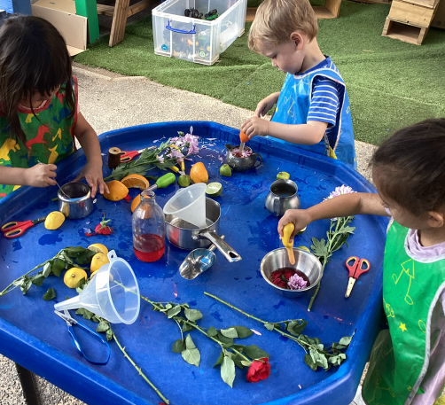
We strive to provide an education your child will never forget. Rich with diverse opportunities and experiences set within a
Christian context.
“Let your light shine”
Matthew 5:16

Slide 3
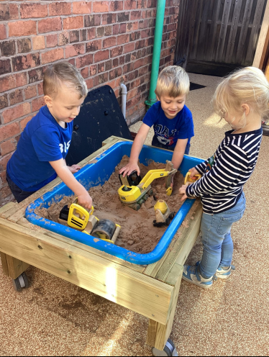
Our Christian values underpin all we do:
* Our children are happy, caring and empathetic to others
*Our children learn and develop as moral individuals within the context of Christian values
“Let your light shine”
Matthew 5:16

Slide 4

As a Rights Respecting School children’s rights are also at the centre of our ethos.
We are a Gold Rights Respecting School.
The children learn about their rights through a variety of different activities and about the importance of children’s rights in the world through themed days.
At the start of this year, our class completed our class charter.

Slide 5


Our School rules
“Let your light shine”
Matthew 5:16

Slide 6
Autumn Term Dates
NSPCC Kindness week – Monday 30th September
Reception starters 2026 Open Day - Wednesday 1st October
Harvest Service at St Boniface (all are welcome to attend) – Friday 3rd October
YEAR 5 – Safety Central Visit – Monday 6th October
Reception starters 2026 Open Morning – Saturday 11th October
Year 5 Pilgrim Day visit to Chester Cathedral – Friday 17th October
Reception 2026 Open Day –
Parents evening face to face appointments – Tuesday 21st October – 3.30 – 6.30pm
Parents evening online appointments – Thursday 23rd October – 3.30 – 6.30pm
RCSAT service of celebration (children only) - Thursday 23rd October pm
Academy photos: families, siblings and individual – Friday 24th October
BREAK for HALF TERM HOLIDAY - Friday 24th October 2025
RETURN TO SCHOOL – Monday 3rd November
Hope Journey – Remembrance Year 6 – Wednesday 5th November am
Remembrance Service at Bunbury Aldersey (all are welcome to attend) – 10.45am Friday 7th November
Reception 2025 Open Day –
Storyhouse Christmas Theatre Visit whole school (children only) –
KS1 Christmas Nativity (all are welcome to attend) – Tue 10th/ Wed 11th/ Thurs 12th December 1.30pm
KS2 Carol Concert (all are welcome to attend) – Tuesday 17th December 6pm St Boniface Church
Christmas Parties (children only) – Thursday 19th December
BREAK for CHRISTMAS HOLIDAY – Thursday 18th December
“Let your light shine”
Matthew 5:16

Slide 7







Autumn Term
This half term our topic is ‘All About Me.’
Next half term our topic will be ‘Traditional Tales.’
Let your light shine”
Matthew 5:16

Slide 8
Nursery WEbpage
https://www.bunburyaldersey.cheshire.sch.uk/class/nursery
The link above will take you to the main Nursery webpage. If you scroll to the bottom of this page, you will find useful documents and our planning.

Slide 9
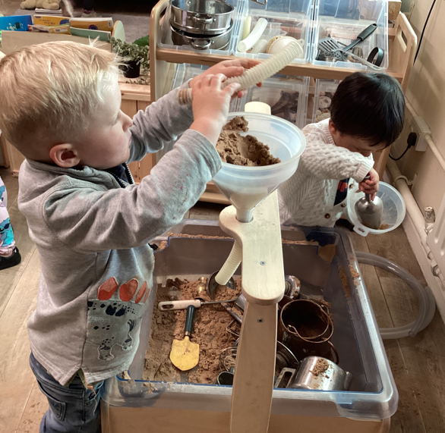
Nursery
Activities in Nursery are carefully planned in order to provide a rich range of learning experiences for all children. In Nursery we follow a topic-based approach, as well as responding to certain events, for example Harvest or Bonfire Night.
There are 7 Areas of Learning in the Early Years Foundation Stage (EYFS), which our activities are planned around:
Personal, Social and Emotional Development
Physical Development
Communication and Language
Literacy
Mathematics
Understanding the World
Expressive Arts and Design
During free play in our continuous provision, children will also have lots of opportunities to develop in these seven areas.
“Let your light shine”
Matthew 5:16

Slide 10
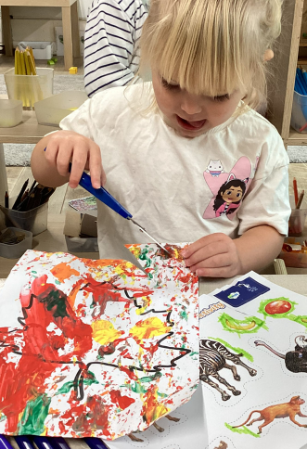
A Typical day in nursery
8:30am-8:45am: Children arrive in to Nursery and go into free play.
8:50am-9am: Register, Good Morning song, Days of the week song, Weather Song
9am-9:30am: Free play inside or outside
9:45am-10am: Small group activities.
10am-10:20am: Snack time
10:20am- 10:30am: Dough Disco
10:30-11:15am: Free Play, inside or outside
11:15am-11:30am: Small group activities
11:30am-11:45am: Story/Singing, wash hands for lunch
11:45-1pm- Lunch in the hall then back to Nursery room for free play (outside)
1pm-1:15pm: Afternoon register and story/singing
1:15pm- 1:45pm: Free play
1:45-2pm: Small group activities
2pm-2:45pm: Free play
2:45pm-3:15pm: Tidy, story/singing and get ready for home time.
“Let your light shine”
Matthew 5:16

Slide 11
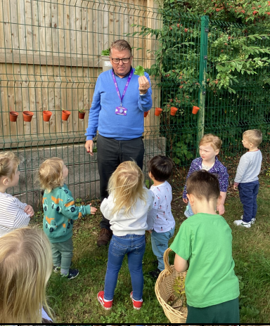
Forest school
Forest school is on a Wednesday afternoon with Mr Robinson.
Please bring in wellies and waterproofs for this day. These can be left in Nursery if you wish.
Please label all clothes, including shoes.
“Let your light shine”
Matthew 5:16

Slide 12


READ WRITE INC
We begin teaching Phonics in the Summer term for those children who are in their final term before beginning Reception. (Pre-School)
Throughout the rest of the year, we have a focus on developing children’s speaking and listening skills. Children will work on the sounds around them, such as environmental and instrumental sounds, as well as rhythm, rhyme and alliteration.
“Let your light shine”
Matthew 5:16

Slide 13
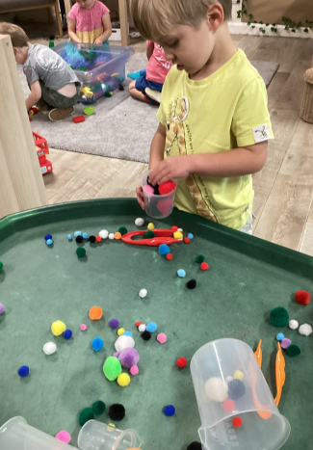
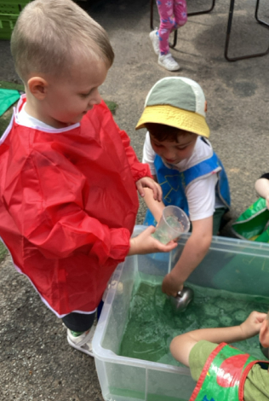
Maths
Maths in Nursery is taught using the First 4 Maths scheme. This approach is also used by the whole school, providing consistency. Short and engaging Maths activities are planned for the children three times a week, to fit into our topics.
“Let your light shine”
Matthew 5:16

Slide 14
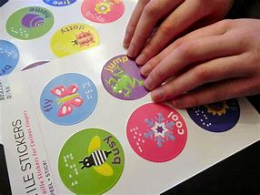
House Teams
Team points
We have four house teams at Bunbury -
Aldersey, Edgerton, Calveley and Beeston.
This year the Nursery children are going to become part of these house teams. Each child is allocated a house. If your child has a sibling in the school, they will be put in the same house as them.
During the week children are rewarded with team points and the wining house is announced during celebration assembly.
“Let your light shine”
Matthew 5:16

Slide 15
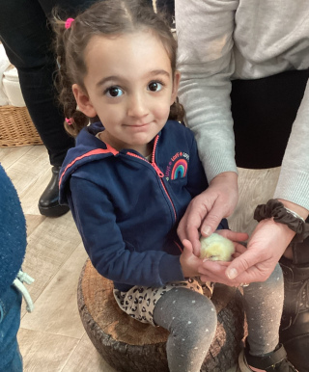
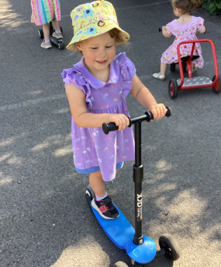
Tapestry
We use Tapestry to provide you with an insight to all the fun things we get up to in Nursery. We will upload pictures, videos and comments to your child’s Tapestry to show you all the super learning that is happening.
If you are having any troubles with accessing Tapestry please get in touch with one of the Nursery team and we can sort this for you.
Let your light shine”
Matthew 5:16”

Slide 16

Purple Mash
Purple Mash is a great app that can help children to gain ICT skills using the EYFS Mini Mash.
Each child has their own log in which will be handed out at the end, so you can access this at home if you wish to.

Slide 17
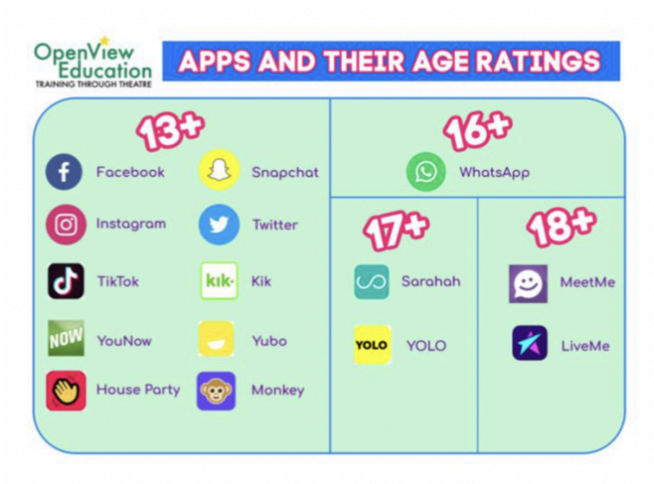
DIGITAL SAFEGUARDING
Bunbury Aldersey School take internet and technology safety extremely seriously.
As a school we educate both parents and children about the benefits but also the dangers with the online world so that we can all use what is a valuable resource safely and responsibly.
We ask that parents reinforce these messages at home by ensuring children are not on the internet unsupervised
There will be further workshops led by PC Andrew Cornall through the year as well as regular guidance on our weekly newsletters.
“Let your light shine”
Matthew 5:16

Slide 18
Communication
If there is anything you would like to talk to us about, no matter how small it may seem, please do! We are always available at the beginning or end of the day, so please do not hesitate to speak to us.
You can email the office on: admin@bunburyaldersey.cheshire.sch.uk
Or contact Mrs Badger: principalbunbury@RCSAT.cheshire.sch.uk
“Let your light shine”
Matthew 5:16

