Slide 1

Bunbury Aldersey
C of E PRIMARY and Nursery School
Meet the Teacher
Year 6
Mrs Haydock and Mrs Cheers
“Let your light shine”
Matthew 5:16

Slide 2
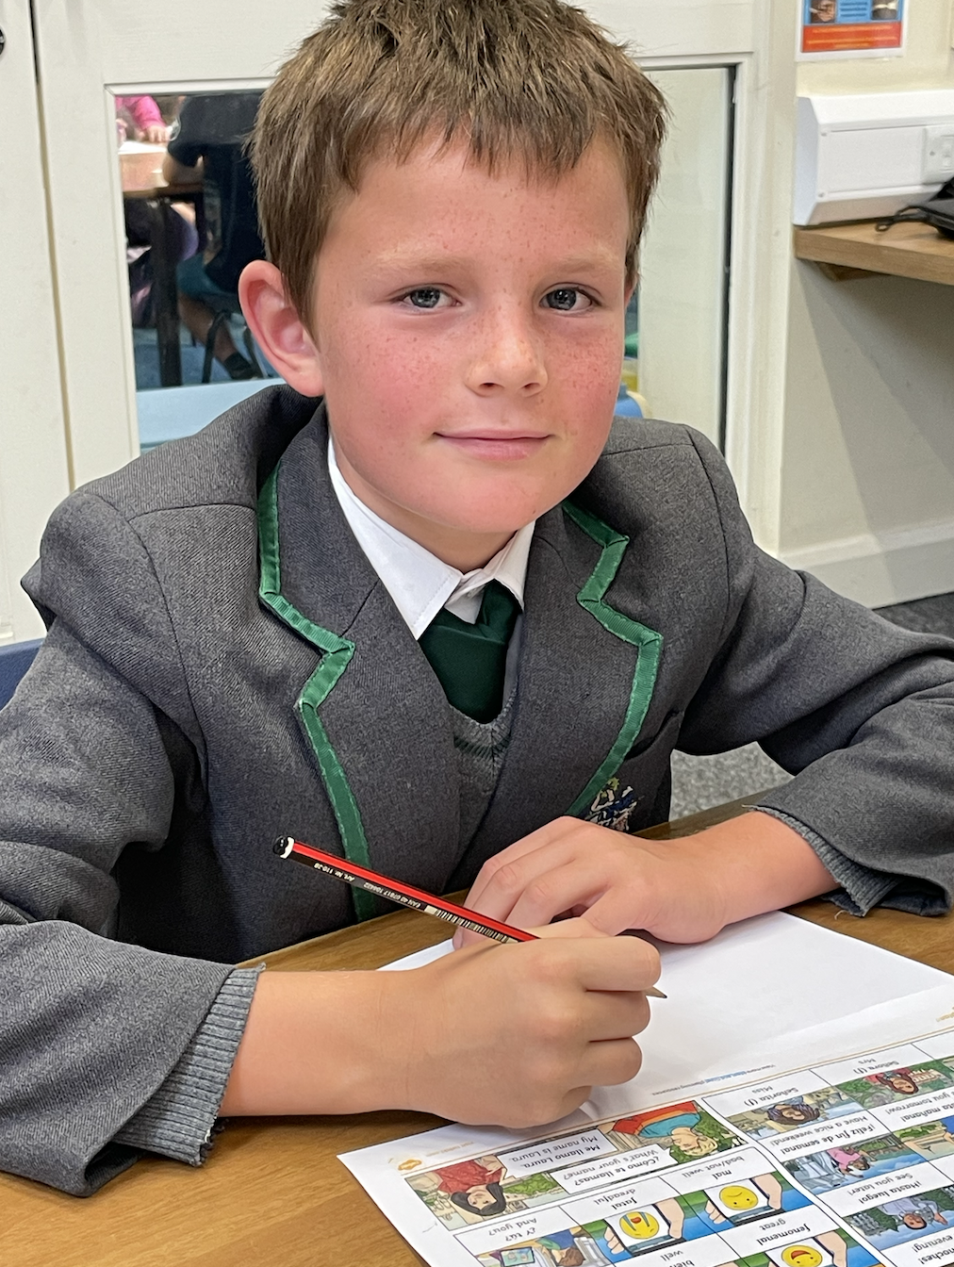
We strive to provide a primary education your child will never forget. Rich with diverse opportunities and experiences set within a
Christian context.
“Let your light shine”
Matthew 5:16

Slide 3
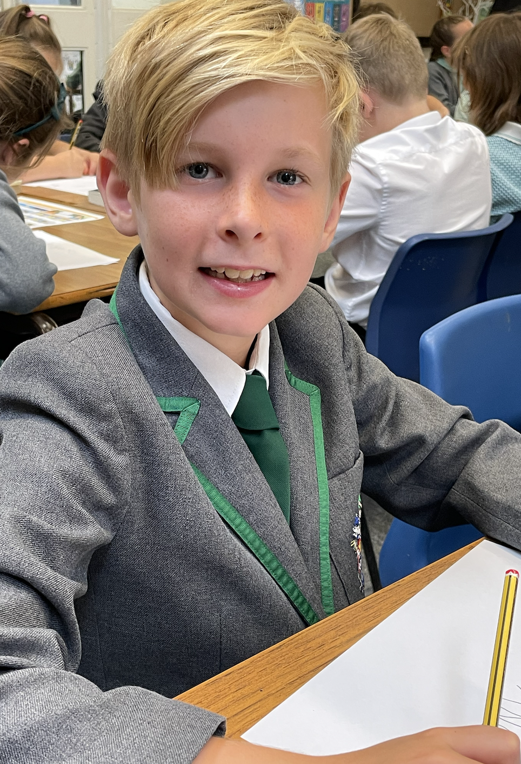
Our Christian values underpin all we do:
* Our children are happy, caring and empathetic to others
*Our children learn and develop as moral individuals within the context of Christian values
“Let your light shine”
Matthew 5:16

Slide 4

As a Rights Respecting School children’s rights are also at the centre of our ethos.
We are a Gold Rights Respecting School.
The children learn about their rights through a variety of different activities and about the importance of children’s rights in the world through themed days.
At the start of this year, our class completed our class charter.

Slide 5

Our School rules
“Let your light shine”
Matthew 5:16

Slide 6
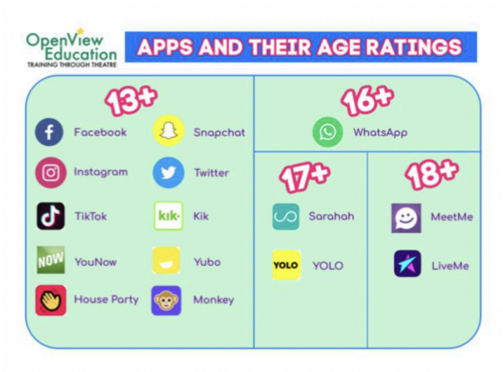
DIGITAL SAFEGUARDING
Bunbury takes internet and technology safety extremely seriously.
As a school, we educate both parents and children about the benefits but also the dangers with the online world so that we can all use what is a valuable resource safely and responsibly.
We ask that parents reinforce these messages at home by:
- ensuring children are not on the internet unsupervised
- ensuring children do not have access to internet/ devices
whilst in bathrooms/bedrooms/closed spaces
- reminding your children about joining chat groups
but also the impact of sharing other pupils’ information.
checking your child’s device for inappropriate apps, messages
ensuring your child does not post or accesses anything inappropriate or upsetting to others
There will be further workshops led by PC Andrew Cornall through the year as well as regular guidance on our weekly newsletters.
“Let your light shine”
Matthew 5:16

Slide 7
Autumn Term DATES
Autumn term dates 2025
NSPCC Kindness week – Monday 30th September
Reception starters 2026 Open Day - Wednesday 1st October
Harvest Service at St Boniface (all are welcome to attend) – Friday 3rd October
YEAR 5 – Safety Central Visit – Monday 6th October
Year 6 – Tarporley High School transition day – Tuesday 7th October
Reception starters 2026 Open Morning – Saturday 11th October
Year 6 – Stockport air raid shelters trip – Tuesday 14th October
Year 5 Pilgrim Day visit to Chester Cathedral – Friday 17th October
Reception 2026 Open Day –
Parents evening face to face appointments – Tuesday 21st October – 3.30 – 6.30pm
Parents evening online appointments – Thursday 23rd October – 3.30 – 6.30pm
RCSAT service of celebration (children only) - Thursday 23rd October pm
Academy photos: families, siblings and individual – Friday 24th October
BREAK for HALF TERM HOLIDAY - Friday 24th October 2025
RETURN TO SCHOOL – Monday 3rd November
Hope Journey – Remembrance Year 6 – Wednesday 5th November am
Remembrance Service at Bunbury Aldersey (all are welcome to attend) – 10.45am Friday 7th November
Reception 2025 Open Day –
Storyhouse Christmas Theatre Visit whole school (children only) –
KS1 Christmas Nativity (all are welcome to attend) – Tue 10th/ Wed 11th/ Thurs 12th December 1.30pm
KS2 Carol Concert (all are welcome to attend) – Tuesday 17th December 6pm St Boniface Church
Christmas Parties (children only) – Thursday 19th December
BREAK for CHRISTMAS HOLIDAY – Thursday 18th December

Slide 8
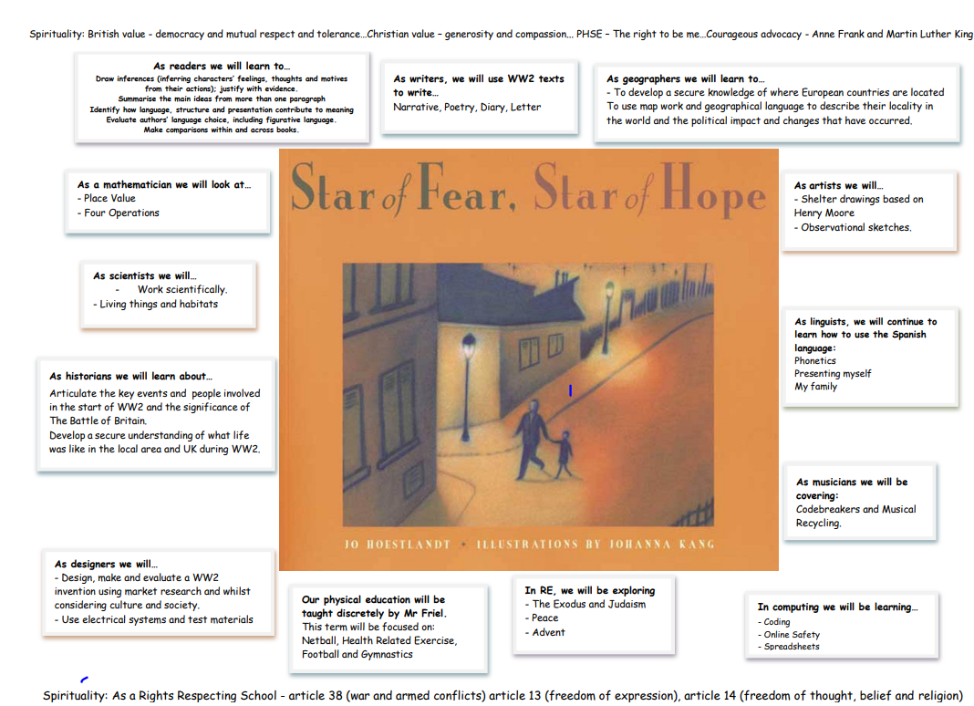
YEAR 6
Y6 will be learning about World War II during the Autumn term.
This topic web shows what we will be covering across the curriculum and can be found on the Year 6 webpage
“Let your light shine” Matthew 5:16

Slide 9
HOMEWORK
Each child has received a reading diary and homework journal in order to complete homework tasks.
Reading – daily reading is given a high priority from reception to year 6. Children across the school will be expected to read at least 5 times per week. Reading entries will be recorded in a reading diary which all the children will be provided with. Each half term, class teachers will also issue a list of recommended reading both fiction and non-fiction linked to the connected curriculum theme.
Spelling – Children will receive a spelling list of age-appropriate high frequency words at the start of each term to learn. Using our booklet ‘Helping your child to spell’ the children need to work on learning around 8 words per week. This will be in addition to spelling patterns from staged spelling groups where words are tested weekly. Children in KS2 will receive these on a Friday and be tested the following Thursday.
MyMaths – Children will receive a weekly online maths task related to learning which has taken place that week in school.
Times tables – Children will receive specific times tables to learn in each year group. Year 2 – 2x,5x,10x with an awareness of 3x and 4x, Year 3 – as in year 2 plus 3x,4x,8x, Year 4 –all times tables plus an awareness of related division facts, Year 5 and 6 all times tables with related division facts.
Home learning projects – As part of our inclusive connected curriculum, all classes will be asked to complete a home learning project once a half term. These projects, Take away homework, are linked to the class learning theme and children have a choice of which task they wish to complete at home. We believe that these projects are a great opportunity for parents/carers to work alongside their child, enhancing their learning experience. The projects are shared and celebrated with other classes.
Knowledge organiser – Key facts, information and vocabulary linked to the area of learning in class for that term. Children will be expected to know some of the facts and use these key words within their learning.
Year 6 – There may be times in year 6 when further homework will be set to extend and reinforce the learning in the classroom.
“Let your light shine” Matthew 5:16

Slide 10
CGP BOOKS
In addition to the work in your yellow homework journals, we will set a weekly page from each of the following CGP books:
          Maths
          Reading
          SPAG
The page numbers will be added to the Y6 homework page on a Friday.
Tasks are to be completed at home on a weekly basis and should marked by the parents/carers (answers are found in each of the CGP books)
We will be able to answer questions should you have any, but will not be marking the work weekly as our time will be spent marking work completed independently in class and providing feedback
CGP books are to be brought into school, together with the yellow homework journals, at the end of each half term.
We will sign and add team points for consistency of completion, effort and good evidence of independent learning.
For parents wishing to follow the additional homework tasks the following books will need to be purchased from CGP. https://www.cgpbooks.co.uk

Slide 11

Maths
MyMaths is an interactive online teaching and homework subscription website for schools that builds pupil engagement and consolidates maths knowledge. It has lessons and tasks to work through which provide step-by-step explanations to break down the lesson content into bite-sized pieces. This will help children to recap a concept and also help you, as parents/carers, to understand the method taught. There are also games to complete.
There are also maths parent guides which have been uploaded onto each year group’s class page. This document provides calculation method examples.

Slide 12
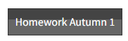
http://www.bunburyaldersey.cheshire.sch.uk/class/year-6
HOMEWORK
The link above will take you to the main Year 6 webpage. If you scroll to the bottom of this page, you will find useful documents for Year 6.
At the top of this page (just underneath the photos) there is a tab:
Here, you will find all the documents your child needs to complete their homework.
Alternatively, the link below takes you straight to the ‘Homework Autumn 1’ section:
https://www.bunburyaldersey.cheshire.sch.uk/page/homework-autumn-1/144388
Homework for this half term is due the week commencing 20th October.
This half term’s takeaway homework is due Wednesday 22nd October.

Slide 13
SATS
Key Stage 2 SATs will take place nationally in the week commencing Monday 11th May 2026 and include:
Reading (60 minutes)
Spelling (approximately 15 minutes)
Punctuation, Vocabulary and Grammar (45 minutes)
Mathematics
- Paper 1: Arithmetic (30 minutes)
- Paper 2: Reasoning (40 minutes)
- Paper 3: Reasoning (40 minutes)
There will be further information in Spring.
“Let your light shine”
Matthew 5:16

Slide 14
High Schools
Fill out ‘home’ local authority’s
application form (i.e. the authority where you live)
It is very important to remember to submit
your application by the closing date of 31st October 2025.
Secondary place offers will be sent out by the local authority in March 2026.
You can complete this online.
“Let your light shine”
Matthew 5:16

Slide 15
PE KITS
Children need to come to school in their PE kit
PE is on the following days: Wednesday and Thursday
PE kit should be named.
Plain black track suit, black shorts or skort, green polo shirt and black canvas pumps/trainers in line with the new uniform, PE black hooded sweatshirt.
NO FOOTBALL TOPS or STRIPS please.
Dark sport trousers may be worn in the colder months.
“Let your light shine”
Matthew 5:16

Slide 16
SCHOOL COMMUNICATION
If there is anything you would like to talk to us about, no matter how small it may seem, please do!
Unless I have a club or other commitment straight after school, I will be on the playground each day at 3.15pm, or please make an appointment through the school office. Unfortunately, I cannot speak with anyone in the morning unless it is an emergency.
You can email the office on: admin@bunburyaldersey.cheshire.sch.uk
Or contact Mrs Badger: principalbunbury@RCSAT.cheshire.sch.uk
“Let your light shine”
Matthew 5:16

Slide 17
Thank you for your support.
“Let your light shine”
Matthew 5:16

