Slide 1

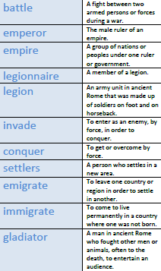
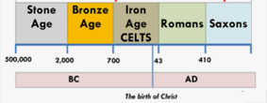
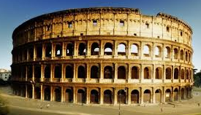

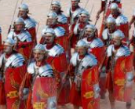
Y
Year 4 – Spring 1: What was the ‘Romanisation’ of Manchester and Britain?
What will I know by the end of the unit?
Who was Julius Caesar? | Julius Caesar was the best-known Roman leader. He created the Julian Calendar, which is what the calendar we use today is based on.
How was Rome founded? | Two brothers, Romulus and Remus, who were abandoned after they were born, created Rome.
What was the Roman Empire? | The Romans invaded and conquered many countries in Europe before heading to Britain.
Who was Boudicca? | Boudicca was a queen of the British Celtic Iceni tribe who led an uprising against Roman occupied towns and cities.
How did the Romans impact Britain? | The Romans left their mark on Britain leaving us new towns, plants, animals, religion, and ways of reading and counting.
Key Vocabulary | Definition

