Slide 1

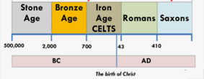
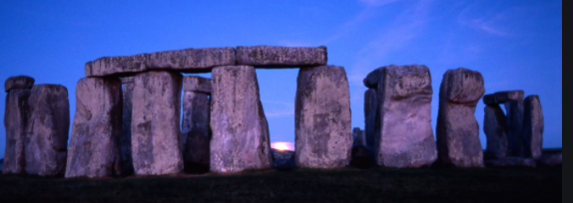
Y
Year 3 – Spring 1: How have ideas from these time periods impacted our lives today?
What will I know by the end of the unit?
When was the Stone Age, Bronze Age and Iron Age? | Stone Age (15000 – 3000 BC) The Bronze Age (3000 – 825 BC) Iron Age (825 – 34 BC
What happened in the Stone Age? | In the early stone age, humans lived in caves. Later, they did start to build huts made out of wood and animal skins. Then towards the end of the stone age, they started to build permanent places to live – with a roof! The only two things humans had to do was to look for food and protect themselves from wild animals. Humans learnt to farm during the Stone Age and people made their own tools.
What is Stonehenge? | Stonehenge: Work started on this super stone circle around 5,000 years ago in the late Neolithic Age – but it took over 1,000 years to build, in four long stages! Archaeologists believe the final changes were made around 1,500BC, in the early Bronze Age
What happened in the Bronze Age? | Bronze is mixture of tin and copper. It could be used to make a greater range of tools and weapons than had previously been possible. Improvements in: navigation skills, astronomy, maths, the invention of a wheel meant animal drawn vehicles could be used.
What happened in the Iron Age? | The Iron Age: where iron became the preferred choice of metal for making tools. These were more efficient tools.
Key Vocabulary | Definition
Stone Age | a prehistoric period when weapons and tools were made of stone or of organic materials such as bone, wood, or horn.
Celts | an army or country that uses force to enter and take control of another country
Bronze Age | a person or group who moves with a group of others to live in a new country or area
Iron Age | a particular attitude towards or way of regarding something; a point of view.
Civilisation | all the weapons that a group or country has or that are available to it.
Neolithic | The New Stone Age

