Slide 1

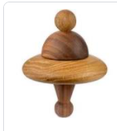
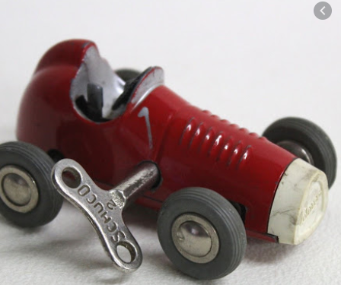
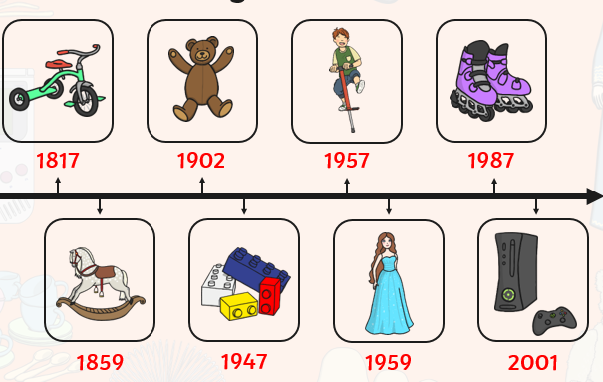
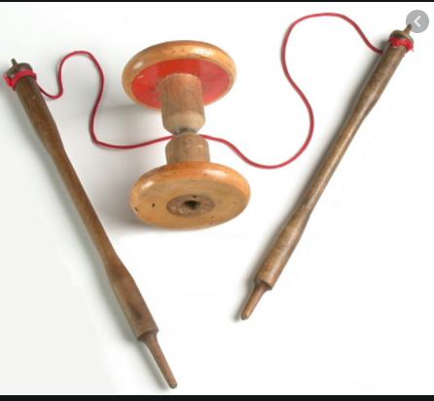
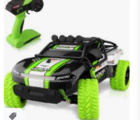
Y
Year 1 – Spring 1: How are the toys I play with different to those 50 years ago?
What will I know by the end of the unit?
All about toys | Old toys were made of: Wood, tin, lead, china New toys are made of: Plastic, foam, rubber, nylon Old toys were mostly handmade. New toys are mostly made in bulk in factories. Old toys often run on clockwork New toys often run on batteries (electricity)
Key Vocabulary | Definition
toys | An object we play with
object | A thing that can be seen and touched.
whip and top
diablo
old | Belonging to the past, something that has been here a long time.
new | Something that has been made for the first time.

