Slide 1
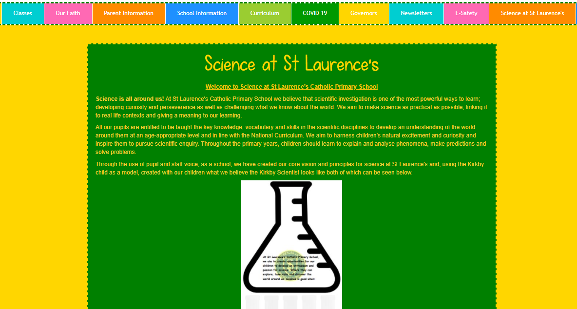
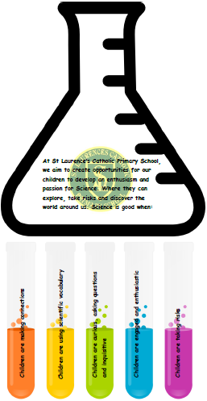
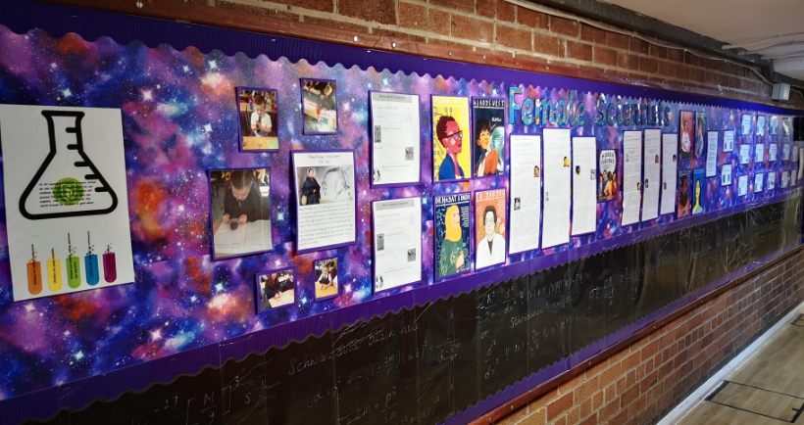
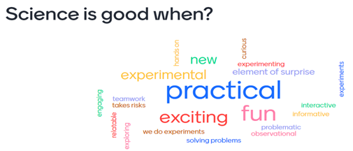
SL A: Science subject leadership is strengthened and developed through the creation and implementation of a clear vision for science.
Before PSQM we needed to create a clear vision and set of principles for science. Pupils and staff were asked what would make science even better. This was used to create our principles.
Visions and principles shared on school website under the new Science at St Laurence’s tab, along with links to virtual science club, as well as on our display in the main corridor.
Staff meeting, via Zoom, to discuss visions and principles incorporating pupil and staff voice, menti meter used to focus on key words. These were then used to create our visions and principles.
Impact: the creation of a whole school vision and principles for science, which included staff, pupils and parents, and sharing it widely across the school has meant the entire community at St Laurence’s can actively engage with science at our school.

Slide 2
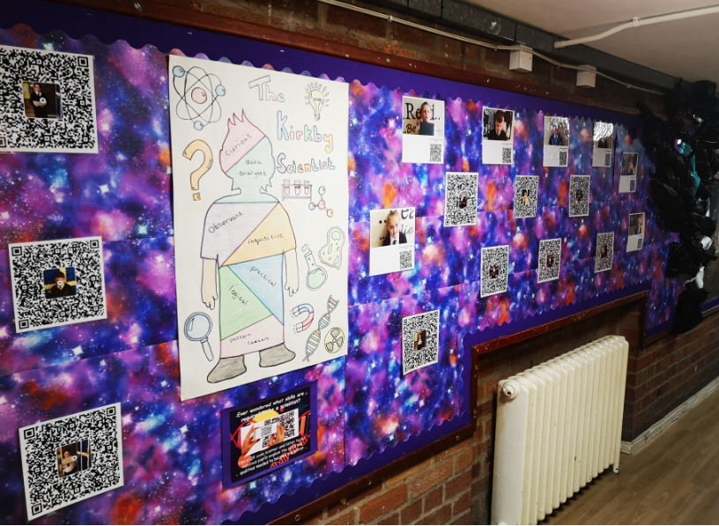
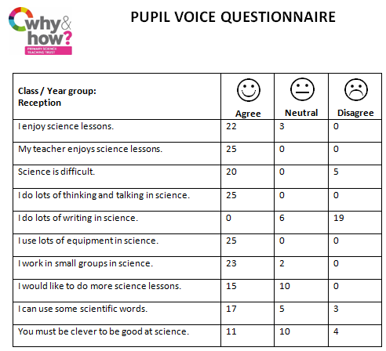
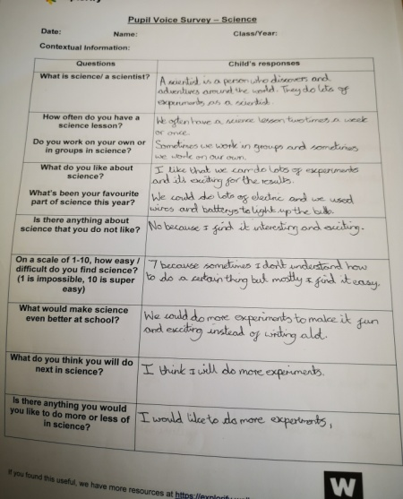
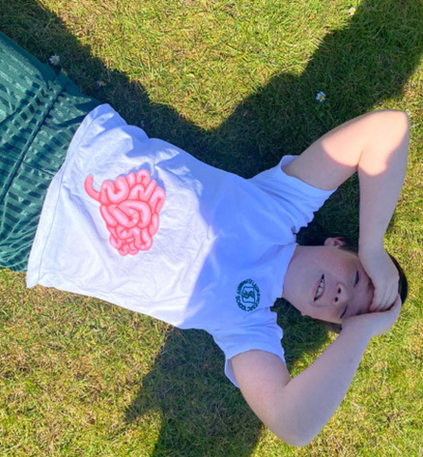
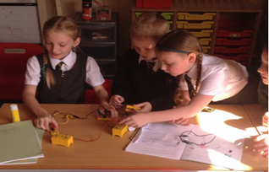
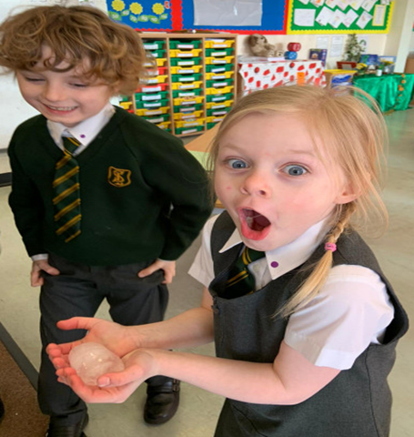
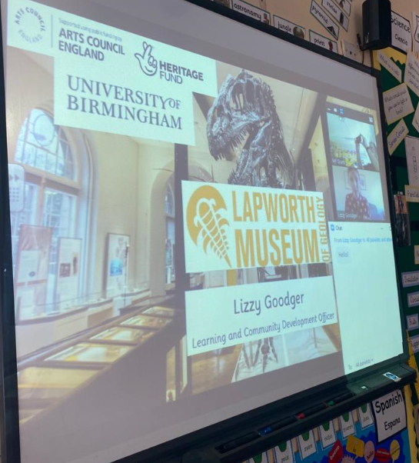
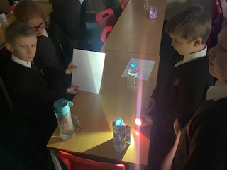
Before PSQM Pupils wanted:
Exciting experiments;
Less writing
Make more things
Speak to scientists, have more science trips
SL A: Science subject leadership is strengthened and developed through the creation and implementation of a clear vision for science.
Science display in main corridor
KS1pupil voice
KS2 child pupil voice
The Kirkby scientist poster was created based on what skills our children, from across all year groups, believed a scientist has. A selection of children from both key stages were then filmed describing what they believe a scientist is. QR codes were then created so children and visitors to our school could watch what our children had to say about being a scientist.
Y6 – human body
Y2 materials
Trips have taken place via Zoom this year. Our Year 3 and 6 children took part in an interactive session with the Lapworth Museum of Geology to enrich and support their learning from the topics they have covered rocks and fossils (Y3) and evolution (Y6).
Y4 – electricity
Children across the school carrying out more exciting experiments that engage them and enhance their learning through practical action.
Impact: Children are more engaged and interested in science. They look forward to lessons and are keen to share their learning experiences, which has had a positive effect on attainment. In addition to this, the children feel valued and listened to.
Y3 light

Slide 3
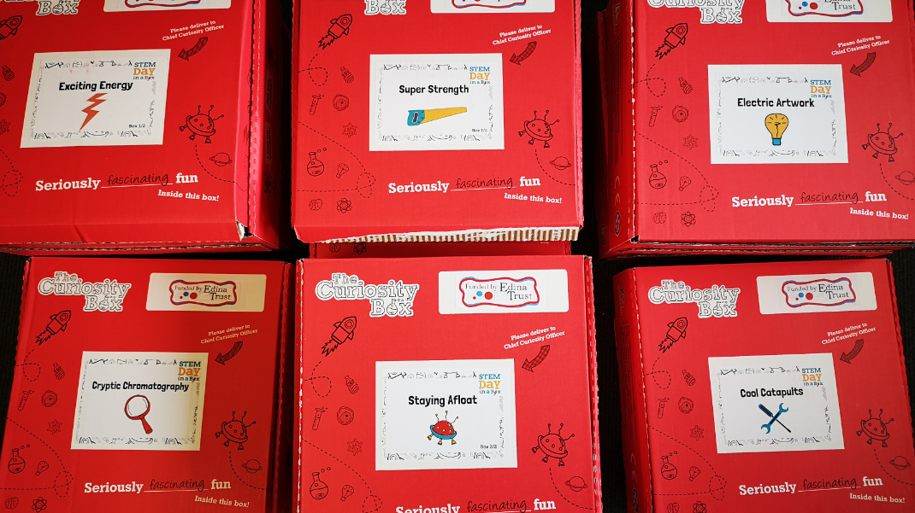
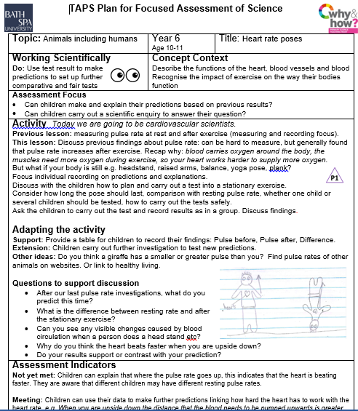
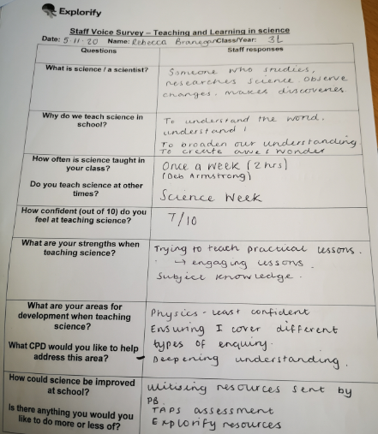
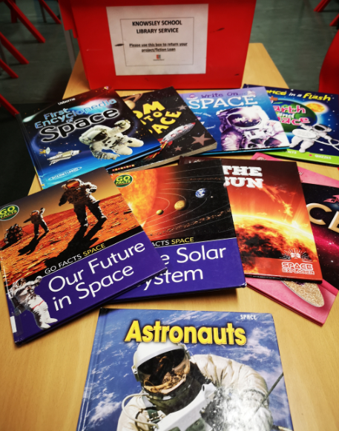
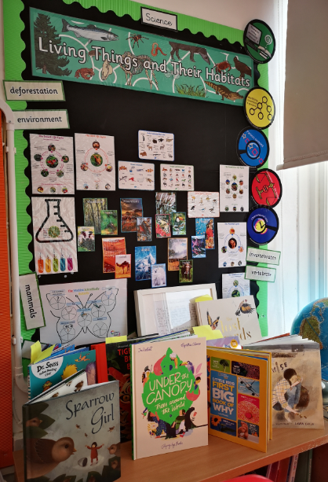
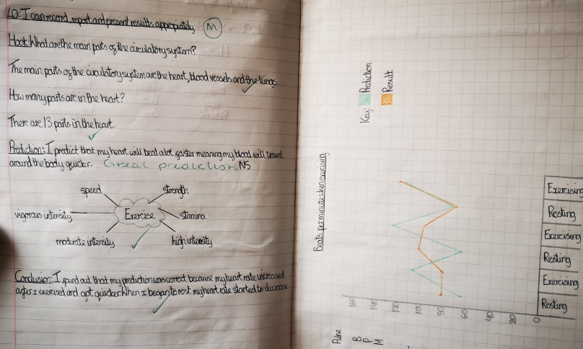
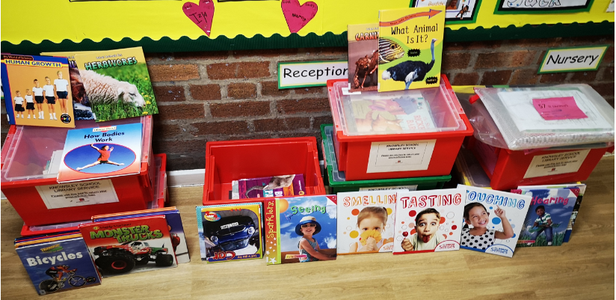
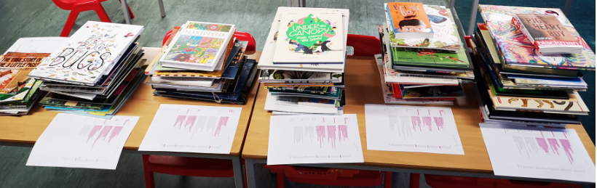
Before PSQM Staff wanted:.
To develop opportunities to link literacy and science.
Better subject knowledge
A greater understanding of scientific enquiry.
To have more up to date resources to support teaching of science
SL A: Science subject leadership is strengthened and developed through the creation and implementation of a clear vision for science.
Cross-curricular STEM curiosity boxes purchased with Edina Trust grant money (to be used for science celebration day at end of year).
TAPS assessment resources shared with staff at staff meeting. Examples of how to use TAPS lessons worked through to support staff with understanding scientific enquiry and how to assess it.
All staff asked to complete staff survey regarding science teaching and learning within our school.
Y4 display new books purchased on display for children to enjoy.
Y6 TAPS lesson
Library loans Y5
Links with local developed to use their library loans to provide good quality texts to support science. After success of this we Spent £2000 purchasing books for FS – KS2. Books on display in class linked to guided reading, lesson planning and reading for pleasure.
Impact: Staff have the resources to deliver cross-curricular lessons between literacy and science. Through use of TAPS assessment they have a great understanding of scientific enquiry and how to assess children accurately within science.
Library loans KS1
New books purchased for each year group for spring and summer terms

Slide 4
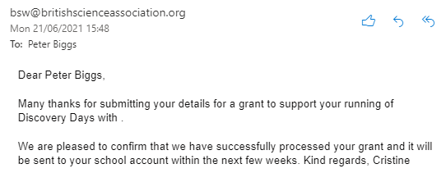
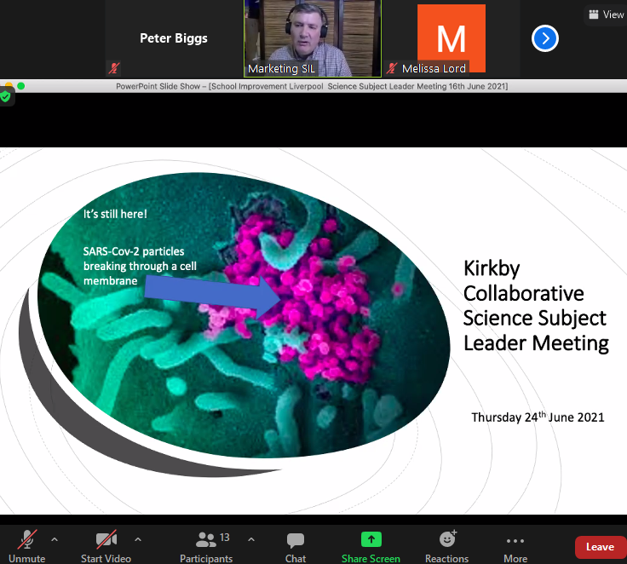
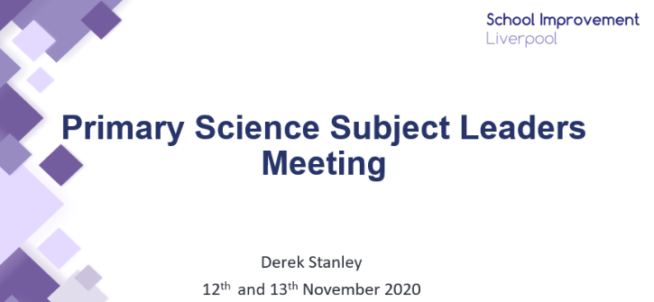
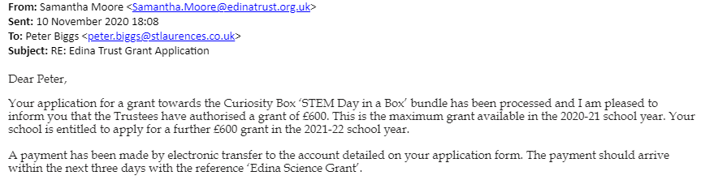
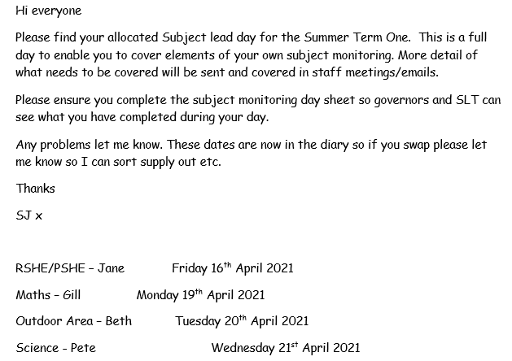
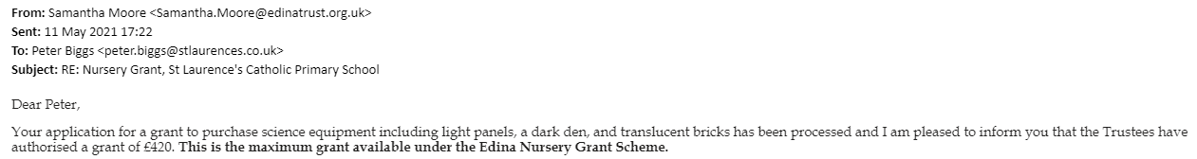
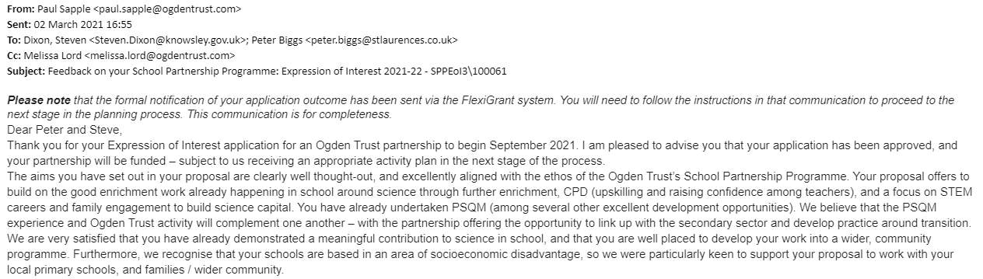
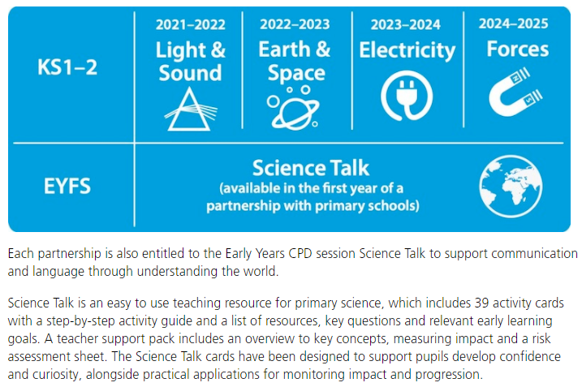
Before PSQM, science CPD had been limited.
SL B: Science subject leadership is strengthened and developed through strategic support enabling improvement to take place.
Dedicated leadership time has allowed me time to successfully apply for grants to boost the science provision within our school from FS – KS2
Termly dedicated subject lead day put in place this year. Opportunities to attend science focus CPD sessions encouraged and supported in addition to PSQM days and festival. Key points always feedback to staff at following staff meeting.
Successful Ogden Trust application has secured the following CPD for twelve primary schools in our partnership. Along with additional CPD for two secondary schools.
Support from our Headteacher and collaborative head lead to a successful application to create an Ogden Trust Partnership for 2021-22. Our role in doing the PSQM was highlighted as a strength.
Impact: CPD has been used to feedback best practice to staff, whilst subject lead time has been used to enhance the provision of science within our school and the wider community.

Slide 5
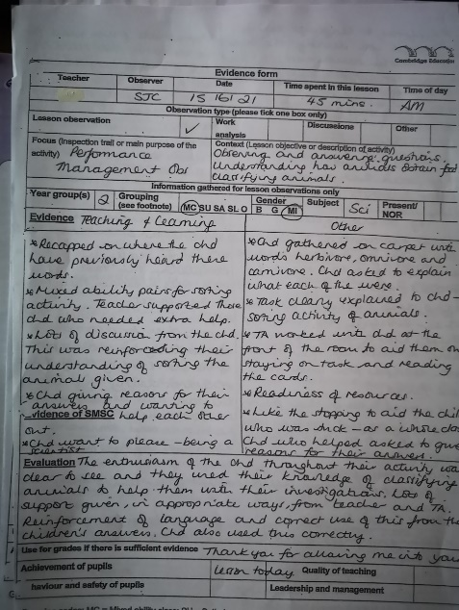
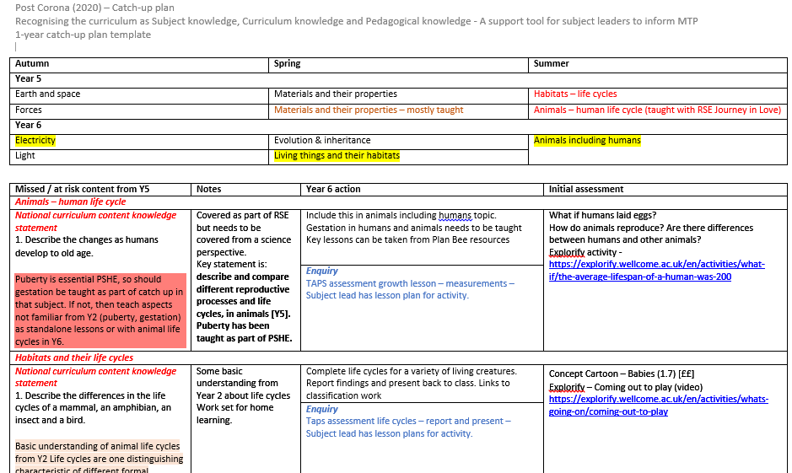
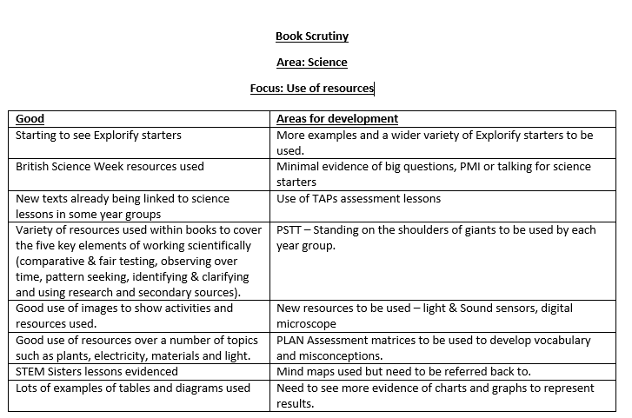
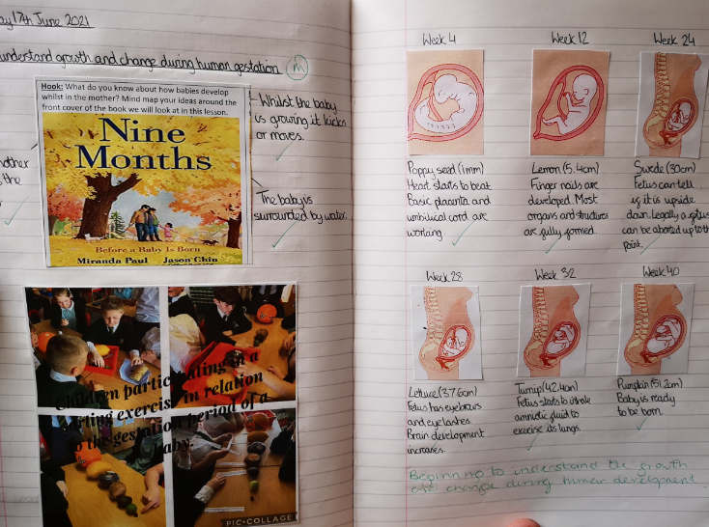
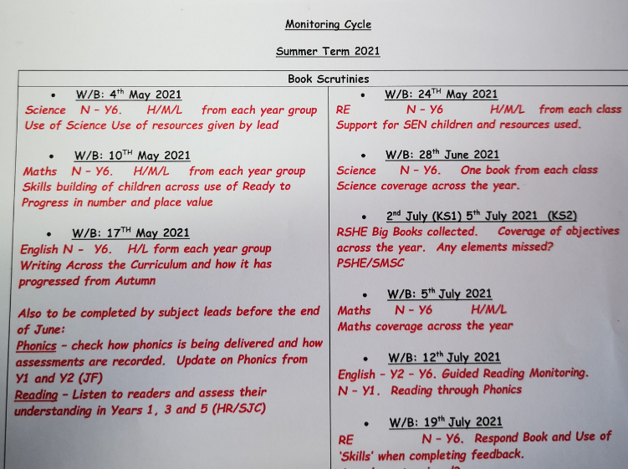
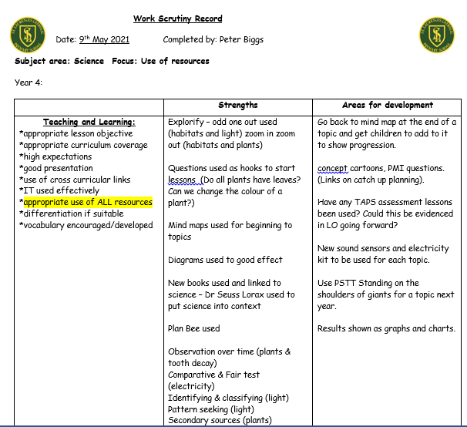
Before PSQM, science wasn’t being monitored as often as the other core subjects.
SL C: Science subject leadership is strengthened and developed through an effective monitoring and improvement cycle that informs development in science.
Monitoring within school was stopped by Headteacher for all subjects during autumn and spring. For summer term a monitoring timetable has been introduced. After discussions with SLT, Science was added to the monitoring cycle twice for the summer term. Book scrutinies have focused on use of resources and curriculum coverage, with a focus on ensuring that catch up, which has been planned and resourced by subject lead, is being delivered. Whole school and individual class feedback given in person and during staff meeting. Lesson observations for science have taken place from EFYS – KS2 with feedback written up and delivered to staff.
Catch up planning completed by SL
Lesson observation feedback
Catch-up curriculum planned for whole school using CALM resources, assessment tools and links provided. Plans monitored to ensure additional topics being covered in all year groups. Example from Yr6, Human development missed in Yr 5 due to first lockdown. Catch up plans shared with Yr 6 teachers new books also being used as hook.
Whole school feedback
Whole school summer monitoring cycle
Class feedback
Impact: Science is now monitored as often as English and maths as a core subject. New resources are being used and are having a positive impact on teaching and learning. Gaps, caused by pandemic, are being covered and subject lead is in regular dialogue with colleagues.

Slide 6
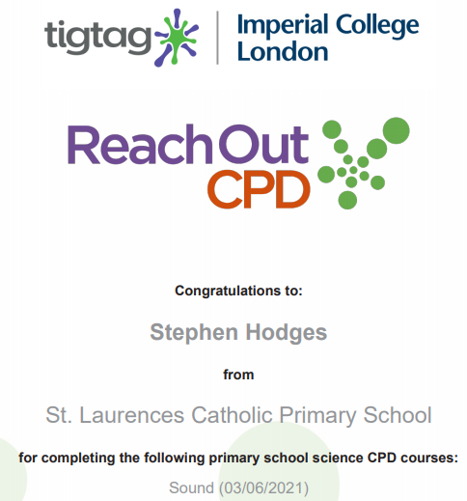
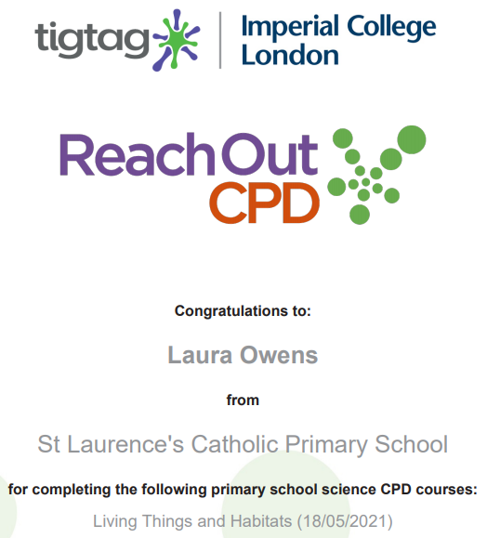
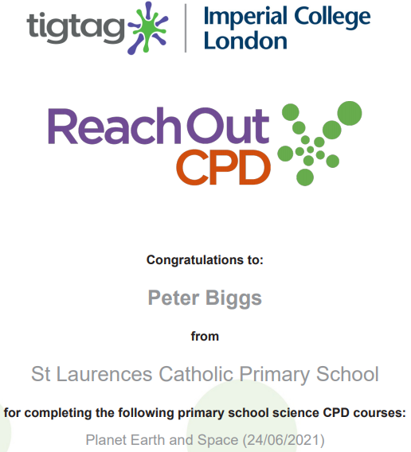
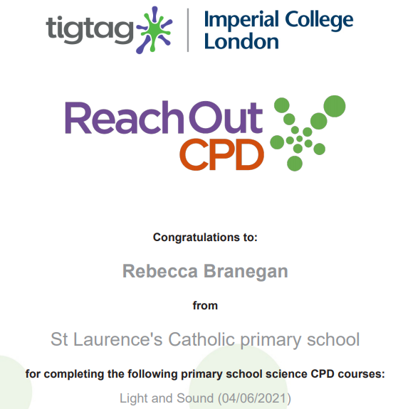
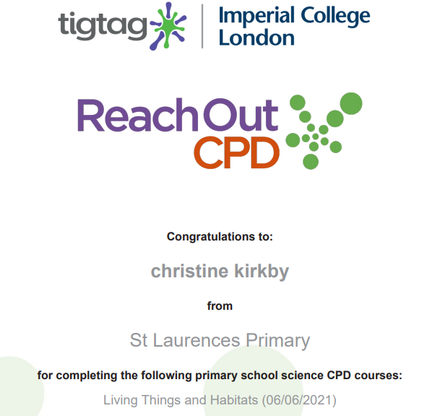
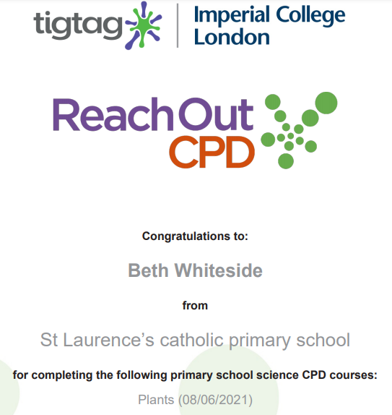
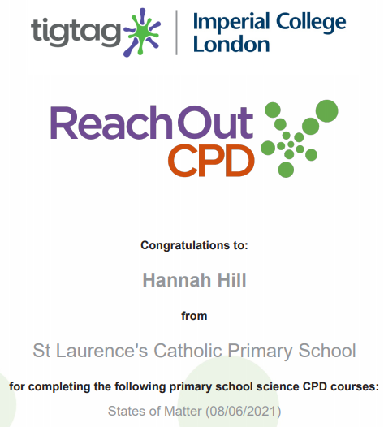
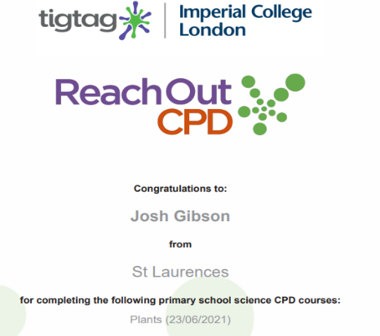
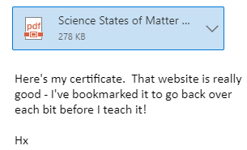
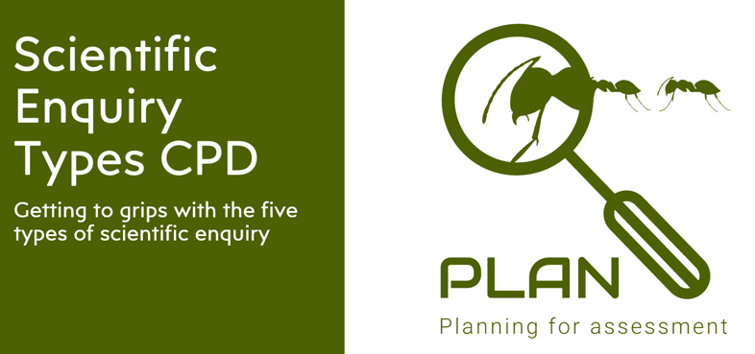
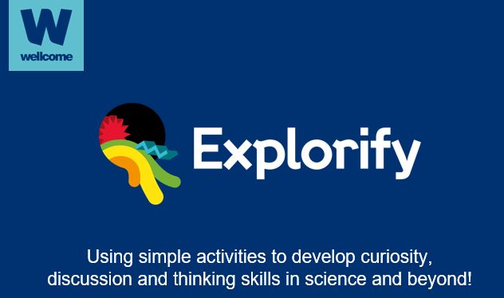
Before PSQM science CPD for staff had been limited. Staff asked for:
Better subject knowledge
A greater understanding of scientific enquiry.
T A: Science teaching is strengthened and developed through engagement with professional development.
For our CPD in Year 2 we chose to look at Habitats as this was the topic we were currently teaching.
We were both interested in the common misconceptions for this topic and the training highlighted the importance of teaching the difference between ‘habitats and homes’.
A home is more of a shelter where a habitat provides the essentials for survival.
Implications for teaching
Teach the difference between habitat and a home. Teach children about habitats and microhabitats. When teaching food chains avoid teaching children that the arrow means ‘eats’. Give children experience of investigating habitats (microhabitats).
During the pandemic, we’ve used Reach Out CPD to allow for staff to develop their subject knowledge at their own leisure and based on their own preference.
I found the Reach out CPD really useful. Each unit had lots of information that was easy to access and I enjoyed the videos and quizzes attached. The course has improved my subject knowledge and provided me with ideas for practical activities for teaching this topic.
Having taught Earth and Space for last five years, I hoping to gain some new insights and resources to use and Reach Out reporter didn’t disappoint. I’ve got new videos to use in class and two new practical lessons that I will explore next year.
The CPD topic I chose to do was our current topic Plants. I was interested in how to make more of our lessons practical and fun.
Scientific Enquiry CPD purchased from PLAN to deliver in future, a scaled down version delivered this year over Zoom. Explorify CPD session delivered during staff meeting (assessment slide has examples of it being used).
Impact: Staff’s confidence and subject knowledge to teaching science has improved. Staff now have a website (Reach Out CPD) that they can refer back to and complete CPD for any subject they teach in the future to improve their subject knowledge at their own pace.

Slide 7
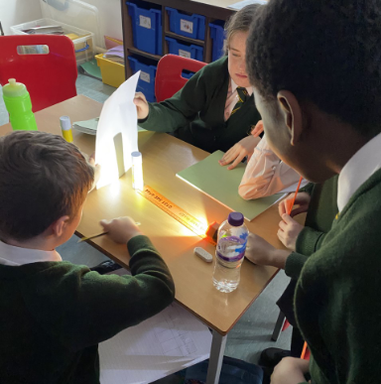
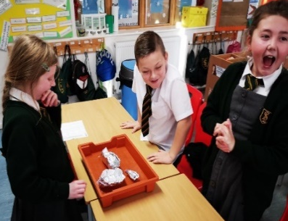
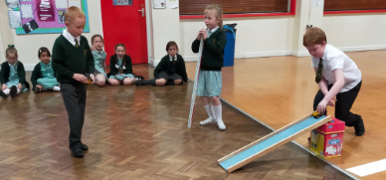
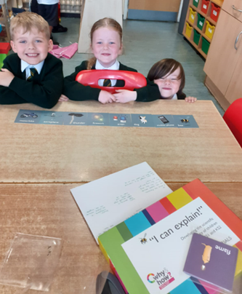
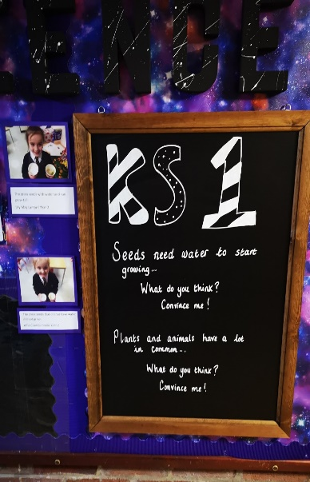






Before PSQM, staff asked for resources, especially in KS1, to engage children in scientific literacy.
T B: Science teaching is strengthened and developed through use of a range of effective teaching and learning strategies
‘I Can Explain’ resource purchased from PSTT to improve children’s science literacy. This resource is able to use from EYF – KS2. This year we have focused on using it with our KS1 children based on staff questionnaire from beginning of the year. Two activities children have are sorting activities one focusing on temperature (hottest to coldest) the other on sound (loudest to quietest). They then have to discuss and give reasons for their ideas.
Practical enquiry is a strategy that children wanted more of from their pupil voice ‘more experiments’ so this year it has been a clean focus for us to ensure that children are engaged and active learners within science lessons.
Sun melts ice, that’s why it’s the hottest.
The North pole has so much ice it can freeze water that’s why it is the coldest. A candle would burn you but it’s not as hot as the Sun! – Yr 1 children
Y5 forces
Y3 forces
Y6 light
A strategy implemented by Year 1 to get children engaged with scientific vocabulary was to use on of their new science based texts ‘ The Keeper of Wild Words’ to go on a plant vocabulary word hunt around our school grounds. Once they found their envelope with their name on, they read the word inside along with the word, information and picture. Finally, in groups, they presented their words to the class and answered some challenge questions.
I think fireworks are the loudest because you can hear them bang from far away. Dogs barking are loudest because dogs are inside and close to us. Aeroplane is the loudest because it’s the biggest. – Yr 1 children
Convince me cards, purchased from TTS, have been used as an assessment tool and to also challenge misconceptions. We have also displayed them on our science display for children to interact with.
Convince me cards are used on our science display on the main corridor for children to read and think about at their leisure.
That’s not true because we grew seeds without water. Yr 2 child
Y2
Convince me cards are an excellent way to deepen learning and to get children thinking about scientific concepts. An example we used was ‘Convince me, Seeds need water to start growing’. We talked about our knowledge of growing plants. Our children remembered that we had grown plants under different conditions. Yr 2 teacher
Impact: children of all abilities are more engaged with their learning. By using a range of strategies, children’s understanding of technical vocabulary and tricky scientific concepts is being taught more effectively.

Slide 8










Before PSQM, teachers aware of health and safety but not CLEAPPS website and resources. Resources were reviewed and staff asked for newer more upto date resources.
T C: Science teaching is strengthened and developed through regular and safe use of up-to – date quality resources.
Across the school, we have used PSTT’s ‘Standing on the Shoulders of Giants’ to learn about scientific discoveries through engaging and practical investigations based on the scientific work of a historic figure below you can see Year 3’s work on Mary Anning.
I liked matching up the fossils with their names and having to draw the rest of the dinosaur skeleton. Yr 3 child
New light and colour resources purchased for nursery.
As a teacher, I love using the Natural Curriculum website to develop cross-curricular links between literacy and science. Every lesson is well structured and engages the students. Yr 5 teacher.
I love watching the videos of the animals and learning about them, it makes English fun. Yr 5 child
Natural curriculum used in KS2 for the first time this year to develop links between science and literacy.
Standing on the Shoulders of Giants is an excellent resource, with well thought out and engaging activities that challenge and develop questioning skills in our children. Our class have really enjoyed learning about Mary Anning and Alice Roberts, who is continuing her legacy today. Yr 3 teacher.
Examining fossils
In year 4, we have been using the natural curriculum grammar lessons weekly. This is a great resource for teachers as it is extremely user friendly and links perfectly to the National Curriculum objectives. Yr 4 teacher
My favourite bit was watching the different videos because I learnt new things. Yr 6 child
Drawing the rest of a skeleton and predicting what animal it may be
Impact: the teaching and learning of science has been improved through the addition and use of new resources that have allowed children and teachers to engage with science in a variety of ways. The cross-curricular nature of the new resources purchased have allowed children to develop links between science and other subjects to deepen their scientific learning further.

Slide 9
















Before PSQM, teachers wanted support to better understand scientific enquiry.
L A: Science learning is strengthened and developed through a shared understanding of the purposes and process of science enquiry.
Y5
Y3
Y4
Year 4 making observations overtime during their plants catch up topic, to observe how water is transported in plants and to observe what plants need to survive.
Year 5 pattern seeking. Children researched gestation periods for different mammals and the number of offspring the produce using Ipads. They then completed a table and a bar chart and used this information to spot patterns
Year 1 carrying out a comparative test into sound. To show progression to the right we have a Year 2 investigation into sound where the children investigate the best materials to make Mr Bear’s house sound proof.
Y2
Children in Y3 classifying reflective and non-reflective surfaces.
Y1
Y2
Y6
Children in Y2 classifying living and non living things.
Year 6 children research the life and work of Carl Linnaeus. They then applied this research and Carl Linnaeus’ method to a creature of their choice.
Y3
Impact: Through support, CPD and monitoring, books now show that children are using a full range of enquiry types and are growing in confidence at asking scientific questions and planning how to investigate them.

Slide 10












Before PSQM, assessment of science was not consistent across year groups.
L B: Science learning is strengthened and developed through a shared understanding of the purposes of science assessment and current best practice.
Y1
Science data is now logged on Primary Progress, this brings it in line with the other core subjects of English and maths. It has all the NC objects and working scientifically objects, which teachers update half-termly. This allows me to monitor the progress of all children in regards to science within our school including specific groups such as SEN or Pupil Premium.
I love using Explorify to introduce new concepts, generate discussion or as a formative assessment tool. Explorify drives talking for science goals and challenges children’s understanding
Year 5 teacher
The lamb is the odd one out because it does not like water.
The duckling is the odd one out because it swims.
Yr 2 child
Y2
Y5
Mind maps have been introduced across science to show what children know at the start of a topic and what they have learnt by the end of the topic. This allows children to see what prior knowledge children have, whilst also addressing any misconceptions that may arise.
This Explorify activity was a great starter as it allowed the children to explore many different reasons for the animals being the odd one out. It tested what they already know and allowed them to share ideas and listen to their peers opinions. Year 2 teacher
Y6
Y4
Y6
Y5
Explorify has been introduced as a tool to assess children’s understanding of scientific concepts using activities such as Odd on out and What if?
Impact: Staff now have a much clearer idea of how to assess science and the resources that are available to aid with this. Science assessment is much more consistent across the school and children’s misconceptions and gaps in knowledge are being addressed more efficiently.

Slide 11










Before PSQM, science capital was an area we wanted to focus, especially within the area our school is in. We wanted to ensure children had the opportunity to engage activities that would enhance their science capital and raise aspirations.
L C: Science learning is strengthened and developed through a shared understanding of the importance of, and strategies for, developing all children’s science capital.
Year 5, had a zoom session with Sophie Montague from the Ice Maidens, the fist all woman team to cross Antarctica using human power alone. This linked the children’s learning from their English lessons (Shackleton’s Journey) and concepts developed in science (materials, insulators, human body, habitats).
Science capital video shared with teachers to develop their understanding of science capital and to them drive it across school.
Our Year 3, 4,5 & 6 children took part in this Year’s NSO (National Space Observatory) Christmas workshop, Santa’s Space Vacation. This interactive session introduced children to the world of astronomy in a fun and informative way.
Y5 pupil comments regarding Ice Maidens session
I thought Santa should visit Mars because the temperature is at his normal temperature. Yr 6 child.
Y5 have worked with Edge Hill University on two separate projects. A five week climate change project and a ‘Fantastic Ferns’ project. Both projects have seen them think about our impact on the environment and how we can reduce our carbon footprint. As part of the project they made their own mini-ecosystem by creating terrariums for a fern.
Impact: staff are now much more aware about what science capital is and how to drive it. Children have taken part in scientific opportunities that, given our location, they may have not know possible. Children are much more excited now about science and it has raised their aspirations about what is possible.

Slide 12









Before PSQM, science capital was an area we wanted to focus, especially within the area our school is in. We wanted to ensure children had the opportunity to engage activities that would enhance their science capital and raise aspirations.
L C: Science learning is strengthened and developed through a shared understanding of the importance of, and strategies for, developing all children’s science capital.
L C:
Y3 Lapworth Museum, Roary (on screen) was a big hit!
Our Year 3 and 6 children took part in an interactive session with the Lapworth Museum of Geology to enrich and support their learning from the topics they have covered rocks and fossils (Y3) and evolution (Y6).
Children in Years 4, 5 and 6 took part in I’m a Scientist Get Me Out of Here ,a student-led STEM enrichment activity. It connects school students with scientists through real-time text based chats. Our children have been able to ask questions and understand the roles different scientists play, how the scientists became scientists and better understand some of the work they do. As a school we joined the Health Zone talking to scientists, whose area of expertise may impact on their daily lives. We were very lucky in our chats to have a public health scientist, who has studied both the Ebola virus and the Corona Virus, a scientist who works at the Institute of Cancer Research and a scientist, who studies how viruses replicate in our cells when oxygen levels are low.
I loved seeing a fire opal – Yr 3 child. I enjoyed all of it, but my favourite bit was seeing Roary (a Skeleton of an Allosaurus. – Yr 3 child. My favourite period was the Cretaceous Period because we looked at fossilised poo – Yr 3 child
It was great to speak to real scientists and talk to them about their projects, especially Stephanie, who could tell us more about Corona Virus. Yr 5 child
I didn’t know there were so many different types of scientists or science jobs! Yr 6 child
Impact: The impact of I’m a Scientist Get me Out of Here initiative was that it raised children’s science capital and broke down established stereotypes as to what a scientist is. The Lapworth Museum trip via zoom allowed our students in year 3 and 6 to apply their learning in context and deepen their learning on the topics they had covered, whilst also improving their science capital.

Slide 13









Before PSQM, science capital was an area we wanted to focus on. We wanted to ensure children had the opportunity to engage activities that would enhance their science capital and raise aspirations.
L C: Science learning is strengthened and developed through a shared understanding of the importance of, and strategies for, developing all children’s science capital.
L C:
The videos are really fun to watch and you never know what you are going to learn each week. Yr 5 child.
We introduced Twig Science Reporter to all classes across the school with the intention to raise the science capital of all children from Yr 1 – Yr 6.
Y6
The children really enjoy watching Science Reporter. Although the language sometimes is a little bit too complex because of the images they are always fully engaged and it leads to great discussions Yr 1 teacher.
Y4
Y5
Y1
Science Reporter is a brilliant tool to improve children’s science capital in a quick, easy and engaging way. The children look forward to it every week. Yr 6 teacher
I’ve found, since using Science Reporter, that there has been a real buzz about science within our class. The news articles are fascinating and the children are enjoying their learning. Yr 4 teacher.
I love using the Science Reporter weekly news updates in my class. The children look forward to it every week and they enjoy learning and understanding the world around them. Some have even shared it with their parents when they’ve gone home to watch again . Yr 5 teacher.
I liked learning about flamingos because I like to learn about new animals. Yr 1 child.
Y6
Learning about the longest animal was the most interesting part of Science Reporter. Yr 2 child.
I really like the idea of the salmon cannon because it helps them get to the other side and gets rid of intruders to keep them safe. Yr 3 child.
Science is my favourite subjects and I enjoy watching the new feeds every week that sir puts on. Yr 6 child.
Y3
Y2
Impact: Children and staff’s science capital and understanding of the world around them has increased through the regular weekly updates given by Science Reporter. Science literacy has also improved because in all year groups it leads to an open discussion about what they have just watched. Finally, children’s engagement and enjoyment of science has increased as they look forward to watching the videos each week.
The children really like watching the news report update. They like learning about new things going on in the world. It’s like a wholly science based Newsround. We use it as a starter activity to get the discussion going with the children before we start science Yr 2 teacher.

Slide 14














Before PSQM, cross-curricular links with science were an area we highlight for improvement.
WO A: Science is enriched by cross-curricular planning that links science to other areas of learning.
EYFS Cross-curricular displays & tables
New high quality texts have been purchased to use for guided reading, reading for pleasure and within lessons. We have also signed up to Literacy Shed Plus to provide children and teachers with high quality cross-curricular texts for guided reading.
Y1 guided reading
Y4 guided reading
Y5 cross-curricular English lesson
Yr 2 child - ‘Butterfly couldn’t find monkey’s mum because she didn’t know that monkey looks like his mum. Butterfly doesn’t look like her babies’
Yr 2 child - ‘Frogs don’t look like their babies either. I’ve got a frog’
For our guided reading session we read ‘Monkey Puzzle’. We discussed why butterfly found it so difficult to locate monkey’s mum.
We recorded animals that do and don’t look like their mums. Yr 2 teacher
I love the illustrations it is such a beautiful book – Yr 6 child
Pollution caused the moths to change over time – Yr 6 child
I learnt that Narwhals have to dive deep for their food because their diet is very limited and so they have to look harder for it.’Yr4 child.
Y2 guided reading
Year 3 child - I found out that light travels extremely fast, much faster than sound!
Yr 3 child - I learnt that plants need to light to make their own food.
For our guided reading session we read a nonfiction textbook about Light and Sound. We shared it as a class and linked it to our learning and add new learning to our ‘Light’ mind maps. Yr 3 teacher
Y6 guided reading
Impact: Children’s scientific literacy and use of vocabulary has improved dramatically from the provision of high quality texts and resources that allow the children to apply their scientific knowledge in other contexts.
One of the new books we have read is ‘Moth’ as part of guided reading the children really loved it and it linked with our science topic of evolution. Year 6 teacher
Y3 guided reading

Slide 15




















Before PSQM, providing extra opportunities to deepen learning outside of the curriculum wasn’t always a focus across all year groups.
WO B: Science is enriched by provision of a variety of opportunities that deepen and extend learning.
Y5
Y5
EFYS
Y5 & 6
Y2
Y6
EFYS
We ran a Crest Discovery day (Machines of the Future), funded by All About STEM, for 100 pupils in Yr 5 and 6. It gave children an insight into how much computers impact on our lives and it linked to real world examples such as: Netflix, Alexa and Siri to put the children's learning into context.
Y3
Y4
British Science Week took place a week early for us this year to encourage families to learn and investigate together at home. Each year group chose their own theme from the PSTT Whistle Stop Science Week resources picking topics such s Ice, space and colour to explore. Children engaged in a different type of scientific enquiry every day and families shared their learning with us via Twitter. We collated the work children had done at home and created a British Science Week display. Building on this success, we introduced a virtual science club on our website to allow families to continue to investigate together.
Y3
Impact: Children’s learning has been deepened by taking part in a range of engaging extra-curricular activities that has allowed them to apply their understanding and learning from the classroom to a range of different scenarios in a fun and exciting way. Celebrating their successes has encouraged both children and their families to continue to carry out scientific enquiries.
Y5
Y1 & 5
Y1
Staff & pupil feedback
Y4

