Slide 1
3L
Miss Branegan’s
Quiz

Slide 2
Quiz Rounds
Round 1 – Disney Riddles
Round 2 – Flags of the world
Round 3 – Crack the code
Rules
You will need a pen and paper.
Write your answer down for each question.
The answers will be revealed after each question.
Be honest and no cheating! Have fun ☺

Slide 3
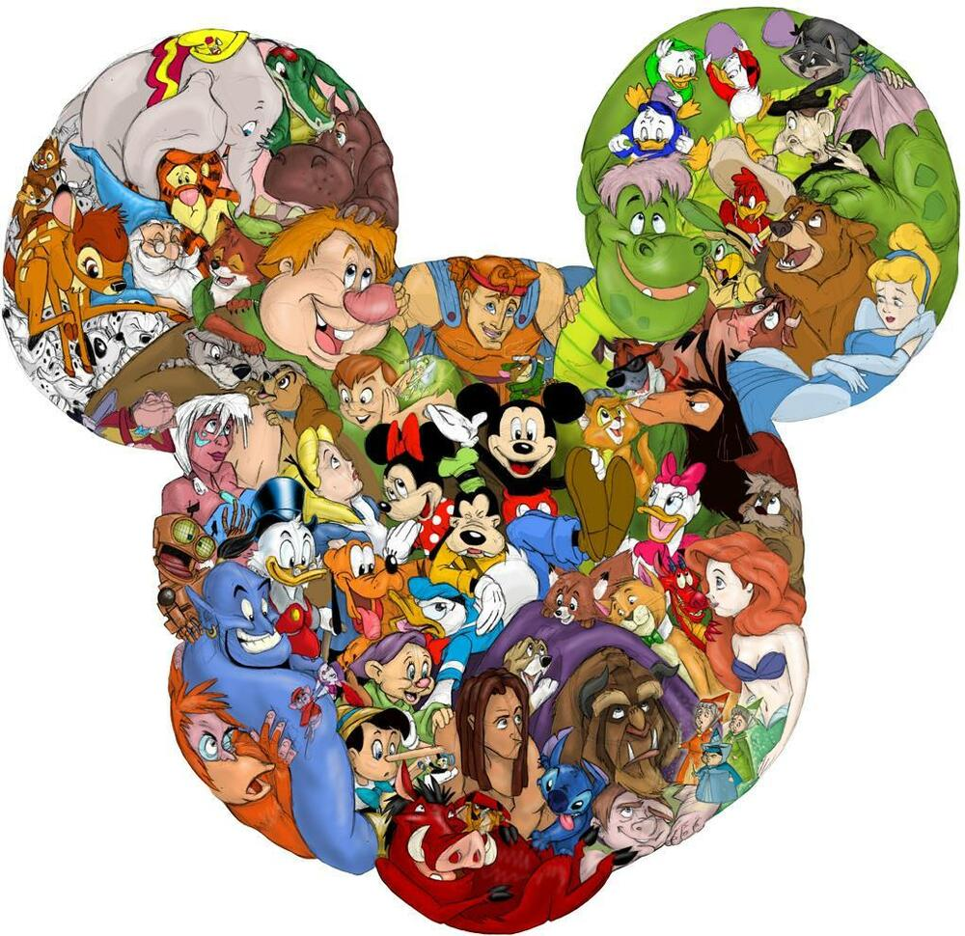
Round 1 – Riddles
Work out the Disney character by solving the riddle. A riddle gives clues about something.

Slide 4
Can you work out the Disney character by solving the riddle?
I am made to cook and clean by my wicked step mother.
I want to go to the ball.
A prince finds my shoe.
Who am I?
I live under the sea.
I love music.
I have to look after a girl named Ariel.
Who am I?

Slide 5
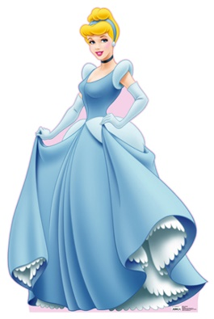
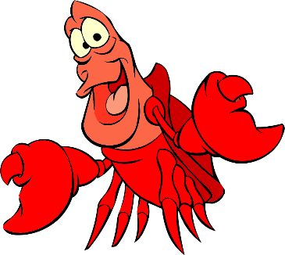
Can you work out the Disney character by solving the riddle?
I am made to cook and clean by my wicked step mother.
I want to go to the ball.
A prince finds my shoe.
Who am I?
I live under the sea.
I love music.
I have to look after a girl named Ariel.
Who am I?
Cinderella
Sebastian

Slide 6
Can you work out the Disney character by solving the riddle?
3. Some people would say I’m cruel.
I hate dogs, especially Dalmatian puppies.
I have black and white hair.
Who am I?
4. I love the summer even though I could melt in the sun.
I am friendly and kind.
I have an orange carrot nose.
Who am I?

Slide 7
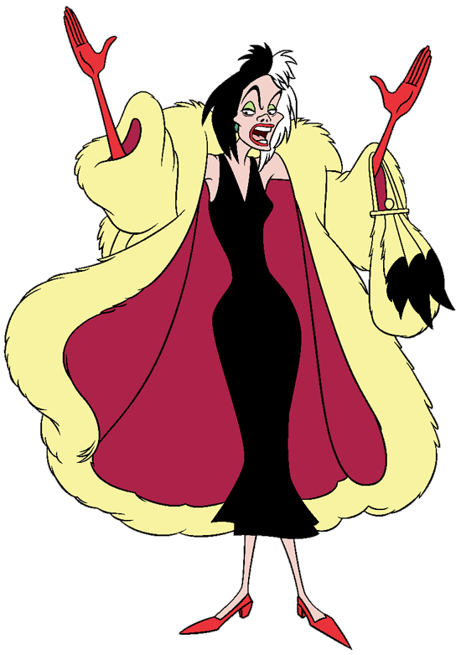
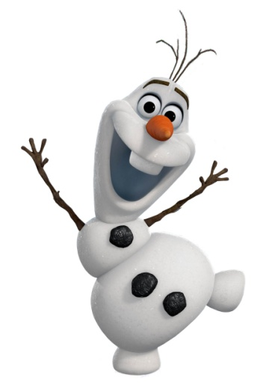
Can you work out the Disney character by solving the riddle?
3. Some people would say I’m cruel.
I hate dogs, especially Dalmatian puppies.
I have black and white hair.
Who am I?
4. I love the summer even though I could melt in the sun.
I am friendly and kind.
I have an orange carrot nose.
Who am I?
Cruella De Vil
Olaf

Slide 8
Can you work out the Disney character by solving the riddle?
5. I love anything to do with Space.
My best friend is a sheriff.
I wear a space helmet and have a famous saying.
Who am I?
6. I live in the jungle.
I am adventurous and I can climb trees.
I was raised by wolves.
Who am I?

Slide 9
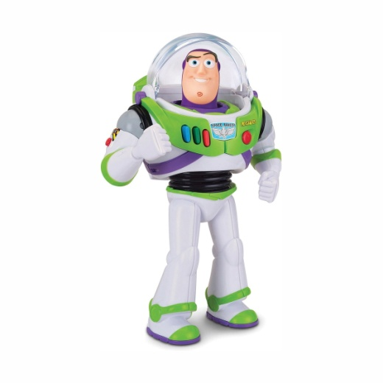
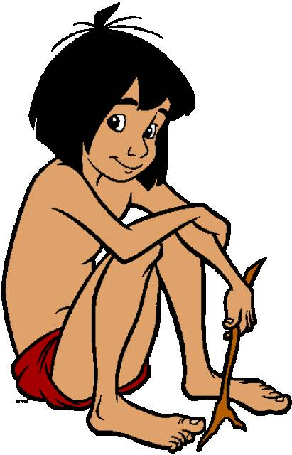
Can you work out the Disney character by solving the riddle?
5. I love anything to do with Space.
My best friend is a sheriff.
I wear a space helmet and have a famous saying.
Who am I?
6. I live in the jungle.
I am adventurous and I can climb trees.
I was raised by wolves.
Who am I?
Buzz Lightyear
Mowgli

Slide 10

Round 2 - Geography/ Flags
Can you name the country of these flags?
We have looked at all of these countries in class so try to use everything you know to work out the correct answer.

Slide 11

Scotland
England
Spain

Slide 12

Scotland
England
Spain

Slide 13

England
Ireland
America

Slide 14
England
Ireland
America

Slide 15

England
Wales
Spain

Slide 16
England
Wales
Spain

Slide 17

England
Tobago
Egypt

Slide 18
England
Tobago
Egypt

Slide 19

England
United Kingdom
Africa

Slide 20
England
United Kingdom
Africa

Slide 21

Round 3 – Crack the code
Each emoji represents a number.
Work out the number sentence and then solve it.
Look carefully at the symbol!

Slide 22
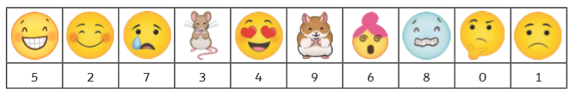





1.
2.
3.
4.
5.

Slide 23
1.
85
18
2.
87
3.
4.
819
5.
1021

Slide 24
Well done you’ve finished the quiz!
What was your score?
What was your favourite round?
Let Miss Branegan know on Seesaw.

