Slide 1
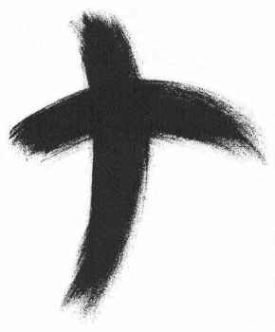
Ash Wednesday

Slide 2
At Mass on Ash Wednesday after the Homily, the priest says:
Dear brethren (brothers and sisters), let us humbly ask God our Father that he be pleased to bless with the abundance of his grace these ashes, which we will put on our heads in penitence.

Slide 3
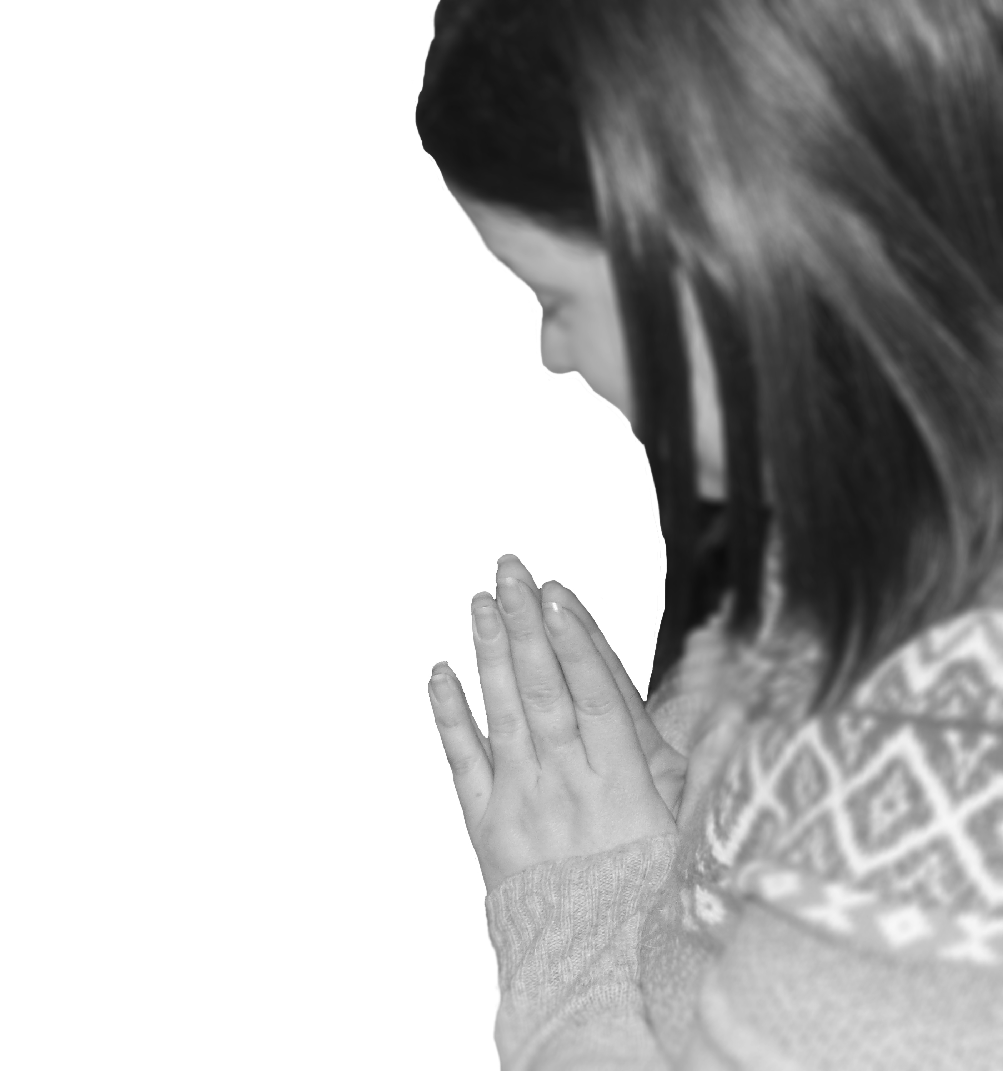
After a brief prayer in silence, he continues with a prayer such as:
O God, who are moved by acts of humility and respond with forgiveness to works of penance, lend your merciful ear to our prayers

Slide 4
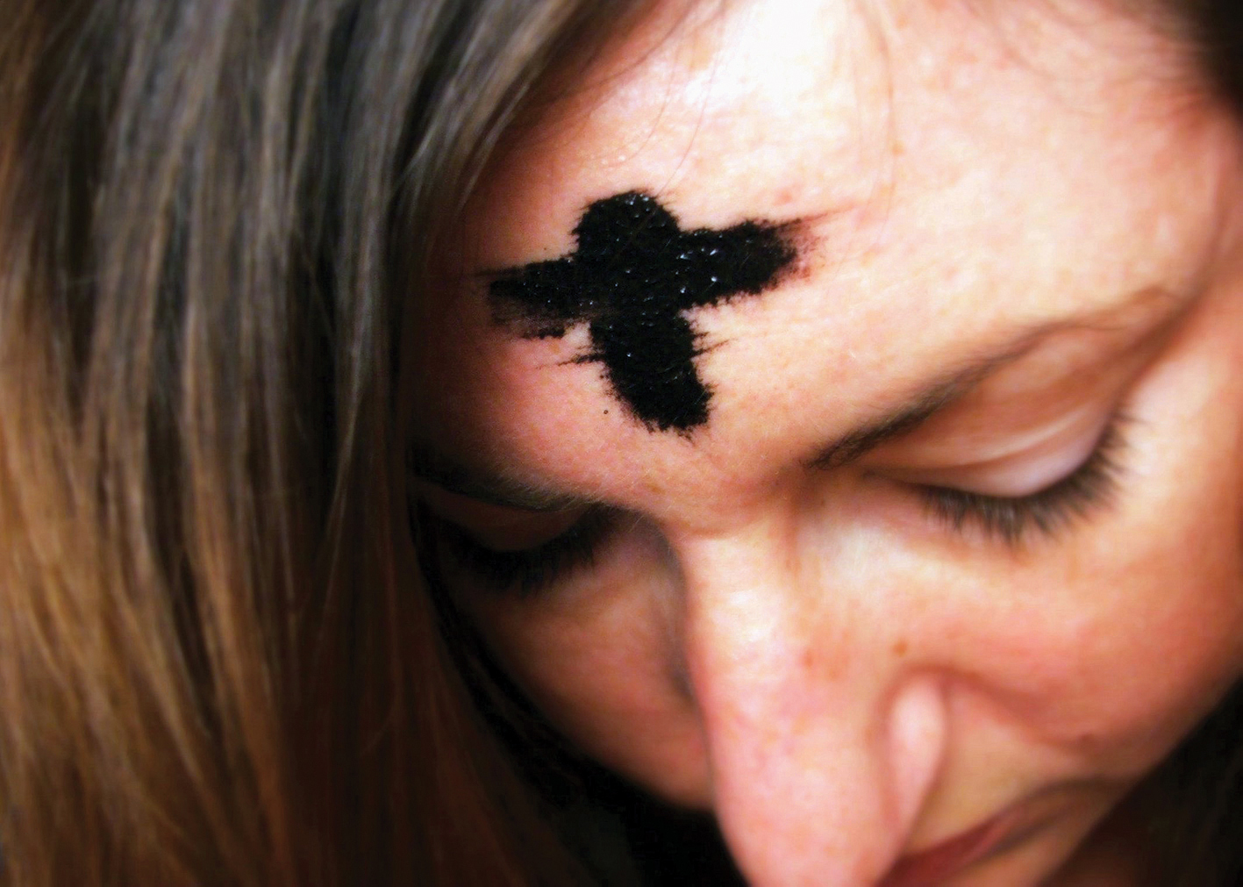
And in your kindness pour out the grace of your blessing on your servants who are marked with thee ashes.

Slide 5
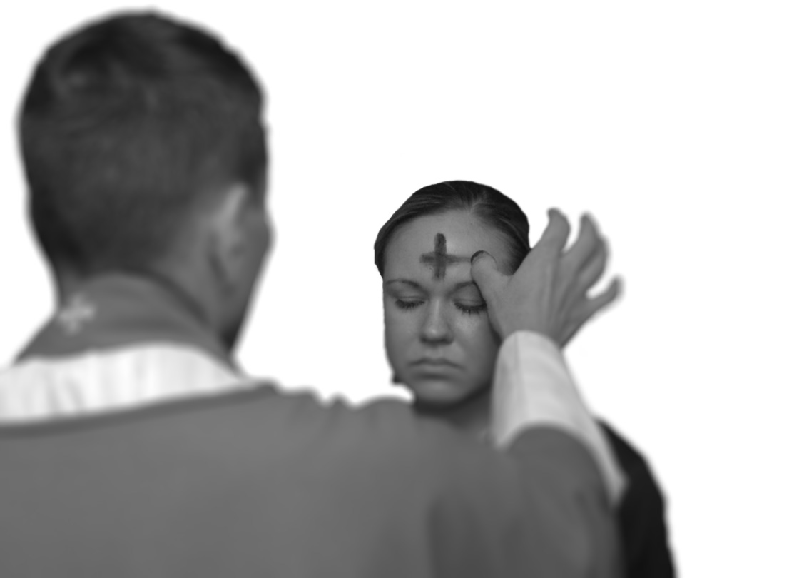
He sprinkles the ashes with holy water, then places ashes on the heads of all those present who come to him, and says to each one:
Remember that you are dust, and to dust you shall return
Or:– Repent , and believe in the Gospel.

