Slide 1
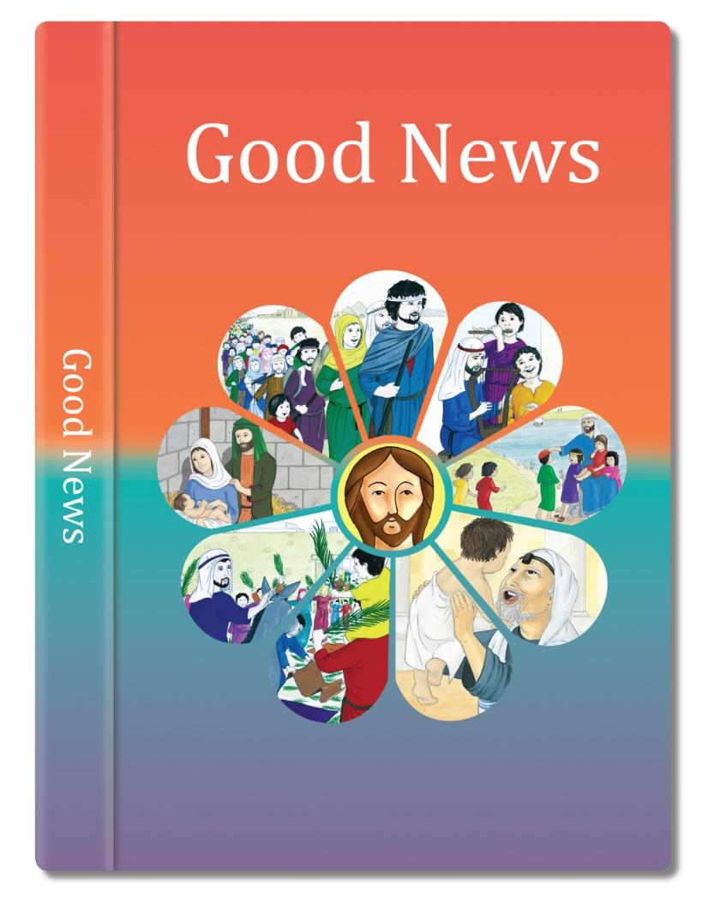

Slide 2

Jesus sometimes said things that people found hard to understand.
Anyone who trusts in me will find out what life really is. I am the living bread which comes from God.
One day he said, “I am the bread of life. Anyone who becomes my
friend will never be hungry.
Anyone who has this bread for food will learn the secret of life that cannot be taken away
Anyone who trusts in me will never be thirsty.
The bread I give is my life. I give it to be the life of the world.”
I will never send away from me anyone who wants to be my
friend.

Slide 3
Many of Jesus’ disciples did not understand this. They went away.
Jesus asked the twelve he had chosen, “Will you also go away?”
Peter answered, “Who else could we go to? You are the one who has shown us what life really is, the kind of life that cannot be taken away.”
Based on John 6: 35,37,51,60,67-68 (God’s Story 3)

Slide 4


