Slide 1


Slide 2

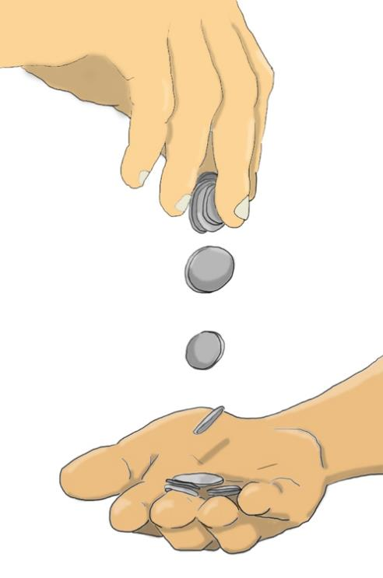
Then one of the twelve disciples - the one named Judas Iscariot - went to the chief priests and asked, "What will you give me if I betray Jesus to you?"
They counted out thirty silver coins and gave them to him.
From then on Judas was looking for a good chance to hand Jesus over to them.
Matthew 26: 14-16
(Good News Translation)

Slide 3


