Slide 1


Slide 2

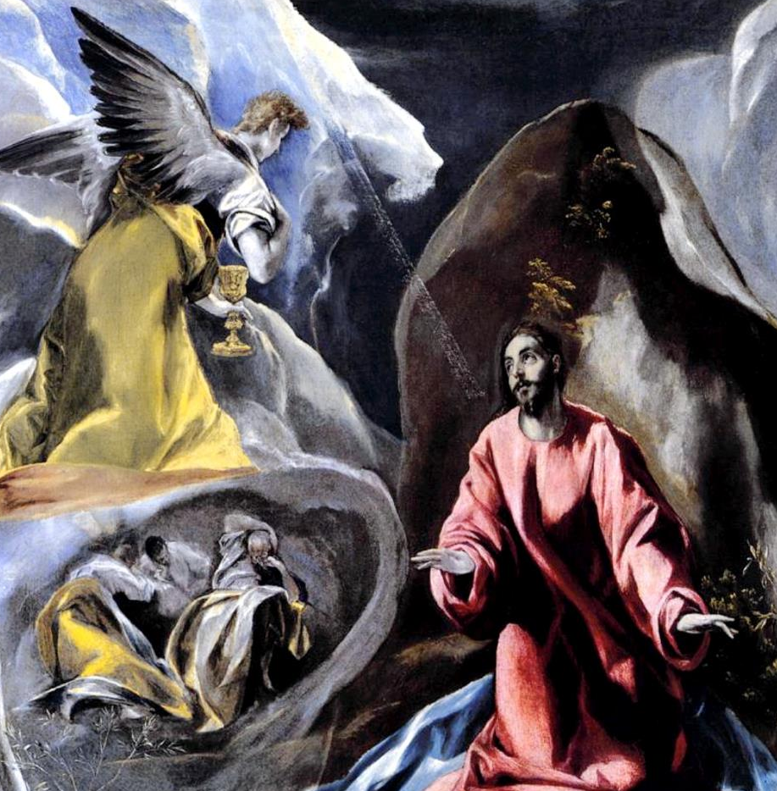
They went to a place called Gethsemane; and he said to his disciples, "Sit here while I pray."
He said, "Abba, Father, for you all things are possible; remove this cup from me; yet, not what I want, but what you want."
He took with him Peter and James and John, and began to be distressed and agitated.
He came and found them sleeping; and he said to Peter, "Simon, are you asleep? Could you not keep awake one hour?
And he said to them, "I am deeply grieved, even to death; remain here, and keep awake."
Keep awake and pray that you may not come into the time of trial; the spirit indeed is willing, but the flesh is weak."
And going a little farther, he threw himself on the ground and prayed that, if it were possible, the hour might pass from him.
And again he went away and prayed, saying the same words

Slide 3
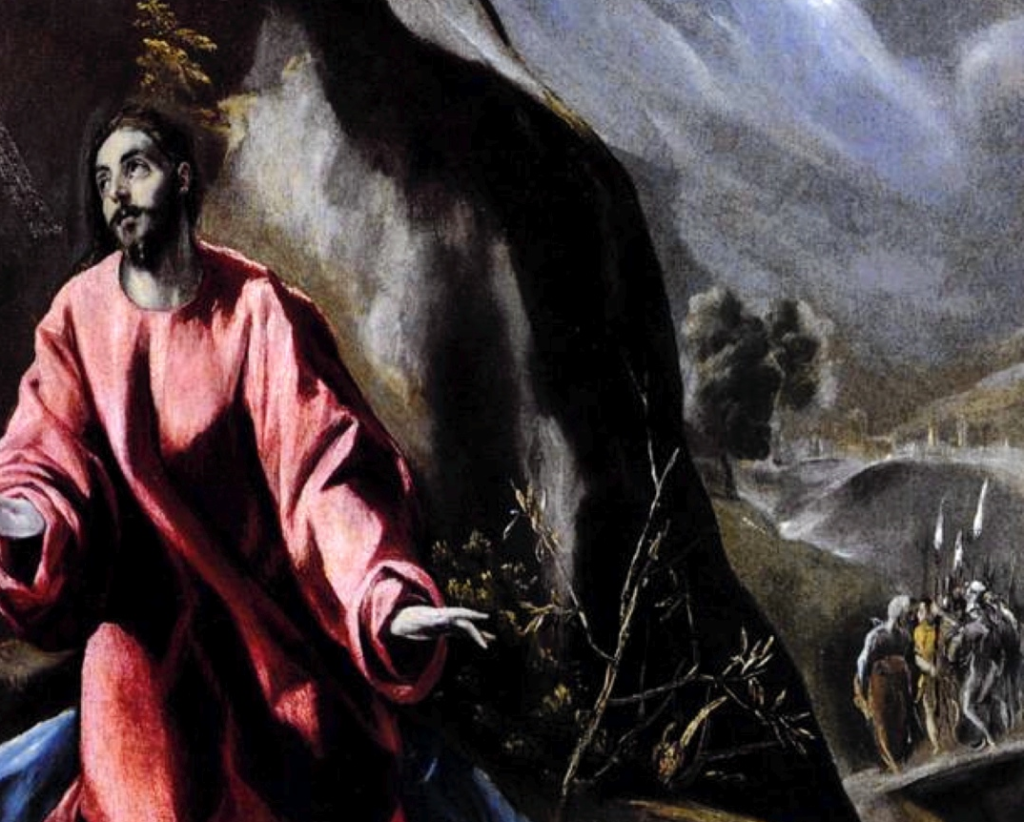
And once more he came and found them sleeping, for their eyes were very heavy; and they did not know what to say to him.
and with him there was a crowd with swords and clubs, from the chief priests, the scribes, and the elders.
Now the betrayer had given them a sign, saying, "The one I will kiss is the man; arrest him and lead him away under guard."
He came a third time and said to them, "Are you still sleeping and taking your rest?
Enough! The hour has come; the Son of Man is betrayed into the hands of sinners.
So when he came, he went up to him at once and said, "Rabbi!" and kissed him.
Get up, let us be going. See, my betrayer is at hand."
Then they laid hands on him and arrested him.
Immediately, while he was still speaking, Judas, one of the twelve, arrived;
Mark 14:32-46
(NRSV)

Slide 4


