Slide 1


Slide 2

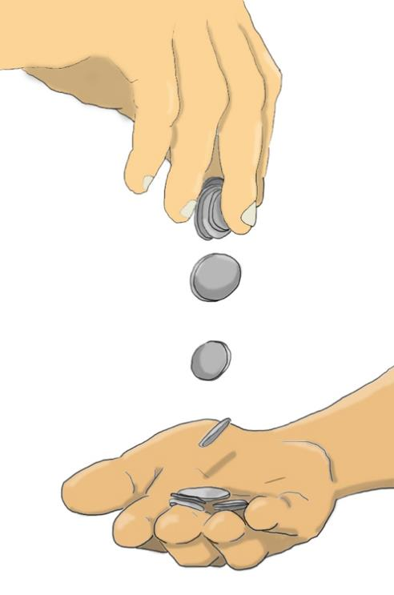
Then Judas Iscariot, one of the twelve disciples, went off to the chief priests in order to betray Jesus to them.
They were pleased to hear what he had to say, and promised to give him money.
So Judas started looking for a good chance to hand Jesus over to them.
Based on Mark 14: 10-11
(Come and See)

Slide 3


