Slide 1


Slide 2

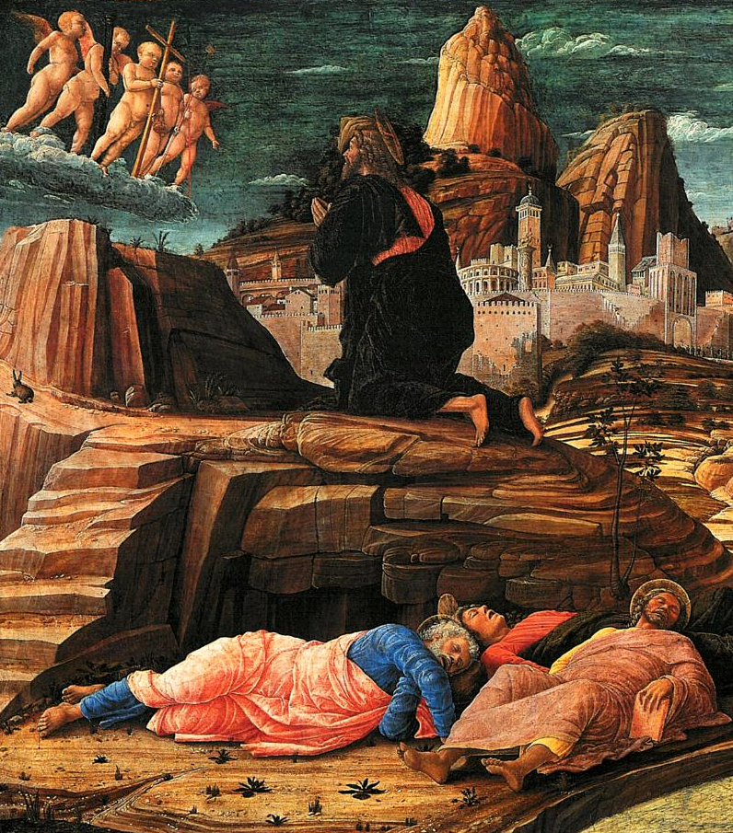
He came out and went, as was his custom, to the Mount of Olives; and the disciples followed him.
Then an angel from heaven appeared to him and gave him strength.
In his anguish he prayed more earnestly, and his sweat became like great drops of blood falling down on the ground.
When he reached the place, he said to them, "Pray that you may not come into the time of trial."
When he got up from prayer, he came to the disciples and found them sleeping because of grief,
Then he withdrew from them about a stone's throw, knelt down, and prayed,
"Father, if you are willing, remove this cup from me; yet, not my will but yours be done."
and he said to them, "Why are you sleeping? Get up and pray that you may not come into the time of trial."

Slide 3

While he was still speaking, suddenly a crowd came, and the one called Judas, one of the twelve, was leading them. He approached Jesus to kiss him;
but Jesus said to him, "Judas, is it with a kiss that you are betraying the Son of Man?"
Luke 22:39-48
(NRSV)

Slide 4


