Slide 1


Slide 2

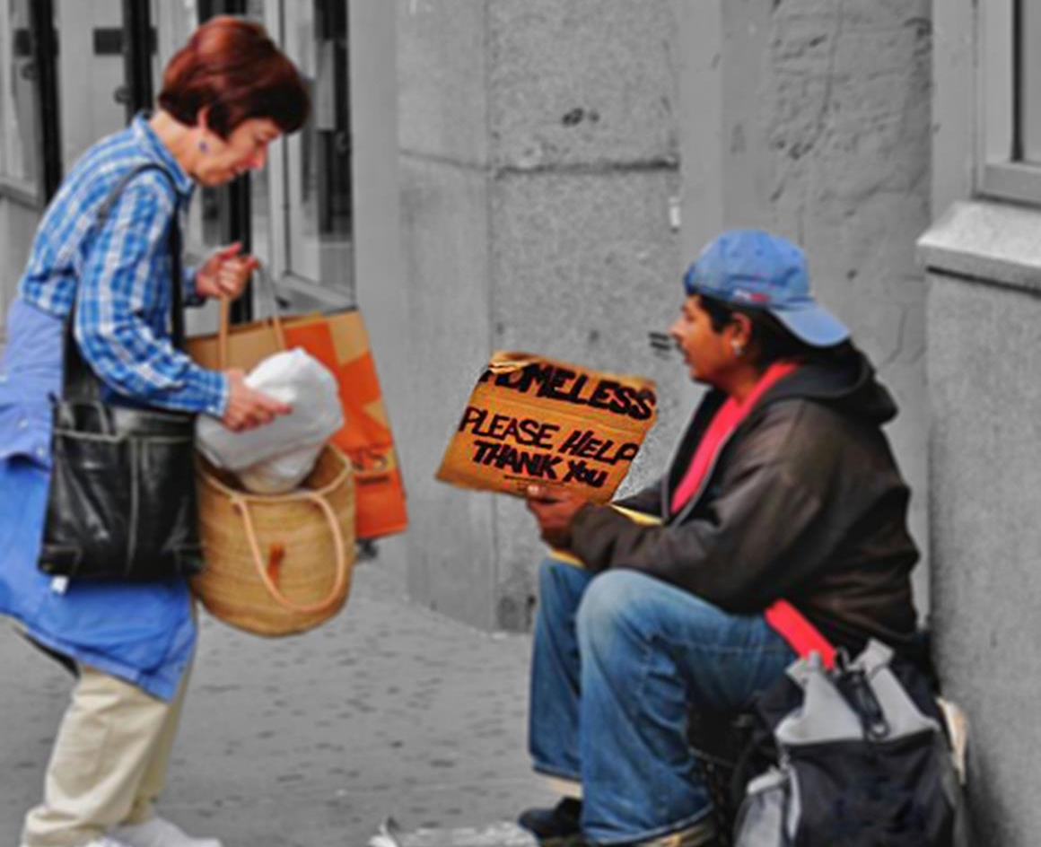
Jesus says, ’Love your enemies; do good to those who hate you, pray for those who treat you badly.
If you lend money to those you hope will help you, what is there special about that? Everybody does that sort of thing.
Don’t retaliate when people are nasty to you. Do to others as you would have them do to you’.
Love your enemies; do good and lend, expecting nothing back. You will get something back: you will be living in God’s Way. God is kind to everyone.
If you love those who love you, what is there special about that? Everybody does that sort of thing.
If you favour those who favour you, what is there special about that?Everybody does that sort of thing.
Based on Luke 6:27-28, 32-36
(Come and See)

Slide 3


