Slide 1
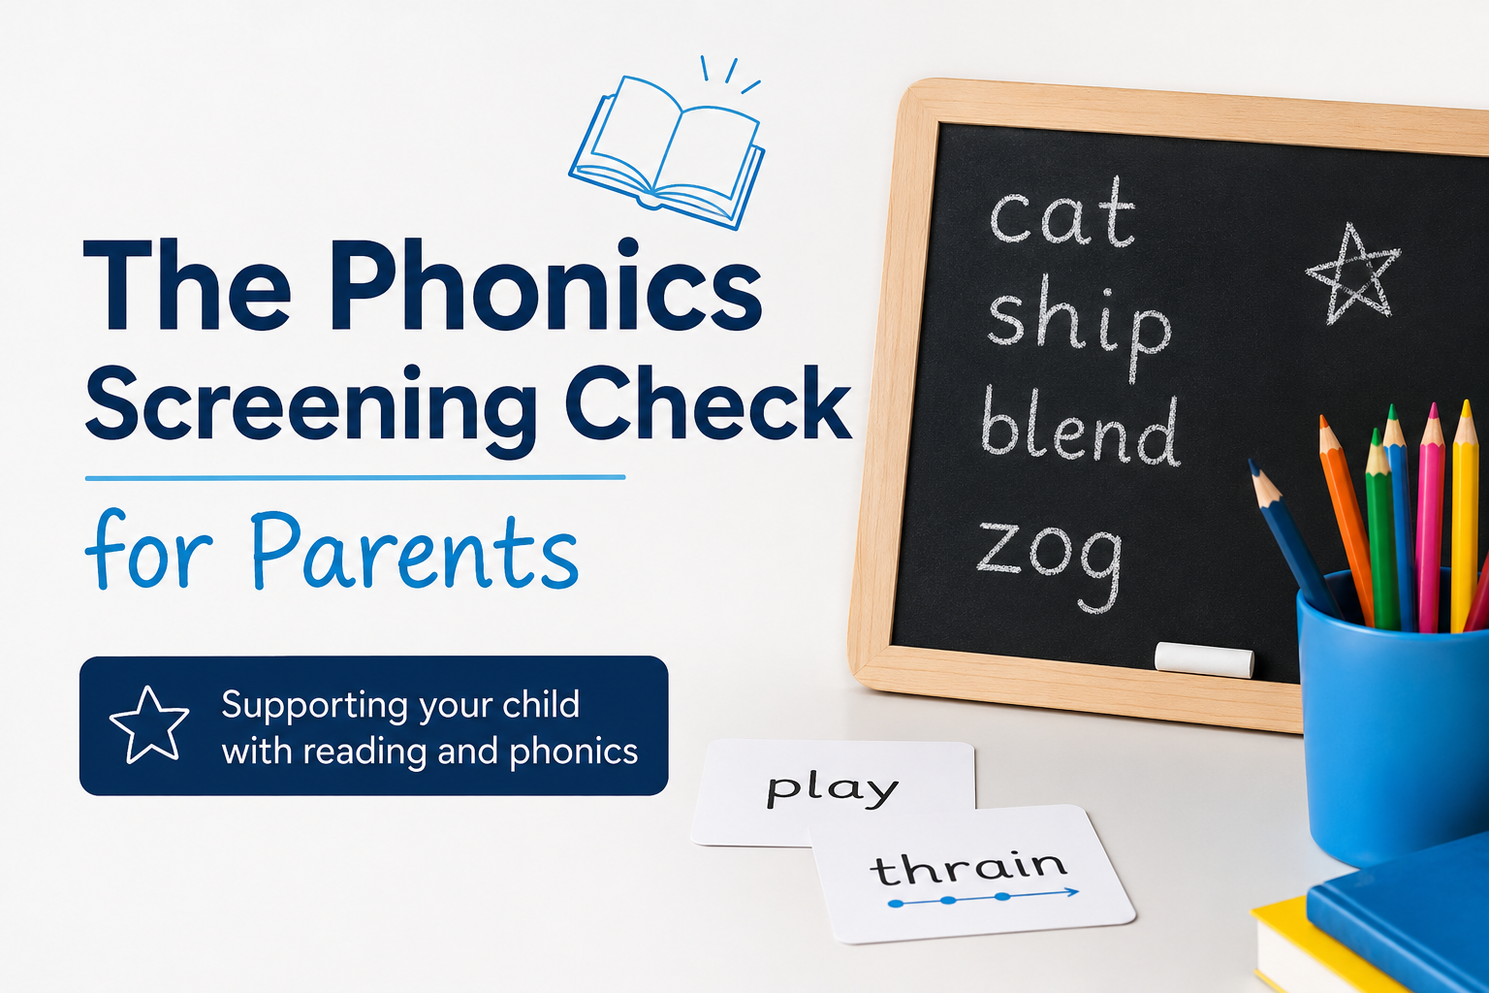
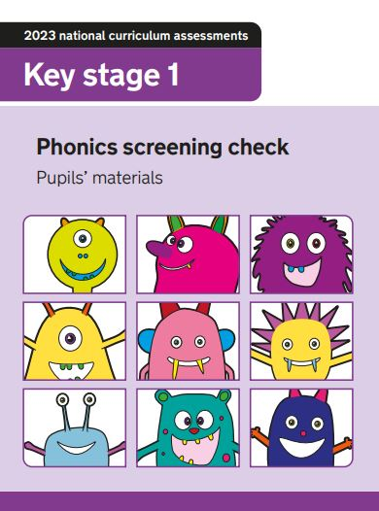

Slide 2


Read Write Inc vs Phonics Screening Check
These are two very separate things with two very different outcomes but RWI really does help the PSC.

Slide 3

What is the phonics screening check?
A statutory assessment for every year 1 child in England.
When – June 8th for 2 weeks
What does it tell us? It basically tells us how well your child can decode words using their skills they’ve been learning.

Slide 4
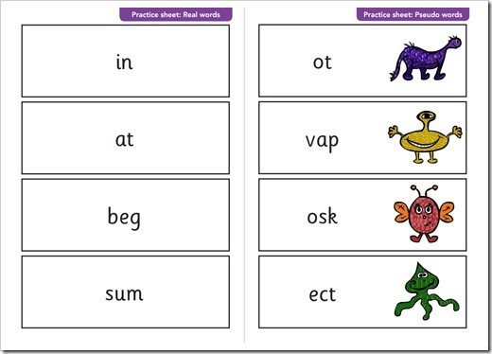
What does it involve?
40 words in total
A mix of real words and nonsense (alien) words.
Children read these words one-to-one with their teacher in a quiet room.
Normally takes between 5-10 minutes depending on the child.

Slide 5

What are alien words?
Made-up words that we expect the children to be able to read.
(How ridiculous!!)
They’re used for testing the children’s ability to decode unfamiliar words.
There’s always an alien next to the word so the children know its not a real word.

Slide 6

How is the check scored?
Maximum score is 40
Expected mark is normally 32. This isn’t confirmed until after the test and there is a possibility it can change.
This is not a case of pass or fail it’s a diagnostic.

Slide 7

How are results used?
Identifies who may need further support
(We will already know this)
Results are shared with parents in reports at the end of the year.
Children who don’t meet the expected level will be reassessed in Year 2.

Slide 8

How do we prepare the children at school?
Daily phonics sessions (RWI)
1:1 support and interventions when needed
Practice real and alien words
Familiarisation – the children have been doing past PSC’s since February
No mention of the word “test”, “pass” or “fail” at all.

Slide 9
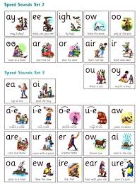

How can you help?
Listen to your child read everyday (RWI coloured books)
Practice reading real words and alien words (QR codes)
Online games – Phonics play or Teach Your Monster to Read
Stay positive with reading, don’t make it a chore, parents read to the children as well, a lot of encouragement.
Sound mats
Past papers all available online (QR codes)

