Slide 1
Welcome to
Year 4
Coffee Morning 24/25

Slide 2
Teaching Staff
4L
Teacher: Miss Birch
Teaching Assistant: Miss Pinnington
1:1 Support Staff – Ms Chatterton
4S
Teachers: Mrs Brogan (Mon-Wed)
Mrs Purchase (Wed-Fri)
Teaching Assistant: Mrs Farrell

Slide 3
Curriculum Coverage
Maths and English every day.
Guided Reading 5 times per week (one day is focussed on spelling). An understanding of the text is constantly checked through questioning. We are now also using RWI to support reading for some children.
Religious Education is taught for 2.5 hours a week and we participate in daily acts of Prayer and Liturgy.
P.E. twice per week with a class teacher.
Science 2 hours per week.
Foundation subjects are taught weekly.
.

Slide 4
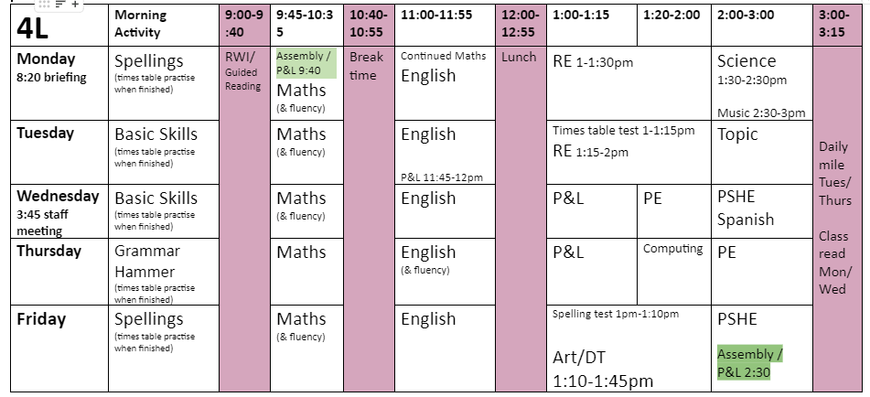

Slide 5
WHOA!
Attendance and Punctuality
As you can see we have a jam packed timetable!
Attendance and punctuality is key to your child achieving their personal and academic success.
The more you are in the easier it gets!
Our target for the year is 96%

Slide 6
Social Media
Twitter or X
School Website
School Spider
SeeSaw
TTRS
Ed Shed
For regular updates on school activity.
Holiday dates, after-school clubs, curriculum coverage, important letters and class pages.
Please ensure we have your most up to date email address on our records as we send lots of information out on here.
QR codes have been sent home to access the app. Please contact us through school hours only.
This app is a great tool for children to deepen their understanding of multiplication.
This has lots of games and activities to encourage learning whilst gaming. This links into spellings.

Slide 7
Free School Meals
FSM
Many children in our school (about 70%) are entitled to Free School Meals and do not claim them.
If you think you may be entitled all you need to do is sign the form and fill out a few details.
It does not effect any benefits, tax credits etc. you may already receive!

Slide 8
Testing
In year 4, in line with all other year groups, we informally assess the children’s progress each half term. This is done over the course of a chosen week in place of usual core subject lessons. Within this week, we focus upon art, music and computing as our foundation subjects.
We do not tell the children, but ask them to complete religion, reading, writing and mathematics tasks to see what they have learned and identify their areas for development – we then focus upon these through interventions and future lessons.

Slide 9
Times Table Testing
Nationally, all children are assessed on their times table knowledge within Year 4. This takes place during the summer term.
This is a short online test, which all children take part in.
They answer 25 questions and are given 6 seconds to answer each.

Slide 10
Best Revision Sites
We recommend two different websites/apps for the children to use when revising their multiplication skills. These are:
https://ttrockstars.com/
https://www.topmarks.co.uk/maths-games/hit-the-button
We use these websites/apps within class throughout the year and saw the benefits of this in previous years.
‘Hit-the-button’ is available on a free website which you can access through this QR code. Please do not purchase the application.

Slide 11
Book Bags
Reading is an extremely important skill to develop and will help the children to improve many aspects of their school work. We recommend at least 10 minutes reading each night (if possible).
Sent home: Friday.
Returned to school: Thursday, Friday at the latest.
If children are on RWI they must reread their book every night until it is changed on the Friday – this helps with their fluency skills even though it may seem tedious!
If your child is on a school book it will not be changed if they finish it early. Please return it to school on Thursday’s.
If your child is a free reader (choosing from the library) they can take up to two weeks to read their book and bring it back when they have finished as long as they let us know.

Slide 12
Homework
Homework will be sent home and collected in line with bookbags. Your child will receive English and Maths homework weekly. English will mainly be comprehension based to help with their inference and deduction skills, Maths will be what we have been learning or times tables practise.
We ask for this to be completed as independently as possible by your child. However, should your child need help, you are welcome to offer as much as is needed. Please note on the sheet which questions the child was assisted with.
We understand that home lives can be hectic so we thank you for your support in doing this. It will make a huge difference to the progress they will make this year!
If your child completes their homework and reading each week they will receive dojos for this to show we appreciate their efforts and dojos lead to prizes.

Slide 13
PE
Class 4L’ PE lessons are Wednesday and Thursday.
Class 4S’s PE lessons are Monday and Wednesday.
PE is an extremely important part of the national curriculum and children must take part.
Children must have the correct PE kit in order to take part in these lessons, for safety purposes. This is as follows; green shorts, white t-shirt and black pumps or trainers. In the winter months, children may wear tracksuit bottoms but shorts must be worn underneath.
PE kit is to be worn coming in to school.

Slide 14
Thank you for listening.
Any questions?

