Slide 1
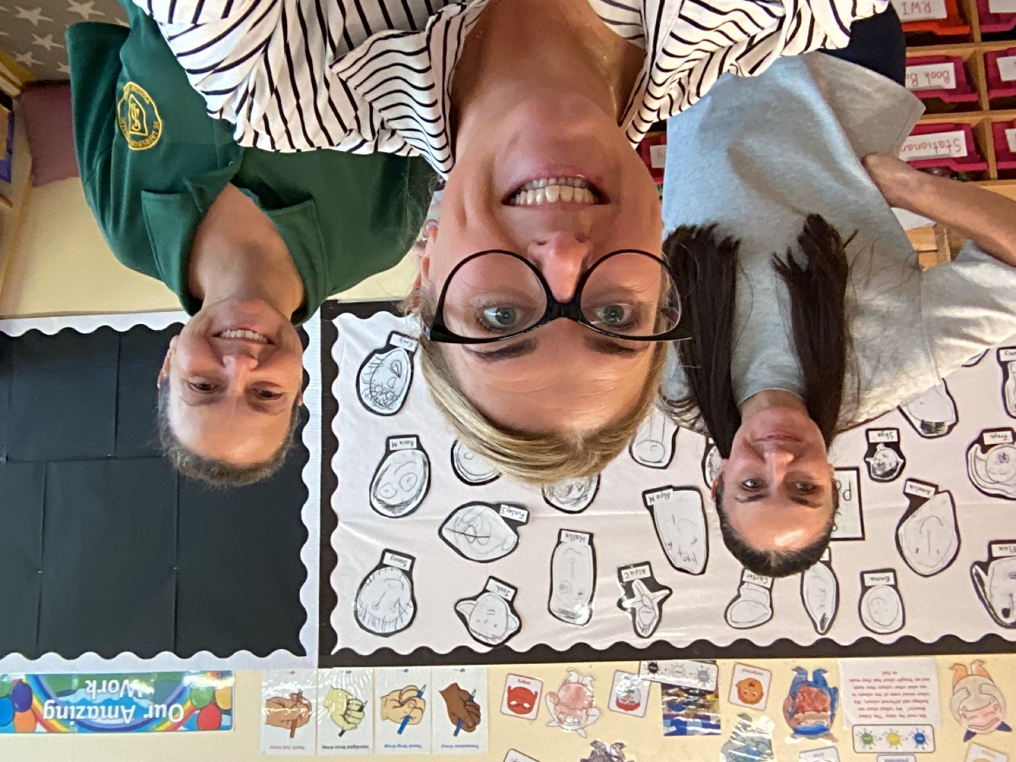
Welcome Parents & Carers
Miss Kirkby, Miss Boyle and Miss Connolly

Slide 2

Safeguarding Information
Any concerns please speak to class teachers at the end of the day or phone and make an appointment
In St Laurence’s our Designated Safeguarding Officer is Mr Cushion and our Deputy is Miss Carroll.

Slide 3
Expectations
Importance of Attendance and Punctuality 8.40am –8.55am (gates open)
3.15pm- End of day
Our attendance target is 96%- class incentives
Expect children to be kind and respectful of one another and our learning environment

Slide 4
Book Bags
Book bags are given out on a Friday and are to be returned on a Thursday.
Children will be read with each day through our RWI.
Books that are sent home are linked to the Read, Write Inc scheme that we have covered in class.
We also send a weekly reading for pleasure book for you to enjoy with your child.

Slide 5
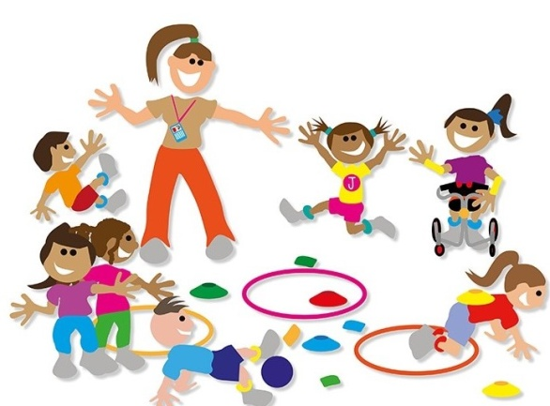
P.E.
P.E. Day is a Thursday and Friday
P.E. Kits are to be worn for school. Please Label all kit.
Physical Friday’s – Fine and gross motor activities available

Slide 6
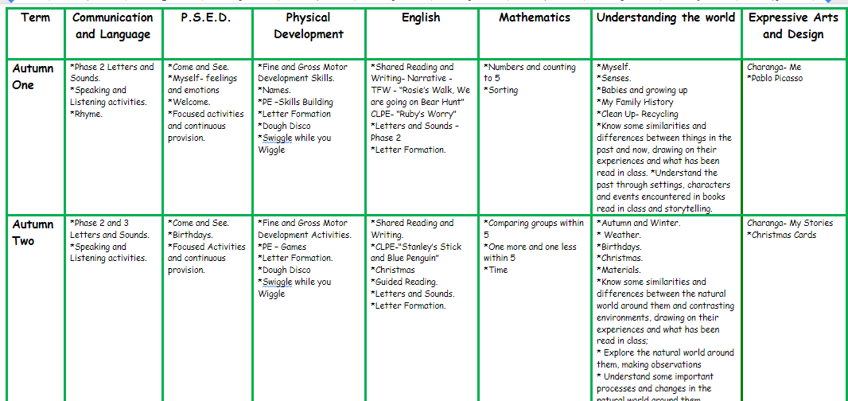
Curriculum
ELG – seven areas 3 prime and 4 specific
PSED, C & L, PD,
Literacy, Maths, UW, EA&D

Slide 7
Topics and Routines
We ensure rules and routines are established early so that children feel safe and secure in their learning environment.
Daily whole class carpet sessions, continuous indoor and outdoor provision, focused adult led activities and independent challenges.
Topics are based on children’s interests, Seasons and To Know you More Clearly.

Slide 8
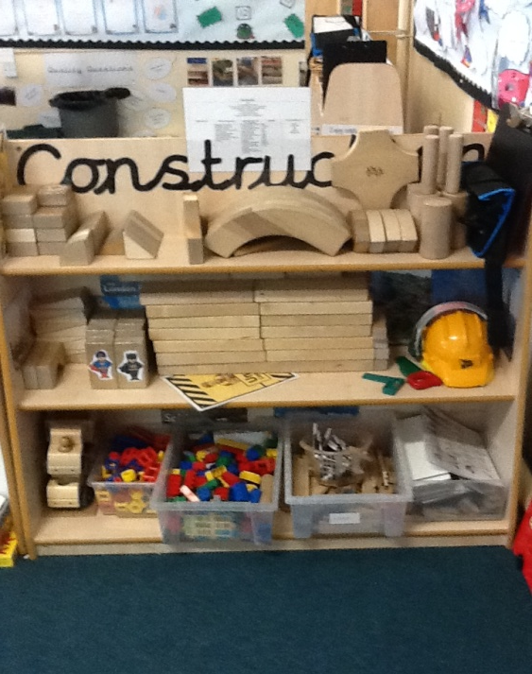
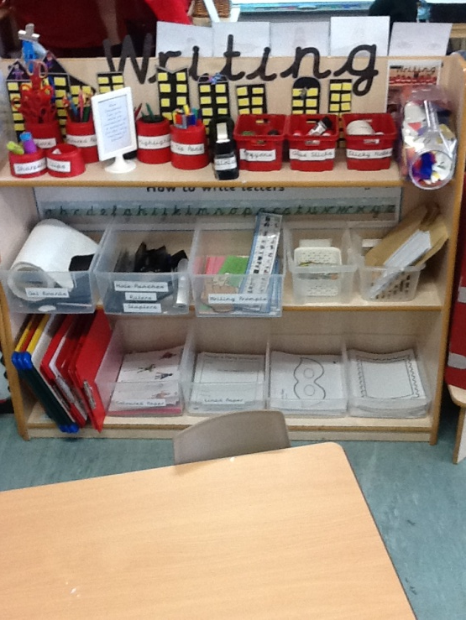
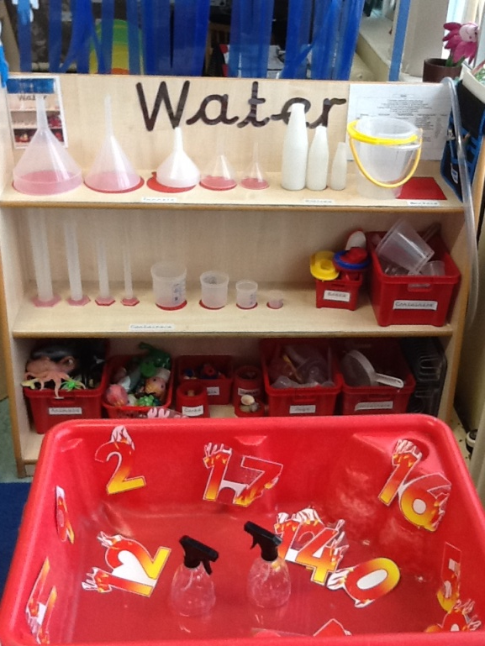
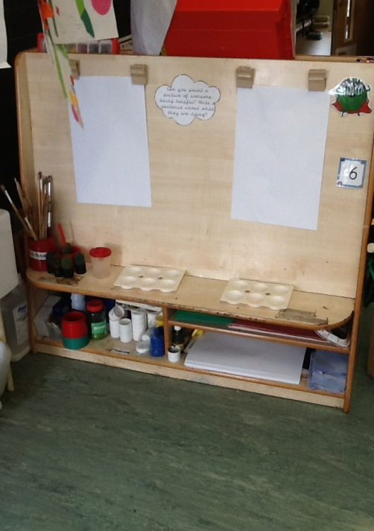
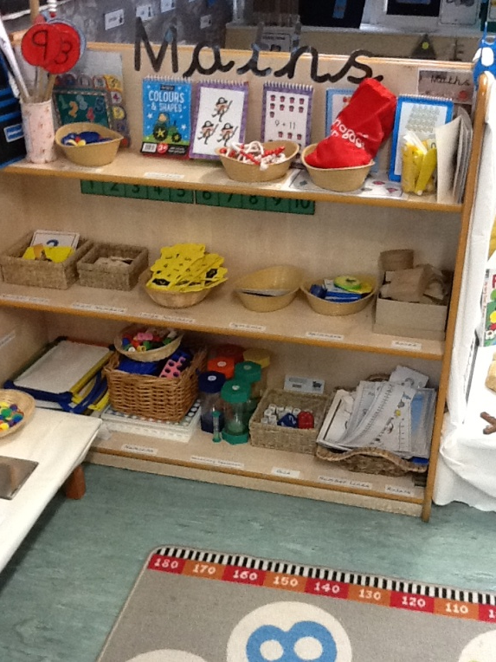
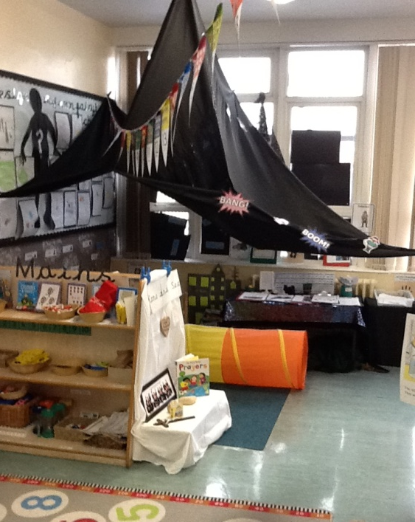
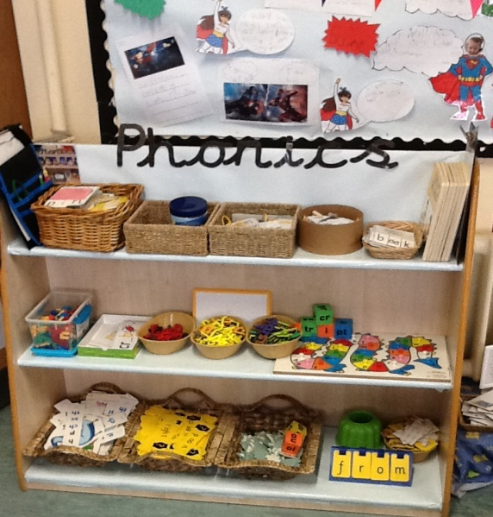
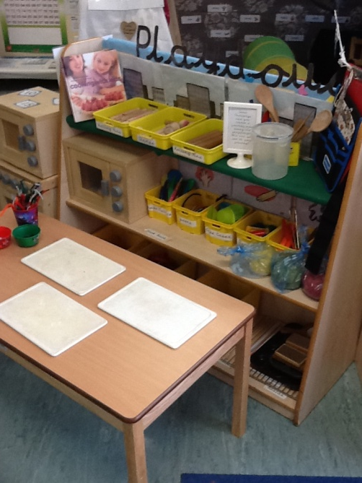
What does it look like in Reception?

Slide 9
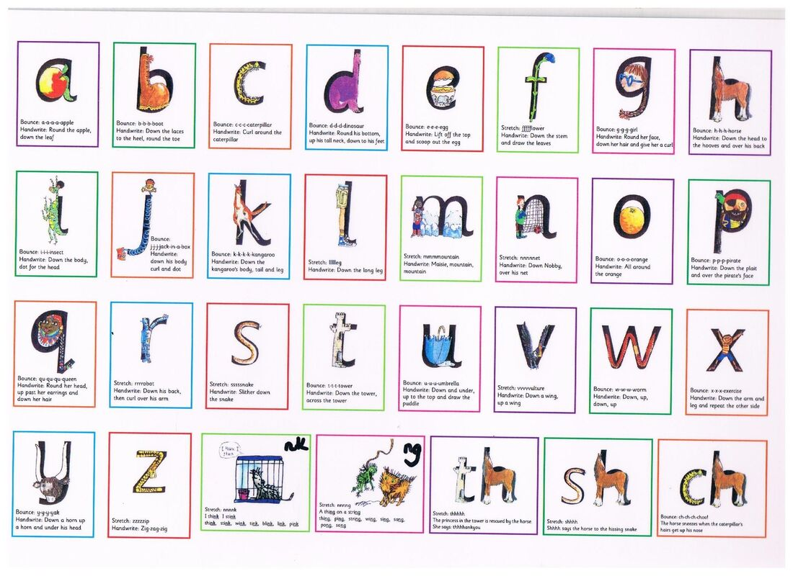
Phonics
In Reception we use a Government approved scheme called Read, Write Inc
Rhyming activities, initial sounds, blending and segmenting, letter formation, writing and reading.

Slide 10
To Know you More Clearly and RSHE
To Know you More Clearly takes places every day. We cover a different topic every 6-8 weeks. We learn about other faiths throughout the year too. Discussion and acting. Please keep an eye out on Tapestry for things we may need to assist with this throughout the year.
RSHE-We follow A Journey In Love
Speaking and Listening activities
All about friendships, ourselves and families

Slide 11
Assessment- What is Baseline?
Over the last few weeks we have been getting to know your child, engaging with them in their play and asking them questions to really develop a strong relationship with them and understand their needs, interests and wants.
We use this information to help us plan activities that are suitable to each child’s needs and abilities.

Slide 12


Parent Communications
School Spider-Website
Google Drive
Twitter
Emails
Parent Pay
Tapestry

Slide 13
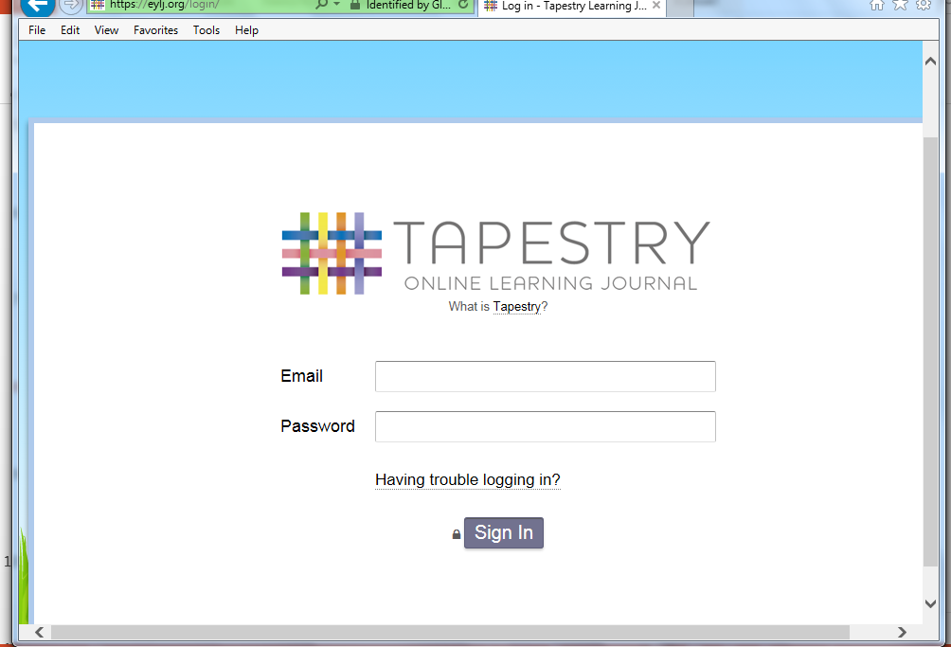
Tapestry
Tapestry is an assessment tool we use to share your child’s learning journey through Reception. We really appreciate it if you comment and like on things we have uploaded and even upload an observation of your child doing something at home. The children then share this with their friends in school and it allows them to talk about their learning at home too.

Slide 14
Trips
We plan trips throughout the year linked to our topics.

Slide 15
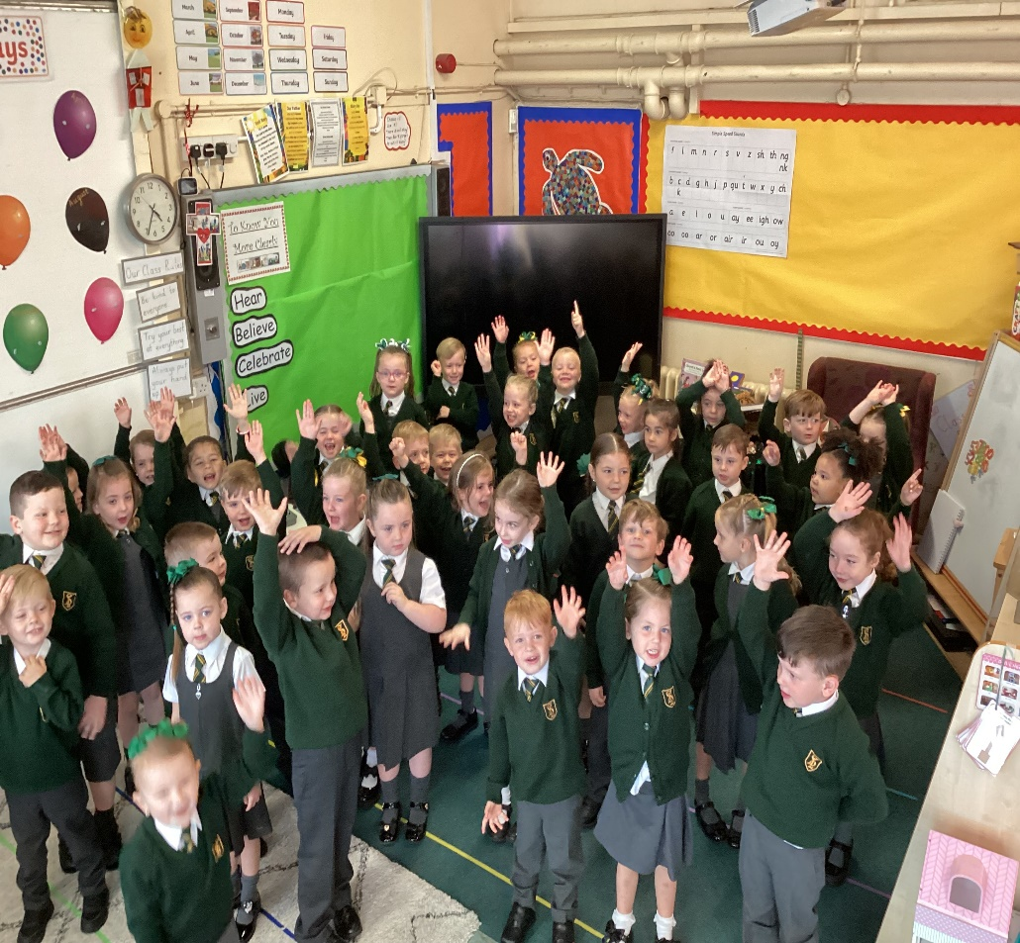
Adventure is at St Laurence's
Your children are at the heart of everything we do...

Slide 16
Thanks for taking the time to attend our Reception presentation.
If you have any questions please feel free to speak to me!

