Slide 1

05/12/22
Key Stage 2 SATs
St Laurence’s Catholic Primary School
Presentation to Parents

Slide 2
Welcome
Y6 staff

Slide 3

Sessions aim:
To develop an understanding of SATs
and share ideas to support children.

Slide 4
Content:
Changes to SATs
Scaled scores
High Attaining children
Tests
Example questions
Writing
Support
Other business
Questions

Slide 5

Assessment and Reporting
As of 2014, the ‘old’ national curriculum levels (e.g. level 3, 4, 5) were abolished as set out in government guidelines.
The 2014 curriculum is rigorous and sets noticeably higher expectations than previous curriculum, which is why all schools have had to work hard to meet and adapt to it since its introduction.
Since 2016, test scores have been reported as ‘scaled scores’.

Slide 6
Scaled Scores
What is meant by ‘scaled scores’?
100 will always represent the ‘national standard’.
Each pupil’s raw test score will therefore be converted into a score on the scale, either at, above or below 100.
The scale will have a lower end point somewhere below 100 and an upper end point above 100.
A child who achieves the ‘national standard’ (a score of 100) will be judged to have demonstrated sufficient knowledge in the areas assessed by the tests.
Each pupil receives:
a raw score (number of raw marks awarded);
a scaled score in each tested subject;
confirmation of whether or not they attained the national standard.

Slide 7
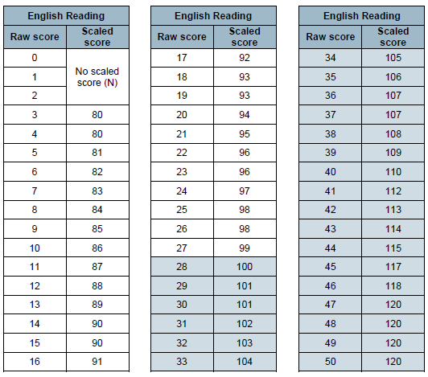
Conversion charts:

Slide 8
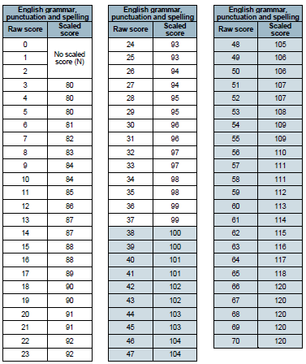
Conversion charts:

Slide 9
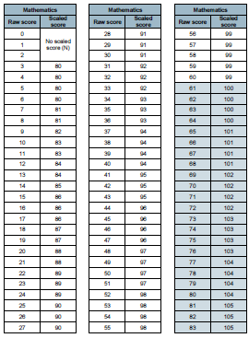
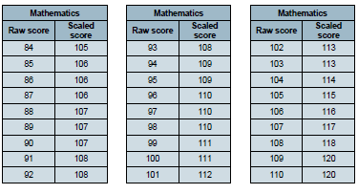
Conversion charts:

Slide 10
Higher-Attaining Pupils
In the past, Key Stage 2 tests were aimed at children achieving levels 3-5 (with a national expectation to reach at least level 4).
This meant that additional level 6 tests were produced for children who demonstrated higher than expected attainment (above level 5).
Under the new system, there are not any separate tests for the most-able children.
Instead, each test will have scope for higher-attaining pupils to show their strengths.
This means that some questions towards the end of the tests may be more difficult for many children but they should be encouraged to attempt as much of the test as they are able to.

Slide 11
The Tests
Key Stage 2 SATs take place nationally in the week commencing 8th May 2023. After the bank holiday on Monday 8th May.
Statutory tests will be administered in the following subjects:
Reading (60 minutes)
Spelling (approximately 15 minutes)
Punctuation, Vocabulary and Grammar (45 minutes)
Mathematics
- Paper 1: Arithmetic (30 minutes)
- Paper 2: Reasoning (40 minutes)
- Paper 3: Reasoning (40 minutes)
There are no tests to be administered in Science this year.
All tests are externally marked.
As in recent years, writing will be teacher assessed internally.

Slide 12
The Tests – 9th – 12th May 2023
SATs is a term people use to refer to End of Key Stage 2 Assessments;
Dates for assessments are seen below. We ask NO holidays take place during this time.
Children will sit the following SATs papers:
- Grammar, Punctuation and Spelling (Paper 1) – Tuesday 9th May 2023;
- Grammar, Punctuation and Spelling (Paper 2) – Tuesday 9th May 2023;
- Reading – Wednesday 10th May 2022;
- Maths Paper 1 (Arithmetic) – Thursday 11th May 2022;
- Maths Paper 2 (Reasoning) – Thursday 11th May 2022;
- Maths Paper 3 (Reasoning) – Friday 12th May 2022.
Writing is assessed using evidence collected by your child’s teacher throughout Year 6, so there is no Year 6 SATs writing test paper.
There will be no Science sampling for Year 6 this year.
Therefore, no Year 6 Science SATs Paper in 2023.
*The key stage 2 tests will be taken on set dates unless your child is absent, in which case they may be able to take them up to 5 school days afterwards.

Slide 13
Example timetable for SATs week
Monday | Tuesday | Wednesday | Thursday | Friday
Bank Holiday | 08:40 – 09:00 Wake up and shake up | 08:40 – 09:00 Wake up and shake up | 08:40 – 09:00 Wake up and shake up | 08:40 – 09:00 Wake up and shake up
 | 09:00 – 09:30: Snack time e.g. toast, fruit etc | 09:00 – 09:30: Snack time e.g. toast, fruit etc | 09:00 – 09:30: Snack time e.g. toast, fruit etc | 09:00 – 09:30: Snack time e.g. toast, fruit etc
 | 09:30 GPS SATs Paper 1 | 09:30 Reading Paper | 09:30 Arithmetic paper | 09:30 reasoning paper 2
 | Break | Break | Break | Break
 | 10:30 Spelling SATs | Revision | 10:30 Reasoning paper 1 | P.E.
 | Lunch | Lunch |  | Lunch
 | Foundation subjects and revision in the afternoon. | Foundation subjects and revision in the afternoon. | Foundation subjects and revision in the afternoon. | Fun afternoon

Slide 14
Grammar, Punctuation & Spelling
A spelling test is administered containing 20 words, which lasts approximately 15 minutes.
A separate test is given on grammar, punctuation and vocabulary.
This test lasts for 45 minutes and requires short answer questions including some multiple choice.
Marks for these two tests are added together to give a total for grammar, punctuation and spelling.

Slide 15
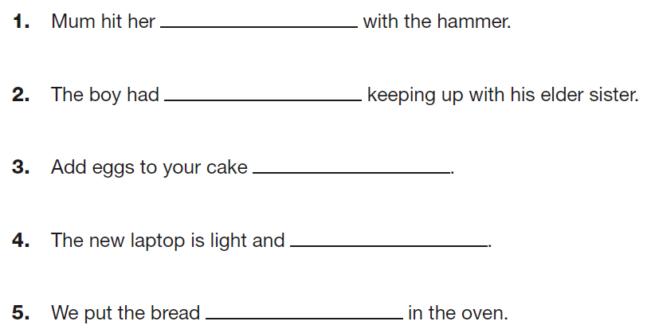

Sample Questions
Grammar, Punctuation and Spelling Paper 1

Slide 16
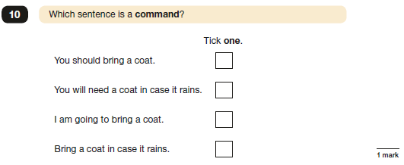
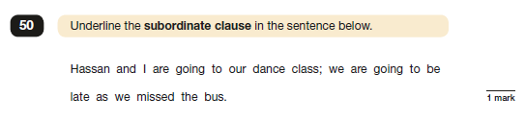
Sample Questions
Grammar, Punctuation and Spelling Paper 2

Slide 17
Reading
The reading test consists of a single test paper with three unrelated reading texts. Children are given 60 minutes in total, which includes reading the texts and answering the questions.
A total of 50 marks are available.
Questions are designed to assess the comprehension and understanding of a child’s reading.
During the reading paper, a child’s inference and deduction skills are thoroughly tested. They will also be expected to answer questions on author choices: explaining why an author has chosen to use particular vocabulary, grammar and text features.
Some questions are multiple choice or selected response; others require short answers and some require an extended response or explanation.

Slide 18
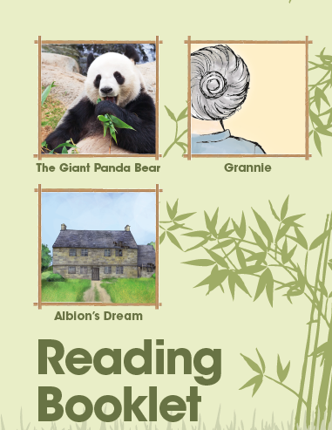
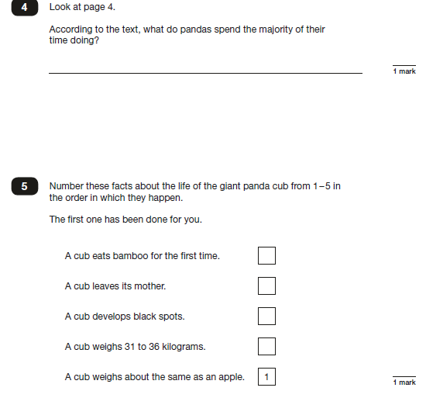
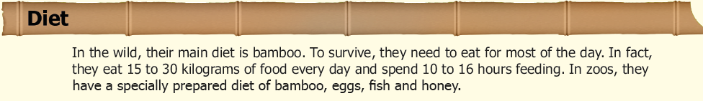
Sample Questions
Reading Paper

Slide 19
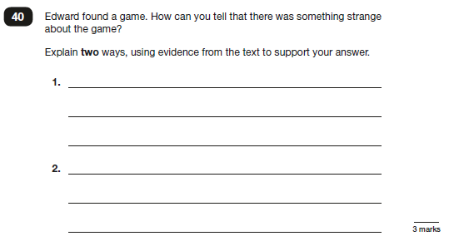
Sample Questions
Reading Paper

Slide 20
Mathematics
The mathematics tests have undergone the biggest change in recent years.
Children will sit three tests: paper 1, paper 2 and paper 3.
Paper 1 is for arithmetic lasting for 30 minutes, covering calculation methods for all operations, including use of fractions, percentages and decimals.
Questions gradually increase in difficulty. Not all children will be expected to access some of the more difficult questions later in the paper.
Papers 2 and 3 cover problem solving and reasoning, each lasting for 40 minutes.
Pupils will still require calculation skills but will need to answer questions in context and decide what is required to find a solution.
Mathsbot.com a great website to use to practise the arithmetic paper. https://mathsbot.com/primary/ks2

Slide 21
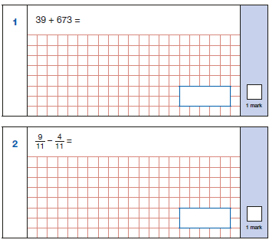
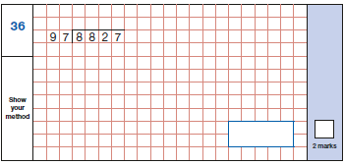
Sample Questions
Maths Paper 1: Arithmetic

Slide 22
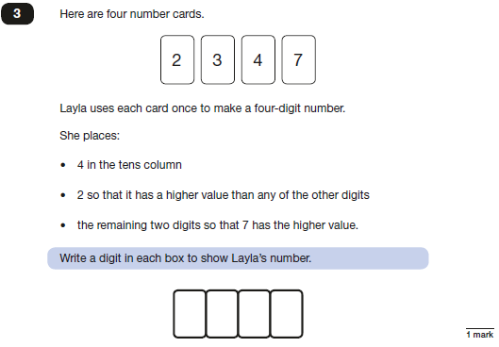
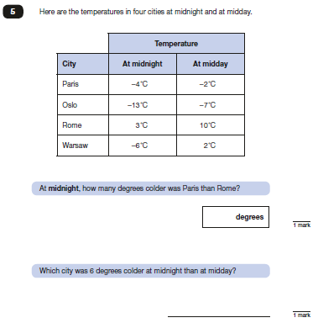
Sample Questions
Maths Paper 2 / Paper 3 : Reasoning

Slide 23
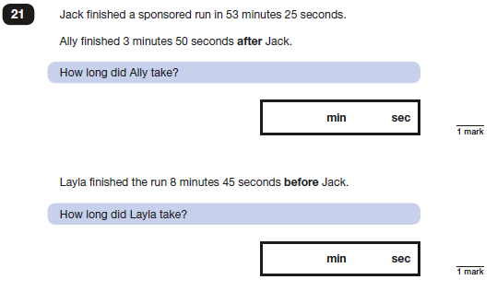
Sample Questions
Maths Paper 2 / Paper 3 : Reasoning

Slide 24
Writing assessments:
Working Towards the Expected Standard The pupil can write for a range of purposes
Use paragraphs to organise ideas
In narratives, describe settings and characters
In non-narrative writing, use simple devices to structure the writing and support the reader (e.g. headings, sub-headings, bullet points)
Use mostly correctly | capital letters
 | full stops
 | question marks
 | commas for lists
 | apostrophes for contraction
Spell correctly most words from the year 3 / year 4 spelling list, and some words from the year 5 / year 6 spelling list
Write legibly

Slide 25
Writing assessments:
Working at Expected Standard Write effectively for a range of purposes and audiences, selecting language that shows good awareness of the reader (e.g. the use of the first person in a diary; direct address in instructions and persuasive writing)
In narratives, describe settings, characters and atmosphere
Integrate dialogue in narratives to convey character and advance the action
Select vocabulary and grammatical structures that reflect what the writing requires, doing this mostly appropriately (e.g. using contracted forms in dialogues in narrative; using passive verbs to affect how information is presented; using modal verbs to suggest degrees of possibility)
Use a range of devices to build cohesion (e.g. conjunctions, adverbials of time and place, pronouns, synonyms) within and across paragraphs
Use verb tenses consistently and correctly throughout their writing
Use the range of punctuation taught at key stage 2 mostly correctly (e.g. inverted commas and other punctuation to indicate direct speech)
Spell correctly most words from the year 5 / year 6 spelling list, and use a dictionary to check the spelling of uncommon or more ambitious vocabulary
Maintain legibility in joined handwriting when writing at speed.

Slide 26
Writing assessments:
Working At Greater Depth Within the Expected Standard Write effectively for a range of purposes and audiences, selecting the appropriate form and drawing independently on what they have read as models for their own writing (e.g. literary language, characterisation, structure)
Distinguish between the language of speech and writing3 and choose the appropriate register
Exercise an assured and conscious control over levels of formality, particularly through manipulating grammar and vocabulary to achieve this
Use the range of punctuation taught at key stage 2 correctly (e.g. semi-colons, dashes, colons, hyphens) and, when necessary, use such punctuation precisely to enhance meaning and avoid ambiguity.

Slide 27
How to Help Your Child with Reading
Listening to your child read can take many forms.
First and foremost, focus developing an enjoyment and love of reading.
Enjoy stories together – reading stories to your child at KS1 and KS2 is equally as important as listening to your child read.
Read a little at a time but often, rather than rarely but for long periods of time!
Talk about the story before, during and afterwards – discuss the plot, the characters, their feelings and actions, how it makes you feel, predict what will happen and encourage your child to have their own opinions.
Look up definitions of words together – you could use a dictionary, the Internet or an app on a phone or tablet.
All reading is valuable – it doesn’t have to be just stories. Reading can involve anything: fiction, non-fiction, poetry, newspapers, magazines, football programmes and TV guides.
Visit the local library - it’s free!

Slide 28
How to Help Your Child with Writing
Practise and learn statutory spelling lists – make it fun!
Encourage opportunities for writing such as letters to family or friends, shopping lists, notes or reminders, stories and poems.
Write together – be a good role model for writing.
Encourage use of a dictionary to check spelling and a thesaurus to find synonyms and expand vocabulary.
Allow your child to use a computer for word processing, which will allow for editing and correcting of errors without lots of crossing out.
Remember that good readers become good writers! Identify good writing features when reading (e.g. vocabulary, sentence structure and punctuation).
Show your appreciation: praise and encourage, even for small successes!

Slide 29
How to Help Your Child with Maths
Play times tables games. https://ttrockstars.com/ Times Table Rockstars
Play mental maths games including counting in different amounts, forwards and backwards.
Encourage opportunities for telling the time.
Encourage opportunities for counting coins and money; finding amounts or calculating change when shopping.
Look for examples of 2D and 3D shapes around the home.
Identify, weigh or measure quantities and amounts in the kitchen or in recipes.
Play games involving numbers or logic, such as dominoes, card games, darts, draughts and chess.
https://mathsbot.com/primary/ks2 brilliant for arithmetic practices paper.
https://satscompanion.com/ - SATs Companion all children have used this and have logins.

Slide 30
Any other business:
First and foremost – DO NOT PANIC.
Boosters
Easter school (April Wednesday 5th & Thursday 6th) 09:00 – 12:00pm
GAPs from COVID
Readers and prompts
Files
Homework & CGP books
Handwriting and presentation
Absence and punctuality
Sleep and breakfast
Water
Screen time at home

Slide 31
















Children’s Digital Playground (6-12)
What are your children doing online?
Watch videos on YouTube
Play a range of online games from Roblox and Fortnite to Toca Boca mobile games
Older children use apps such as Tik Tok to post videos online and live-stream
Some may also be using platforms like Snapchat and Instagram although minimum age is 13
Use educational apps to supplement learning

Slide 32

Any questions?

Slide 33
Thank you.

